Slide 1
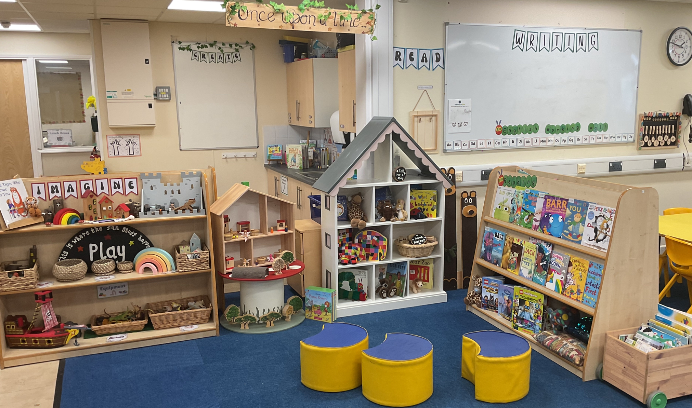
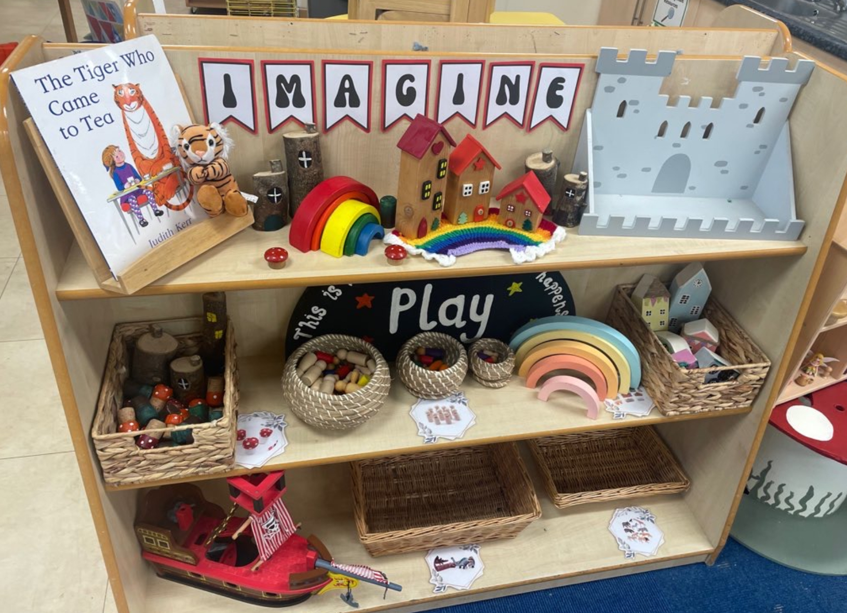
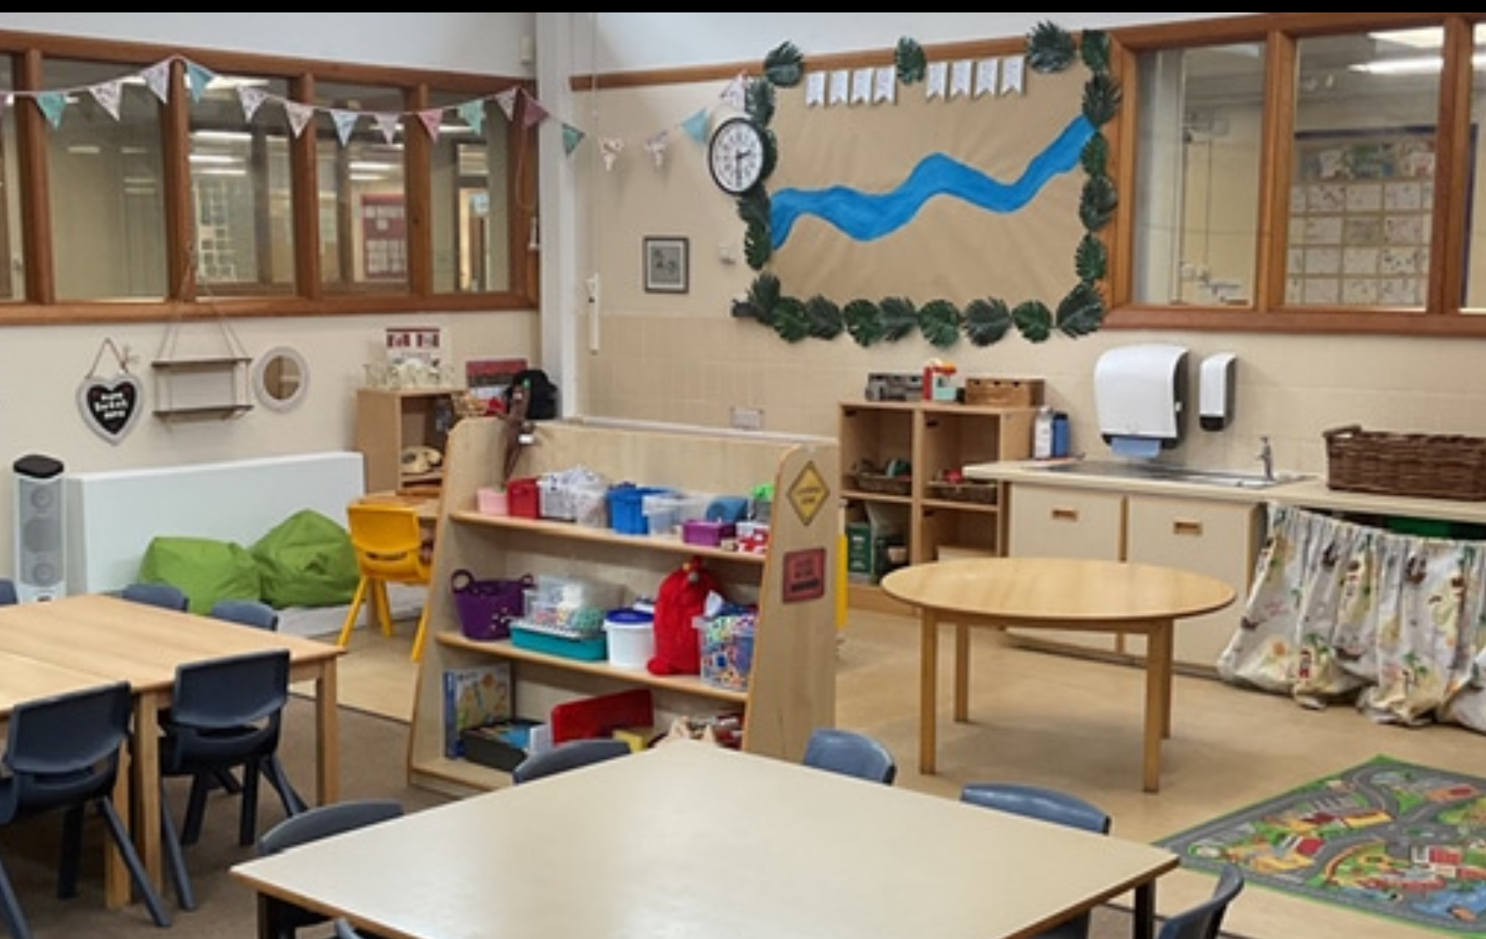


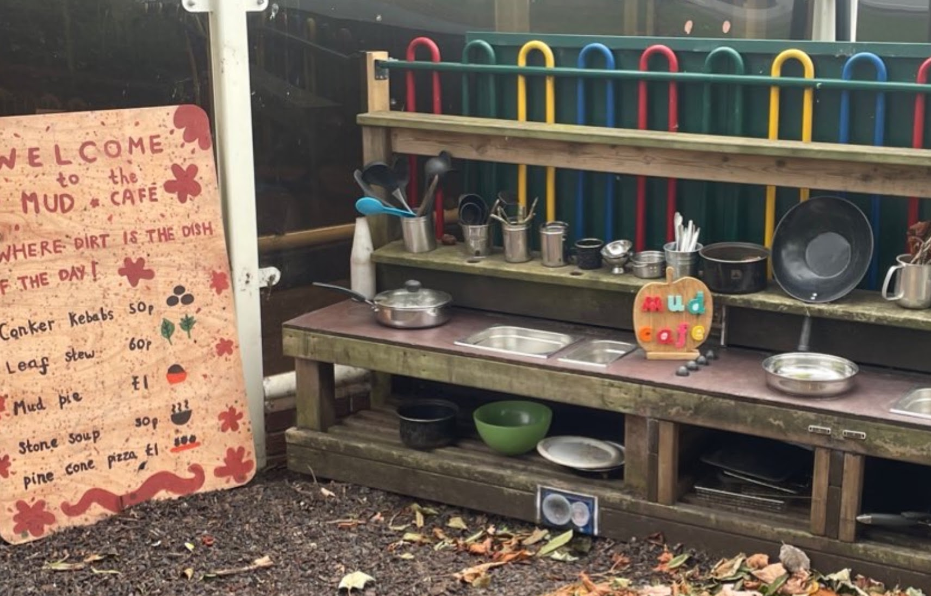
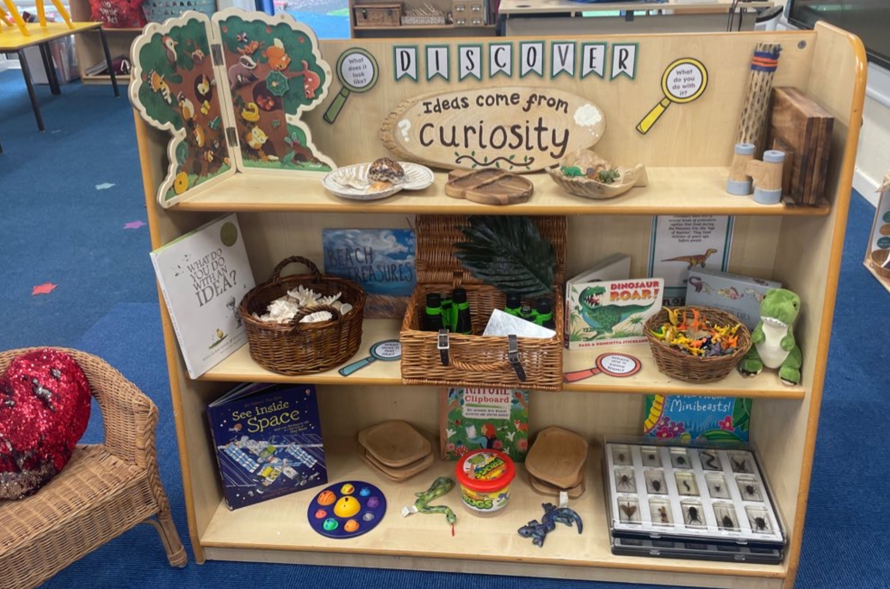
Reception 2026-2027

Slide 2
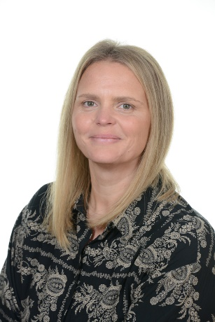
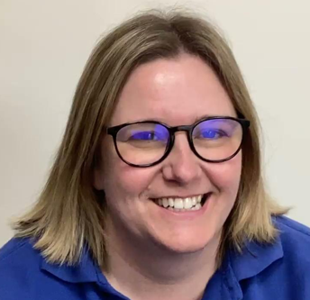
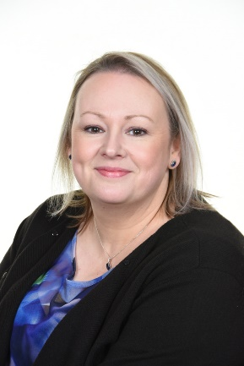
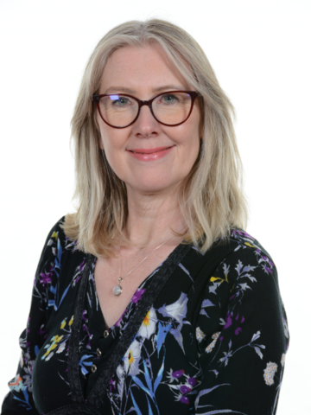
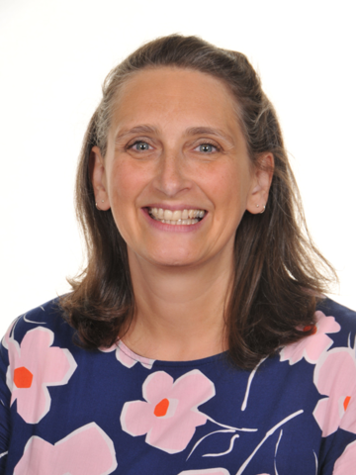
Names You Need To Know
•Principal - Mrs Lees
•Vice Principal - Mrs Watson
•Office Staff – Mrs Loton Mrs Wood Mrs Hulme
•School leadership team
Early Years –Mrs Gratton KS1 – Mrs Culshaw Lower KS2 Mrs Lawrie Upper KS2 –Miss Willington
•SENCO– Miss Willington
•Safeguarding Team
Mrs Lees Mrs Watson Mrs Clifford Mrs Culshaw
Miss Willington Miss Stones (Swanstars)
Chair Of Local Governing Body: Dr Audrey Skidmore
Notes:
LG

Slide 3
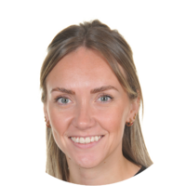
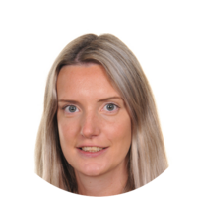
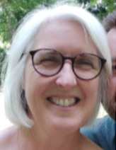
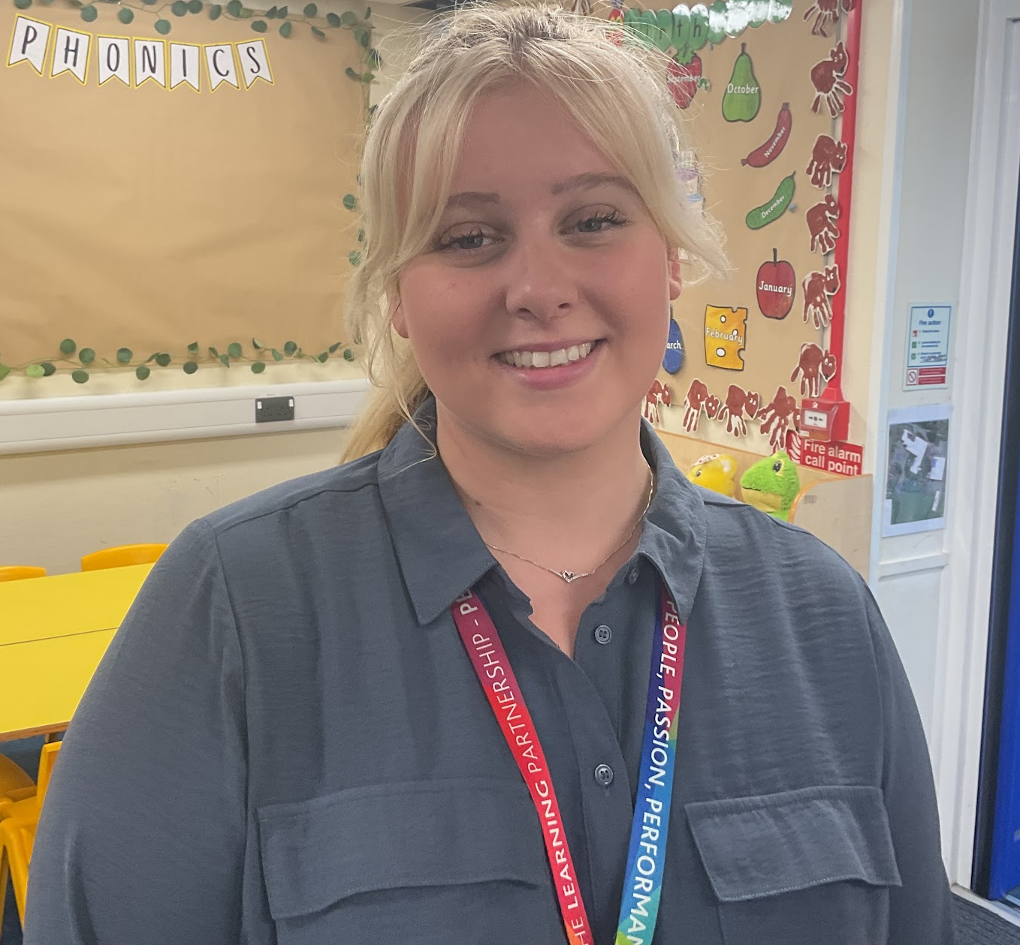
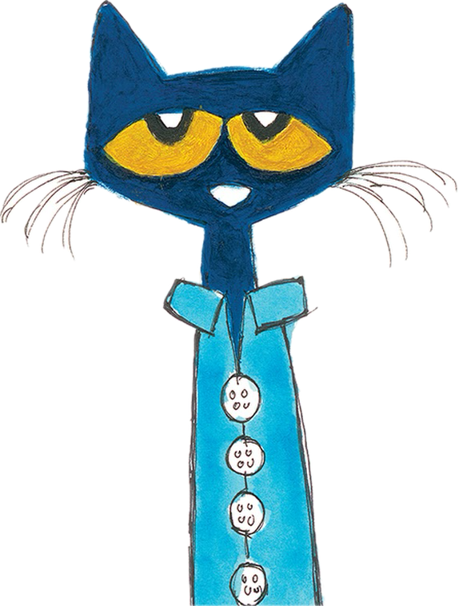
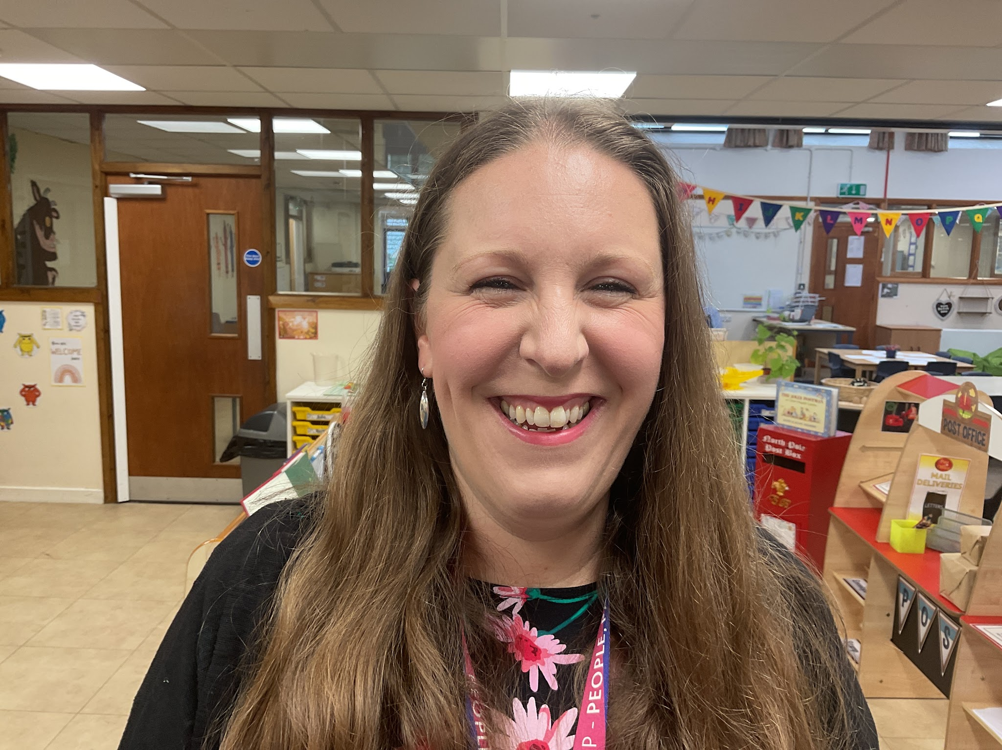
The Reception Team
Mrs Gratton–Early Years Foundation Stage Lead
Mrs Sutton, Miss Jones and Mrs Gratton– Reception Teachers
Mrs Palin – Teaching Assistant
Miss Boschi – Teaching Assistant
Miss Friesner – Teaching Assistant including class cover
Notes:
LG

Slide 4
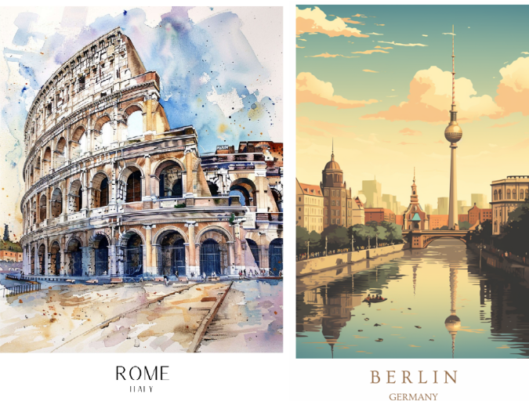
Classes
Mrs Gratton’s class: Berlin
Mrs Sutton and Miss Jones’s class: Rome
You will find a label on your child’s water bottle which tells you your child’s class, teacher and house team.
House teams determine which colour PE top you will need to purchase.
Notes:
LG

Slide 5



All About Our School
Welcome to Wistaston Church Lane Academy, where four words define what makes our school so special: Welcoming, Community, Limitless, Aspirations.
Help children to reach their potential and benefit from the greater resources that partnership within the trust brings.
Notes:
CE

Slide 6
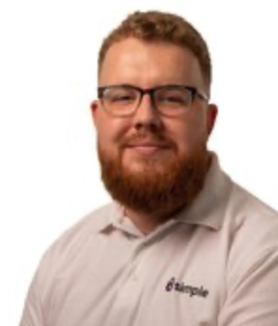
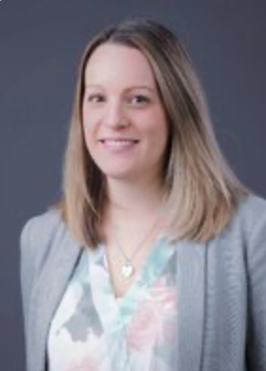
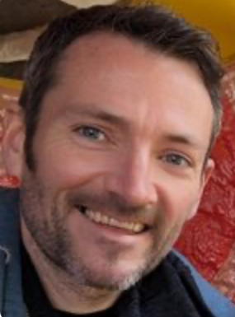
Our Governors
Dr Audrey Skidmore (Chair of governors)
Ben Leighton (Vice Chair of Governors)
Anthony Buckles
David Hastie
Gillian Louden
Holly Hulett
The Local Governing Board consists of a body of dedicated individuals who work together to lead and manage our school.

Slide 7

Our Website
Notes:
LG

Slide 8
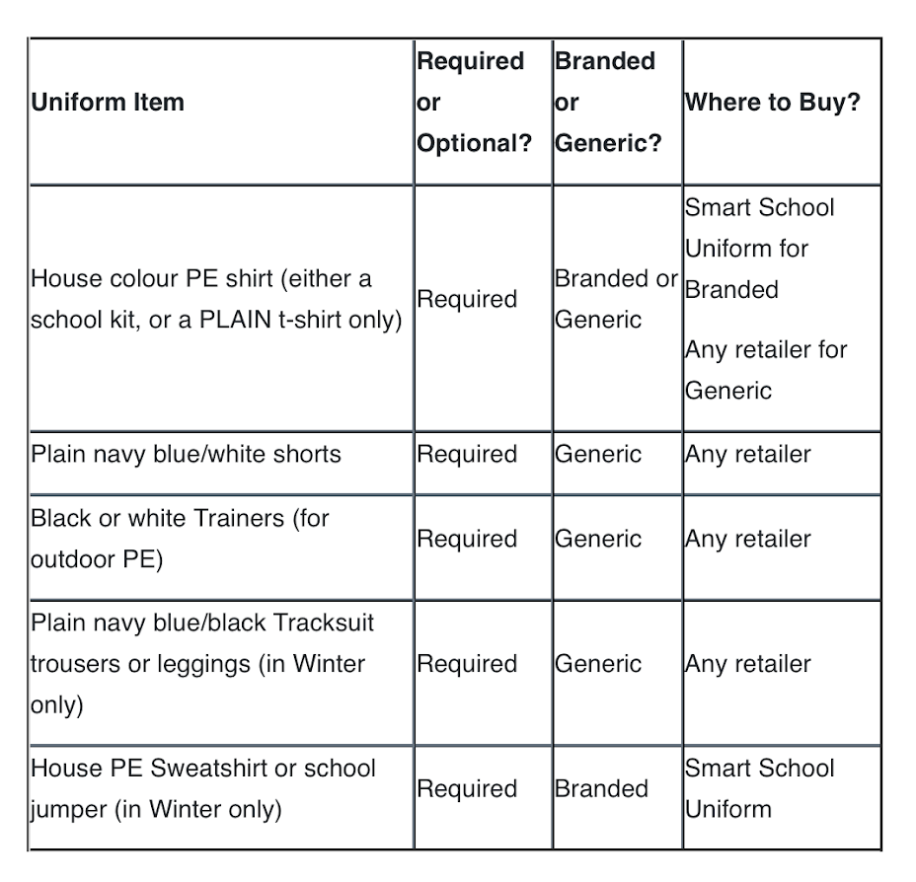

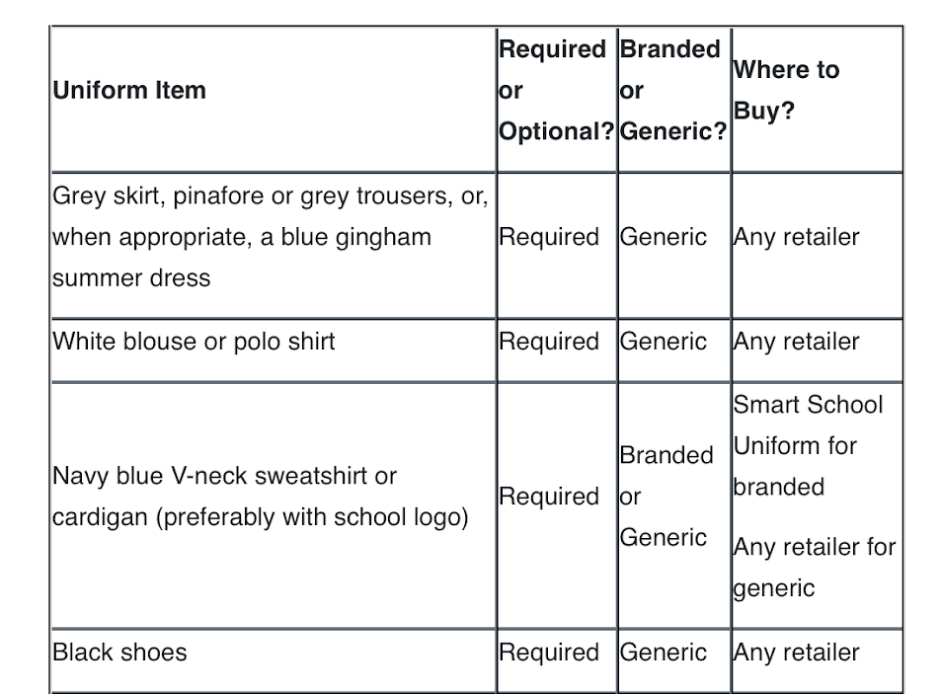
Our Uniform
We take pride in pupils' appearance and we have a consistent approach for uniform throughout the school. Pupils in each year group must wear the uniform listed below.
We go on a welly walk weekly so please send your child with a pair to stay in school (named bag please)
Notes:
NL

Slide 9
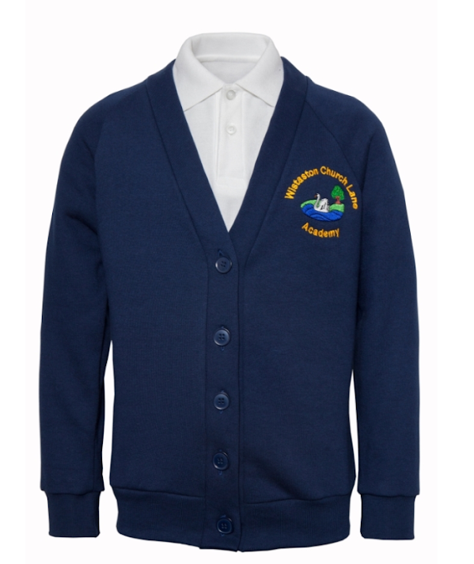

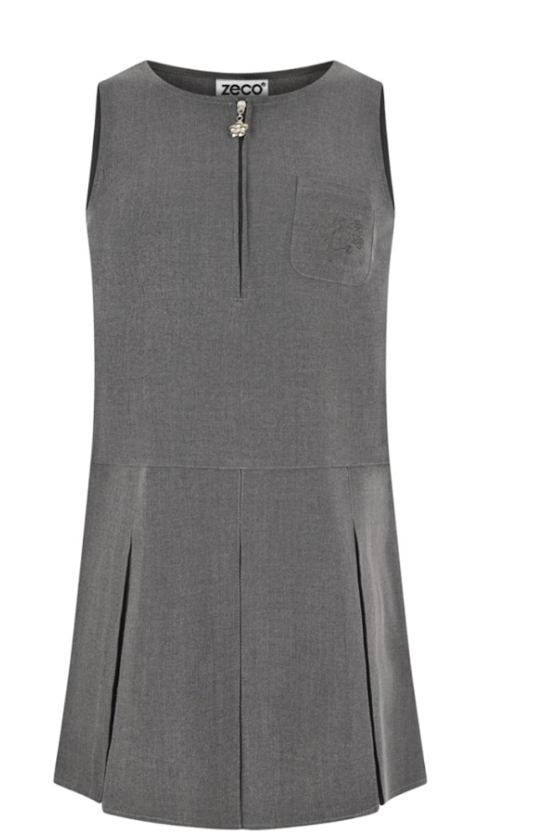

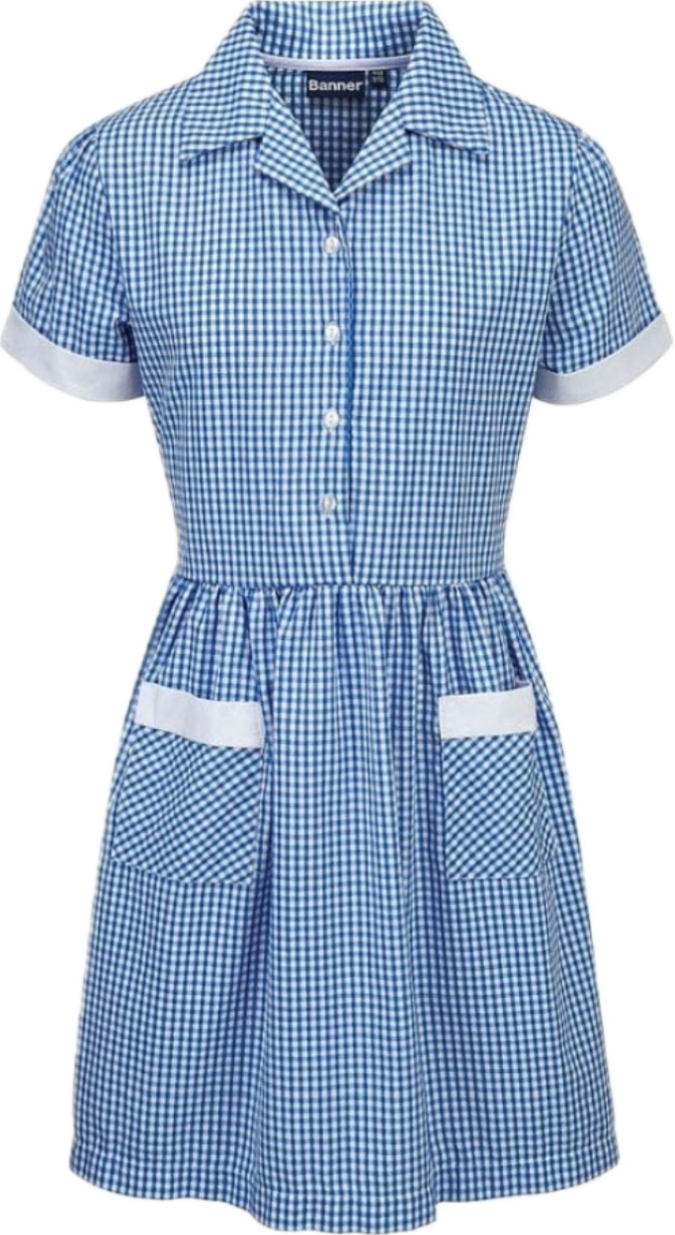

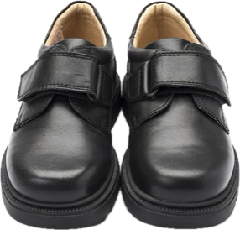
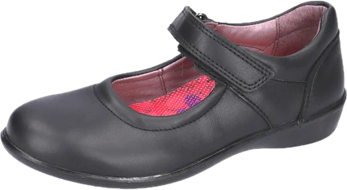
Our Uniform
Please name EVERYTHING
Notes:
NL

Slide 10
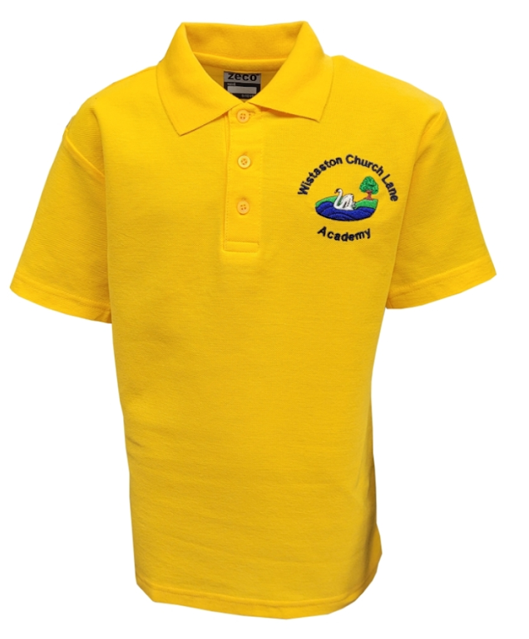

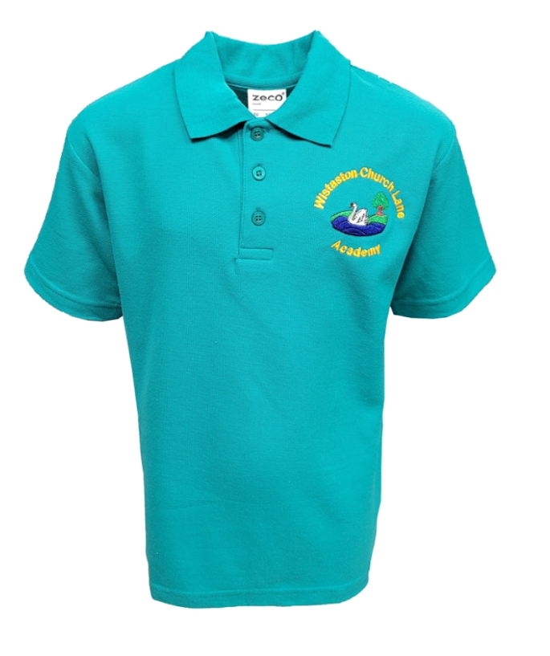
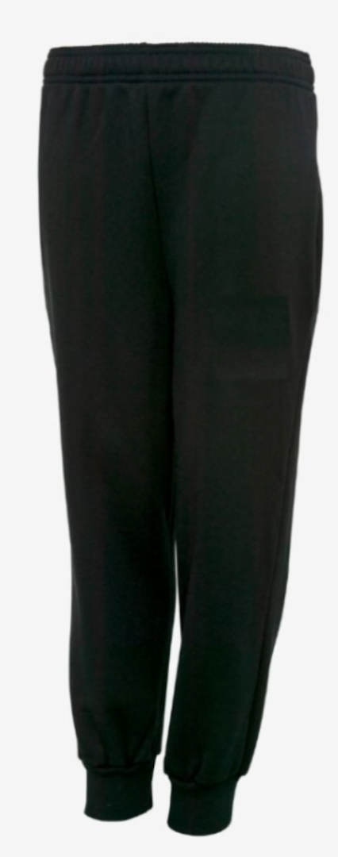
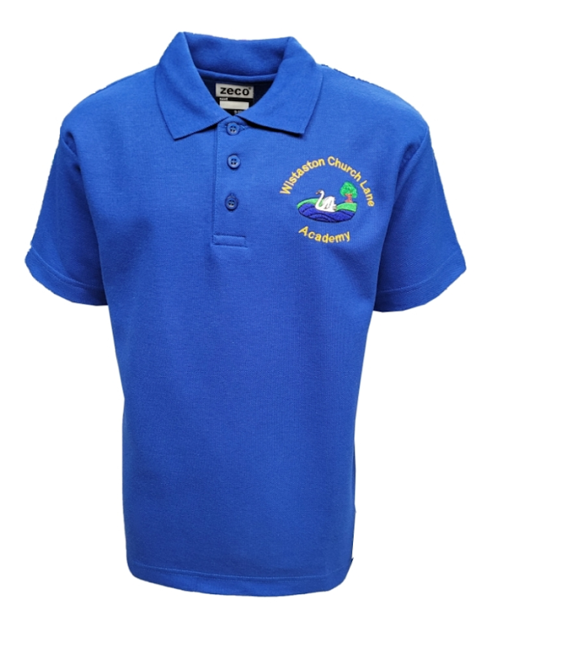
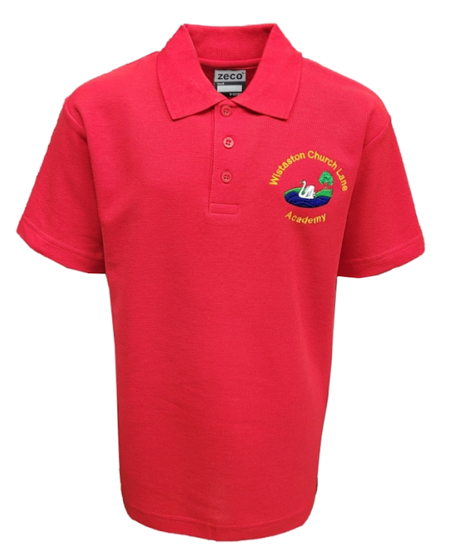
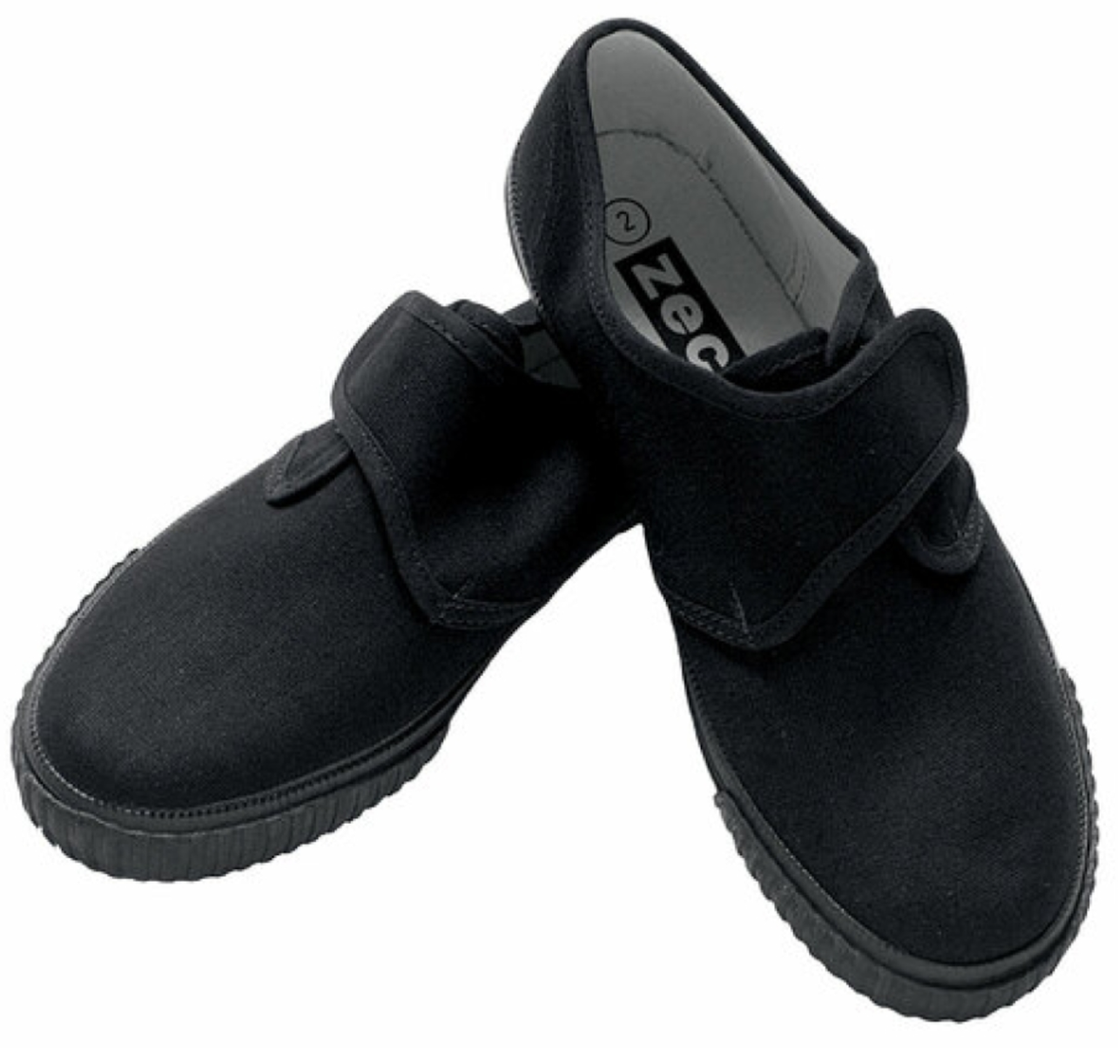
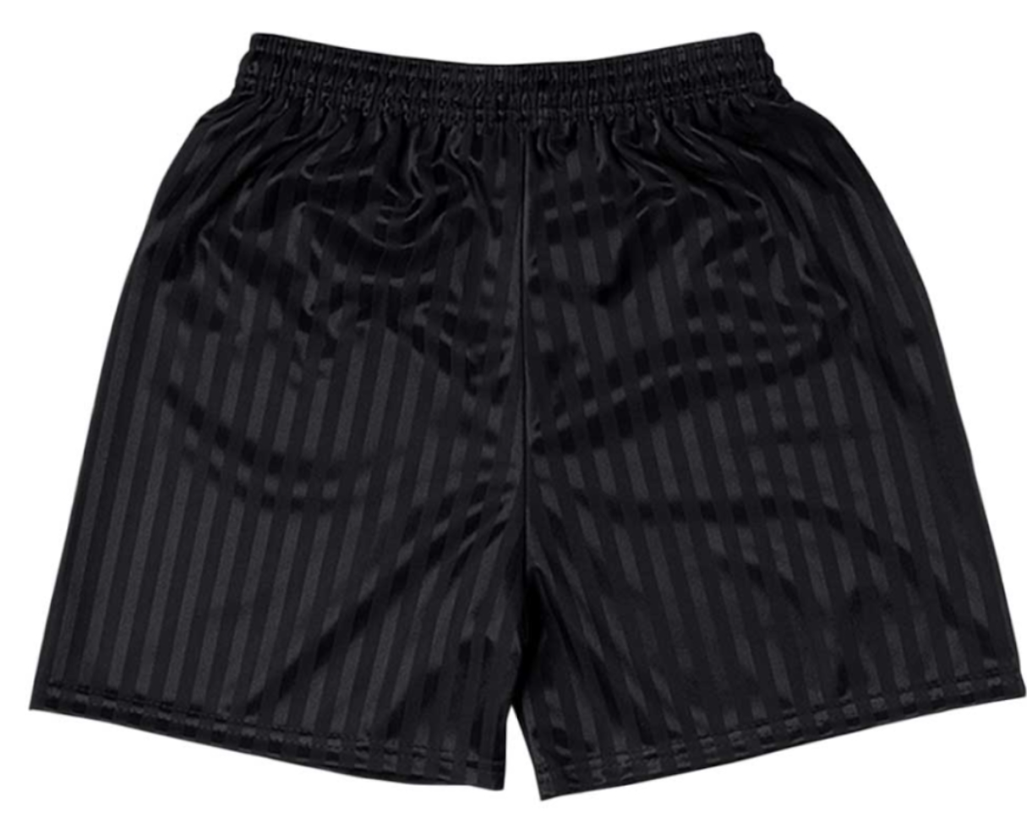
Our P.E Uniform
Please name EVERYTHING
Notes:
NL

Slide 11
Starting School
In the morning the children will come in to class via the tunnel doors between 8:40 and 8:50.
The outside areas may be set up ready for Busy Bee Learning Time and we do ask that children do not play with equipment before or after school.
In the afternoon the children will come out of Berlin’s classroom door. We will open our classroom doors at 3.15pm and send your child to you once we have seen you.
Please let us know if anyone different will be picking up – we will not be able to let a child go to an unknown adult or an adult that has not been identified to us.
In the morning we will be busy welcoming the children in to school. Please contact the office staff if there is any information that the staff need to be aware of.
Notes:
LG

Slide 12
Our Curriculum
Activities in Reception are carefully planned and organised in order to provide a range of learning experiences.
Planning is carried out using a topic-based approach, following the children’s interests and responding to specific events.
There are 7 Areas of Learning in the Early Years Foundation Stage (EYFS), which activities are planned around:
•Personal, Social and Emotional Development
•Physical Development
•Communication and Language
•Literacy
•Mathematics
•Understanding the World
•Expressive Arts and Design
Throughout the EYFS, children will be working towards the Early Learning Goals. These describe the level of attainment expected at the end of your child’s Reception year in school.
Notes:
LG

Slide 13

What do we do all day?
Busy Bee is the children’s favourite time. It is when they can choose their play. The day always starts with Busy Bee. They are the most important times of the day. Play is crucial in the Early Years Foundation Stage (EYFS) as it’s the primary way children learn and develop. Play allows children to explore, learn about the world, develop social and emotional skills, and build confidence. The EYFS framework recognises and promotes learning through play,
During the day, the children will take part in 15 - 20 minute teacher led lessons. These will focus on maths, writing/reading, phonics and our topics.
We have P.E each week and the children
come in their P.E kits on this day.
Notes:
NL

Slide 14
Reading, Writing, Maths, Phonics
Reading: Children will bring home a colour banded reading book.
We encourage re-reading of books for fluency and understanding. This may mean changing their books less regularly.
Children are expected to read regularly at home. Please record this on pageticker. This is an online reading diary, This can be any book that they have at home as well as their school reading books.
Writing: We focus on building finger muscles and confidence and mark making first. The children love our Pathway for writing stories and writing special codes for their drawings.
Phonics: We use a scheme called Rocket Phonics. The children will enjoy daily phonic sessions where we learn letter sounds and how to blend through games, stories and flash cards.
Maths: We use white rose and maths mastery to help the children build a good number sense. We focus on numbers to 10, addition, subtraction, odds and even numbers, doubles, shapes, length, weight and capacity. Subitising is an important skill for us.
Notes:
LG

Slide 15

Our Weekly Newsletter
Notes:
Lg

Slide 16
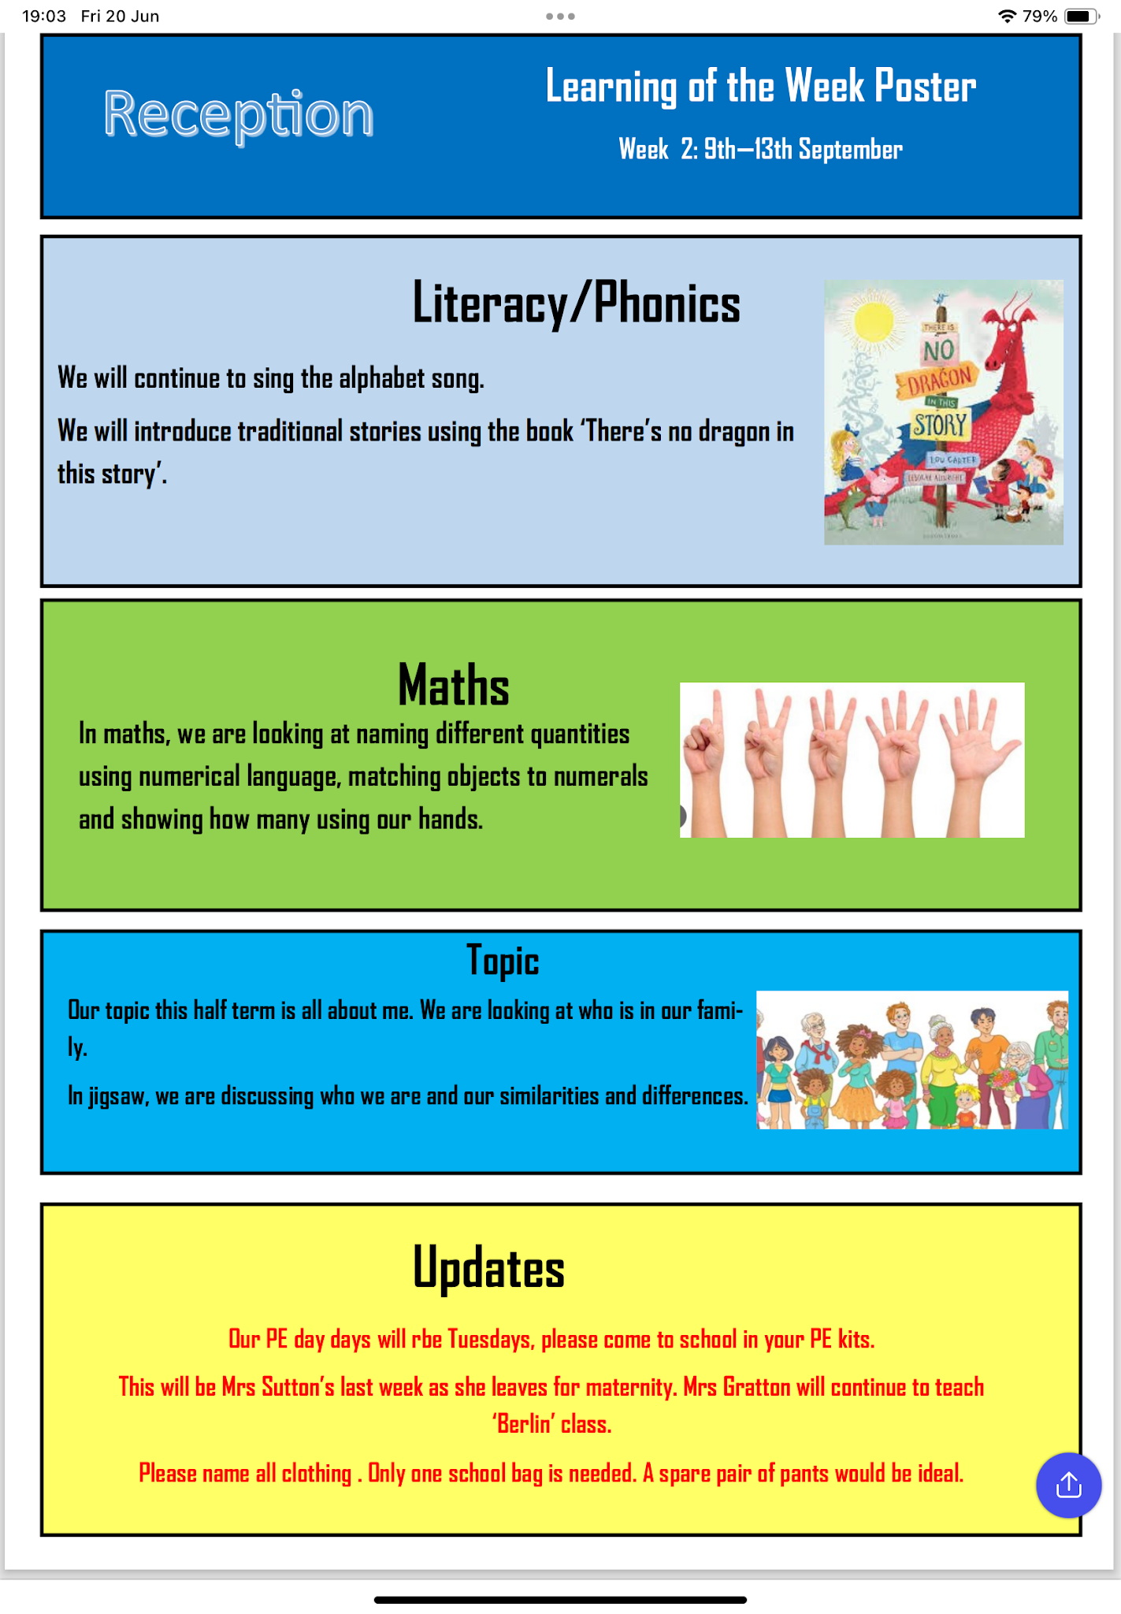
Our Weekly learning poster
Notes:
LG

Slide 17

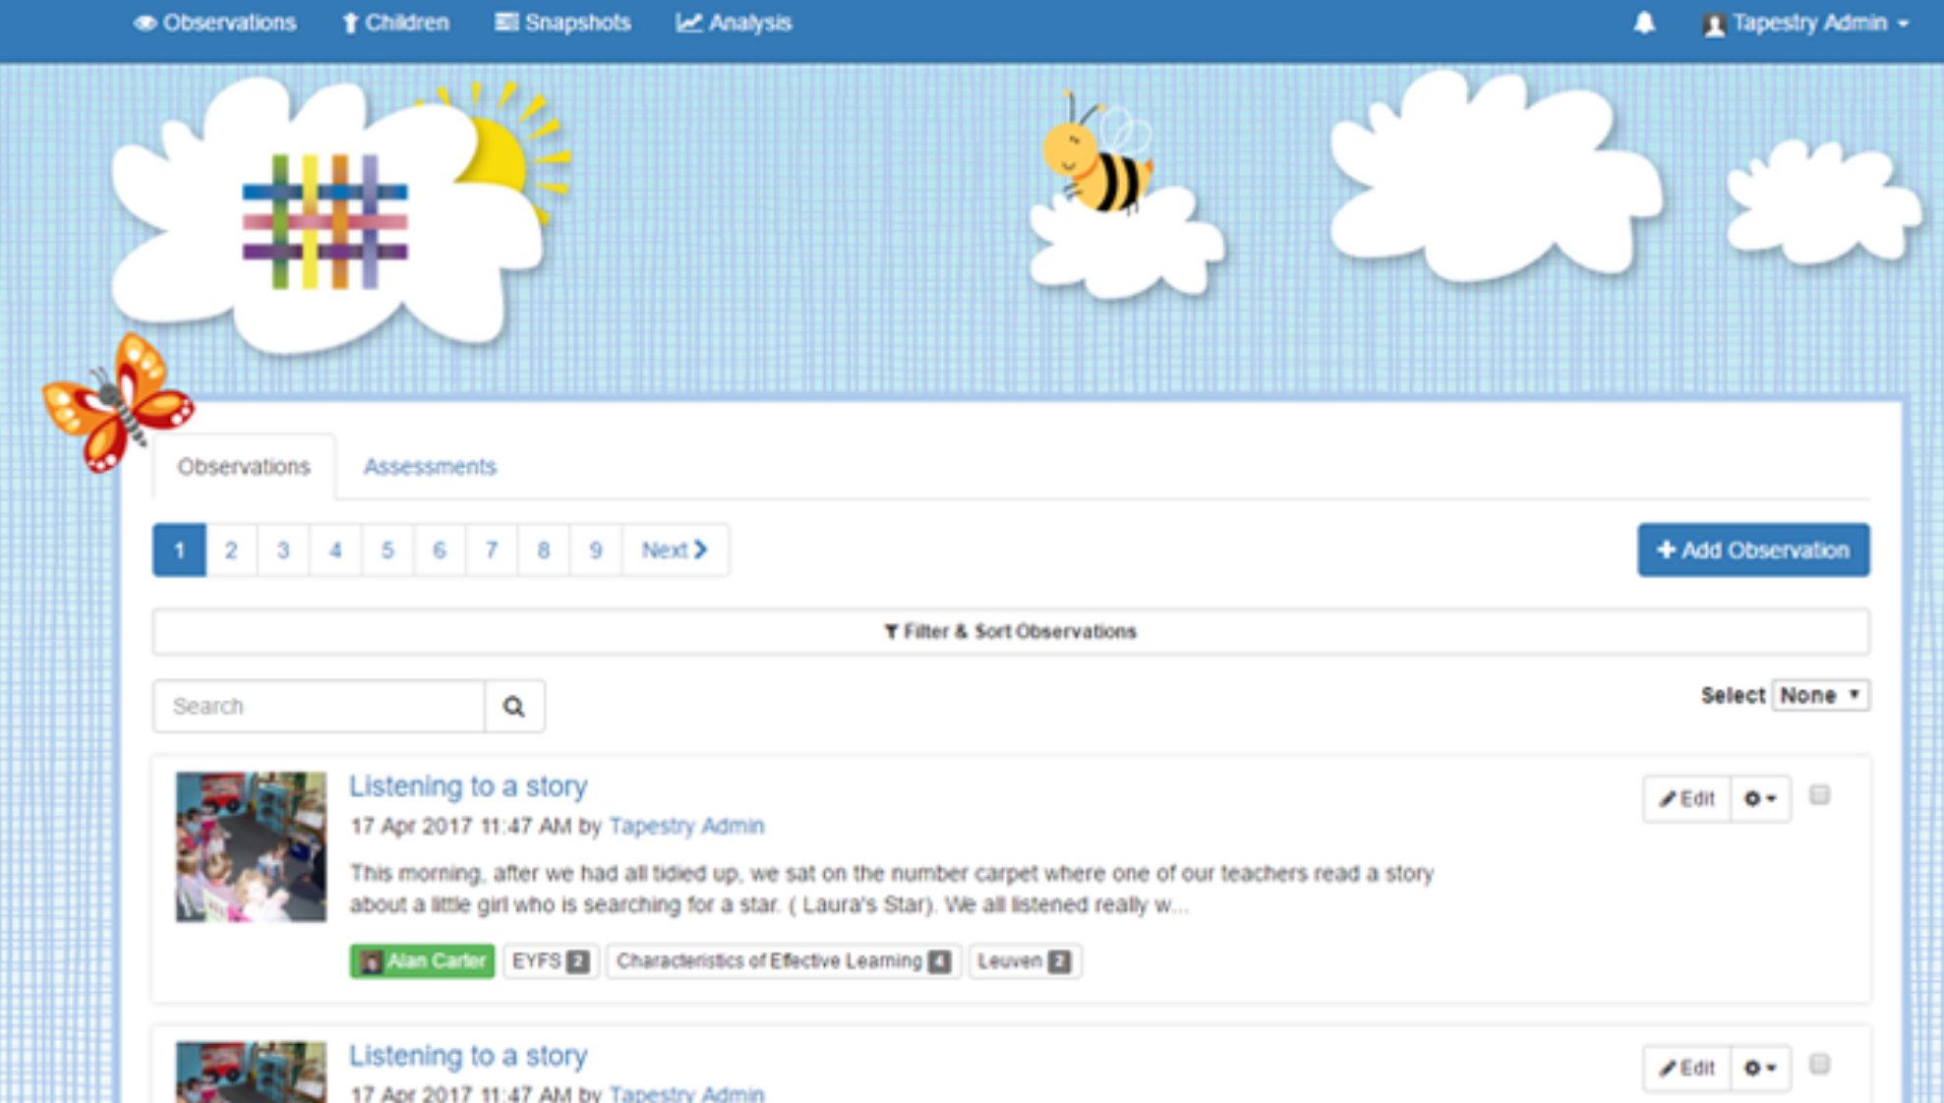

Tapestry
Tapestry is about capturing the magic of a child's early years experience, and recording children's learning in a way that is both secure and that we can share with parents.
Using a personal and secure username and password given to you by our school you will be able to view all of your children’s observations, photographs and even video from their time in Reception.
Tapestry helps to build strong partnerships between parents and the staff at school by giving you the option of interacting with the observations made by our staff and by allowing you to make your own observations from home.
Positive comments about work only please.
Notes:
NL

Slide 18


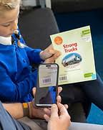
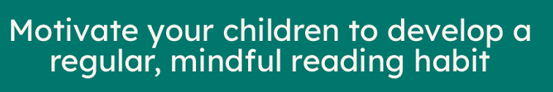

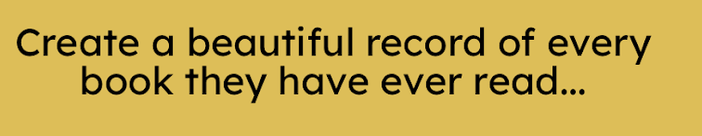

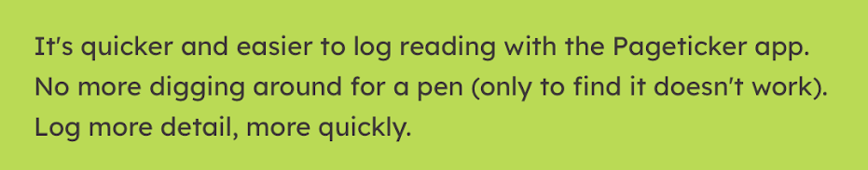
Pageticker
Notes:
NL

Slide 19

Food and Drink
Lunch: All Reception and Key Stage 1 children are entitled to a free school meal each day. Children can choose from a variety of dishes each day which include a Vegetarian option.
We cater for all dietary requirements – please speak to your class teacher who will organise a meeting with the catering staff. Please also let us know about known allergies.
The children choose their lunch with you at home. The menus can be found on the school newsletter. Each morning we ask the children what they would like so don’t worry if you have forgotten. The Foundation staff will go into the hall for the first weeks as well to support.
Snacks: Children will receive a free piece of fruit during the day. No other snacks are needed unless for specific medical reasons.
Drinks: All children will be given a free water bottle provided by the Friends when they start school which is to be brought in each day, filled with fresh water. Milk is also available.
Notes:
LG

Slide 20

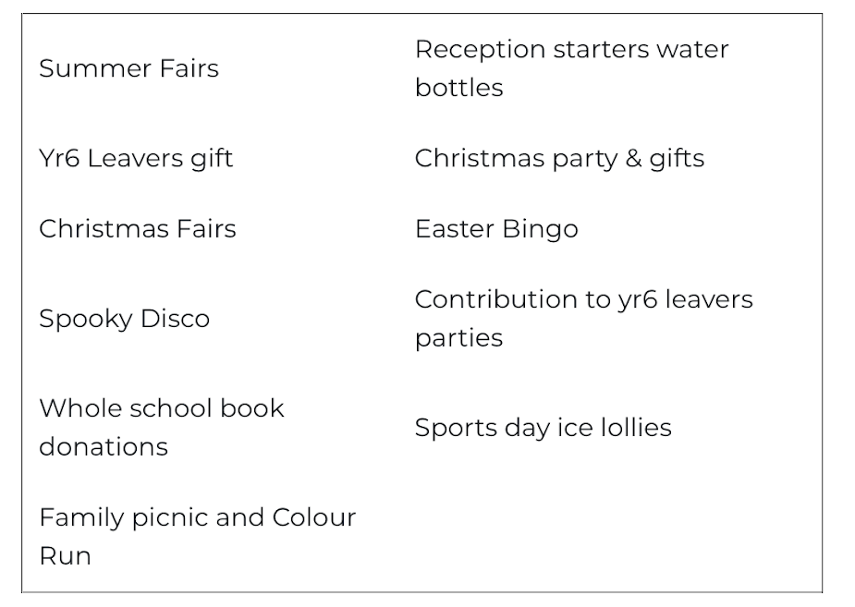
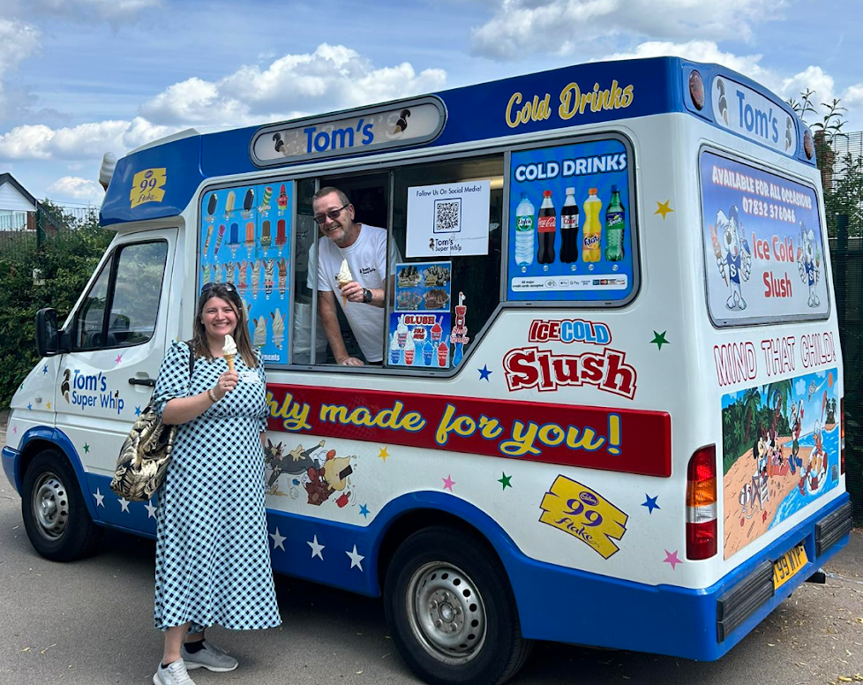
Friends of Wistaston
The Friends are a group of parents, carers and grandparents who form our PTA. We are a registered charity, (charity number 1046749) and have been part of WCLA since 1995- 30 years in 2025! We work with the school and community to raise money and organise events for the benefit of all pupils attending WCLA, both school and Nursery.

Slide 21

Swan Stars
Swan Stars Manager: Miss Wendy Stones
Swan Stars Deputy Manager: Mrs Jane Simons
At Swan Stars we provide a fun, child-led club. Our before and after school club caters for children from Reception right through to Year 6. In both our Infant and Junior clubs we offer many exciting activities ranging from role play, craft sessions, themed events, science experiments, outdoor fun, computing, active zones and much, much more! The children are provided with a nutritious breakfast and a yummy afternoon snack.
The children tell us we are the best club around!

Slide 22
Frequently Asked Questions
Who do I tell if my child is unwell?
Contact the office staff admin@wistaston.cheshire.sch.uk 01270 663619
This is the same is you have a medical appointment for your child, you want to let staff know someone else is collecting your child or you need to let the class teacher’s know anything.
Who do I contact if I have a concern about my child?
Again contact the office staff. They will be able to address your concern to the correct member of staff. Special Need support with our SENCO, Safeguarding concerns with Mrs Lees, our Safeguarding Lead, or to Mrs Gratton, the EYFS Lead. We do try get back to you quickly but as we are teaching this might be after school.
What happens if my child has an accident at school?
We use meditracker to record and bumps and grazes. You will be notified by email.
Can I have a list of class names for birthday parties or Christmas cards?
Notes:
CE

Slide 23

Getting school ready….
Encourage your child to get dressed by themselves.
Wear the school shoes for a little bit before school starts.
Name Everything!
Purchase a book bag and not a rucksack. (Spare underwear)
Read the Trust’s Getting School Ready Leaflet
Read stories together each day.
Help your child to independently use the toilet.
Practice writing names and holding a pencil and using scissors.
Look at objects when outside and see if you can see how many there are.
Look out for letters and numbers in the environment (sounds not names).
Play games to take turns while having fun together.
Send any medicine/ asthma to school in a named box/ bag with the completed form.
Let us know about any allergies.
Recognise names
Notes:
Lg

