Slide 1

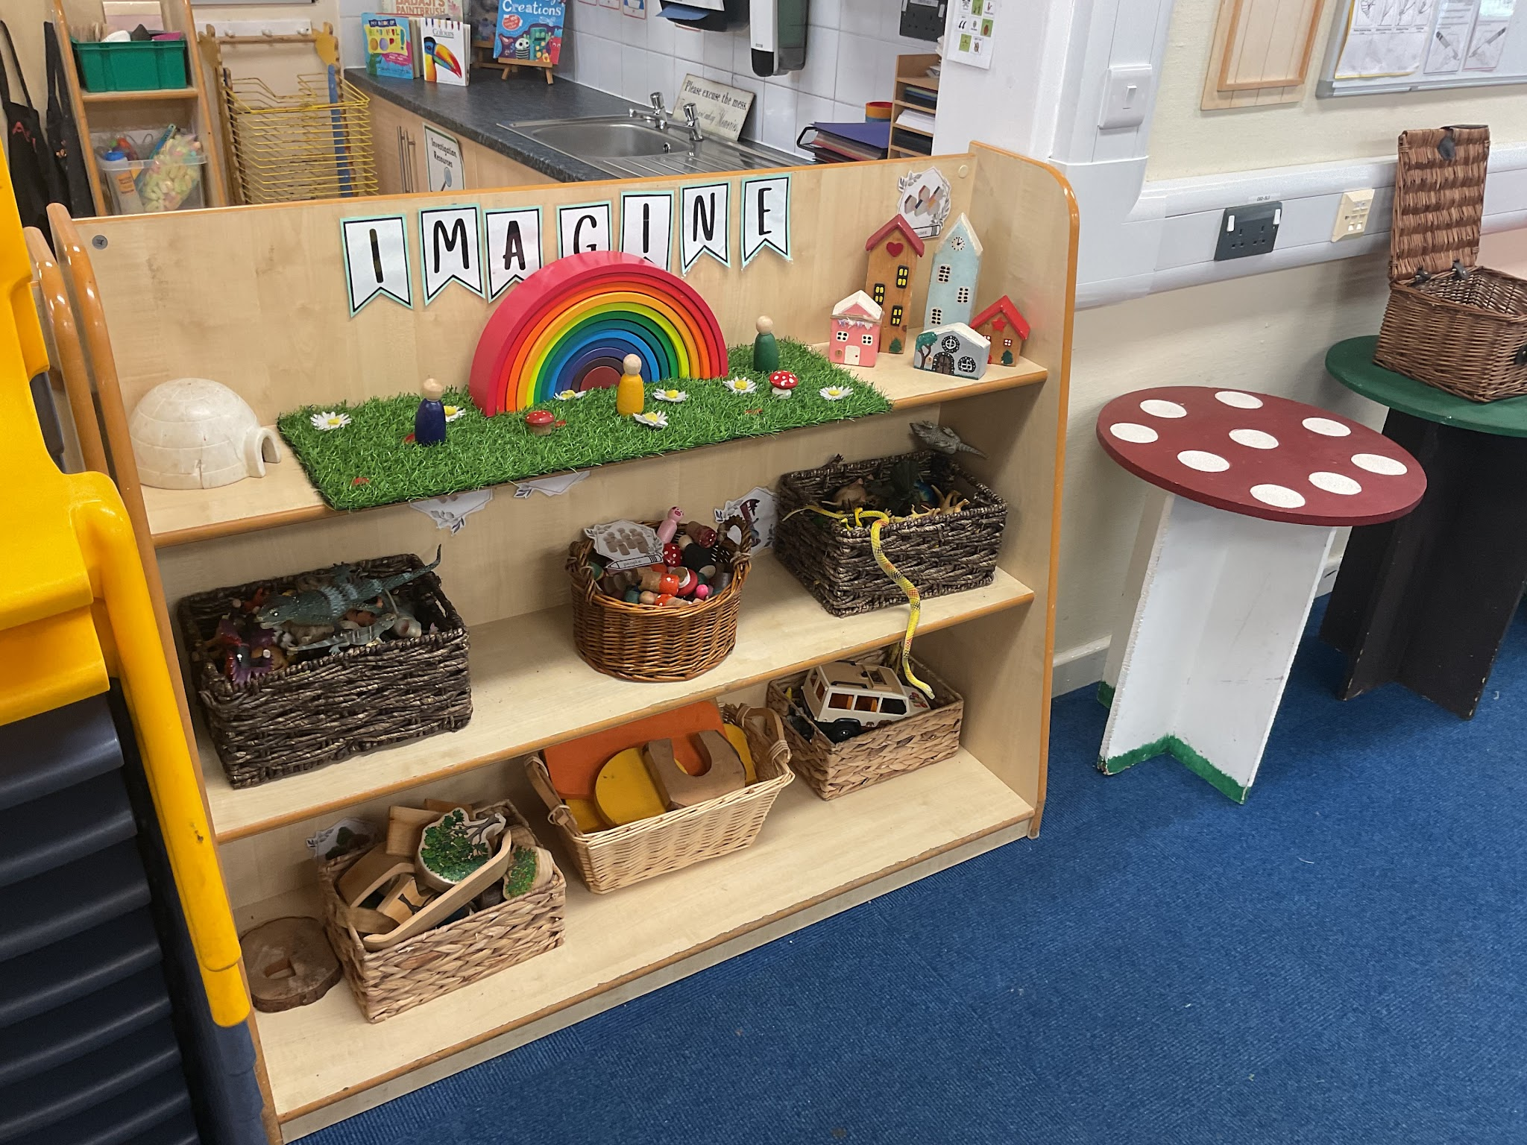
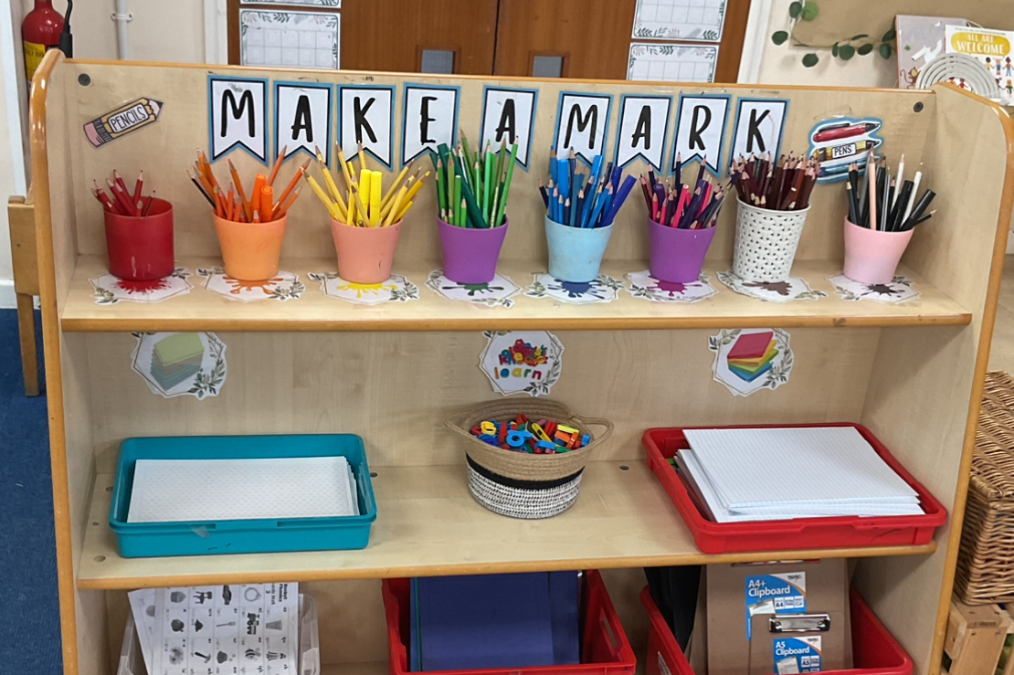
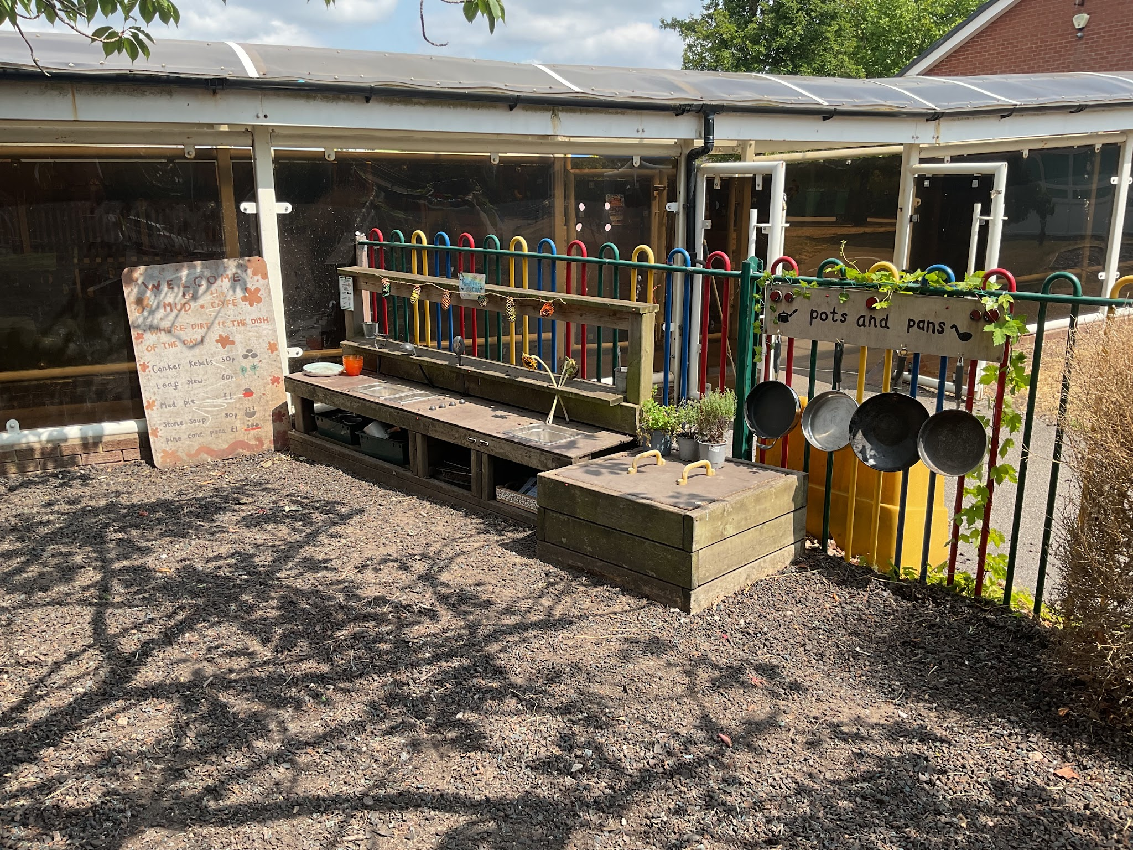
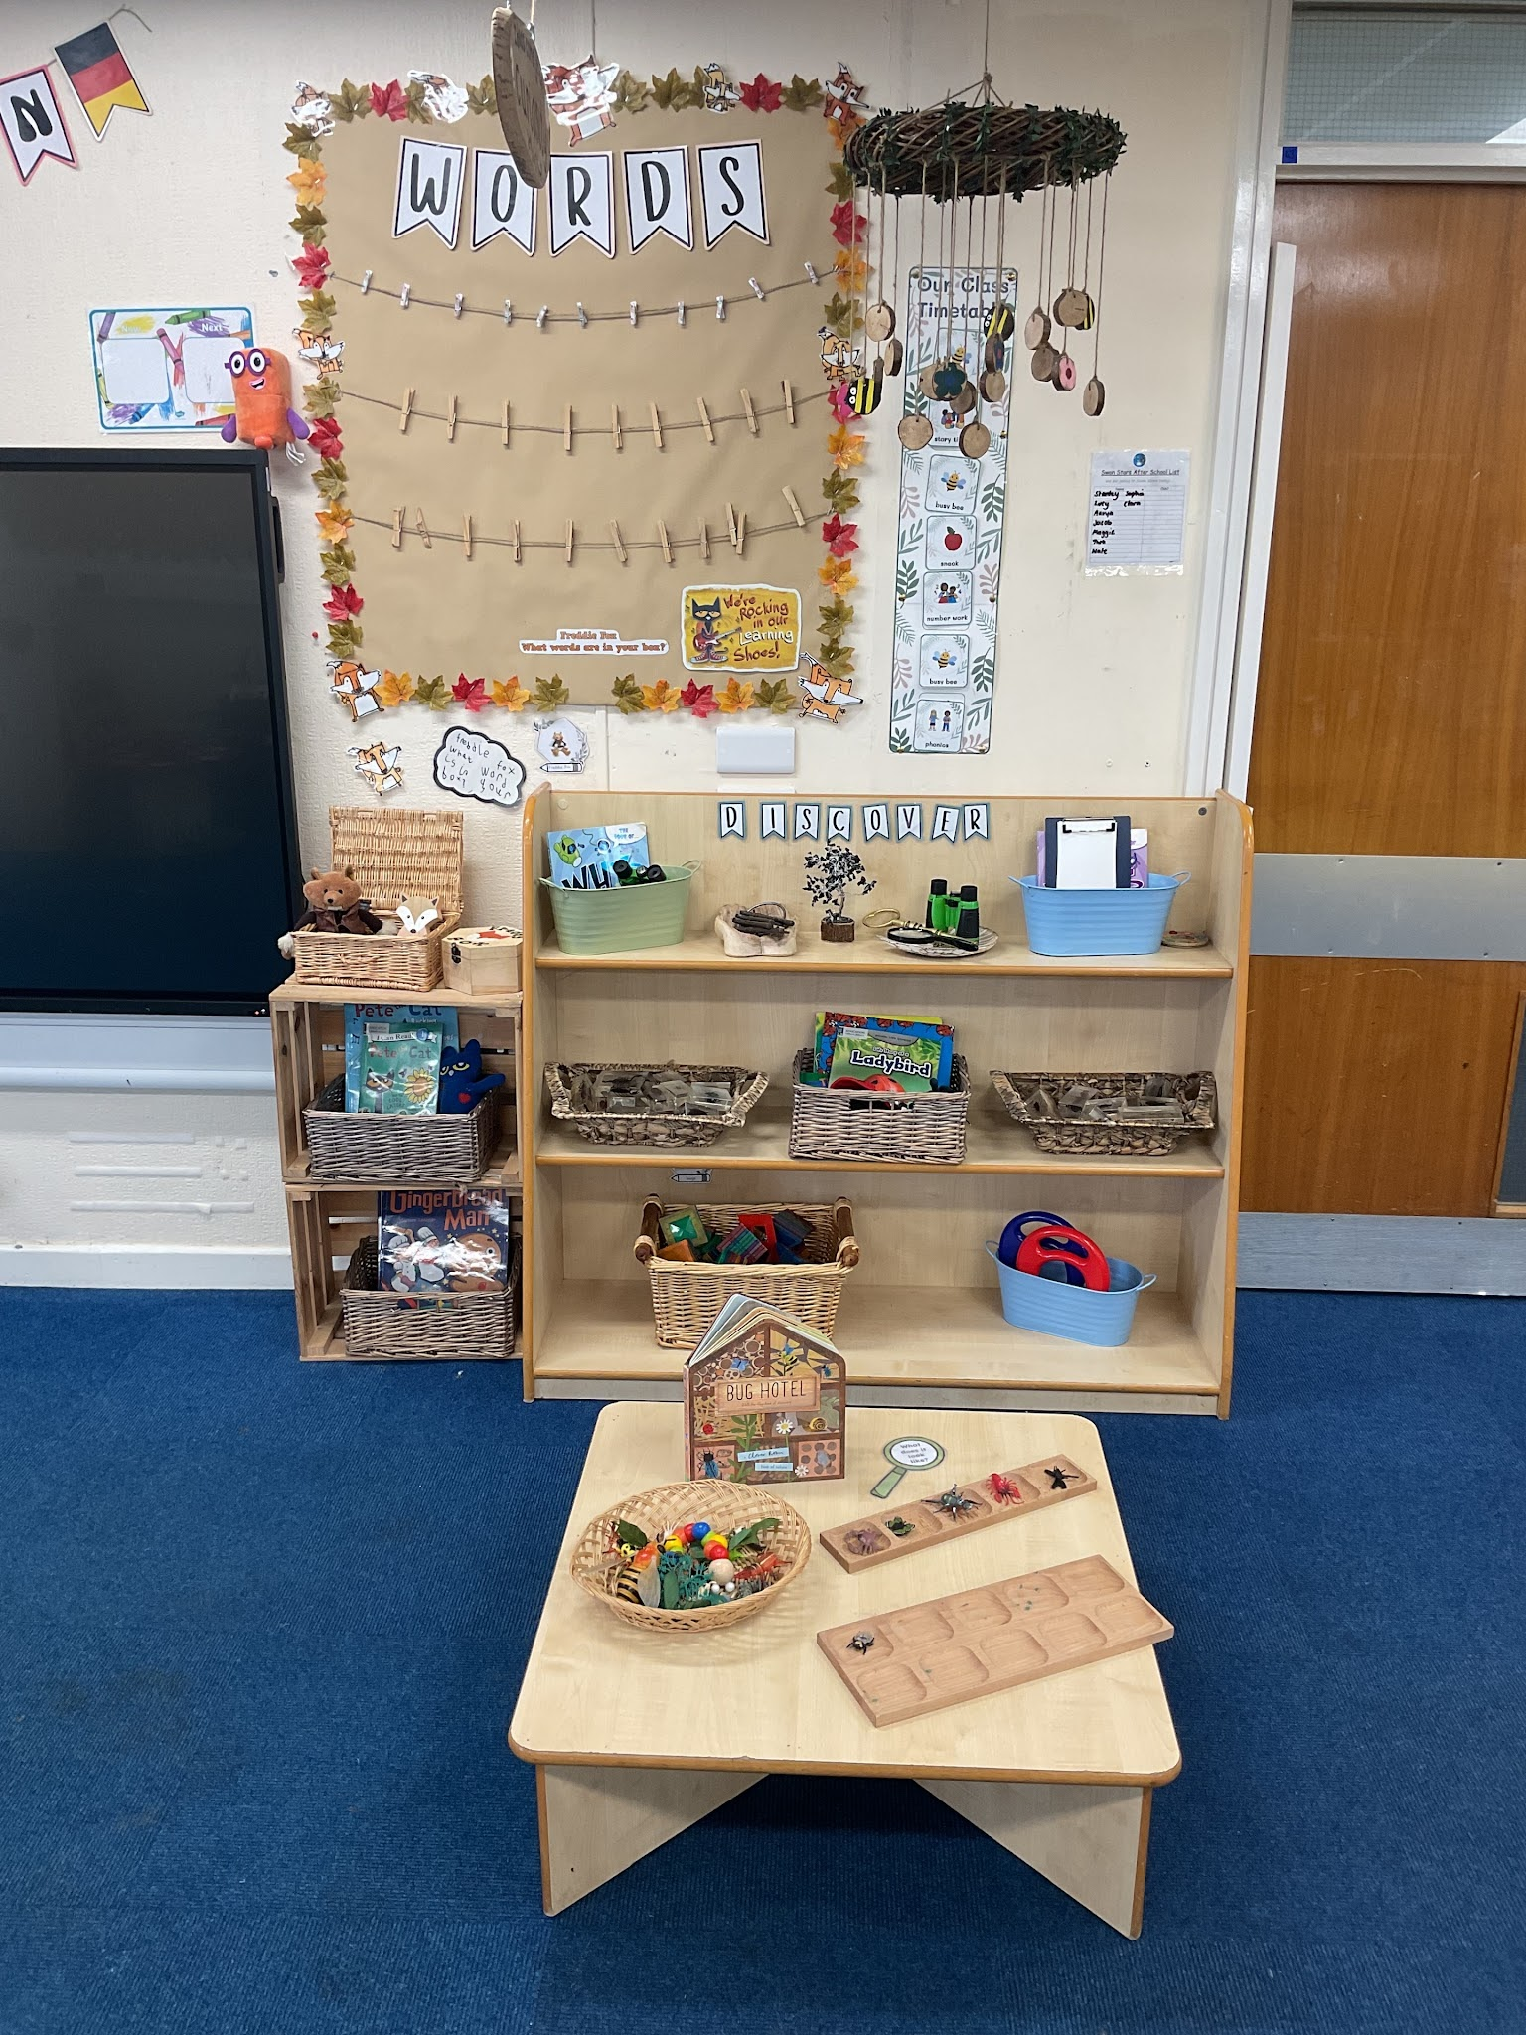

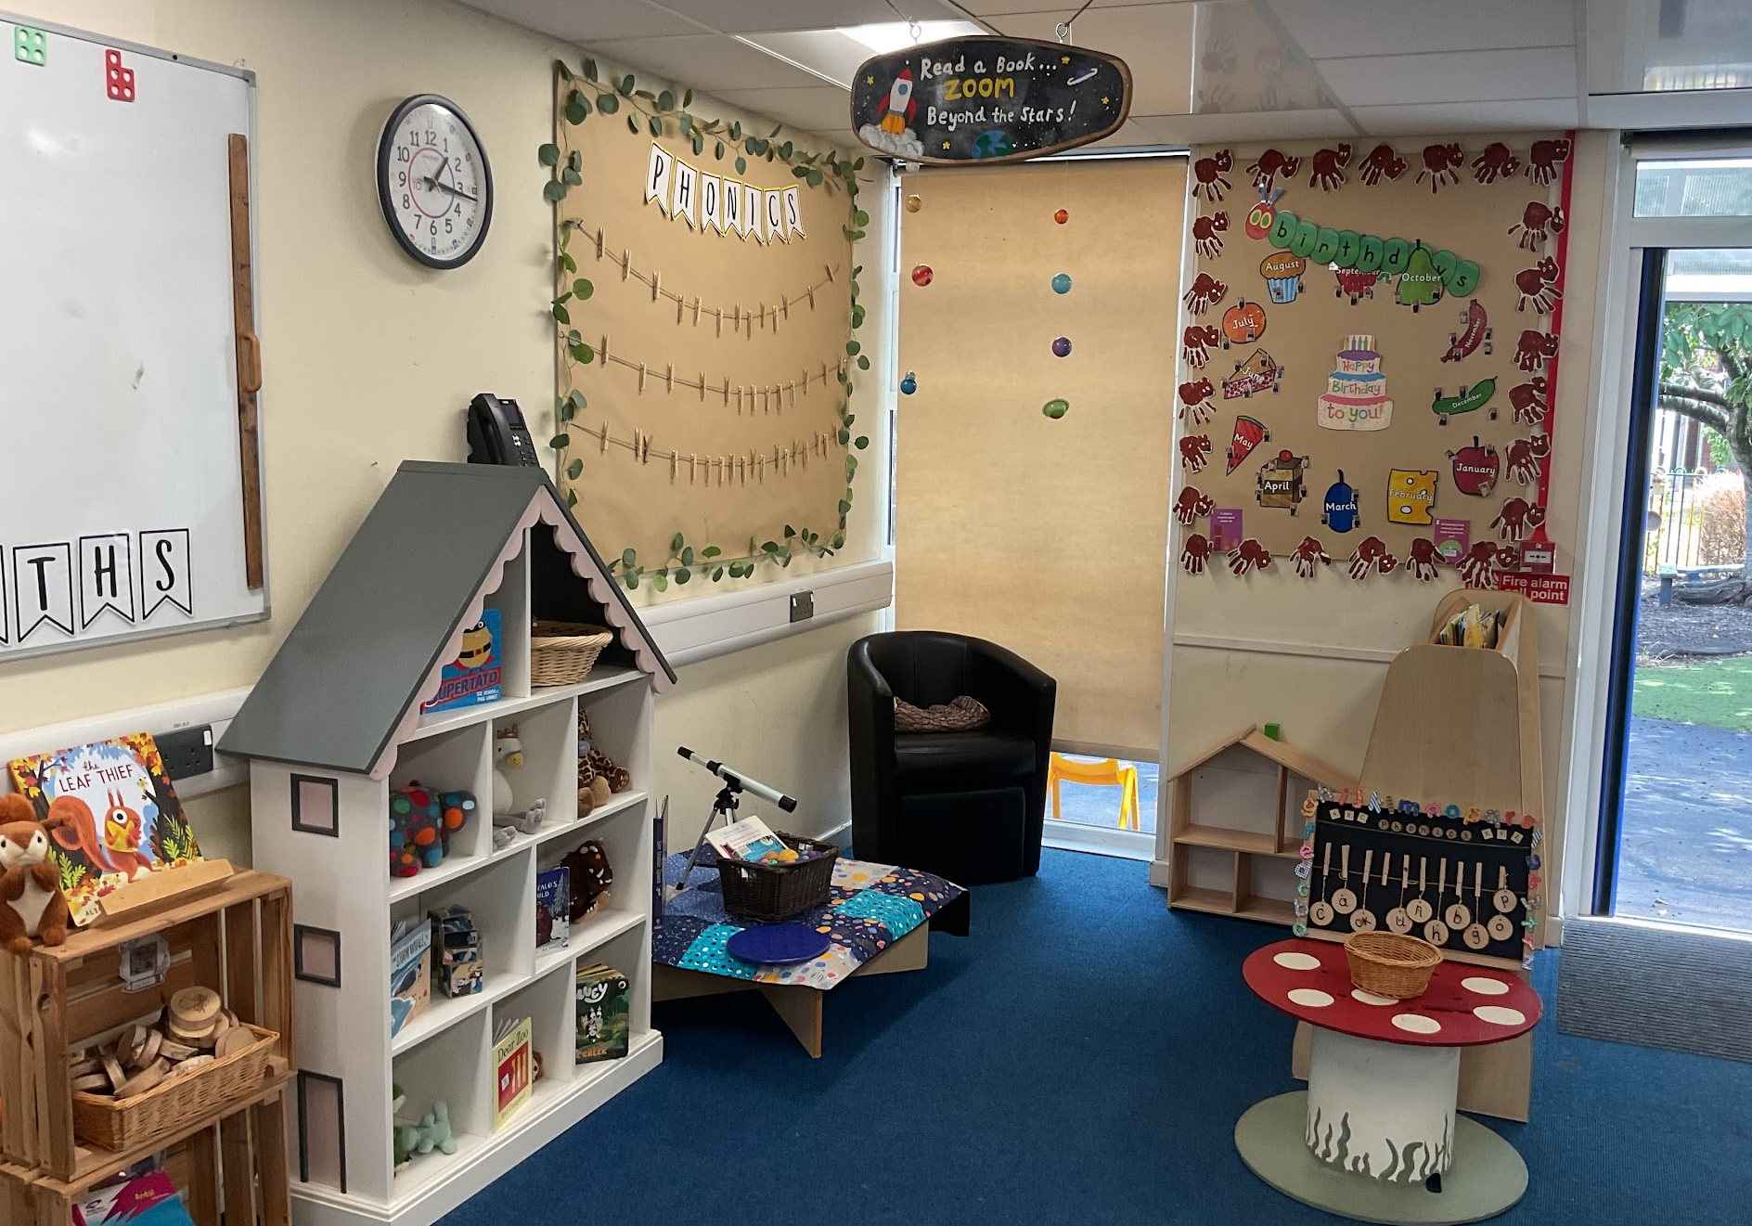
Reception 2026-2027
Information for parents

Slide 2
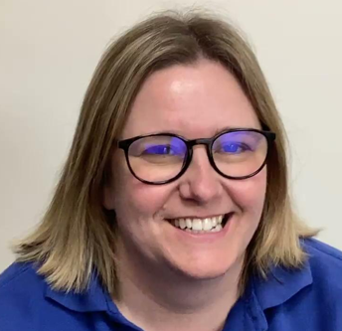
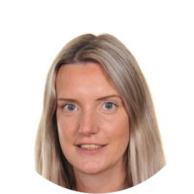

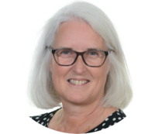

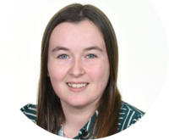
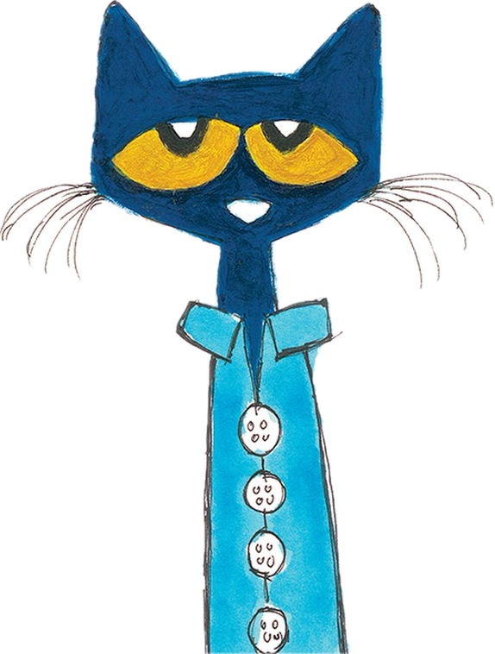

Changes to the Reception Team
Mrs Gratton–Early Years Foundation Stage Lead and Berlin teacher
Mrs Sutton and Miss Jones- Rome Teachers
Mrs Palin, Miss Bateman and Miss Godfrey -Teaching Assistant
Miss Friesner – Teaching Assistant including class cover
Notes:
LG

Slide 3
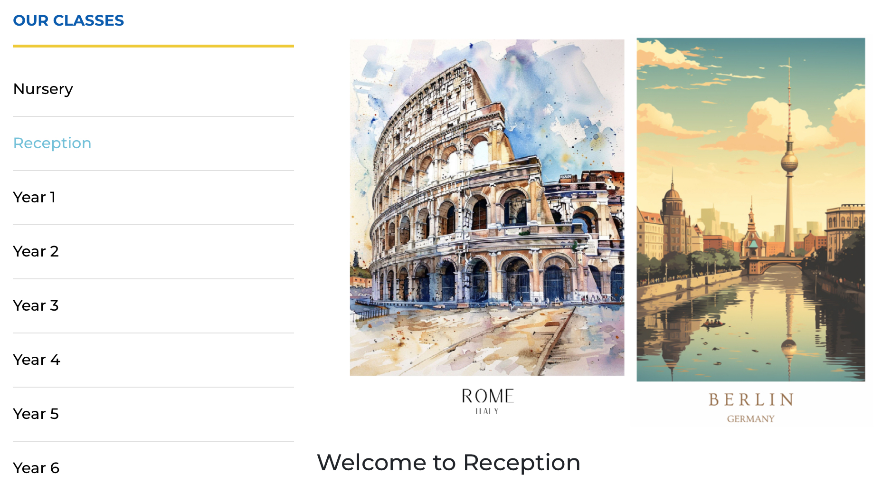
Our Website
Each term you can see an overview of the learning focus for writing, reading, our topics and our personal and social development ‘Jigsaw’ focus on the website.
Click on our classes and reception.
Notes:
LG

Slide 4
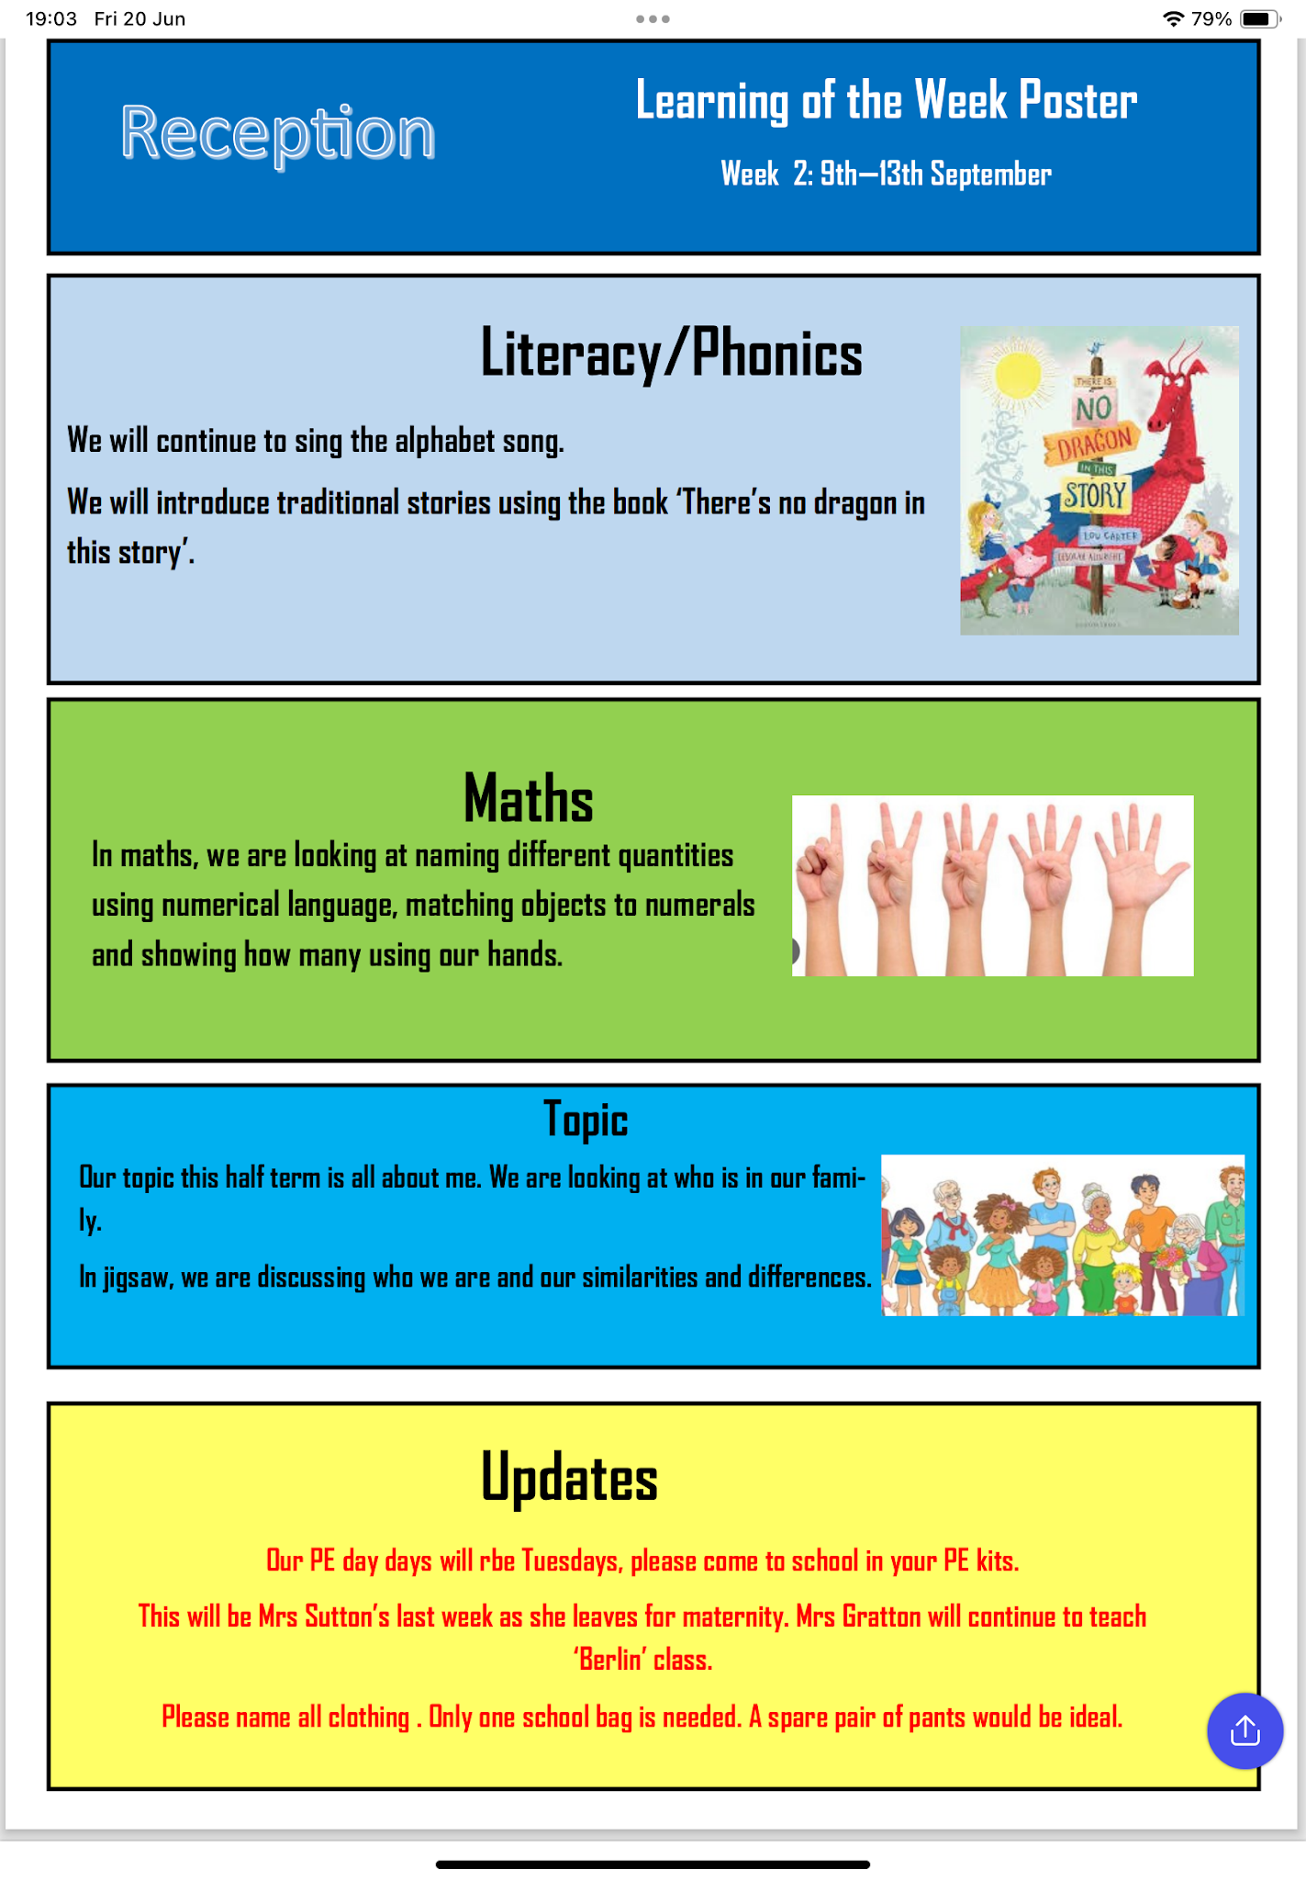
Our Weekly learning poster
You will receive a Friday email with the following week’s learning focus and updates.
Notes:
LG

Slide 5
Our Curriculum
Activities in Reception are carefully planned and organised in order to provide a range of learning experiences.
Planning is carried out using a topic-based approach, following the children’s interests and responding to specific events.
There are 7 Areas of Learning in the Early Years Foundation Stage (EYFS), which activities are planned around:
•Personal, Social and Emotional Development
•Physical Development
•Communication and Language
•Literacy
•Mathematics
•Understanding the World
•Expressive Arts and Design
Throughout the EYFS, children will be working towards the Early Learning Goals. These describe the level of attainment expected at the end of your child’s Reception year in school.
Notes:
LG

Slide 6
Reading
Fostering a Love of Reading in Reception
Quality texts are at the heart of our learning. Sharing stories daily develops language, vocabulary, imagination and a love of books.
Read together every day
In the early stages, reading at school and at home may look like a game — spotting and recognising letters and sounds, playing with rhyming words or blending simple CVC words such as cat, pin and sun. These short, playful moments build important phonics skills while children continue to enjoy sharing stories, exploring books and developing a love of reading.
Rocket Phonics – Our Reading Journey
🟣 Lilac – Developing book behaviours
Enjoys handling books, looking at pictures and talking about stories. Beginning to understand how books work.
🩷 Pink – Early phonics
Beginning to recognise and use taught sounds. Developing confidence with simple words and blending.
🔴 Red A – Building confidence
Applies taught phonics to read simple words and short sentences, with support where needed.
🔴 Red B – Developing independence
Reads a wider range of decodable words and sentences with increasing accuracy and confidence.
Notes:
LG

Slide 7
Writing
In Reception, we believe that becoming a writer begins with talking, listening, sharing stories and developing a love of language. Each writing unit begins with an exciting hook to capture children’s interest. We immerse children in our key texts, returning to them regularly to develop vocabulary, comprehension, imagination and confidence.
We use Pete the Cat to help children settle into school and practise speaking in sentences: “Come on, Pete. Come out to play!”
“Come on, Pete. What shall I say?”
We also have Freddie Fox’s Vocabulary Box: “Freddie Fox, Freddie Fox, what words are in your box?”Children collect and use new vocabulary from our stories and experiences, helping them to develop a rich bank of words for talking, playing and writing.
Inspired by Drawing Club, children begin to represent their ideas through drawings, symbols and their own ‘codes’ and messages. As their phonics knowledge develops, these marks gradually become recognisable letters, sounds, words and sentences.

Slide 8
Maths
In Reception, we want children to develop a love of mathematics and become confident, curious and resilient mathematicians.
We use a combination of the White Rose Maths EYFS approach and mastery principles. Children explore mathematical ideas through play, practical experiences, stories, songs, games and everyday routines.
Our focus is on developing deep understanding and strong number sense, rather than simply learning procedures or counting to increasingly large numbers. We place particular importance on children developing a secure understanding of numbers to 10 and then to 20, before moving on to larger numbers.
Children develop their ability to subitise — recognising how many objects are in a small group without needing to count them — as well as counting accurately, comparing quantities, understanding composition and making connections between numbers.
We encourage children to notice, investigate, make connections and explain their mathematical thinking. By developing secure foundations and a deep understanding of number, children become confident mathematicians who can apply their knowledge in new and meaningful situations.

Slide 9
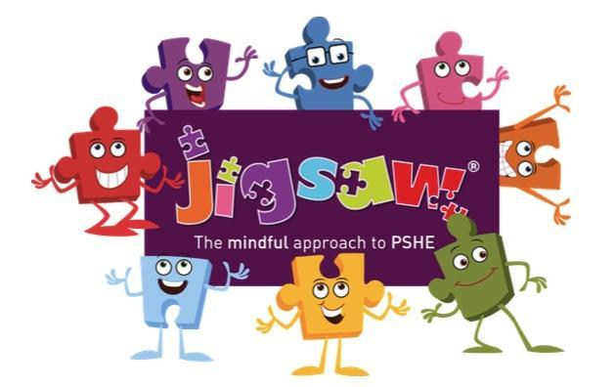
PSED- Jigsaw
Jigsaw is a whole-school programme that supports children’s personal, social, emotional development and wellbeing. It helps children develop the skills and understanding they need to build positive relationships, manage their emotions, develop confidence and make healthy, respectful choices.
Our Jigsaw focus is ‘Celebrating Difference’. We encourage children to notice and celebrate what makes each person special and unique. We talk about families, friendships, similarities and differences, kindness, respect and how we can make everyone feel valued, included and welcome.

Slide 10
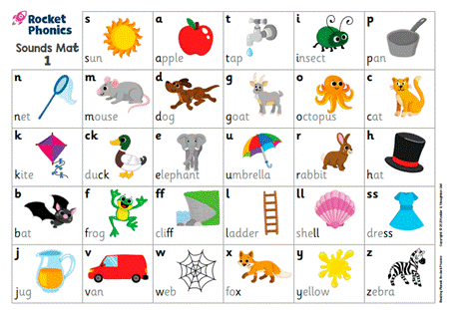
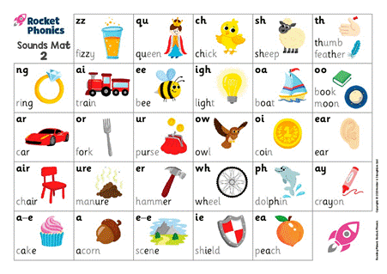
Phonics
We follow the Rocket Phonics programme.
During the Autumn Term, children will learn new sounds and practise blending sounds to read words and segmenting words to write them. As children develop their phonics knowledge, they will begin to apply the sounds they know when reading and writing independently.

Slide 11
How to help at home
Phonics
There are lots of fun, everyday ways you can support your child’s phonics learning at home. Keep sessions short, playful and positive — little and often is best!
Oral blending
Say the sounds in a word and encourage your child to blend them together: “c-a-t… cat!” Try this without showing the written word at first. You can make it into a game using names, toys, food or things you can see around the house.
Letter and sound recognition
Practise recognising the letters and saying the pure sound they represent. Look for sounds on signs, packaging, books and around your home. Remember, we are learning the sound, rather than adding an extra “uh” to it.
Blending words
When your child knows the sounds, encourage them to put them together to read simple CVC words such as sat, pin, dog. Encourage them to look at each letter, say the sounds and then blend them together.
Keep it playful, celebrate effort and avoid pressure. Your encouragement and enjoyment of reading together make a huge difference.

Slide 12
How to help at home
Pencil Grip
We encourage the children to use the correct pencil grip.
Palmar grasp → Digital grasp → Static tripod → Dynamic tripod
As children develop, we encourage them to move towards a comfortable three-finger grip, with the pencil controlled by the fingers rather than the whole hand.
How can you help at home?
Build hand strength and fine-motor control through playdough, threading, tweezers, Lego, puzzles, cutting, colouring and drawing. Encourage lots of opportunities to mark-make and practise writing without making it feel like a chore.
Strong hands + good control = confident writers!

Slide 13
How to help at home
Letter Formation
Our letter formation rhymes
a – Around the astronaut’s helmet and down into space.
t – From the tiger’s nose to his tail, then follow the stripe across the tiger.
m – Down, up and over the mouse’s ears, with a little flick for his nose.
d – Around the duck’s body, up to its head and down to its feet.
n – Down the net handle, then up and over the net.
s – Under the snake’s chin, slide down and round its tail.
p – Down the penguin’s back, then up and around its head.
i – Down the iguana’s body, then draw a dot at the top for the leaf.
b – Down the bear’s back, then up and around his belly.
e – Around the elephant’s eye and down his trunk.
o – All around the octopus!
c – Curl around the cat.
u – Down and around the umbrella, stop at the top, and down to the bottom with a flick.
l – All the way down the lollipop.
k – Down the kite, up and across, back and down to the corner.
g – Around the goat’s face, up to his ear, then curl under his chin.
h – Down, up and over the helicopter.

Slide 14
How to help at home
Letter Formation
r – Down and around the rainbow.
f – From the flamingo’s neck, all the way to its foot, then across its wings.
v – From the top of the wave, to the bottom, up the wave, down the wave and back up to the top.
w – Down the wave, up the wave, down the wave and back up to the top.
x – Down the kite, up and across, back and down to the corner.
y – Down the yoyo, then follow the string around.
z – Zip across, zag down and across the zebra.
Try this at home
Say it → Watch it → Air write it → Write it
Practise letters using large movements first — in the air, on a tray of flour, with chalk or with your finger — before moving onto pencil and paper.
Keep it short, playful and positive. Good letter formation develops gradually as children build their fine-motor control and confidence.

Slide 15

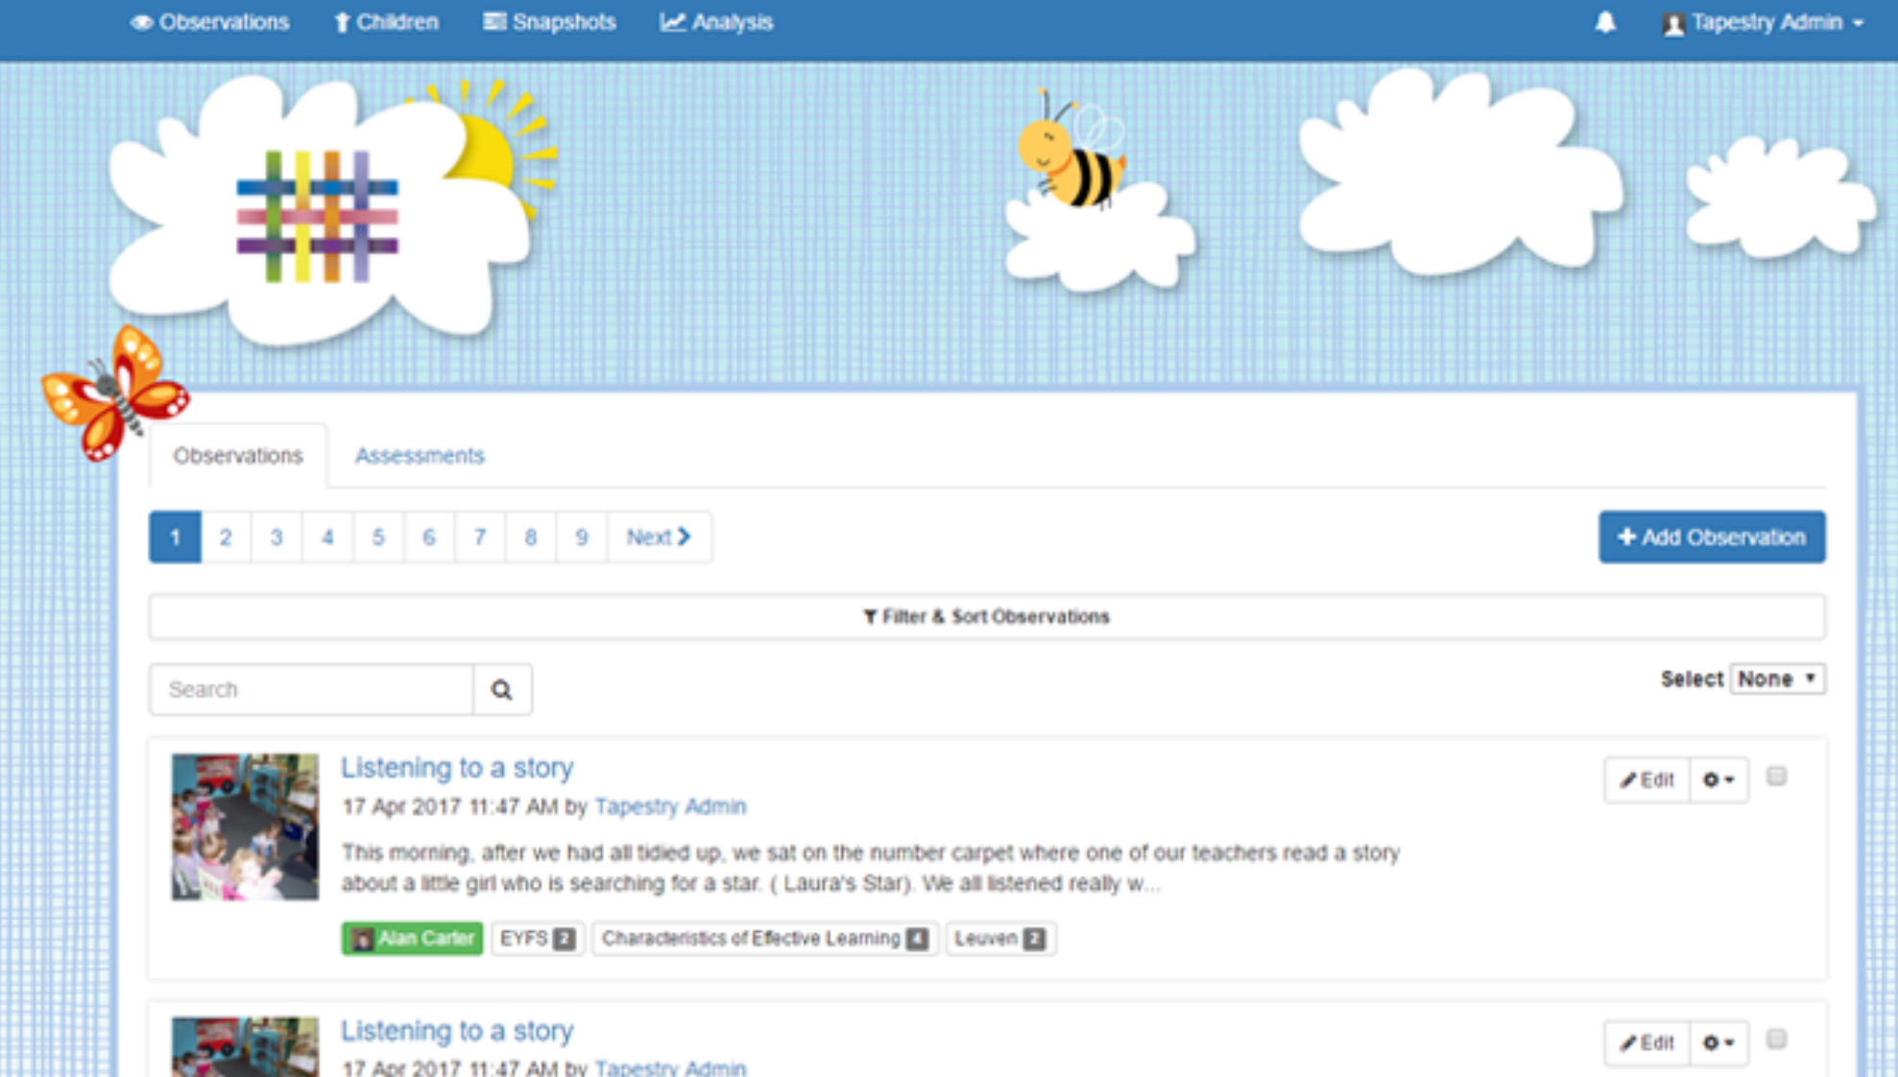
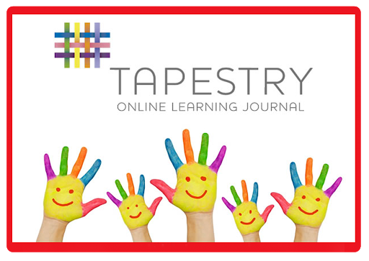
Tapestry
Tapestry is about capturing the magic of a child's early years experience, and recording children's learning in a way that is both secure and that we can share with parents.
Using a personal and secure username and password given to you by our school you will be able to view all of your children’s observations, photographs and even video from their time in Reception.
Tapestry helps to build strong partnerships between parents and the staff at school by giving you the option of interacting with the observations made by our staff and by allowing you to make your own observations from home.
Positive comments about work only please. For all other communication please use the school office.
Notes:
NL

Slide 16
How to help at home
Reading
How to support your child at home
Read with your child every day and practise the sounds they have learnt.
Keep reading enjoyable. Sometimes read the story to your child to develop their enjoyment and fluency.
Talk about the pictures, characters and events to develop comprehension and language.
Re-read favourite stories. Repetition helps children develop confidence and fluency.
Initially, your child may receive a lilac book with no words. These books develop storytelling, language and comprehension skills. How to support your child with reading at home (This link includes a video about reading at home)
A coloured banded reading book will be sent home and books will be changed weekly.
Children will read with an adult in school at least once a week.
Children will move up through the colour bands when they are ready, following an assessment of word recognition, fluency and comprehension.
Please record reading at home and school in the Page Ticker.
We encourage re-reading of books for fluency and understanding. This may mean changing their books less regularly.

Slide 17

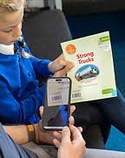
Pageticker
In Reception, we use Page Ticker as our online reading log. This is where you can record your child’s reading at home and share their reading experiences with us.
You should receive your own Page Ticker login details from school. Please keep these details safe, as you will need them to access your child’s reading log.
We ask that you read with your child every day and record this on Page Ticker.
Reading doesn’t have to be a long session. You could read a book together, Let your child practise reading their school book, Talk about the pictures and characters, Ask questions about the story, Encourage your child to sound out unfamiliar words or Share a bedtime story together.
After reading, please record the reading on Page Ticker each day. You can add a short comment about how your child got on, for example, a word they found tricky, something they enjoyed, or how confidently they read.
Notes:
NL

Slide 18
How to help at home
Maths
Maths is all around us! Everyday moments, play and conversations are wonderful opportunities to develop your child’s mathematical thinking.
• Count together – steps, toys, plates, stairs or objects when tidying up.
• Spot numbers – look for numbers on doors, signs, buses, clocks and houses.
• Play games – dice, dominoes, board games and cards help develop counting, recognition and number sense.
• Practise subitising – show a small number of objects or dots and ask, “How many can you see?” without counting.
• Compare and sort – “Who has more?” “Which is bigger?” “Can you find all the red ones?”
• Explore shapes and patterns – notice shapes around the home and make patterns with toys, objects or clothing.
• Use maths in routines – cooking, sharing food, setting the table, shopping and getting dressed all provide opportunities to talk about number, measure, size and position.
Most importantly, talk about maths! Ask “How do you know?”, “Can you find another way?” and encourage your child to explain their thinking.
Our focus is not on rushing to bigger numbers, but on developing secure number sense and a deep understanding of the numbers children already know.

Slide 19
Useful Information
P.E days are Wednesdays. Children should come to school in their P.E kits.
Spooky Disco Day is just before half term. Look out for the dates for these events on the school newsletter. The children can come to school in their spooky outfits, witches, pumpkins, ghosts, vampires etc all day.
Miss Friesner joins the class when the teachers have planning and preparation time. She will teach the Jigsaw sessions and Miss Jones will teach our P.E sessions.
Welly walks will usually happen on a Thursday. Wellies can now come into school please. Named please.
Rucksacks cannot be stored on pegs or trays. This means staff and children cannot identify and access them easily. Please bring a book bag or draw string bag.

