Slide 1
Whitemoor Lakes Residential
Monday 8th December - Wednesday 10th December 2025

Slide 2
Why Whitemoor Lakes?
Whitemoor Lakes is an outdoor education centre which promotes the following skills through their activities:
Communication
Teamwork
Independent thinking
Physical activity
Problem solving
Resilience
Social skills
Leadership
Time management.
All of these qualities reflect areas of our school values.

Slide 3
Day of travel
We will leave school at approx. 9.45am on Monday 8th December.
Things to bring:
Packed lunch in a disposable bag.
Wear clothes suitable for the activities
Light-weight waterproof coat
Reading books, colouring or Top Trumps for the journey. No electronic devices or cameras.

Slide 5
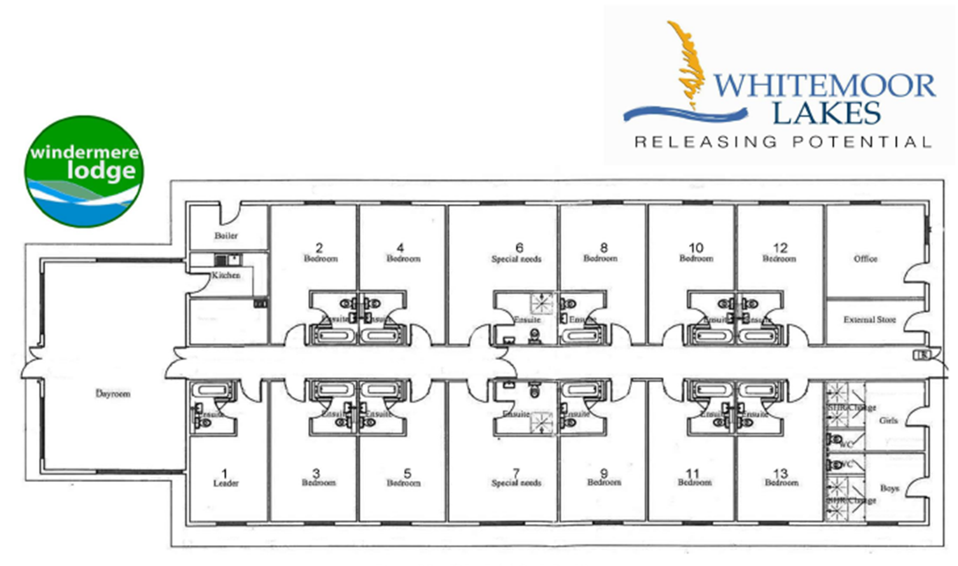
Walk in shower
Walk in shower

Slide 6
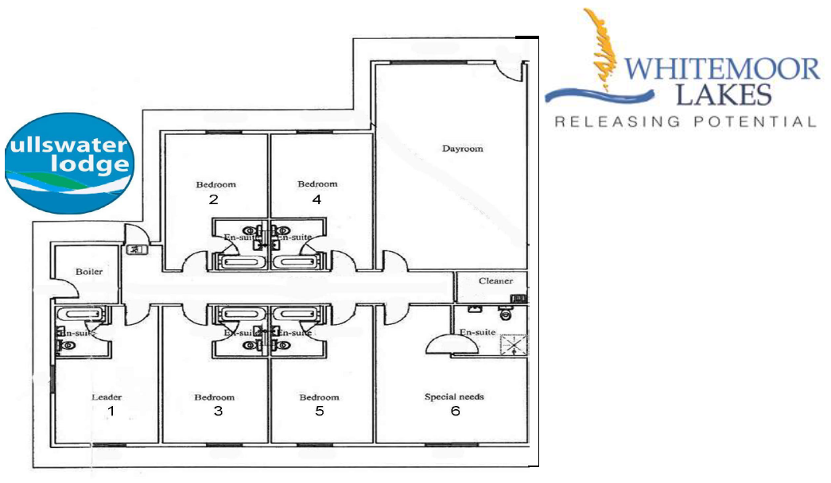
Walk in shower
Whitemoor Lakes, Barley Green Lane, Lichfield, Staffordshire, WS13 8QT t: 01283 795000 f: 01283 791057 e: enquires@whitemoorlakes.org.uk

Slide 7
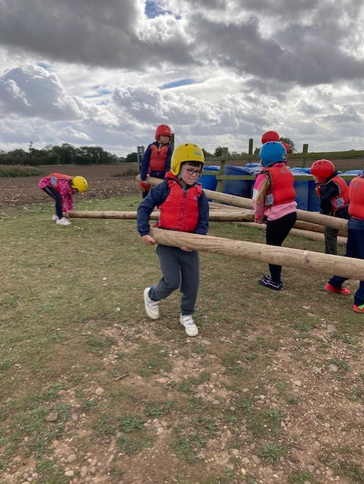
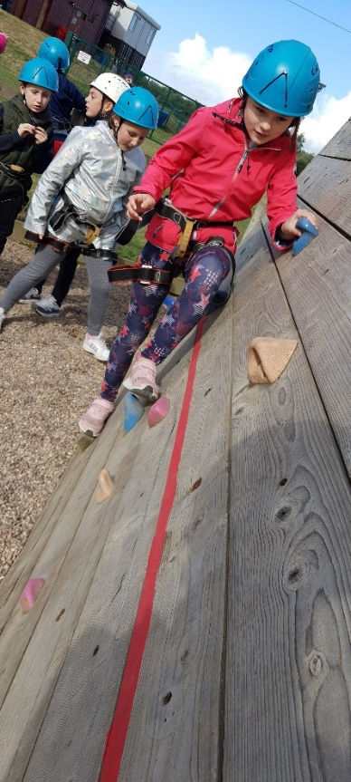
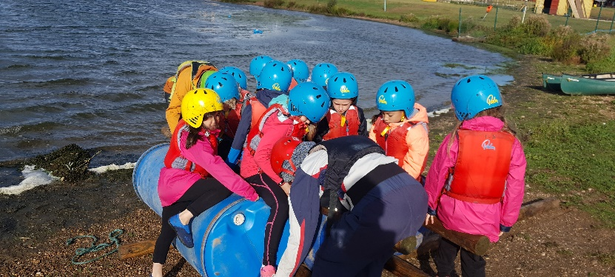
Activities we have had over the last two years- they are allocated to us
Challenge course
Camp fire
Archery
Leap of Faith
Problem Solving
Team games
Orienteering

Slide 8

Christmas Action Plus (xmas A+)
Throughout December we offer something extra special for our school groups. The Christmas Action Plus package takes a festive twist and includes meals, en-suite accommodation, 10 festive themed activities, a full Christmas dinner, and a present from Santa himself for every child during your visit.

Slide 9
Example Timetable Activities
 | 9.30-11.00 | 11.30-1.00 | 2.00-3.30 | 4.00-5.30 | 7.00-8.30
Day 1 | Travelling | Arrival and welcome | Challenge course | Raft building | Campfire
Day 2 | Archery | Buggy building | Climbing | Zip wire and abseiling | Team games
Day 3 | High ropes | Wide games | Travelling

Slide 10
Equipment list
Whitemoor Lakes Yr4
General items
Towels x2 (large & small)
Wash kit (toothbrush, tooth paste, soap, flannel, shampoo, roll on deodorants only)
Pyjamas
Teddy
Hair bobbles for long hair *No earrings or tape to cover them for all activities*
Reading book/colouring/small games (no electronics)
Enough underwear and socks for your stay, plus spares in case you get wet.
Carrier bag for dirty/wet clothes
A few things to remember:
Clothes may get dirty, so don’t pack ‘best’ clothes or shoes.
Tracksuit bottoms are good for activities, please avoid jeans and skirts.
Footwear: A variety of shoes. Old trainers/walking boots/wellington boots for mud and wet, something for indoors and something for games. No open toed shoes.

Slide 11
Equipment list
Whitemoor Lakes Yr4
Outdoor activities
At least one set of clothes per day including: jogging/tracksuit bottoms, t-shirts, sweatshirts/jerseys, warm socks (no jeans)
Warm layers
Sensible trainers or outdoor shoes
Waterproof jacket
Hat and gloves (if needed)
Suncream (if needed)
Water sports
Clothes you don’t mind getting wet (two sets)
Shoes to get wet
Spare towel
A bag for wet things
Indoor activities
Long sleeves for archery
Indoor shoes
Optional items
Waterproof trousers
Torch

Slide 12
Meals
Children will eat together in the dining hall.
Please bring a packed lunch for the first day in a disposable bag.
All other meals are provided (including hot options for breakfast, lunch and dinner)
Fresh fruit is always available
Dietary requirements will be given to the catering team and will be catered for. (We use the information you have provided for your child. Please notify the office as soon as possible if there are any changes to dietary requirements).

Slide 13
Medicine
If your child requires an inhaler, please ensure they have it in their rucksack. (Please note: a medication form will still need to be completed and handed in to a first aider).
Please ensure all medical information that we hold is up to date.
If your child requires prescribed medicine, please ensure it is handed in to a nominated first aider or class teacher on the day of the trip.
Make sure it is in a clearly-labelled container with a completed medication form. (These can be collected from the school office prior to the visit.)

Slide 14
Return to school
We are due to return to school just after the normal school day ends on Wednesday 10th December.
If you have any further questions about the visit, please don’t hesitate to ask.
https://activity-centres.naycacuk.co.uk/whitemoor-lakes/

