Slide 1
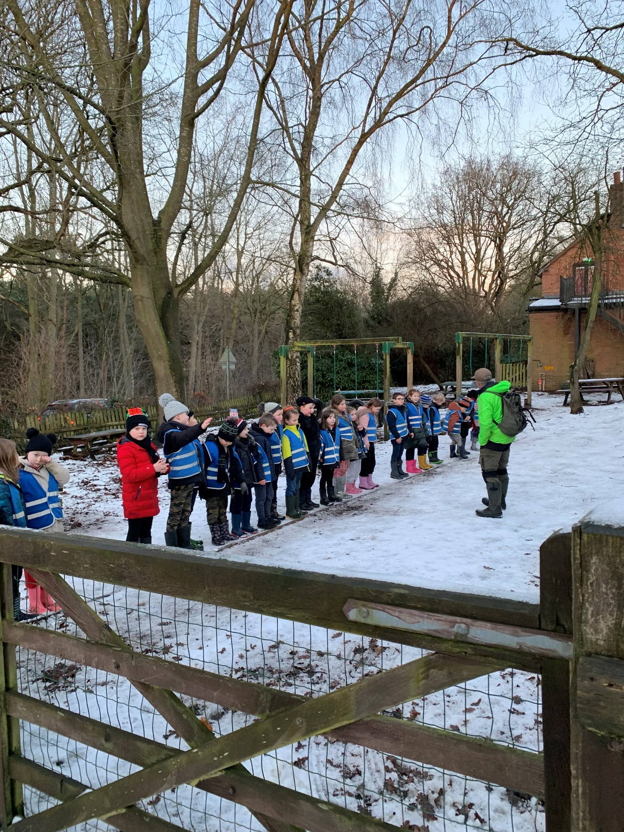
STAFF
Y3D
Miss Davenport, Mrs Machin and Mr Farrall
Y3L
Mrs Lawrie, Miss Gray and Mr Farrall

Slide 2
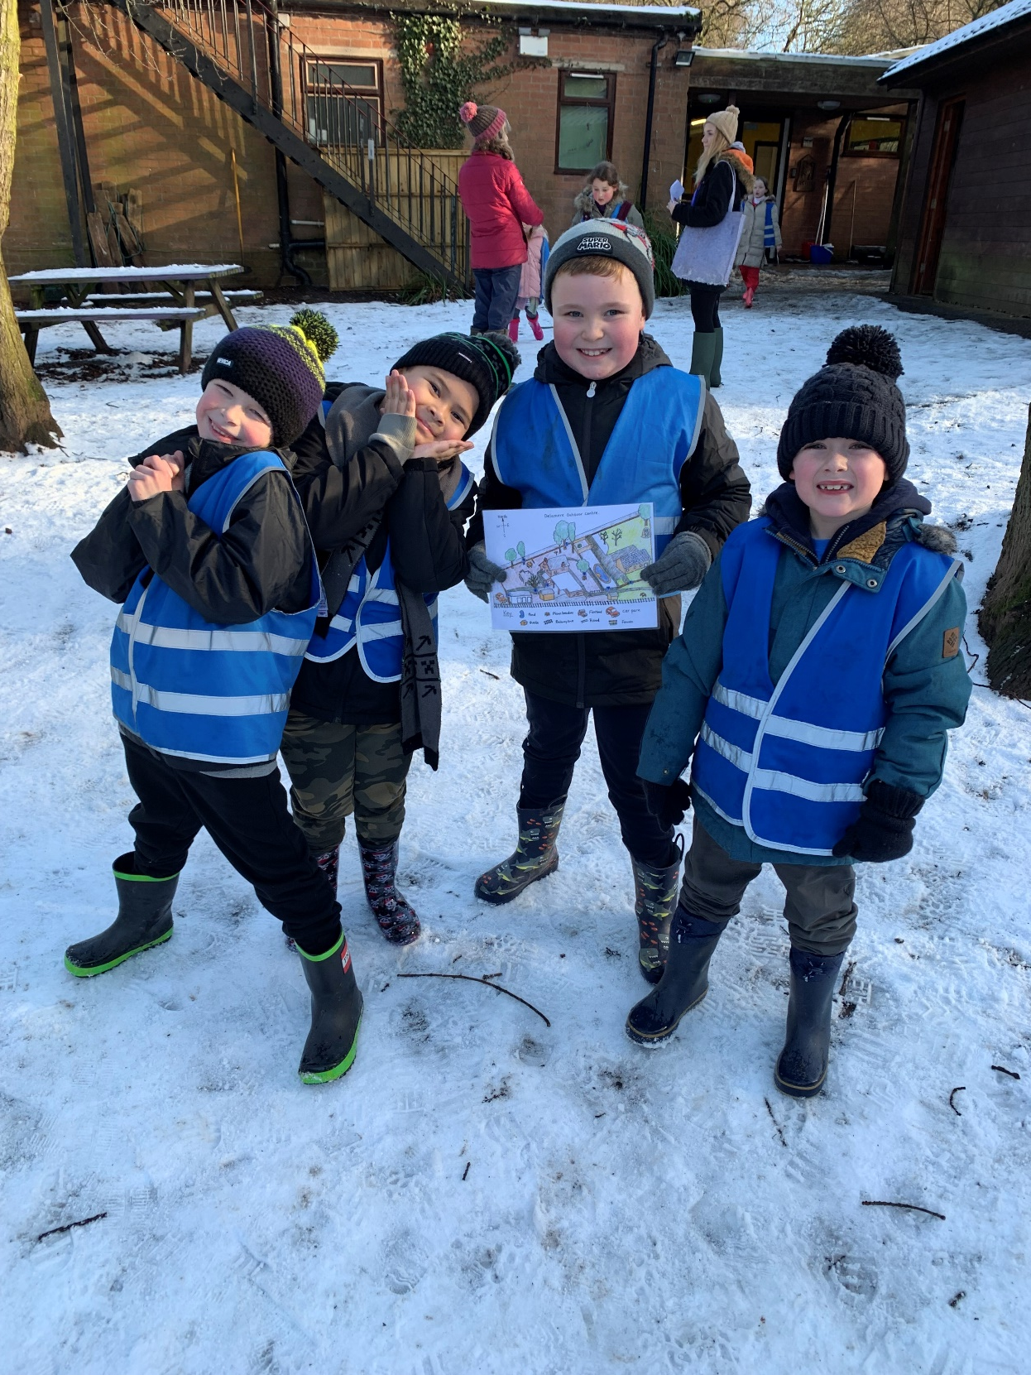
Day 1 Activities

Slide 3
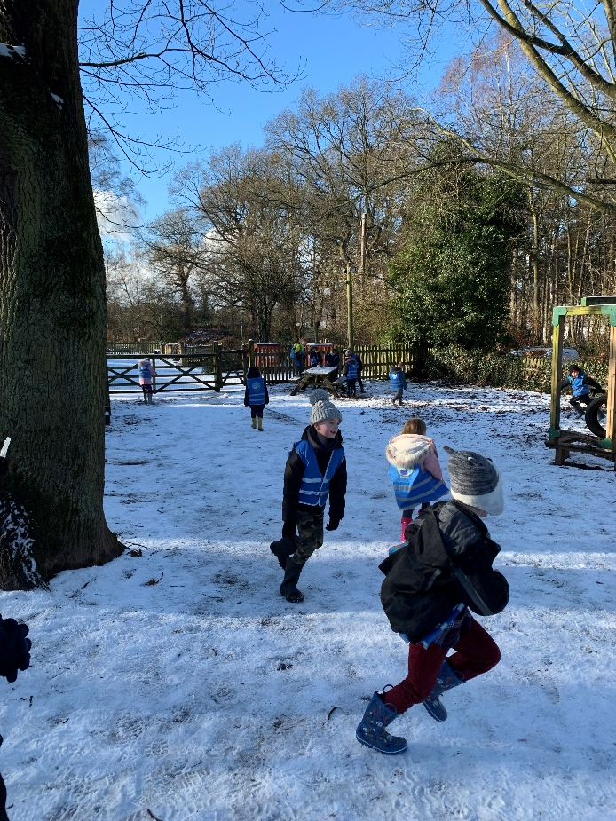
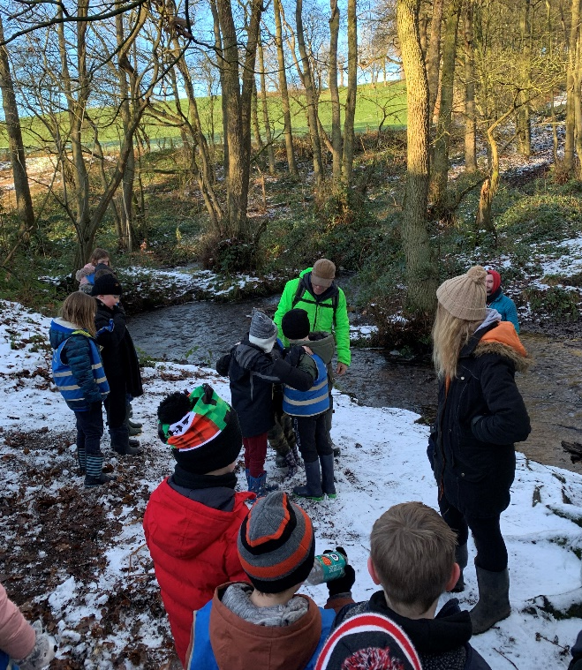
ACTIVITIES – DAY ONE
Introduction to the centre
Habitat Walk (Ranger Led)
Packed Lunch (Children need to bring this with them in a disposable bag)
Orienteering (Ranger Led)
Evening Meal
Camp Fire & Toasting Marshmallows
‘Midnight’ Walk (Children can bring a torch if they wish to, this is not compulsory)

Slide 4
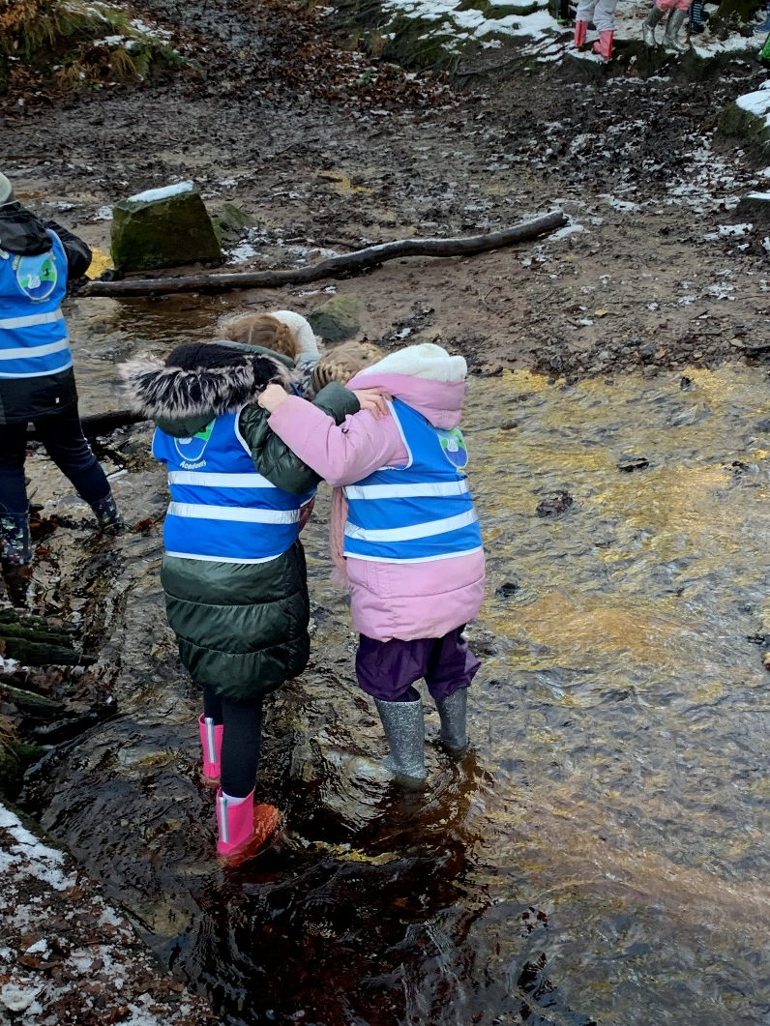
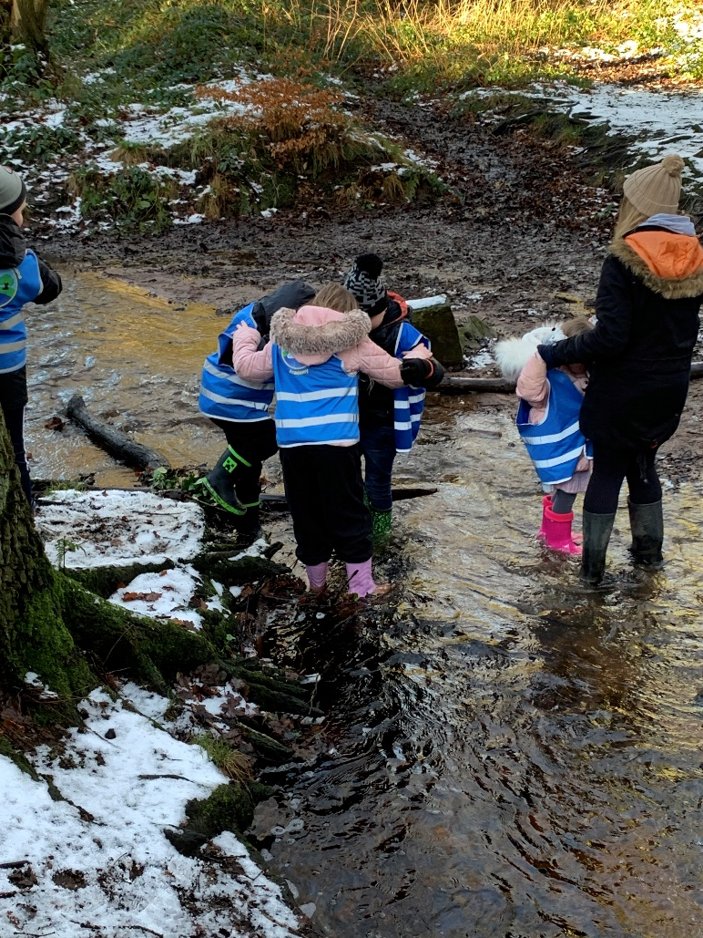
Crossing the Stream in a Team

Slide 5
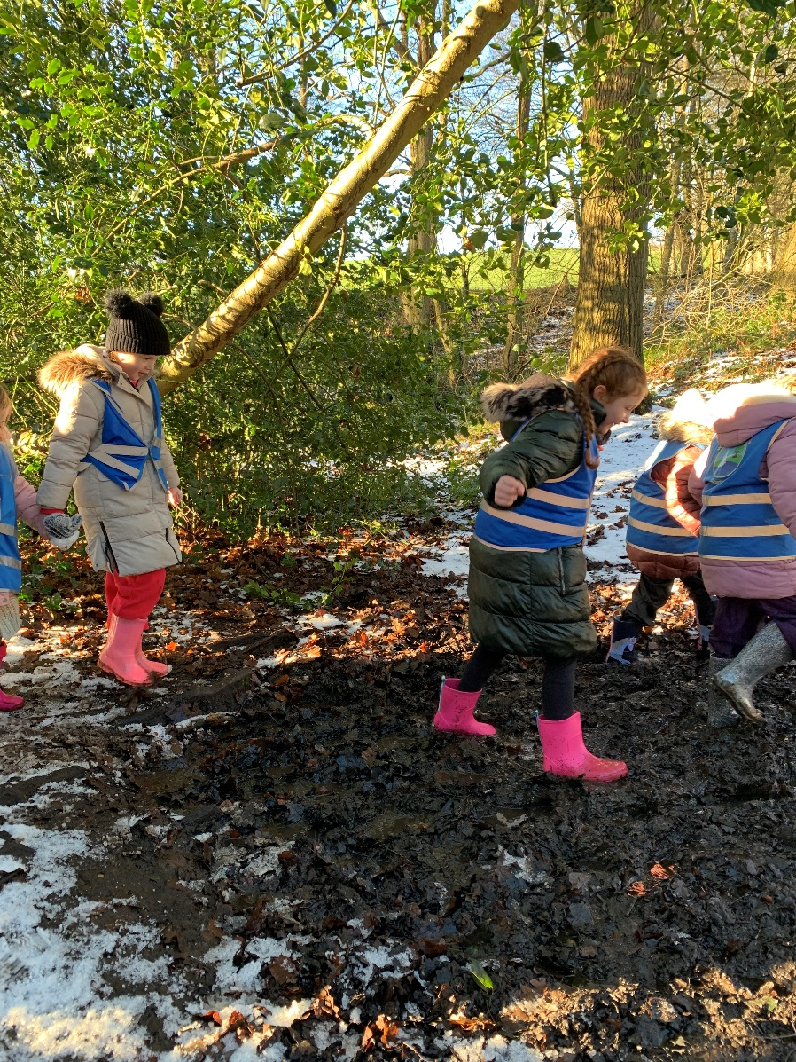
Getting stuck in the mud!

Slide 6
Packed Lunch
For day 1 of the trip your child will need to bring a packed lunch and drink from home.
Please can these be disposable.

Slide 7
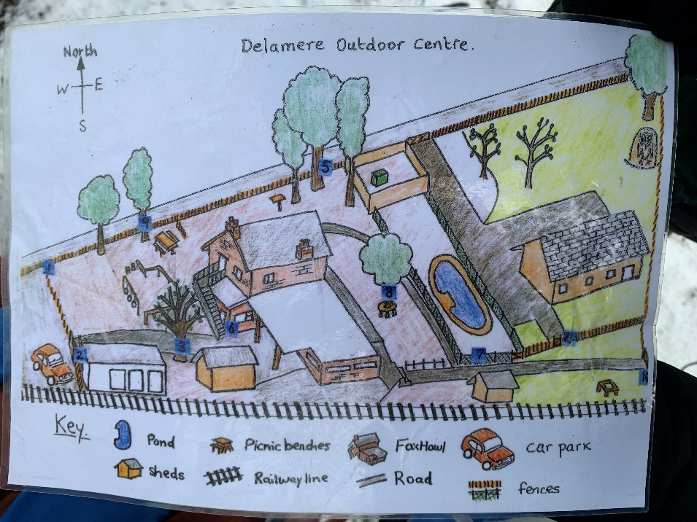
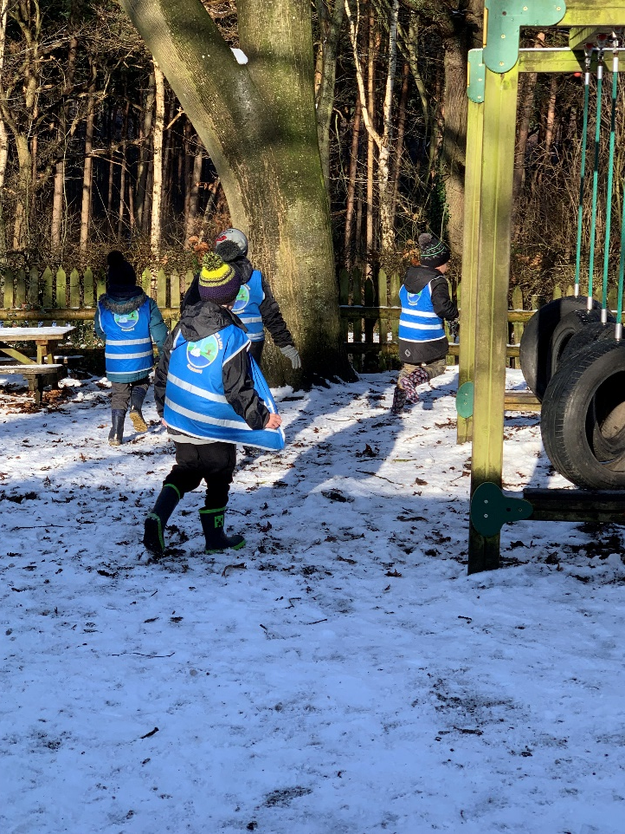
Orienteering

Slide 8
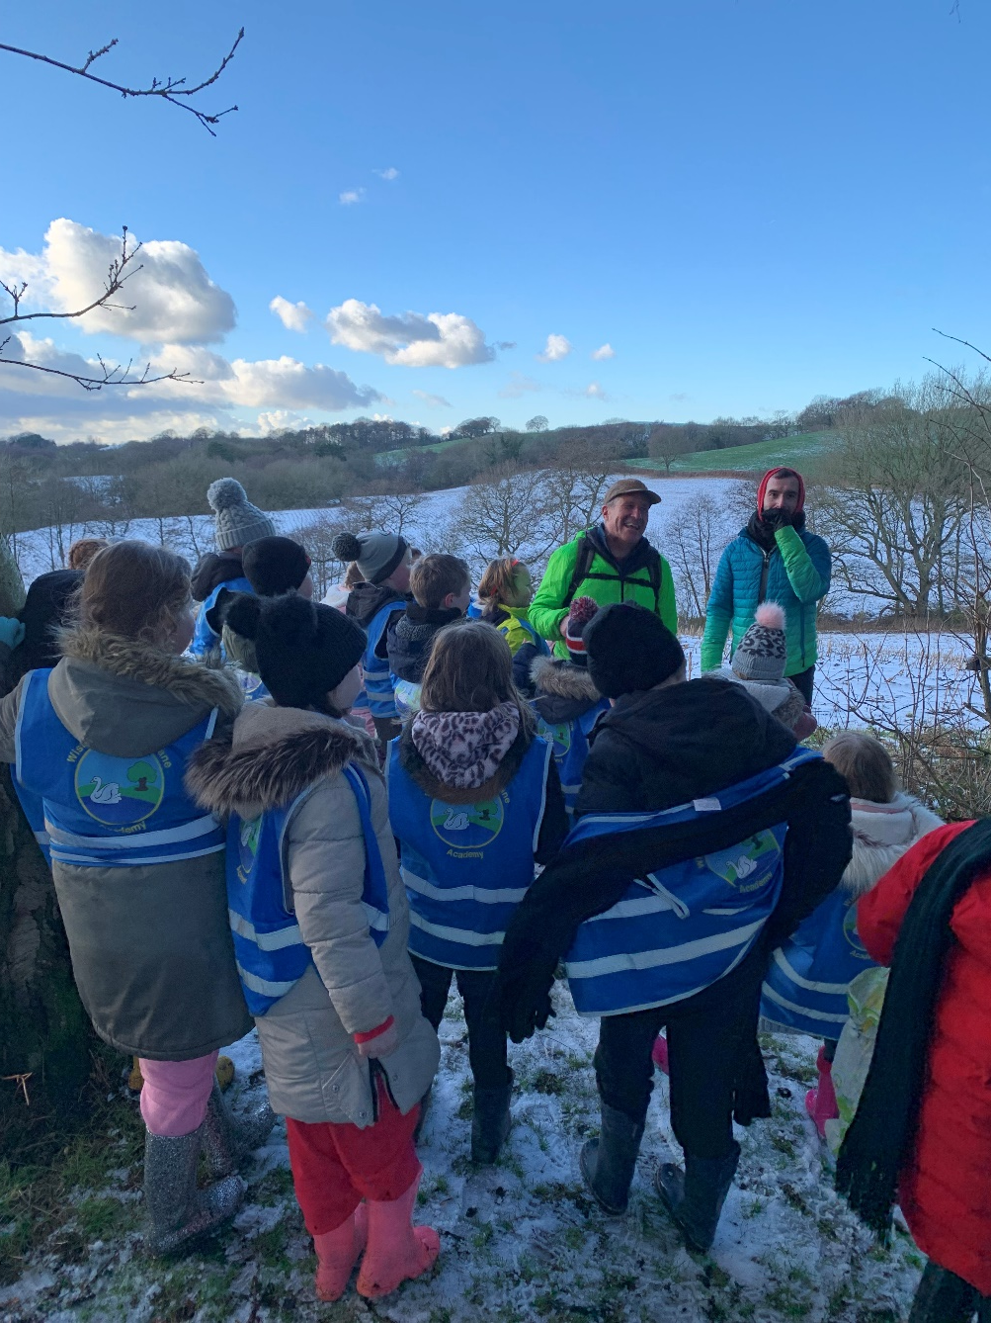
FOX HOWL, DELAMERE
Y3D
Wednesday 17th – Thursday 18th January
Y3L
Thursday 18th – Friday 19th January
Children need to come to school at normal time and will return home before the end of the school day.

Slide 9
Evening meal
Children are given two choices for their evening meal with a dessert.
Day 2 - Lunch menu consists of sandwiches, crisps, fruit etc.
Fruit Squash/Water and biscuits for morning/afternoon snacks.
A drink and a biscuit before bedtime.
Toasted marshmallows on the first night (weather permitting)

Slide 10
Camp fire

Slide 11
Evening stroll 'Midnight walk'

Slide 12
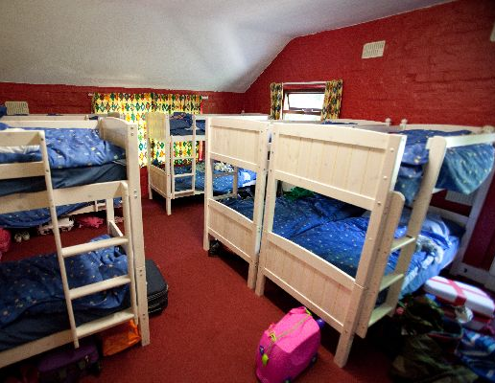
Bedtime
2 dormitories
1 girls dorm and 1 boys dorm
1 teacher dorm upstairs and 2 teacher dorms downstairs.

Slide 13
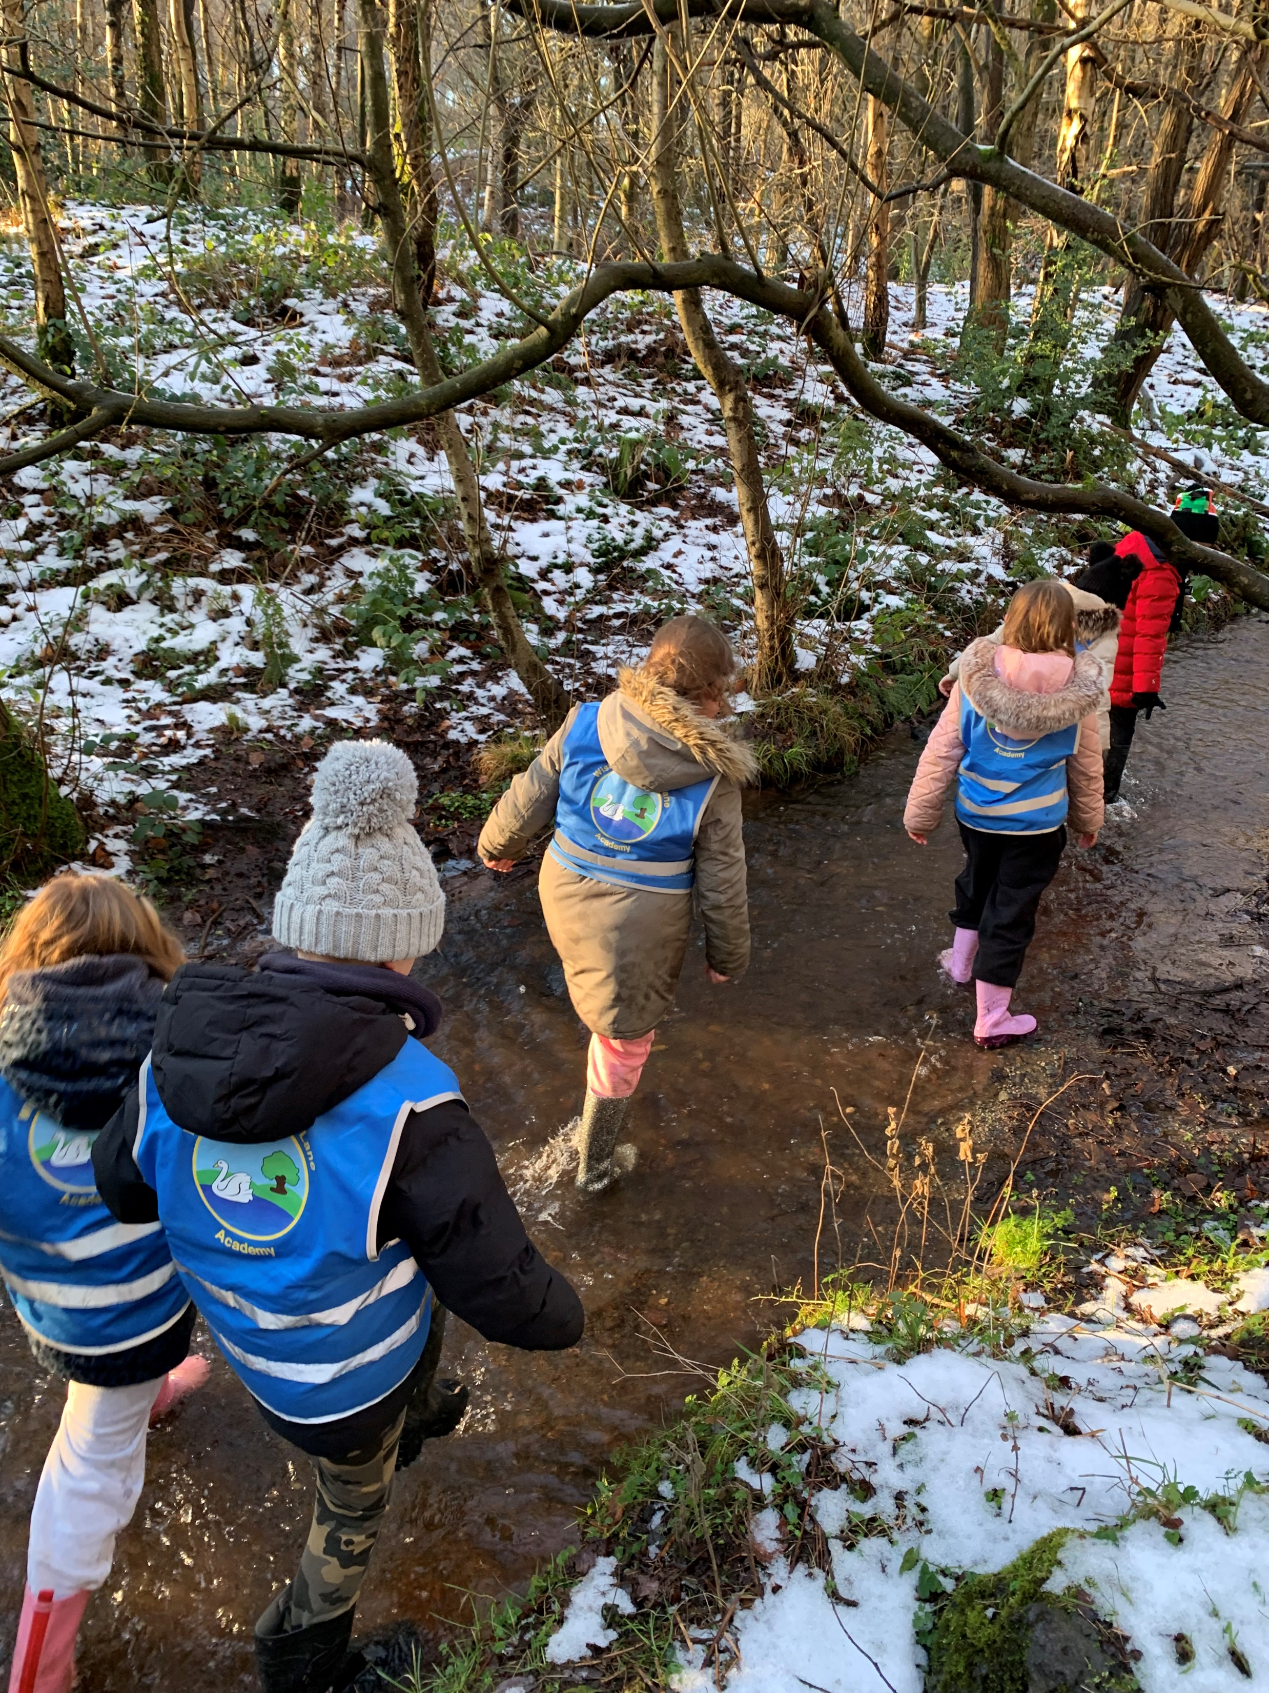
Day 2 Activities

Slide 14
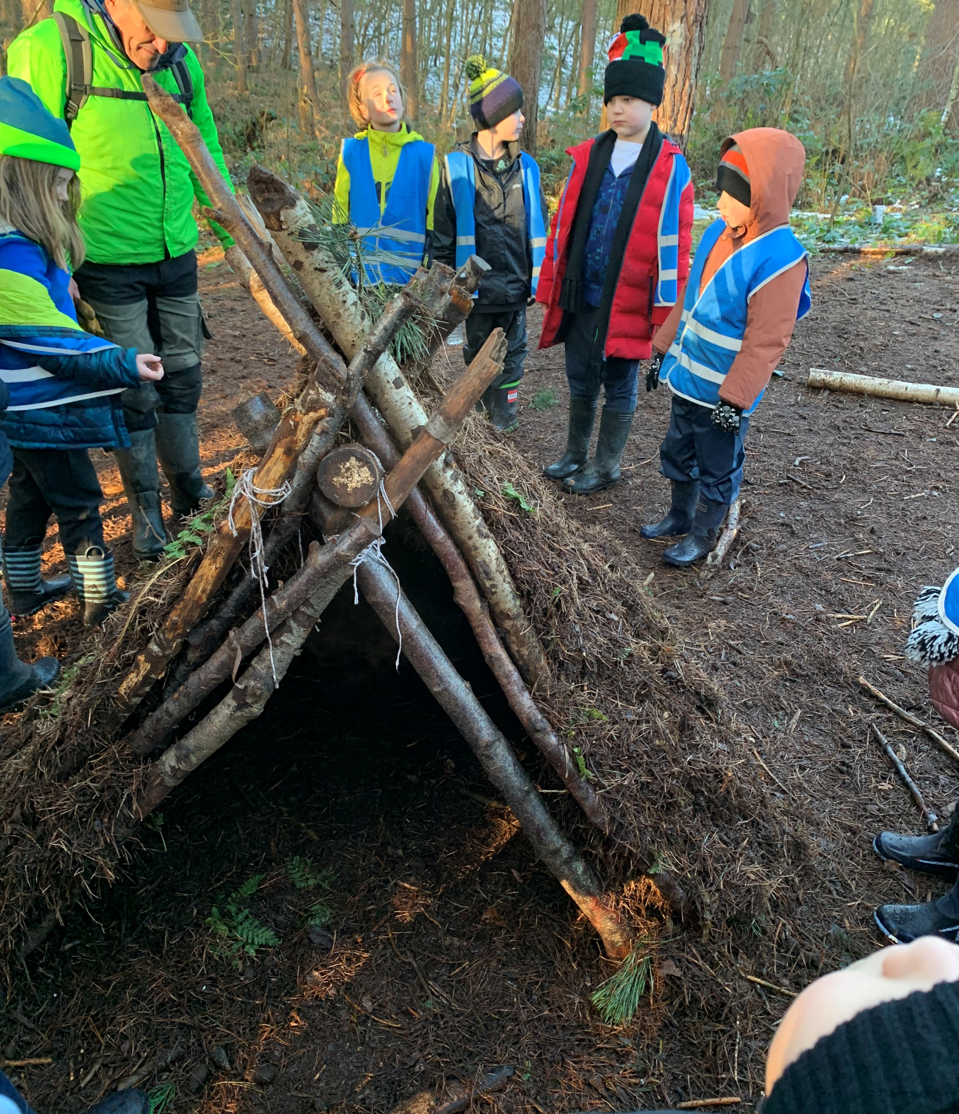
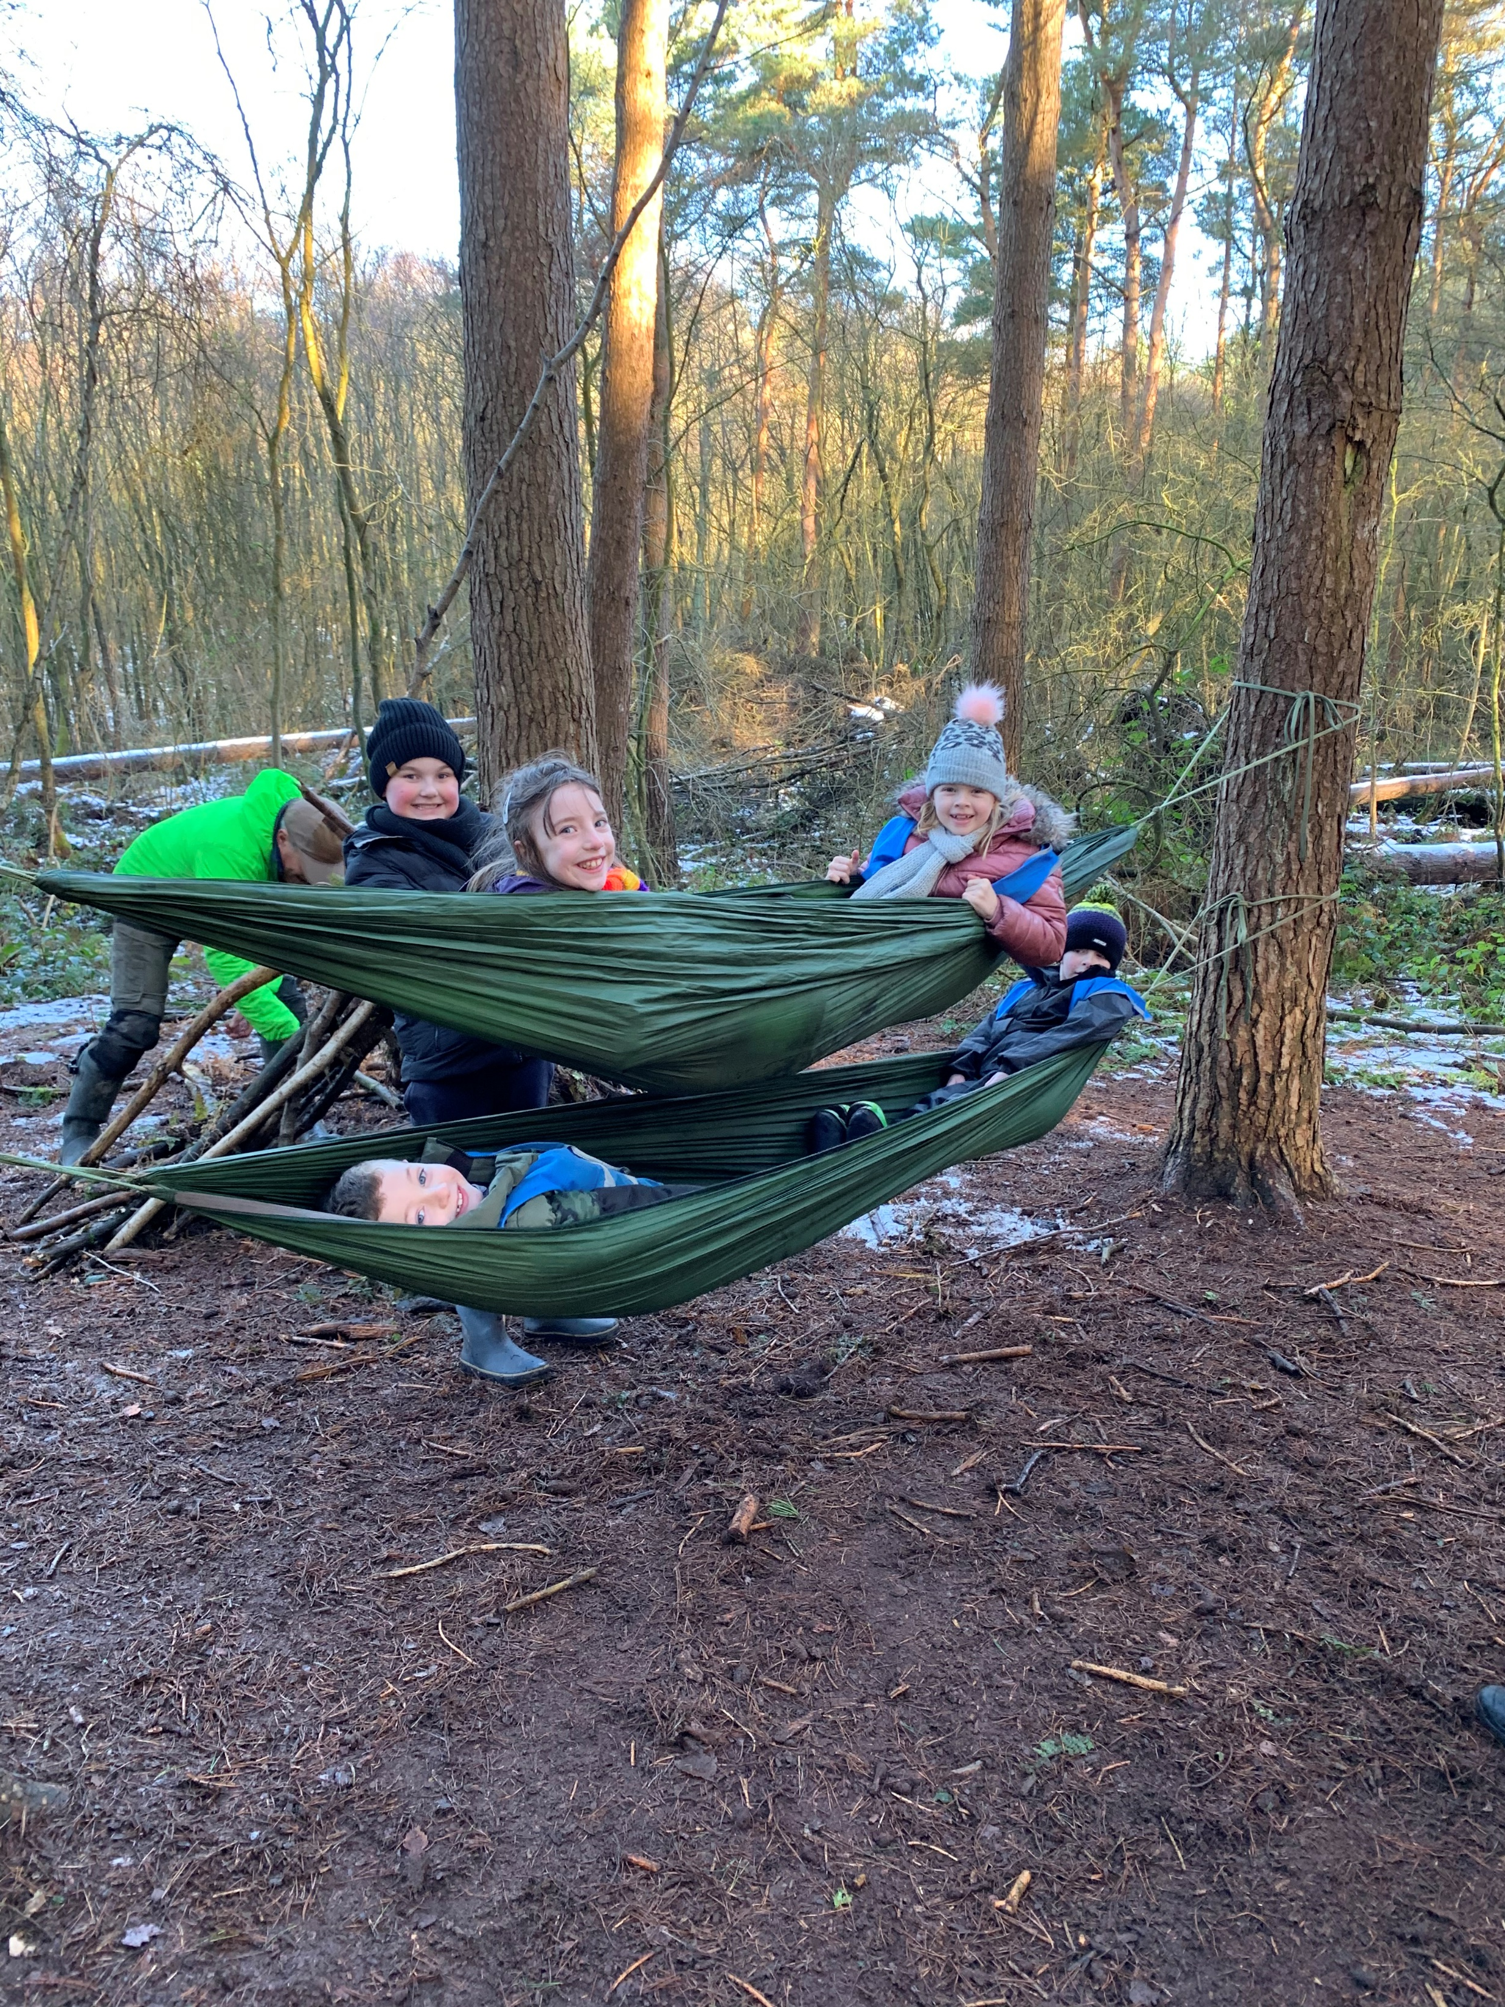
ACTIVITIES – DAY TWO
Breakfast
Packing suitcases!
Den Building (Ranger Led)
Putting up Hammocks (Ranger Led)
Lunchtime
Fun Activities/Games
Return to school

Slide 15
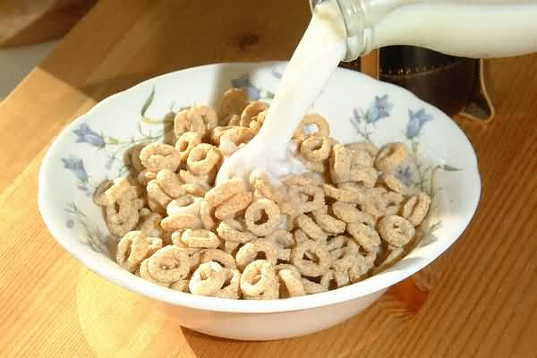
Breakfast
This Photo by Unknown Author is licensed under CC BY

Slide 16
Learning how to Tie Knots and build an a frame

Slide 17
Putting up Hammocks/ shelters

Slide 18
Testing them with Water

Slide 19
Den Building

Slide 20
WHAT TO TAKE
Waterproof trousers if possible or leggings/joggers that will dry quick.
Thermals/extra layers e.g. vests
Socks
Warm waterproof coat with hood
Wellies or walking boots
Hat, scarf, gloves
Two complete changes of clothes
Nightwear and slippers
Towel
Toothbrush and toothpaste
Hairbrush
Plastic bag or bin bag for dirty clothes
A small game (not electronic) or a book to read
Teddy bear
No spending money is needed

Slide 21
MEDICATION
Please give any medication to the teacher on the morning of the visit. (Please speak to your class teacher beforehand to discuss this.)
A medication form must be completed.
Centre staff will be informed of any food allergies/intolerances in order to plan meals during our stay.

