Slide 1
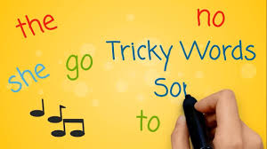
English Support Session Thankyou for your questions. This morning we will look at the following areas: Tricky words - how to teach them Bug Club - how to navigate and get the coins / more books allocated. Please ensure microphones are muted throughout the sessions. Any questions must be related to what is discussed – any other questions will have to wait until our next support session.

Slide 2
What are tricky words?
When we teach reading, we teach the children how to sound out words and blend them together, however for some words this is not always possible – the English language is tricky!
When looking at tricky words, we teach the children which part of the word is “tricky” and why.
Unfortunately there are no “magic tricks” for children to learn these words – they are words we just have to remember. Sometimes there are patterns, but we have to learn these words by sight.

Slide 3
Which parts of these words are not phonetic (the letter doesn’t make the sound you think it should?) the my go

Slide 4
Learning Tricky Words
Tricky words song – link will be put on the website
Phonics hero – link will be put on the website
This song is great as it is a catchy tune and teaches children how to spell the word as well as read them.
There are songs available for the different phases of phonics tricky words too!
All links are available under “useful resources” on our website.

Slide 5
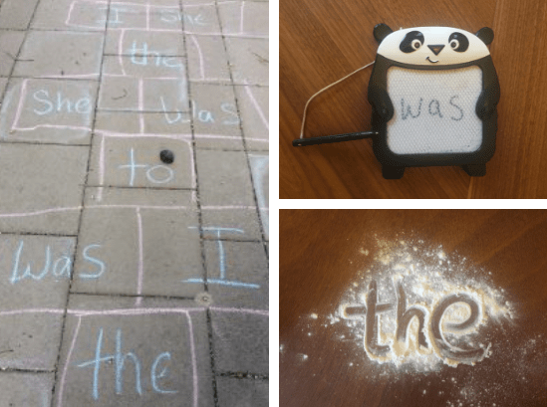
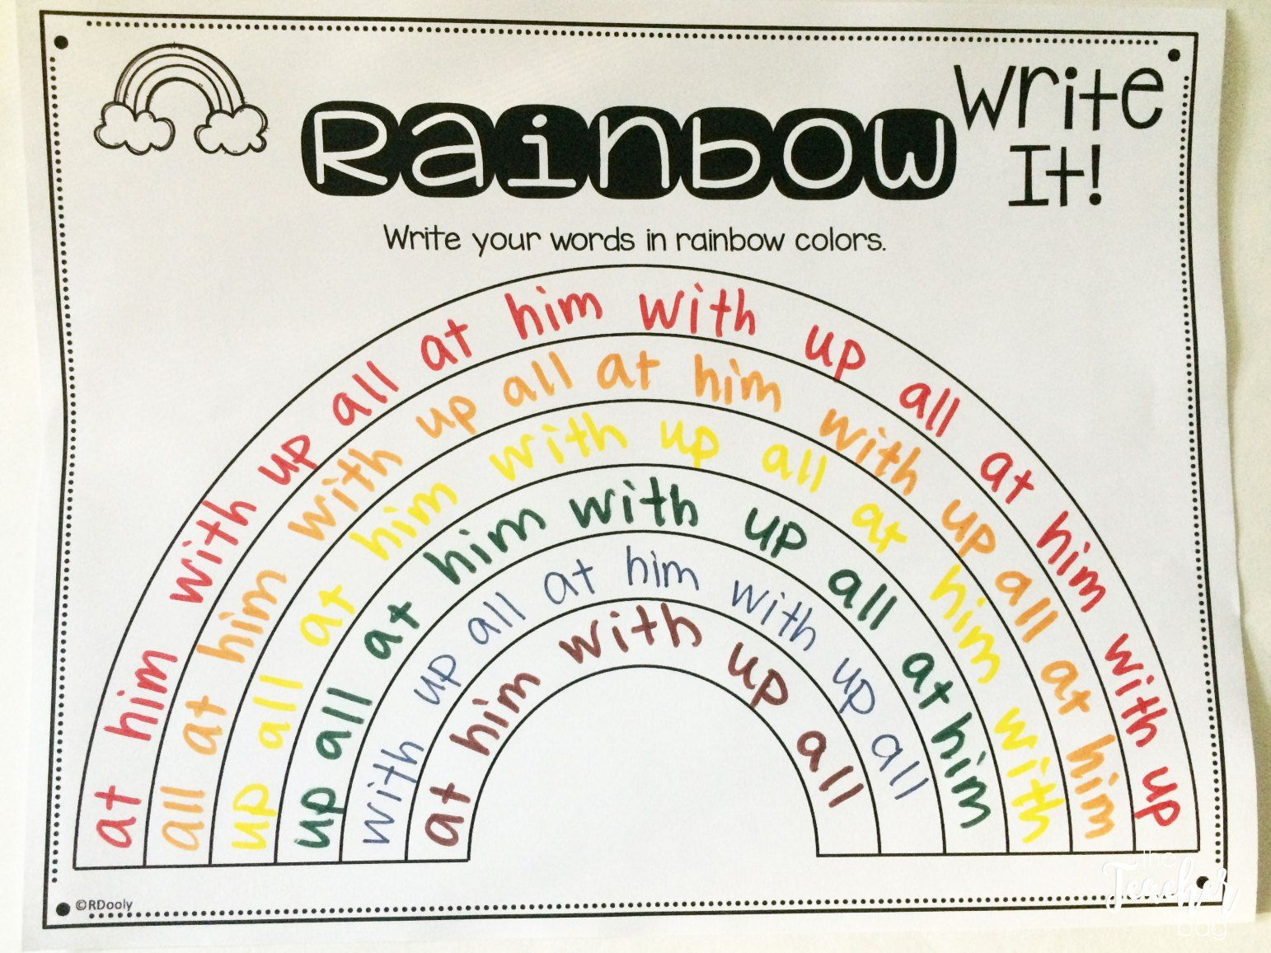
Learning Tricky Words
Writing the words in different media
Tricky word rainbows

Slide 6
Jumbled up letters
Which tricky words have I jumbled up?
T e h
y m
o g

Slide 7
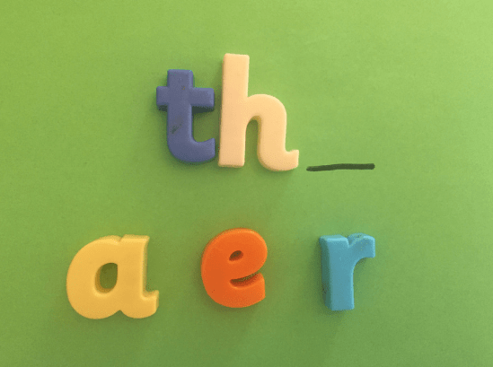
Word Detective
Play ‘Word Detective’: show the student(s) a tricky word written on a whiteboard and ask the student(s) to read and orally spell the word. Turn the board away and erase a letter.
Show the student(s) and ask them to identify the missing letter. The missing letter should then be written in again
Lets have a go!
(stop sharing screen at this point)

Slide 8
Bug Club
How to log on
How to access the books
How to earn coins / rewards

