Slide 1
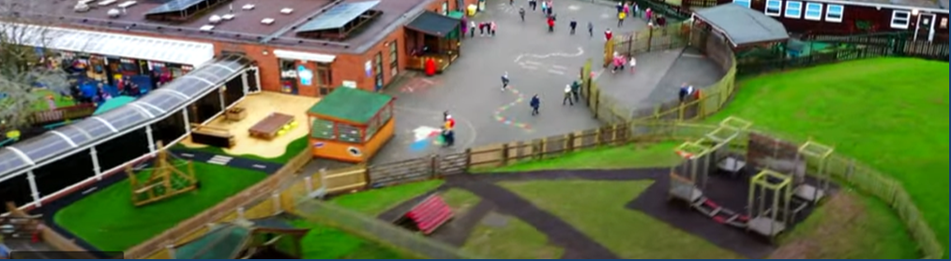
Cygnets Nursery Class
Wistaston Church Lane Academy
The Learning for Life Partnership

Slide 2
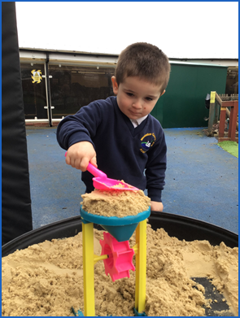
All Nurseries
Meet the needs of all children: play, rest, nourishment, comfort etc.
Develop children’s independence and ability to manage their own needs
Follow the guidelines set out in the Early Years Foundation Stage 2021. Same 7 areas of learning with clear focus for children aged 3-4 on:
Communication and Language
Personal, Social and Emotional Development
Physical Development
All notice what children like, enjoy and need and use this to plan activities
and make learning enjoyable
Provide 15 or 30 hours funding + wrap around care
Work with parents to achieve the best for each child

Slide 3
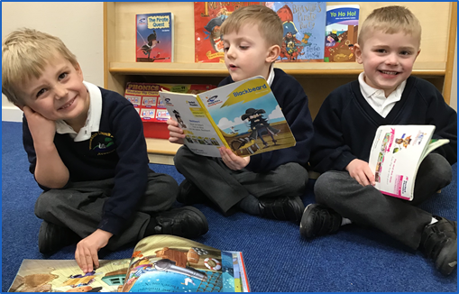
Day Care Nursery
Greater number of staff
Open 50+ weeks of the year
Flexible sessions offered
More detailed daily feedback for parents
Daily activities built totally around children’s interests and likes
Maintained School Nursery
Staff qualified to graduate level+
High level of expertise: Principal, SENCo, speech & language, subject specialists etc
Open 38 weeks of the year
Caring and nurturing but clear focus on preparing children for their next steps
Part of a wider school community
Begin to settle and feel part of school

Slide 4
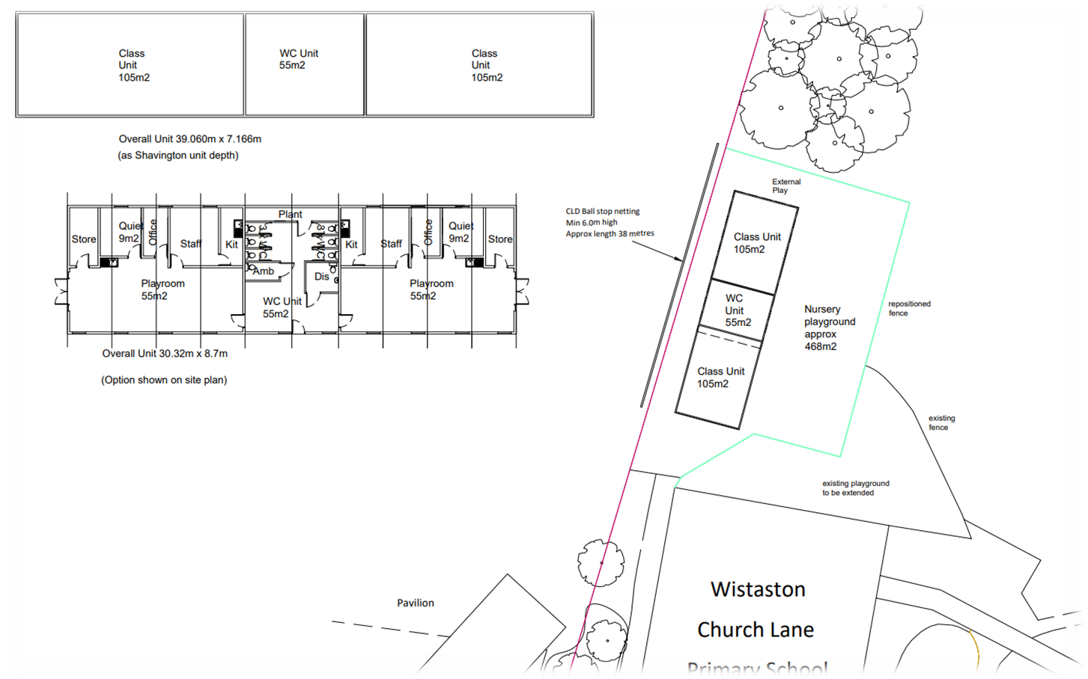

Slide 5
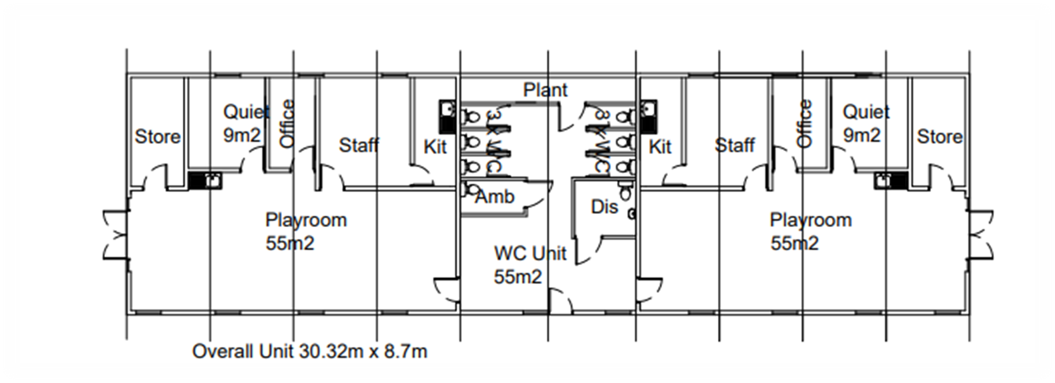

Slide 6
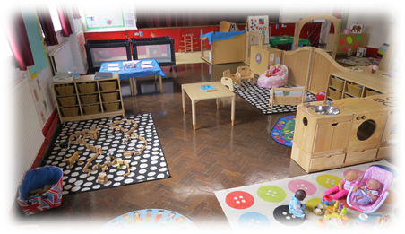
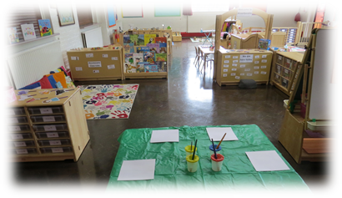
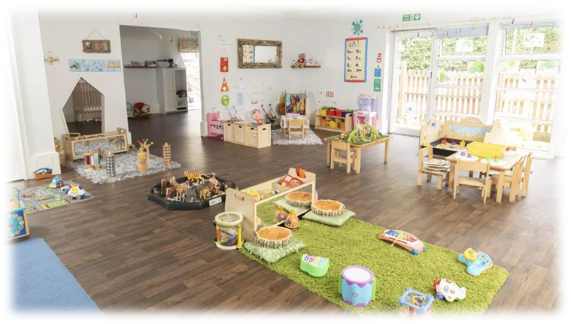
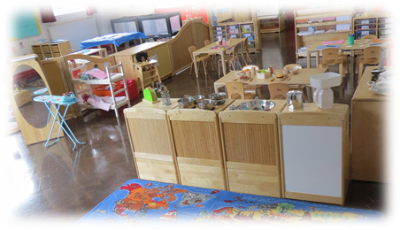
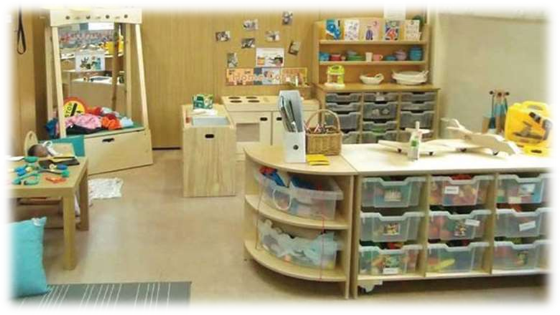
Pack away

Slide 7
Funding
All children are entitled to 15 hours early education funded by the local authority
Some children are entitled to 30 hours of funded education depending on family circumstances
Children can start after their 3rd birthday. Funding starts the term after. E.g. a child born on 29th January would have funding after the Easter break.
All sessions most be paid for, either through
LA funding or payments from parents
Session | Cost
Before School | £5.15
Morning/Afternoon Session | £15.50
Lunch Time Supervision | £2.00
After School Club | £10.25
Full Unfunded Day | £48.40

Slide 8
Next Steps:
Parent Guide
Registration forms to be completed and returned
Confirmation of places
A drop in stay and play session
June/July
Open Tuesday 5th September 2023

