Slide 1
Whitemoor Lakes Residential
Wednesday 4th October- Friday 6th October 2023

Slide 2
Why Whitemoor Lakes?
Whitemoor Lakes is an outdoor education centre which promotes the following skills through their activities:
Communication, teamwork, independent thinking, physical activity, problem solving, resilience, social skills, leadership and time management.
All of these qualities reflect areas of our school values.

Slide 3
Day of travel
We will leave school at approx. 9.45am on Wednesday 4th October.
Things to bring:
Packed lunch
Wear clothes suitable for the activities
Light-weight waterproof coat
Reading books, colouring or Top Trumps for the journey. No electronic devices or cameras.

Slide 5
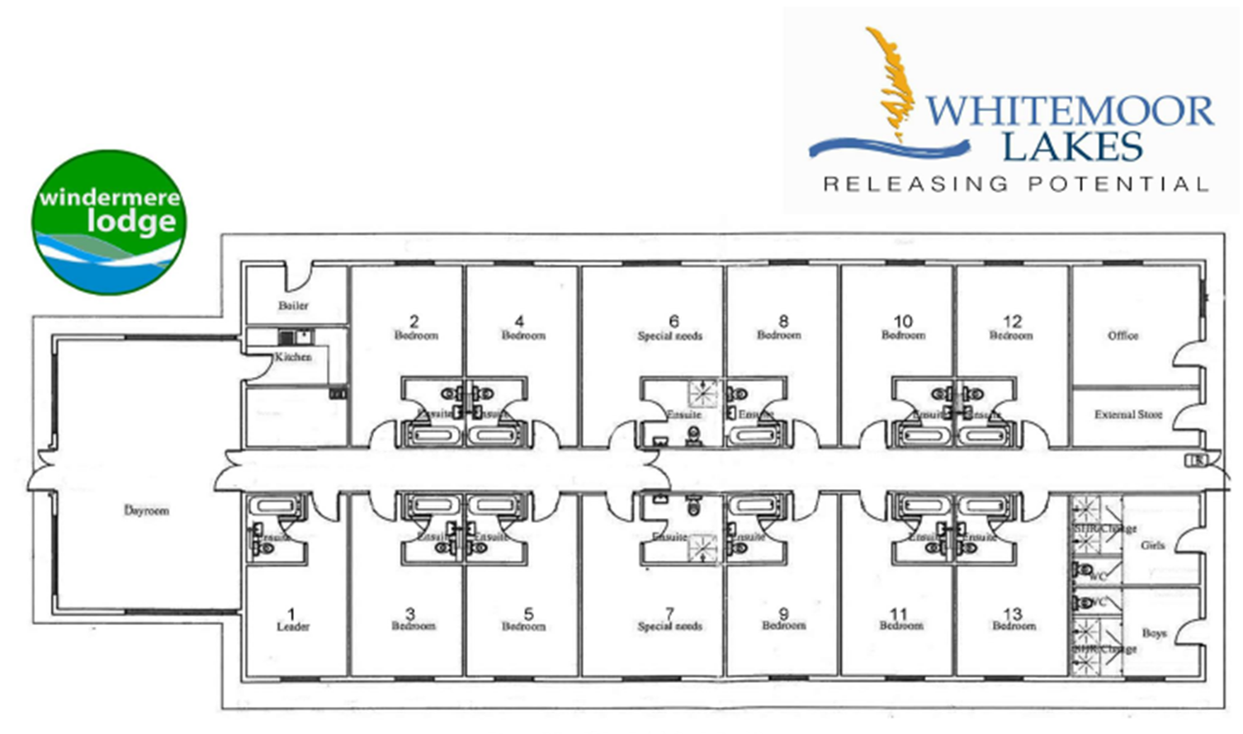
Walk in shower
Walk in shower

Slide 6
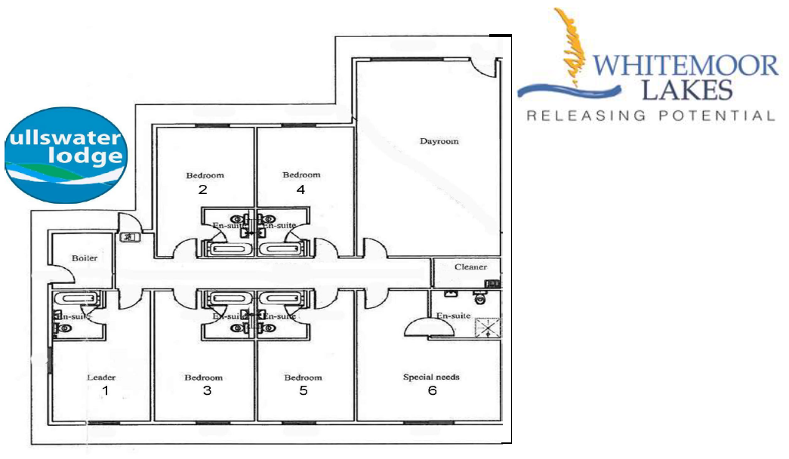
Walk in shower
Whitemoor Lakes, Barley Green Lane, Lichfield, Staffordshire, WS13 8QT t: 01283 795000 f: 01283 791057 e: enquires@whitemoorlakes.org.uk

Slide 7
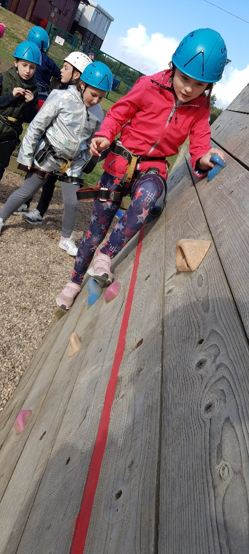
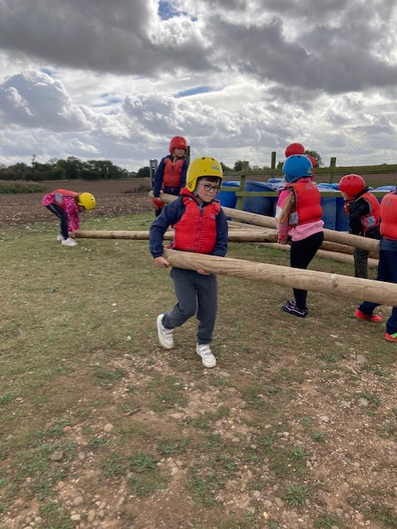
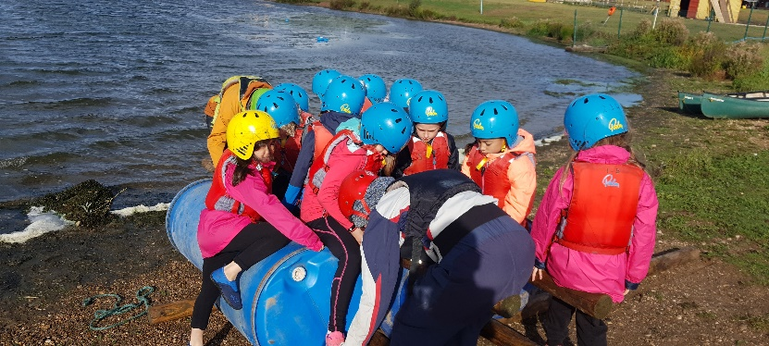
Activities
Challenge course
Raft building
Camp fire
Archery
Wide Games
Problem Solving
Climbing
Team games
High ropes
Abseiling & Zip Wire
Orienteering

Slide 8
Example Timetable Activities
 | 9.30-11.00 | 11.30-1.00 | 2.00-3.30 | 4.00-5.30 | 7.00-8.30
Day 1 | Travelling | Arrival and welcome | Challenge course | Raft building | Campfire
Day 2 | Archery | Buggy building | Climbing | Zip wire and abseiling | Team games
Day 3 | High ropes | Wide games | Travelling

Slide 9
Equipment list
Whitemoor Lakes Yr4
General items
Towels x2 (large & small)
Wash kit (toothbrush, tooth paste, soap, flannel, shampoo, roll on deodorants only)
Pyjamas
Teddy
Hair bobbles for long hair *No earrings or tape to cover them for all activities*
Reading book/colouring/small games (no electronics)
Enough underwear and socks for your stay, plus spares in case you get wet.
Carrier bag for dirty/wet clothes
A few things to remember:
Clothes may get dirty, so don’t pack ‘best’ clothes or shoes.
Tracksuit bottoms are good for activities, please avoid jeans and skirts.
Footwear: A variety of shoes. Old trainers/walking boots/wellington boots (but not for raft building)for mud and wet, something for indoors and something for games. No open toed shoes.

Slide 10
Equipment list
Whitemoor Lakes Yr4
Outdoor activities
At least one set of clothes per day including: jogging/tracksuit bottoms, t-shirts, sweatshirts/jerseys, warm socks (no jeans)
Warm layers
Sensible trainers or outdoor shoes
Waterproof jacket
Hat and gloves (if needed)
Suncream (if needed)
Water sports
Clothes you don’t mind getting wet (two sets)
Shoes to get wet
Spare towel
A bag for wet things
Indoor activities
Long sleeves for archery
Indoor shoes
Optional items
Waterproof trousers
Torch

Slide 11
Meals
Children will eat together in the dining hall.
Please bring a packed lunch for the first day.
All other meals are provided (including hot options for breakfast, lunch and dinner)
Fresh fruit is always available
Dietary requirements will be given to the catering team and will be catered for. (We use the information you have provided for your child. Please notify your class teacher if there are any updates to these).

Slide 12
Medicine
If your child requires prescribed medicine, please ensure it is handed in to a nominated first aider or class teacher on the day of the trip.
Make sure it is in a clearly-labelled container with a completed medication form. (These can be collected from the school office prior to the visit.)
If your child requires an inhaler, please ensure they have it in their rucksack. (Please note: a medication form will still need to be completed and handed in to a first aider).
Please ensure all medical information that we hold is up to date.

Slide 13
Return to school
We are due to return to school Just after normal school day ends on Friday 6th October.
If you have any further questions about the visit, please don’t hesitate to ask.
https://activity-centres.naycacuk.co.uk/whitemoor-lakes/

