Slide 1
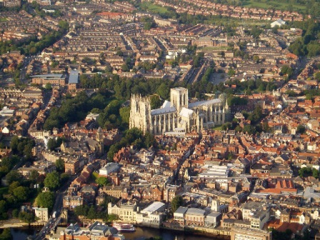
Year Five York Residential
http://upload.wikimedia.org/wikipedia/commons/d/db/York_%28Aerial_view%29.jpg

Slide 2
Why York?
http://www.dave-ford.co.uk/Jorvic_Coppergate.htm

Slide 3
Dates
Wednesday 1st May
Arrive at school for 7.45am.
Friday 3rd May
Return to school for 5.30pm approx.
2 night residential

Slide 4
Travelling
Malbank Coaches
70-seater bus
Services – Birch or Hartshead Moor

Slide 5
Where we stay

Slide 6
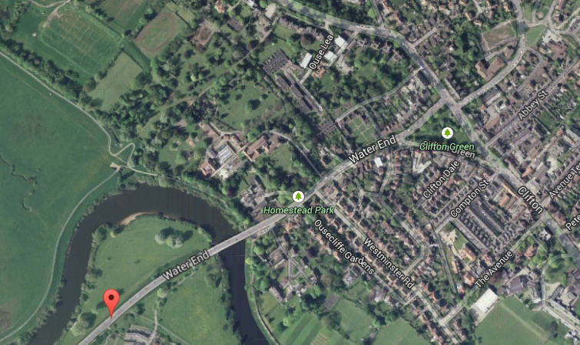
Accommodation
http://www.yha.org.uk/hostel/york
Water End, Clifton, York, North Yorkshire, YO30 6LP
30 minute walk into the city centre
Nearby convenience stores, chemist, hospital
3 star accommodation
Children will be in rooms of 4 to 8 beds
Most bedrooms are en suite
Key cards to access corridors/rooms (school staff have access to all pupils’ rooms)
All food is provided (apart from packed lunch on Day 1)
Bedding is provided

Slide 7
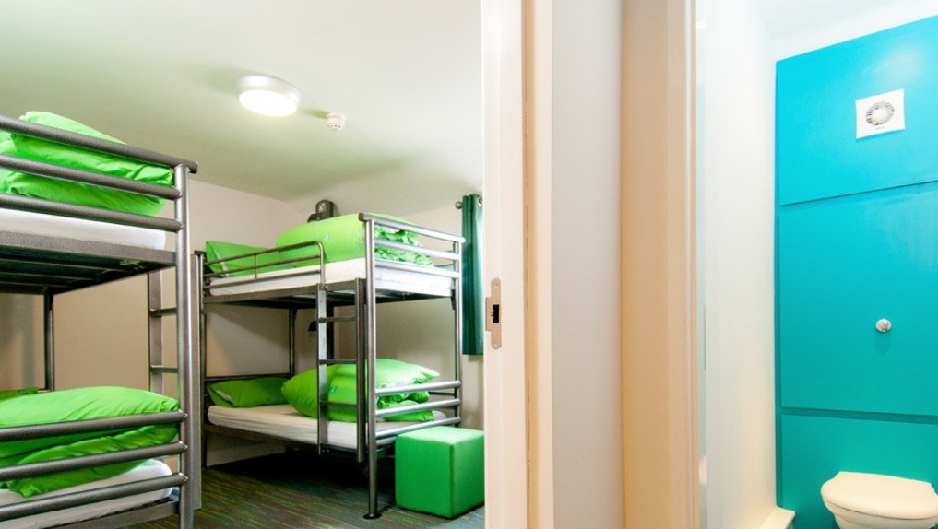
Accommodation

Slide 8
Day 1
Arrive at school – 7:45am
Departure from school – 8:00am
Arrive at York International Youth Hostel – 11:30am approx.
Lunch – 11:45am
Walk into York – 12:30pm
Begin to explore the city (City Walls - Bootham Bar to Foss Bank)
National Railway Museum
York Minster/Clifford’s Tower
Return to the Youth Hostel
Workshop – 5:00pm
Tea time – 6:00pm/6:30pm
School-run activity before bed
Times are subject to change.

Slide 9
Day 2
Breakfast and briefing about the day – 8:00am
Walk into York – 9:30am
Barley Hall (including workshop)/Jorvik
Lunch – 11.30am/12:00pm (in the lunch room at Barley Hall)
Jorvik/Barley Hall (including workshop)
York Boat
Shops (including The Shambles)
Return to the Youth Hostel
Workshop – 5:00pm
Tea time – 6:00pm/6:30pm
School-run activity before bed
Times are subject to change.

Slide 10
Day 3
Pack bags for home – 7:30am
Breakfast and briefing about the day – 8:00am
Walk into York – 9:30am
Clifford’s Tower/York Minster
Lunch – 11:30pm/13:00pm (in the lunch room at DIG)
DIG shop
DIG workshops
Get onto the coach – 2:00pm
Return to school – 5:30pm (approx.)
Times are subject to change.

Slide 11
Kit List
Rucksack
Packed lunch for Day 1
Named purse/wallet with up to £10 spending money (2 x £5 is recommended)
Waterproof coat
Weather appropriate accessories e.g. hat, scarf, gloves or suncream!
Clothes for each day
Toiletries and towels
Sensible shoes (lots of walking!)
Reading book
Small game/colouring etc (no electronics)
Medication with completed medication form – given to the class teacher or a first aider

Slide 12
Consent and payment
The cost of this visit is £198.37, and a contribution of this amount is requested from parents to enable this visit to go ahead.
A deposit of £50 is required by 23rd February 2024 if you wish to confirm your child’s place.
The final balance will need to be paid by 27th March 2024.
All payments for the trip should be paid via your child’s account on Arbor. You will also need to give consent for the visit which should also be confirmed via Arbor.

Slide 13
Thank you
We will share information about the visit with the children in school between now and May.
We would now welcome any questions you may have using the chat function.

