Slide 1






Year 9 Options Choices 2026
Remember, you must:
Enter, sit down and remain in silence
Put your coat on the back of your chair
Put your bag underneath your chair
Sit up straight
Face the front and look directly at the speaker
#TeamWoodhey

Slide 2
Options Choices – what is it?
The chance to decide your future!
Set you on a path to future study, apprenticeship or a career
Allow you to personalise your curriculum for the next two years
An exciting time ahead!
#TeamWoodhey

Slide 3
Options Choices – top tips!
Pick subjects that link to your future aspirations – university/ apprenticeship/career
Do your research – what do colleges/universities/employers look for?
Pick subjects that inspire and motivate you
If you are unsure what you want to do in the future, pick a range of subjects that are different
Discuss your choices with your parents, carers and teachers – don’t decide in isolation
#TeamWoodhey

Slide 4
Options Choices – things to avoid!
Picking subjects based on your friends’ choices
Picking subjects because they have lots of practical in Key Stage 3 – all subjects in Key Stage 4 have greater writing demands
Pick subjects because you think they are easier than others
Unless you have a real passion for a subject, try to avoid picking subjects that are similar
#TeamWoodhey

Slide 5
Options Choices – why study a language?
Your language offer is Spanish
Studying Spanish is highly valued for a number of reasons:
  One of the most widely spoken language in the world with real life application
  If you are considering travelling in the future, allows you to travel with confidence and not Google Translate! (Spain, Mexico, South America, Caribbean)
  Spanish spans a range of careers, for example: business, sport, travel, armed forces, medicine, law – employers want global skills!
  Studying a language is proven to improve memory and concentration skills which has a positive impact on other subjects
  Keeps your options open for further study because of your improved retention
Spanish is useful. Spanish is global. Spanish is for your future. Spanish takes you further than the classroom.
#TeamWoodhey

Slide 6
Options Choices – why study Separate Sciences
If you are passionate about Science; Separates are for you!
Study science in more depth
Learn more about how science shapes the world, from medicine and healthcare, to technology, engineering and AI. Renewable energy and climate change, to the human body and the universe
Demonstrates a strong commitment and academic ability
Like Spanish, keeps your options open for future study
Three sciences. Three GCSEs. Endless possibilities.
#TeamWoodhey

Slide 7
Options Choices – why study a vocational subject?
A vocational subject is equivalent to a GCSE, and provides more opportunity for hands-on learning, linked to real jobs and industries
More coursework-based assignments means less reliance on exams
Vocational subjects are not easier, just different – you learn by doing and can chunk your learning
Our vocational courses are: Child Development, iMedia and Sports Science. 3D Design and Art, whilst GCSEs, are also structured like a vocational qualification
Vocational: Different learning, real skills, real futures
#TeamWoodhey

Slide 8
Options Choices – what support have you already had?
Don’t forget, you have already had lots of support to start thinking about options so far this academic year!
  Post-16 event in September with the universities, colleges and apprenticeship providers
  Careers fair in January with employers from a plethora of industries
  Careers work in form time that covered topics like different qualifications, being prepared for work, etc.
#TeamWoodhey

Slide 9
Options Choices – what support is available?
Use your form time learning and resources in Showbie to help
Speak to your form tutors and class teachers
Speak to Mr McMahon, Mrs Sharp or Mr Holden
Parents’ and Carers’ Evening on 12th February (online)
Week commencing 2nd March – Options assemblies all week
Options Evening on 5th March (FB Hall)
Speak to the colleges that will be at Options Evening
#TeamWoodhey

Slide 10
Options Choices – what do I have to study?
You will all study the compulsory subjects below to GCSE standard:
  English Language
  English Literature
  Maths
  At least Science Trilogy (previously known as Combined Science)
You will all study the compulsory subjects below, but will not achieve a GCSE in them, unless chosen as an option:
  PE
  RE
  PSHCE
#TeamWoodhey

Slide 11
Options Choices – what do I have to choose?
You must pick at least one of the subjects below:
  Computer Science
  Geography
  History
  Separate Science (previously known as Triple Science)
  Spanish
#TeamWoodhey

Slide 12
Options Choices – what can I choose?
You will then pick two subjects from this list:
  3D Design* (previously known as Design Technology)
  Art*
  Business Studies
  Child Development
  Computer Science
  Dance
  Drama
  Food Preparation and Nutrition
  iMedia
  Geography
  History
  Music
  PE (this will either be GCSE PE or Sports Science)
  RE
  Separate Science (previously known as Triple Science)
  Sociology
  Statistics
  Spanish
#TeamWoodhey

Slide 13
Options Choices – things you need to be aware of
We work to try and get everyone studying the options they pick
Sometimes, based on the timetable structure, it might not always be possible for you to get the options you have chosen
Subjects need to have a minimum number of students to run, if there are not a minimum number of students, the subject may not run
If either of the above are the case, you will be spoken to individually to pick a reserve choice
You cannot choose both 3D Design and Art
#TeamWoodhey

Slide 14
Options Choices – what happens next?
Attend Parents’ and Carers’ Evening and Options Evening
Speak to your subject teachers, form teacher and Year 9 Progress Team
Discuss your choices with your parents and carers at home
Keep checking your school email – 6th March options choices form will be released to you!
Log on to the options choice system and make your choices
The deadline is the 27th March!
#TeamWoodhey

Slide 15
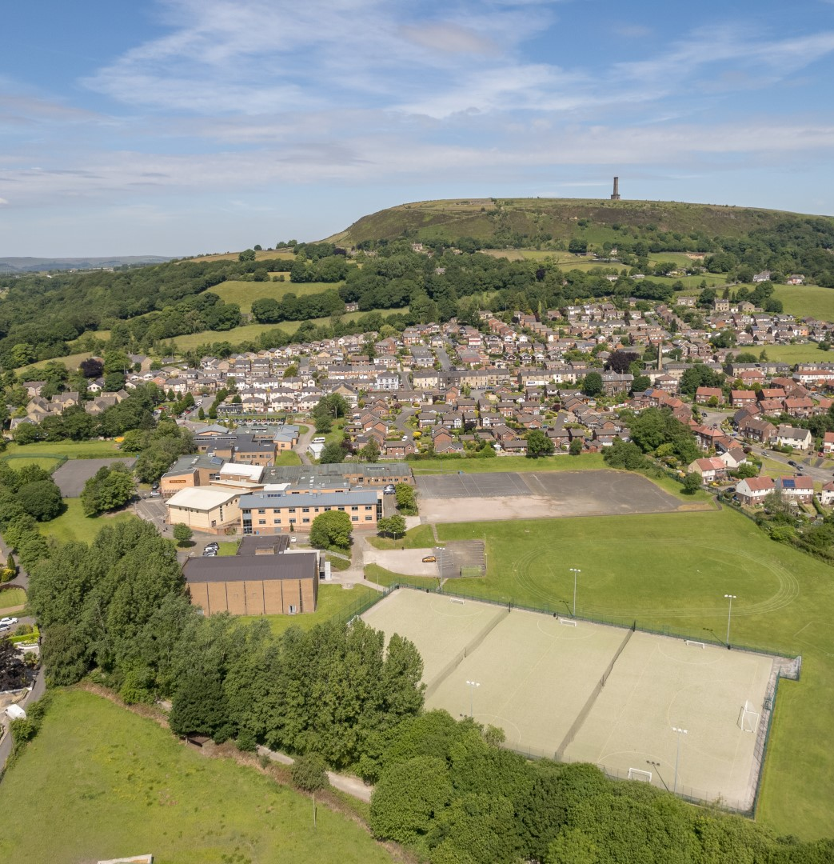
Bolton Road West,
Ramsbottom,
Bury,
Lancashire,
BL0 9QZ
Tel: 01706 825 215
Email: woodhey@woodhey.set.org
Visit: www.woodhey.bury.sch.uk
#TeamWoodhey

