Slide 1
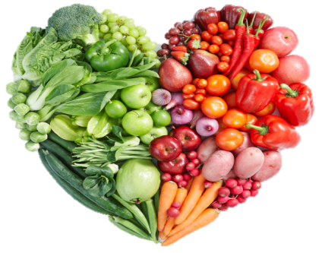
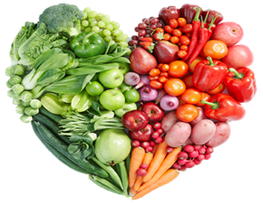
WEEK ONE
Week commencing: 5th & 26th Jan, 16th Feb, 9th March.
 | Monday | Tuesday | Wednesday | Thursday | Friday
Blue | Cheese Pizza | Pork Sausage | Roast Chicken | Chicken Curry | Fish Fingers
Yellow | Spinach Curry | Vegan Sausage | Quorn Dippers | Tomato Pasta Bake | Fishless Fingers
Green | Jacket Potato with choice of fillings | Jacket Potato with choice of fillings | Jacket Potato with choice of fillings | Jacket Potato with choice of fillings | Jacket Potato with choice of fillings
Vegetables and Salad | Rice Sweetcorn Salad Bar Fresh Bread | Mashed Potato Carrots Salad Bar Fresh Bread | Roast Potatoes Peas Salad Bar Fresh Bread | Rice Broccoli Salad Bar Fresh Bread | Chips Peas Salad Bar Fresh Bread
Dessert | Ice Cream Fresh Fruit Yoghurt | Fruit Sponge Fresh Fruit Yogurt | Chocolate Orange Cookie Fresh Fruit Yogurt | Jam Roly Poly Fresh Fruit Yogurt | Banana Bread Fresh Fruit Yogurt

Slide 2
WEEK TWO
Week commencing: 12th Jan, 2nd & 23rd Feb, 16th March.
 | Monday | Tuesday | Wednesday | Thursday | Friday
Blue | Cheese Pizza | Beef Bolognese | Chicken Roast | Cheese Topped Shepards Pie | Fish Fingers
Yellow | Cheese & Bean Wrap | Vegetable Hot Pot | Butternut Squash Wellington | Vegan Shepards Pie | Vegetable Grill
Green | Jacket Potato with choice of fillings | Jacket Potato with choice of fillings | Jacket Potato with choice of fillings | Jacket Potato with choice of fillings | Jacket Potato with choice of fillings
Vegetables and Salad | Potato Wedges Peas Salad Bar Fresh Bread | Sweetcorn Salad Bar Fresh Bread | Mashed Potatoes Cabbage Salad Bar Fresh Bread | Carrots Salad Bar Fresh Bread | Chips Peas Salad Bar Fresh Bread
Dessert | Mousse Fresh Fruit Yoghurt | Oat Cookie Fresh Fruit Yogurt | Jelly Fresh Fruit Yogurt | Sponge Cake Fresh Fruit Yogurt | Lemon Cookie Fresh Fruit Yogurt

Slide 3
WEEK THREE
Week commencing: 19th Jan, 9th Feb, 2nd & 23rd March.
 | Monday | Tuesday | Wednesday | Thursday | Friday
Blue | Cheese Pizza | All Day Breakfast | Roast Chicken | Beef Chilli Con Carne | Fish Fingers
Yellow | Coconut Curry | Veggie Breakfast | Vegetable & Stuffing Tart | Cheese Pasta | Quorn Dippers
Green | Jacket Potato with choice of fillings | Jacket Potato with choice of fillings | Jacket Potato with choice of fillings | Jacket Potato with choice of fillings | Jacket Potato with choice of fillings
Vegetables and Salad | Rice Sweetcorn Salad Bar Fresh Bread | Baked Beans Peas Salad Bar Fresh Bread | New Potatoes Carrots Salad Bar Fresh Bread | Sweetcorn Salad Bar Fresh Bread | Chips Peas Salad Bar Fresh Bread
Dessert | Chocolate Crispy Cake Fresh Fruit Yoghurt | Fruit Salad Fresh Fruit Yogurt | Chocolate Sponge Fresh Fruit Yogurt | Apple Sponge Fresh Fruit Yogurt | Shortbread Fresh Fruit Yogurt

