Slide 1
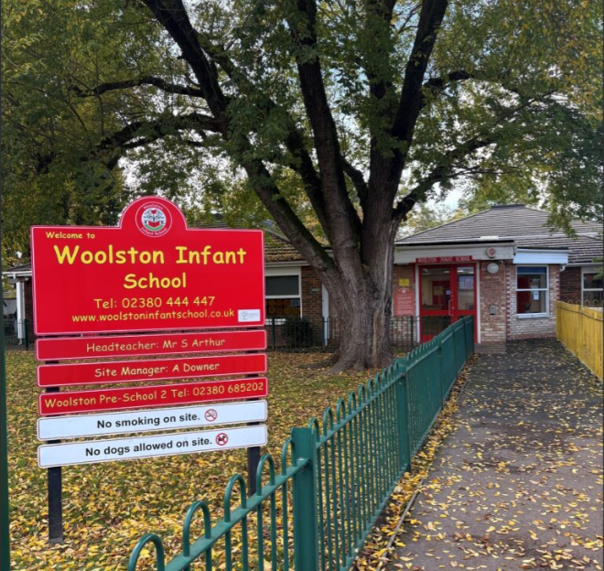

Woolston Infant School
Prospectus
2025 – 2026 tents

Slide 2
Contents
Message from The Headteacher 3
Message from The Governors 4
Our Vision 5
Our Curriculum Intent 8
Our Facilities 15
Wraparound Care 16
School Lunches 17
The School Day 18
School Uniform 19
Friends of Woolston School 21
What does OFSTED say about the school? 20
How to contact us 22

Slide 3

A message from the headteacher
I am proud to be the Head Teacher of Woolston Infant School - a happy, friendly, caring and exciting place where every child matters and children come first.
We believe that children respond to a caring and secure environment where mutual trust and respect for each other leads to high expectations in social and academic skills.
I hope you find this prospectus informative and helpful. It is difficult to capture ‘in print’ the feel and ethos of a school but I am sure this prospectus will give you a flavour of the warm, caring and open environment which we aim to provide.
From the outset we will work to form a close liaison between staff, parents and Governors, as it is our
common aim to provide the best possible education for all the children in our school.
Simon Arthur
Headteacher

Slide 4
A message from the governors
We are pleased that you are anticipating sending your child to Woolston Infant School and hope that this Prospectus will give you an insight into the life and work of the school.
Your child’s first years in school are critical. A good start to education will help them achieve the very best later. We hope that you will want to share in your child’s learning and so lay a firm foundation for his or her future. We believe that an interested learner is a more willing learner.
In a fast moving, ever-changing world our children must be literate and numerate, but they must also be able to think for themselves; weigh up evidence and make judgements; care for and about people and things and learn what is or is not acceptable within the community. Emotional development, social adjustment and positive attitudes are as important as a store of knowledge
If your child is to join us for the first time, we welcome you as parents and look forward to a happy and successful partnership during the time your child attends this school. If you already have a child here, we are pleased to renew the partnership.
Andy Steege
Chair of Governors

Slide 5
Vision and values
At Woolston Infant School we believe that everyone matters.
We will provide a happy, caring and safe learning environment in which children can develop their academic, personal and social skills. We will ensure that all children have the opportunity to reach their full potential through a curriculum that is creative, challenging and fun.
We will develop partnerships within school and the wider community.
Parents will be encouraged to actively share in their child’s learning and wider school life.
We aim for our children to become independent, healthy and responsible members of the community equipped with the skills and attitudes to be lifelong learners.’

Slide 6
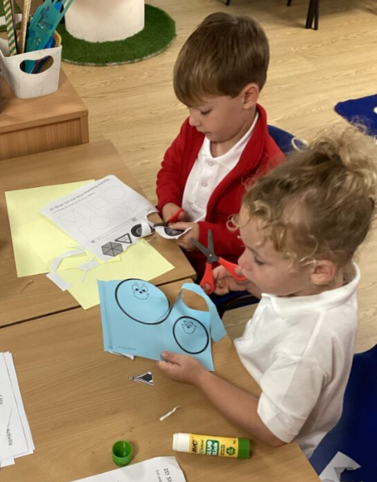
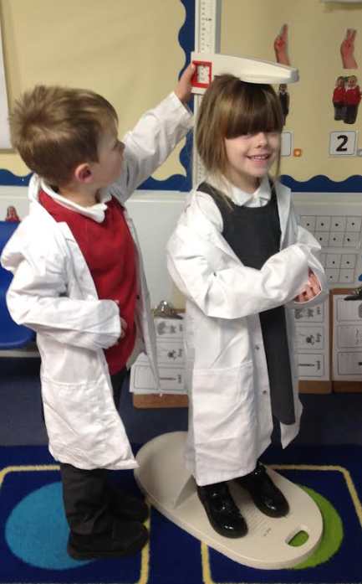
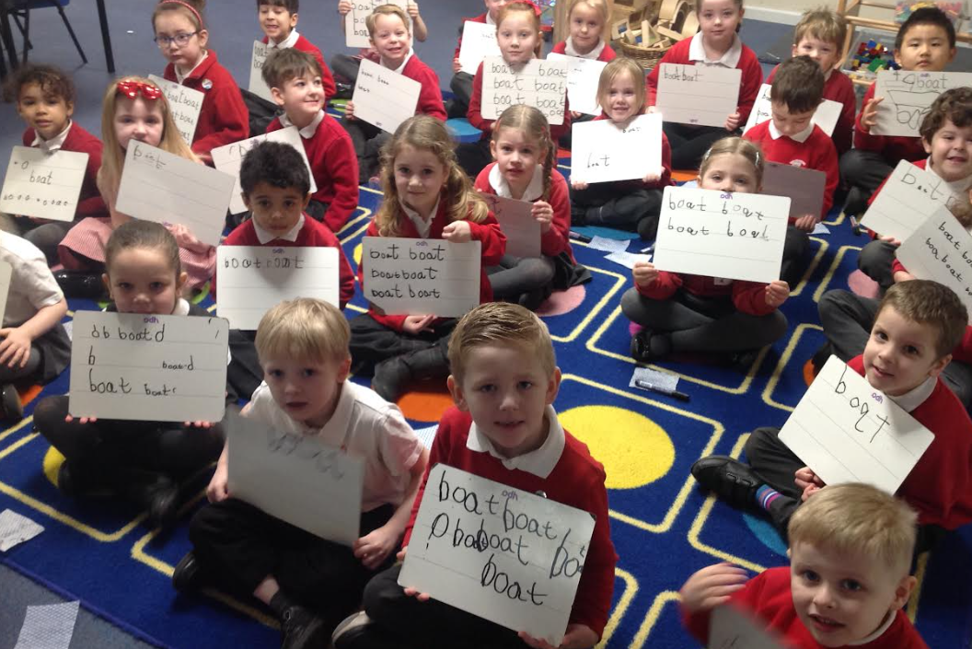
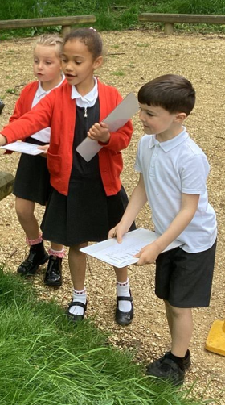
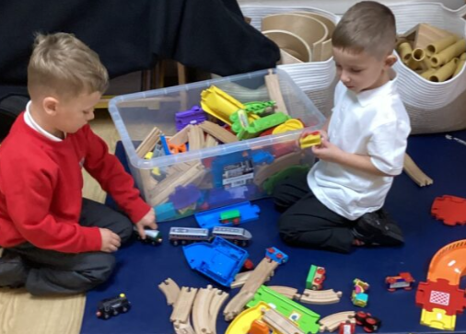
Vision and values
Kindness
Tolerance
Perseverance
Achievement
Co-operation

Slide 7
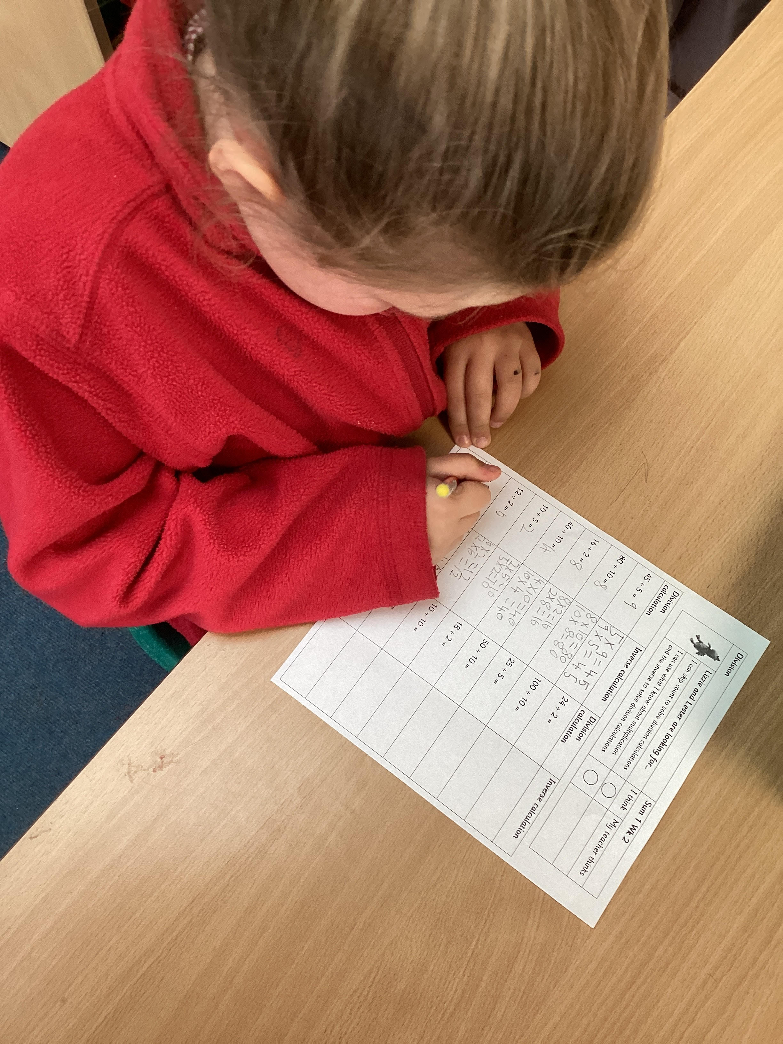
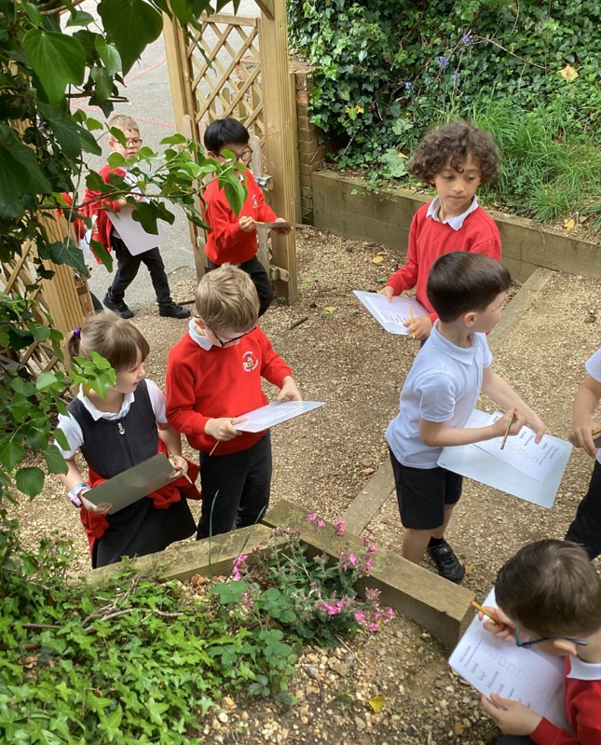
Our curriculum
We are passionate about entitling all children to enjoy learning which is purposeful and responsive, underpinned by our knowledge of how young children thrive in early years education. Every child will achieve essential knowledge, flexible skills and positive attitudes so as to be ambitious learners and enjoy future personal successes.
We want all children to develop a thirst for reading, writing and maths whilst ensuring these key skills are taught through engaging, purposeful and creative units of work. Our learning environments are stimulating, and we offer a wide range of high-quality resources and facilities including new technologies, practical resources and outdoor spaces.
We utilise these in our teaching to ensure children gain a wealth of knowledge, skills and experience throughout their time with us. Our children are at the heart of everything we do. We have a strong pupil voice and are proud of their willingness and ability to make thoughtful contributions to our school community.

Slide 8
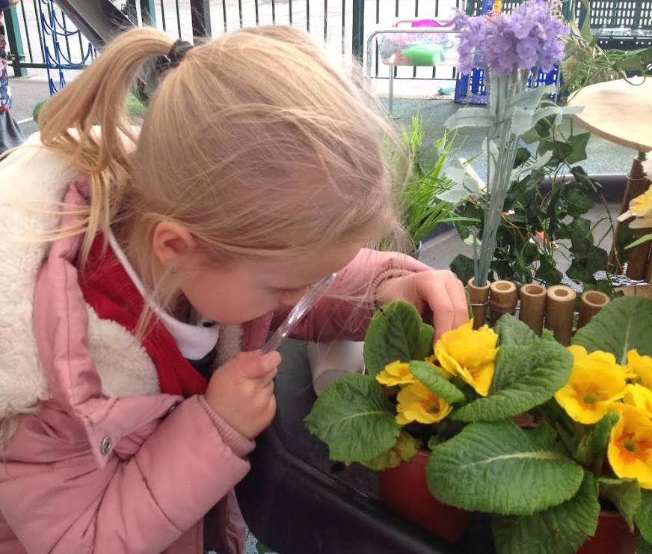
Early Years Foundation Stage
Early years foundation stage
We are committed to ensuring every child makes a positive, happy and seamless leap into the beginning of their school journey in a safe and nurturing environment.
At Woolston Infant School our Early Years provision builds upon the foundations of preschool and focuses on the prime areas of learning. We believe that each child is unique and needs positive relationships as a prerequisite to becoming a happy and confident learner with a sense of belonging in their new school community.
We are proud of the opportunities we offer through our open ended, free-flow learning environment. Our curriculum is carefully planned both based on the children's interests as well as offering creative opportunities that will increase and widen every child's knowledge and skills. Children learn and make strong progress in personal and social development, alongside reading, writing and maths.
Children apply these skills through purposeful and exciting learning experiences across all areas of the EYFS curriculum and have autonomy of their own abilities and take pride in their learning.

Slide 9
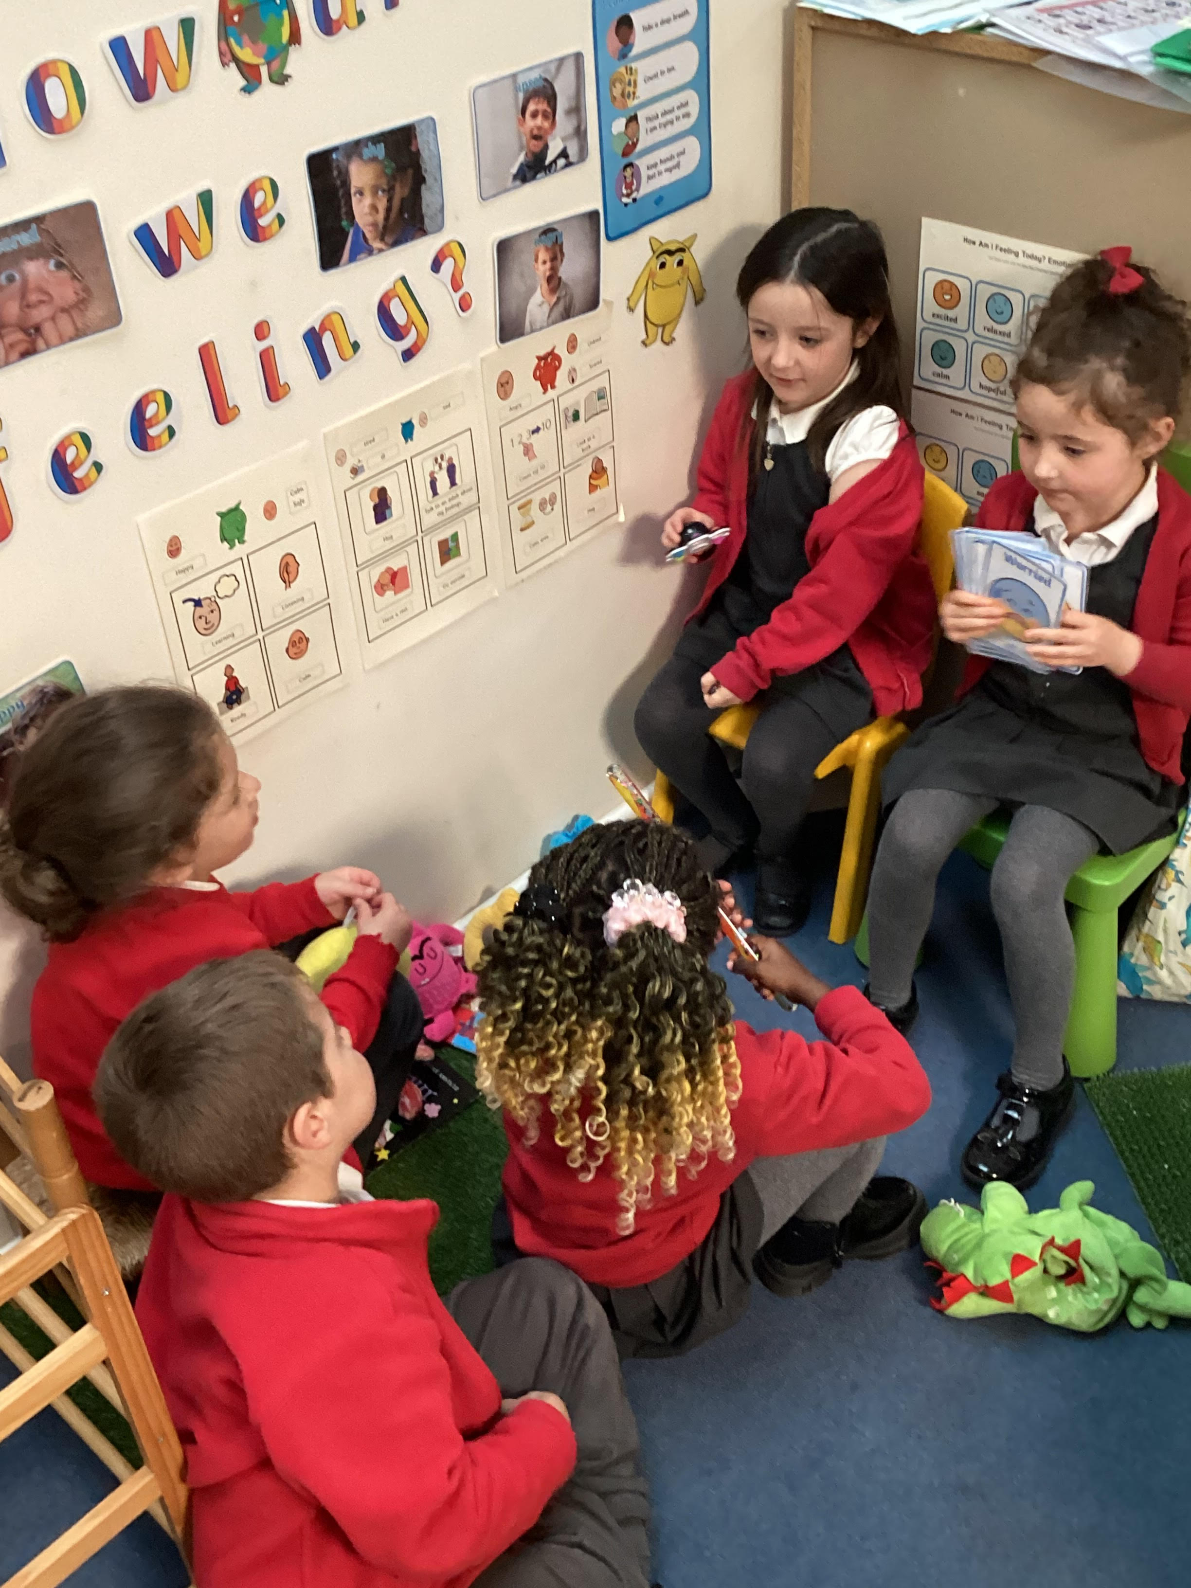
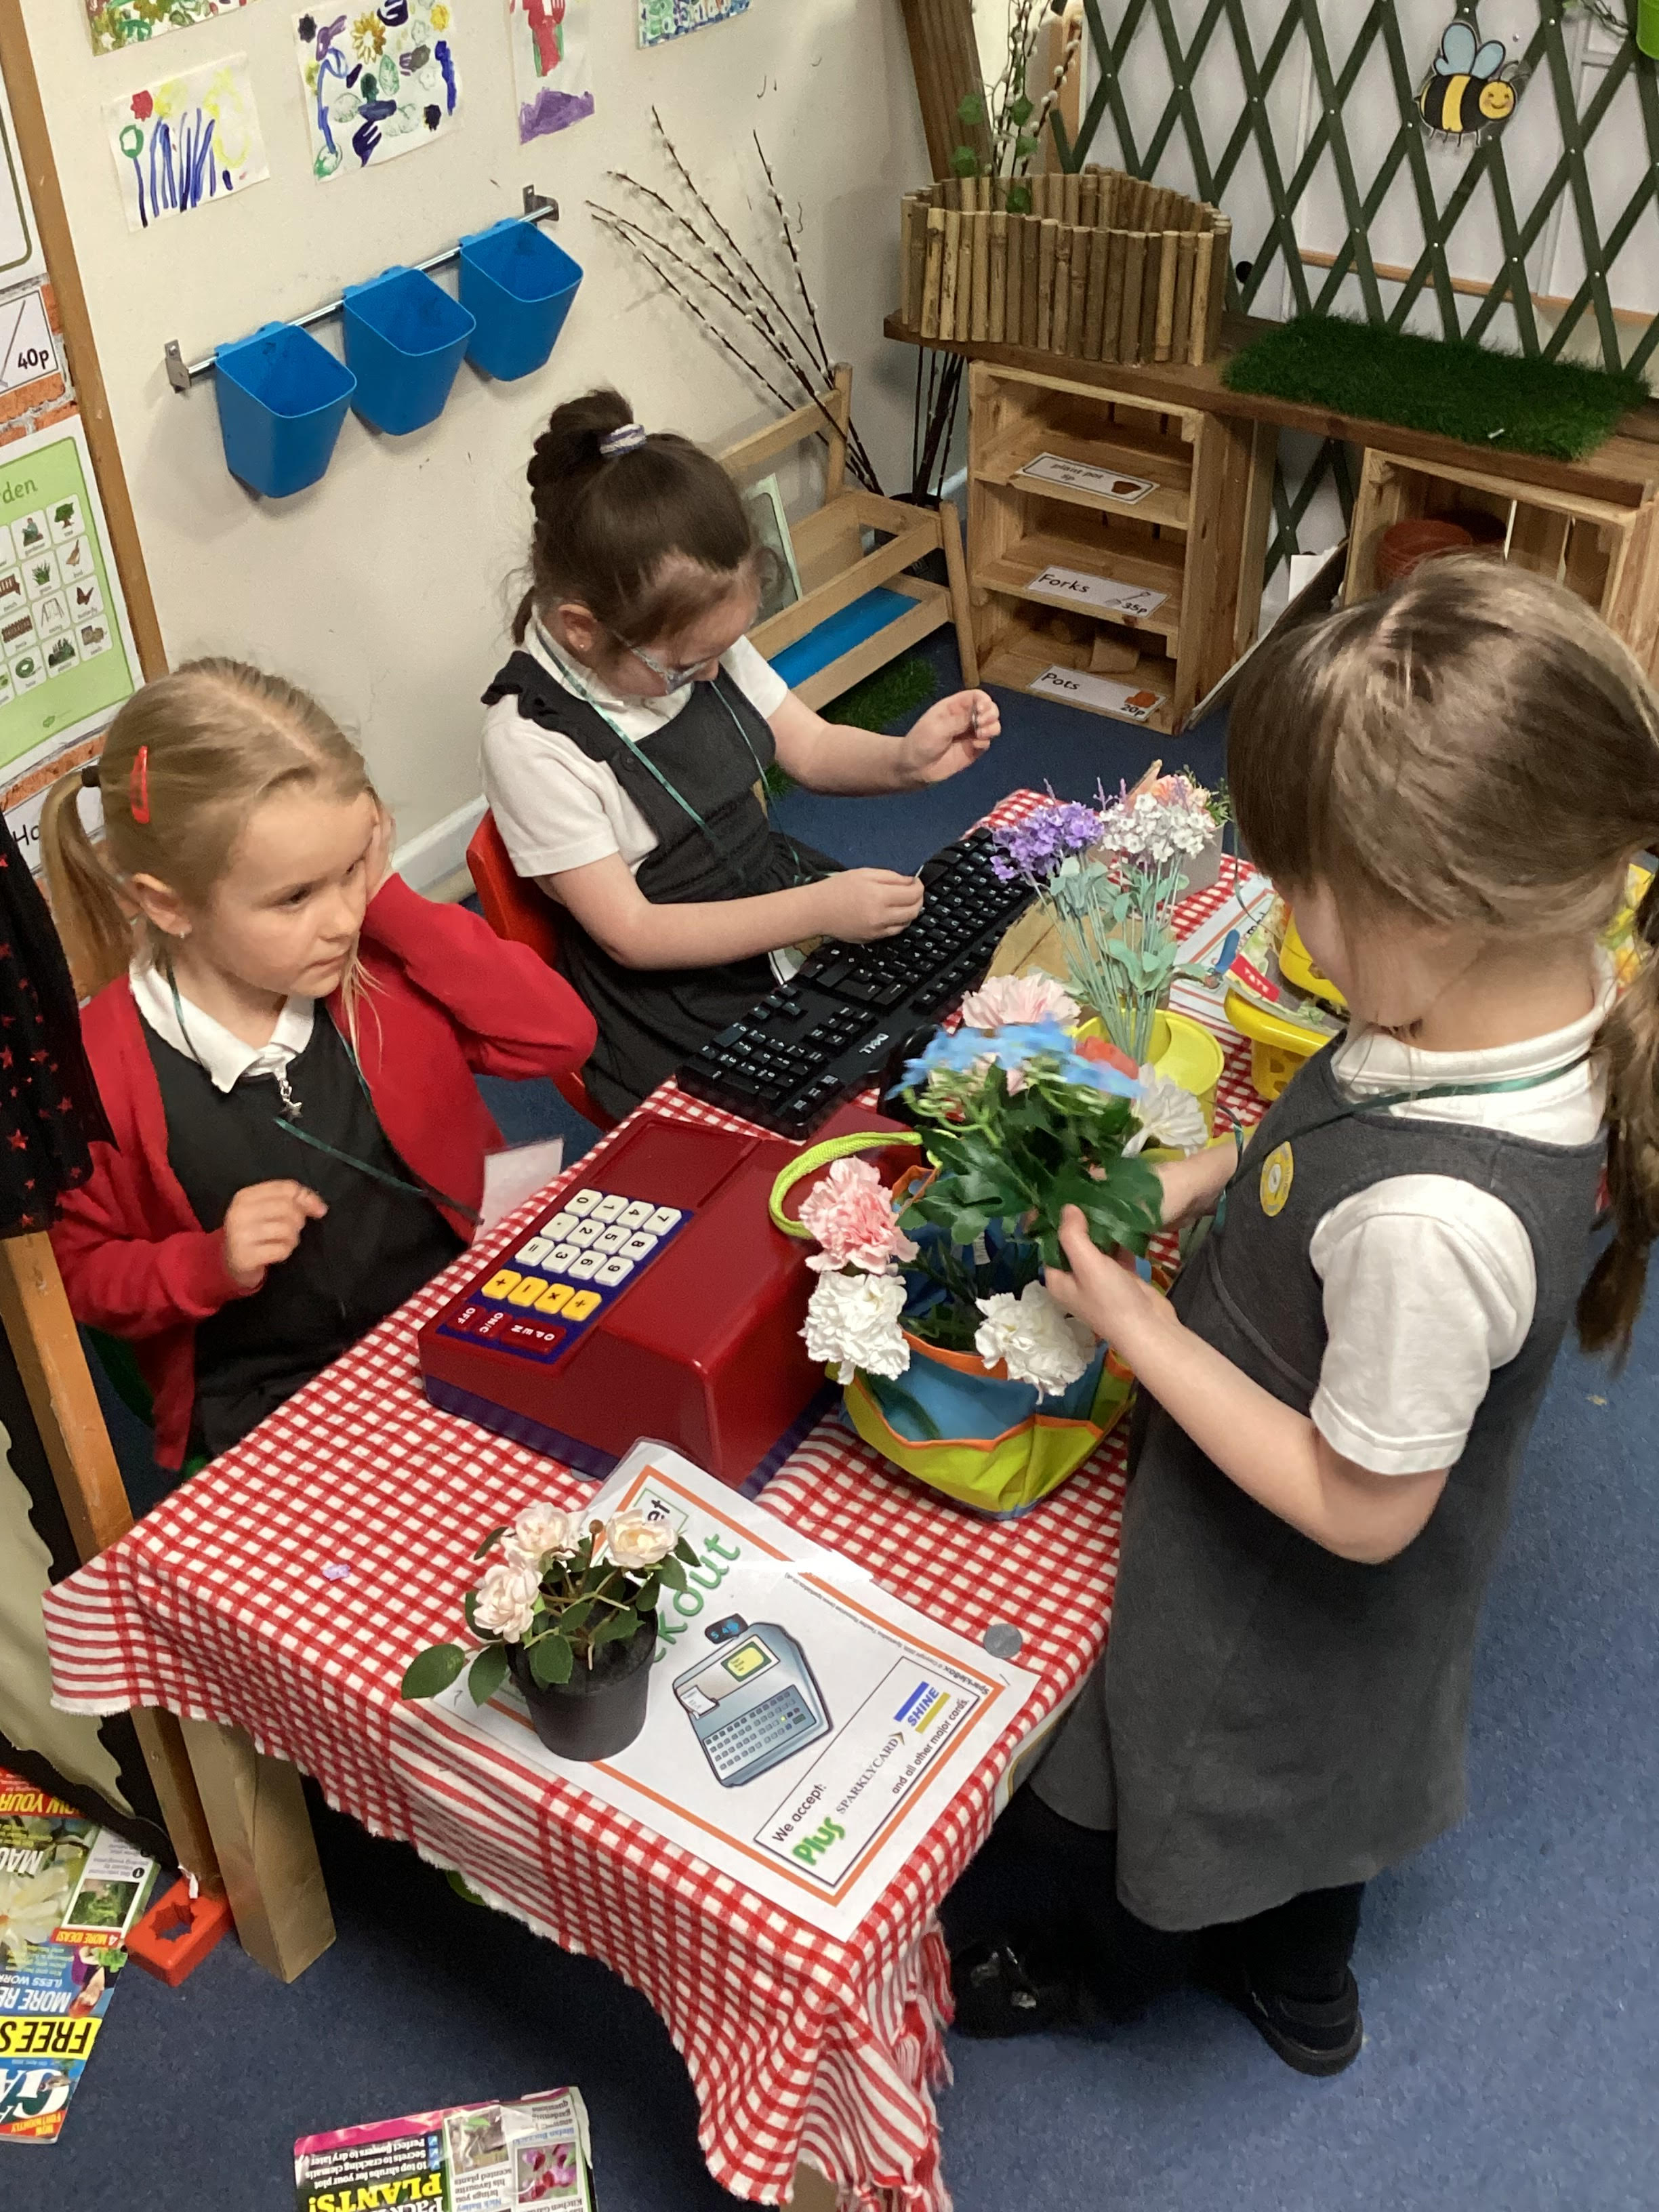
Early Years Foundation Stage
Early years foundation stage
We embed the Prime Areas of learning; Personal and Social and Emotional Development, Communication and Language and Physical Development through the Reception year.
Our play-based environment offers challenges, independence and is accessible to all children. We have inspiring well resourced classrooms and outside learning areas that are accessible for every child.
We encourage all of our pupils to explore, show curiosity and take risk.
“Woolston Infant School is a happy place. Pupils enjoy coming to school. They form positive, warm relationships with each other and adults as they learn and play.” - Ofsted Inspection Report March 2024.

Slide 10
Year 1 and 2
The foundations for academic success are built on during these years, alongside the development of self-confidence and a love of learning. Learning is personalised to meet the needs of each individual child.
We follow the National Curriculum for all subjects and teachers plan units of learning in the key areas of English, Mathematics, Science as well as the wider curriculum of History, Geography, Art, Computing, DT, PE, RE and RHE.
Through our well planned and sequenced curriculum, our children are responsive learners who take risks and show resilience. Phonics, literacy and maths skills are taught daily through exciting and creative learning.
Curiosity and enquiry remain at the heart of the curriculum, as the children are encouraged to develop their creative thinking and independence where they apply essential knowledge and use skills flexibly and purposefully.
We use the local area and our local community as a basis for much of our learning, giving children a sense of identity and pride in their local area.

Slide 11
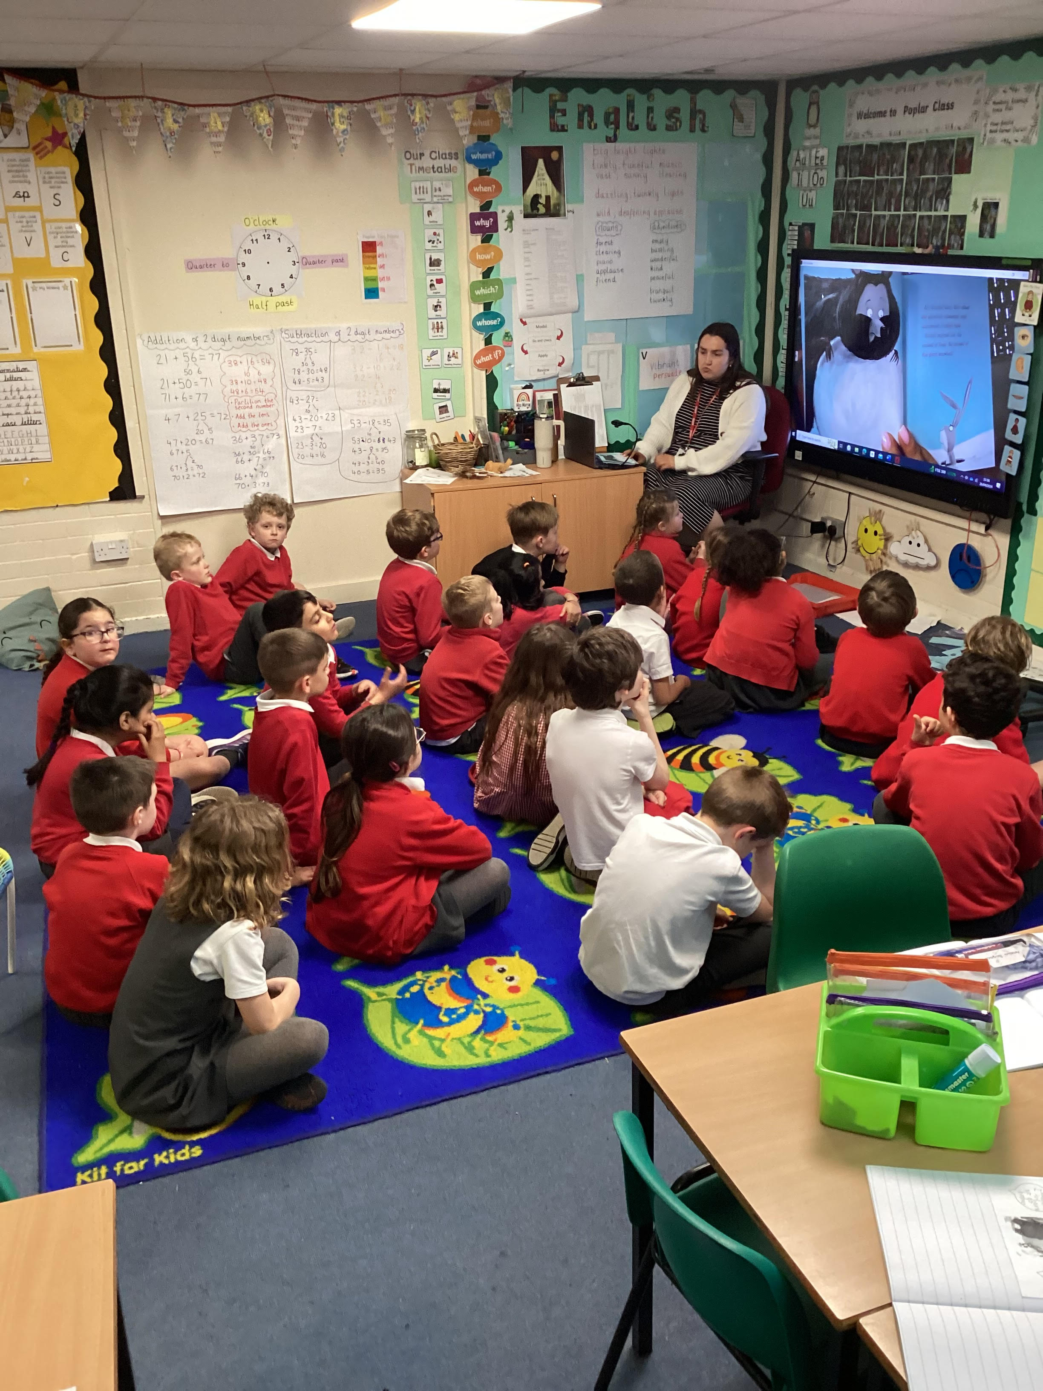
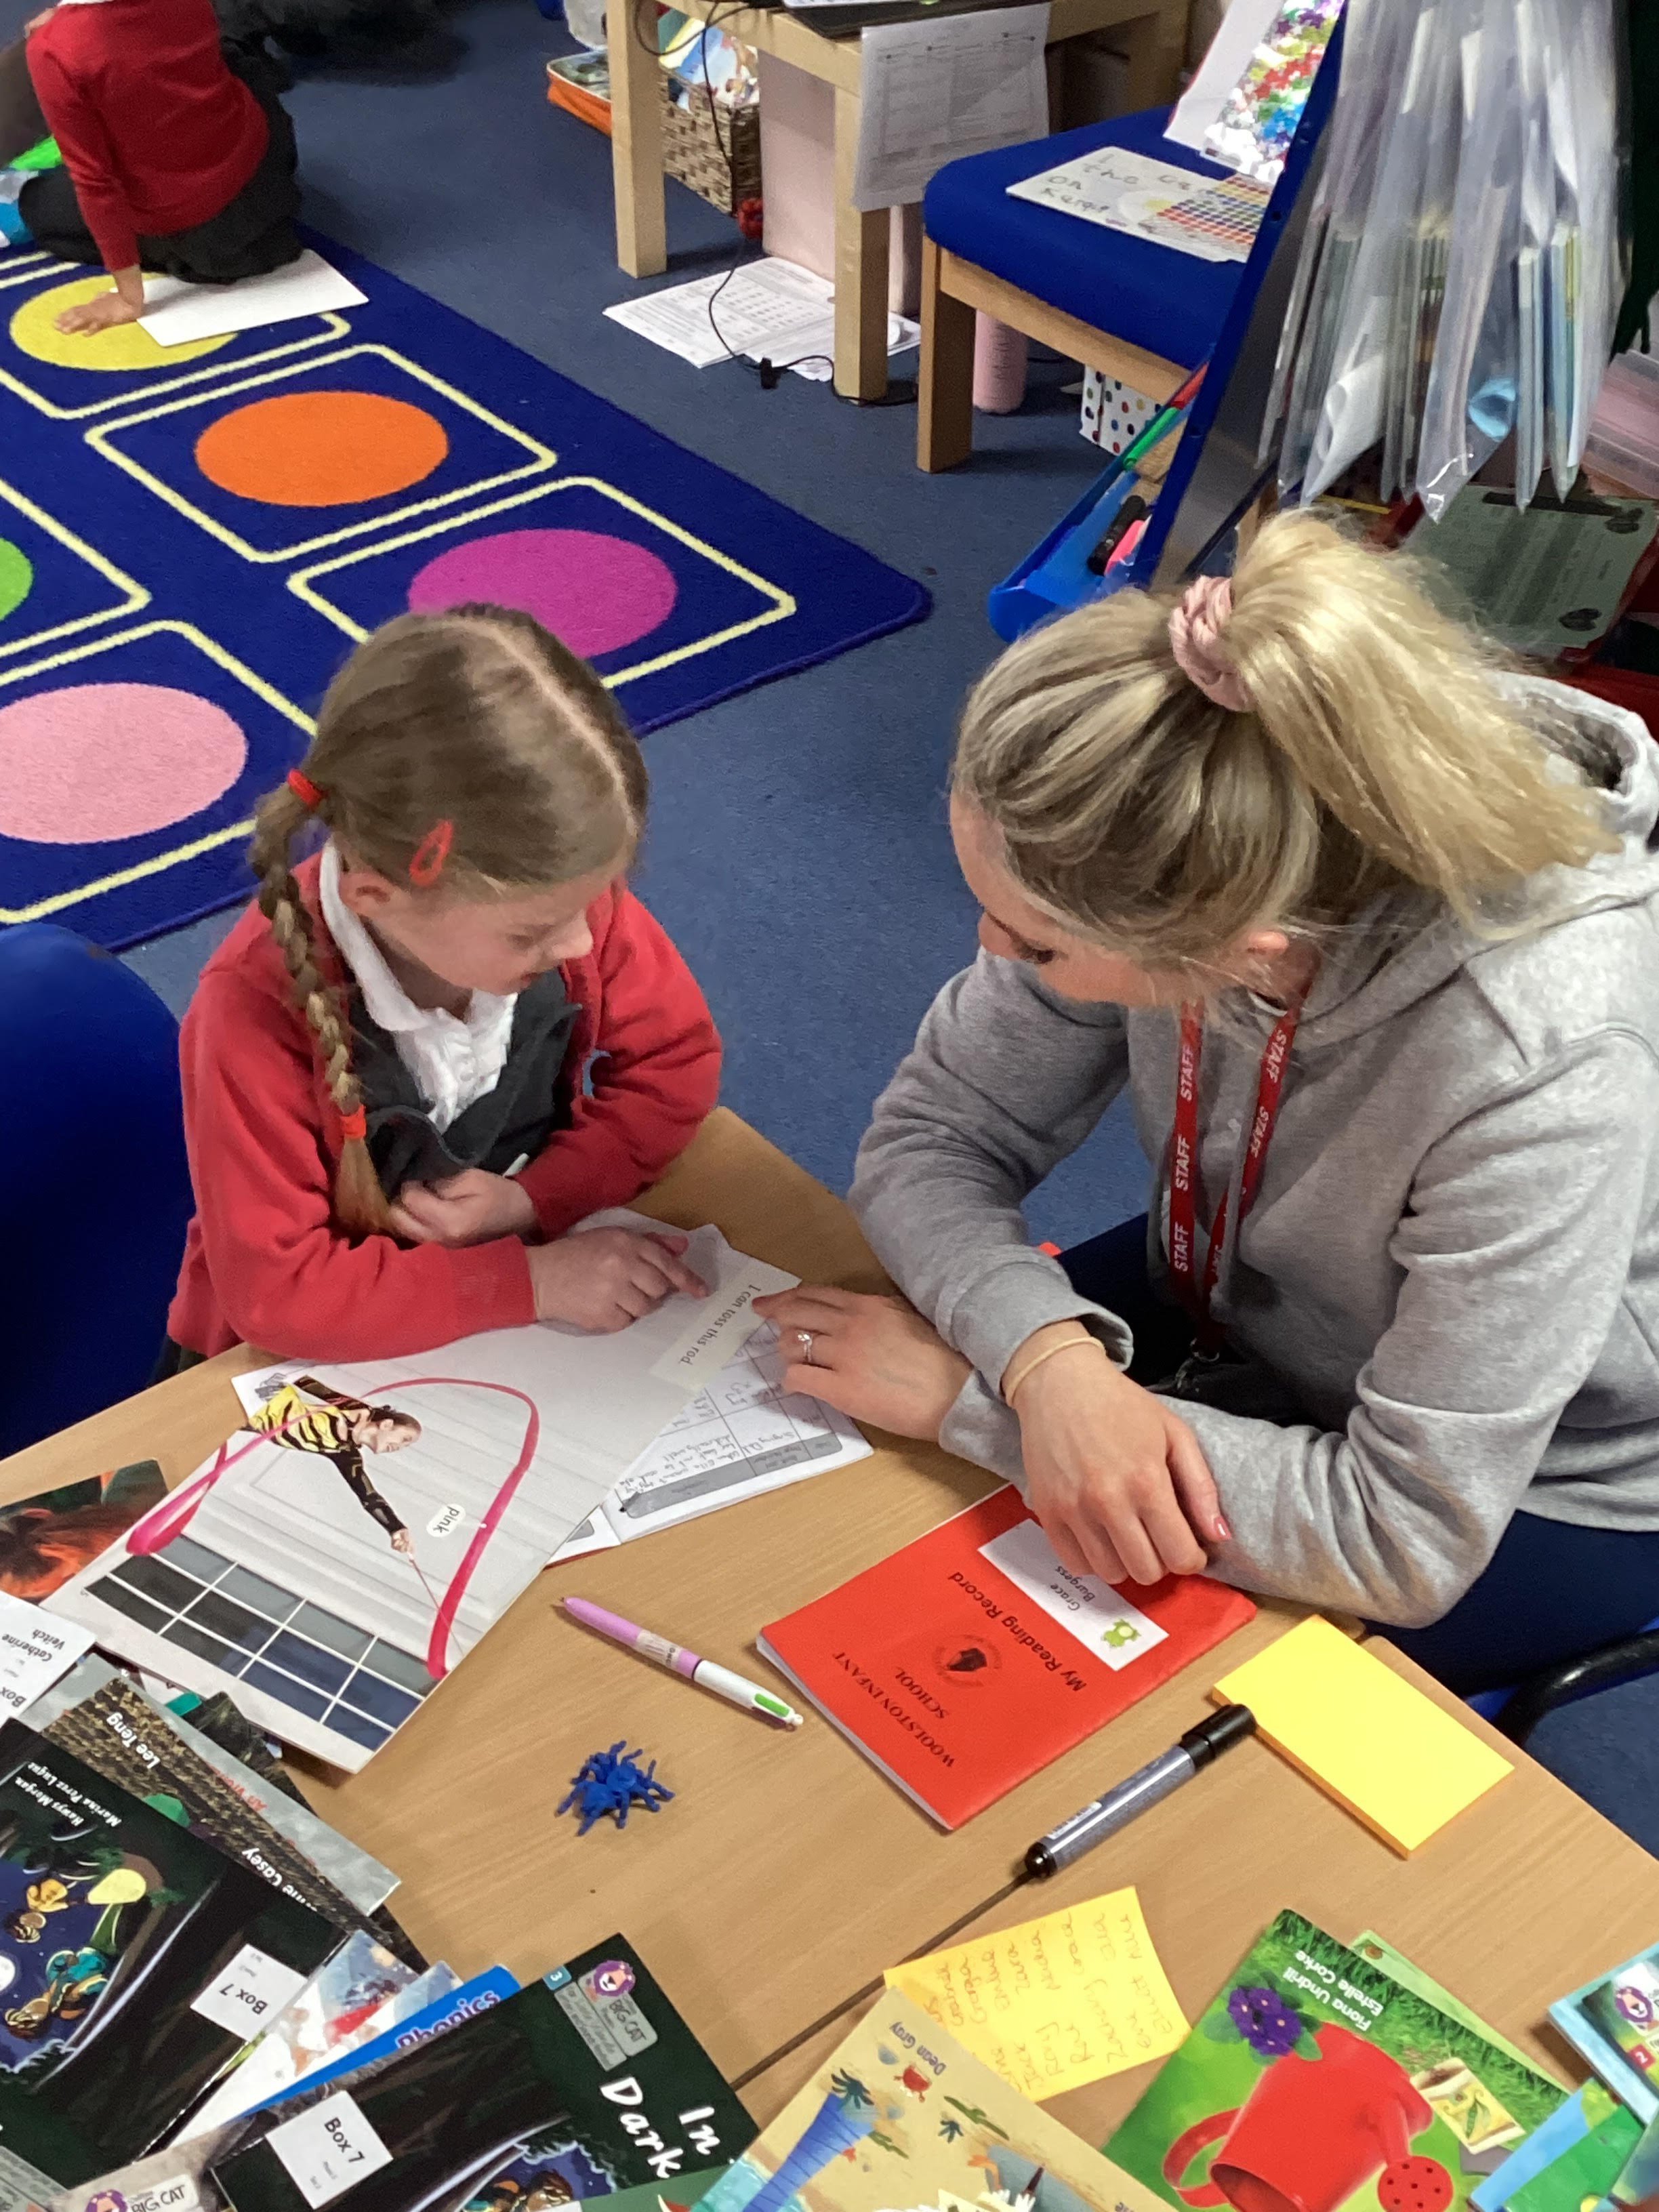
Teaching
From the outset, we have high expectations of all children, both educationally and socially. We are convinced that good standards of behaviour and high self-esteem provide a secure basis for learning. We also recognise that children benefit enormously when parents, carers and teachers work together. We therefore aim to develop a close partnership between home and school. We will keep you informed about progress of your child and hope that you will feel able to discuss with us any concerns.
“Staff are well trained to be able to identify pupils’ needs and provide timely support and help.”
- Ofsted Inspection Report March 2024.

Slide 12
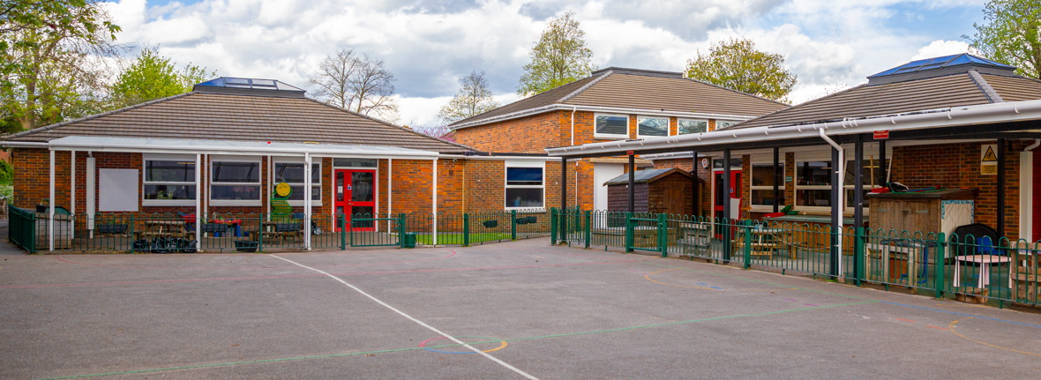
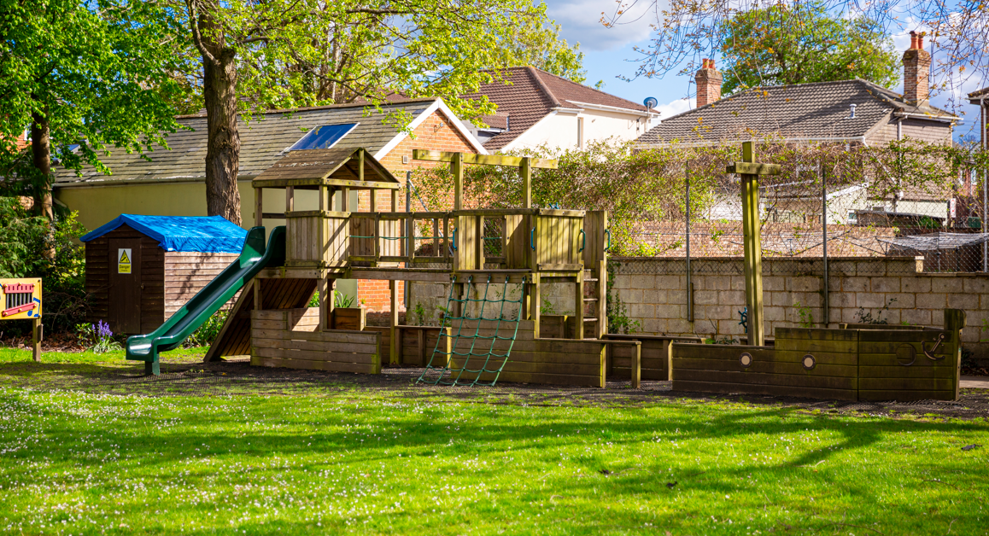
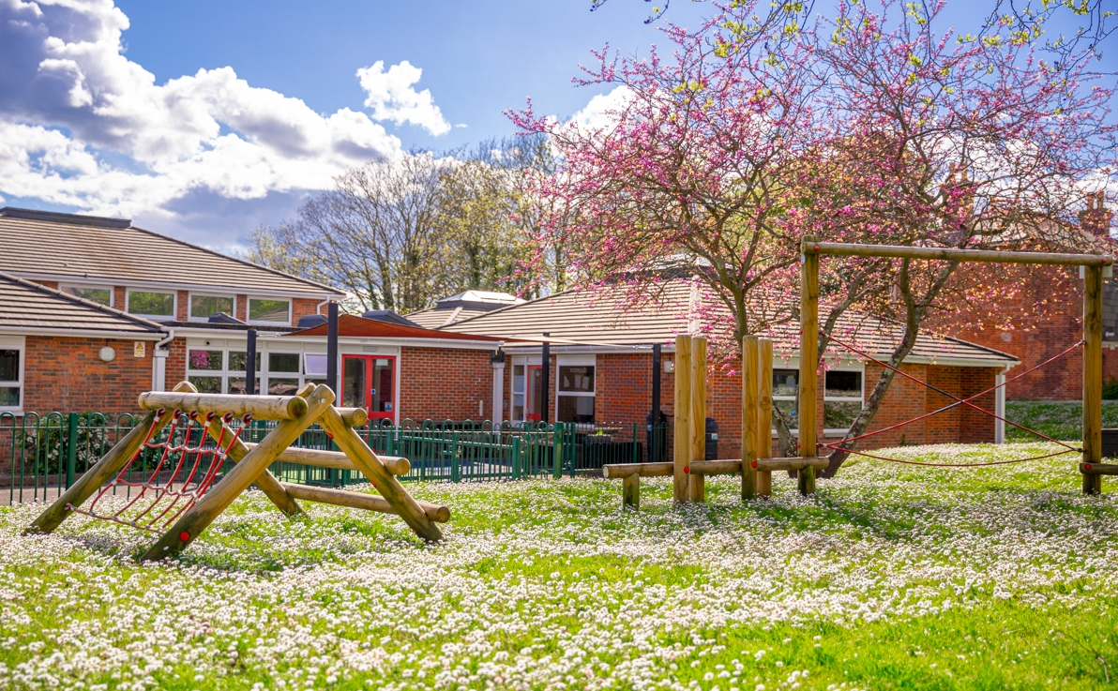
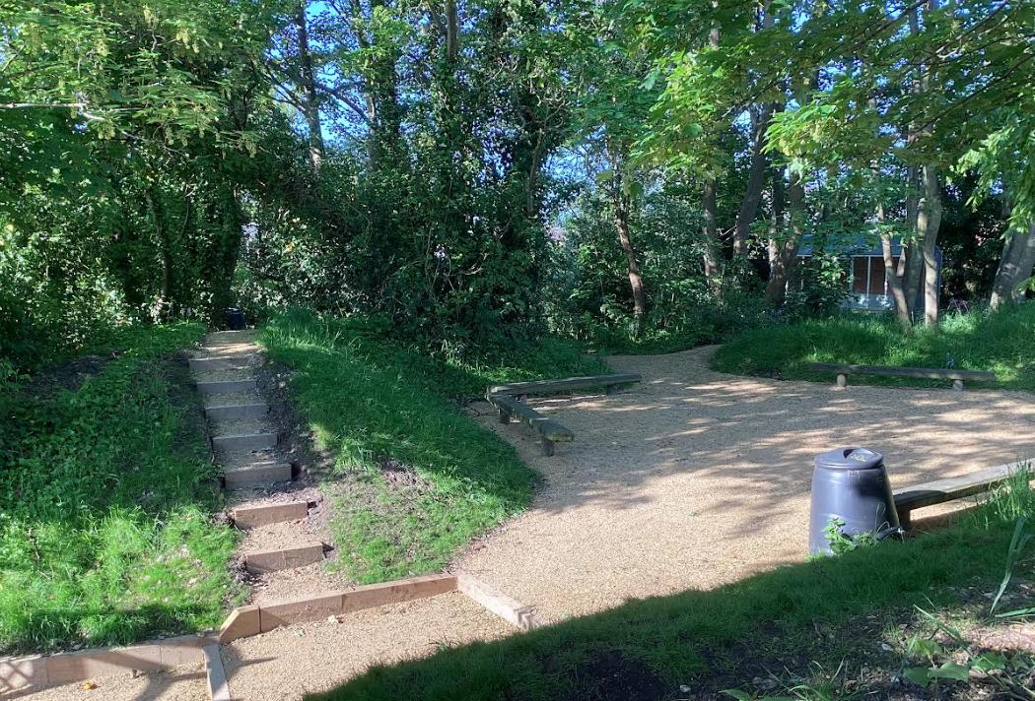
Our School grounds
We have worked hard over the last few years to develop our school grounds to provide a safe and attractive environment for our children.
We have a good-sized playground and grassed areas which enable children to enjoy playtime and outside P.E.
The covered areas provide the children with a safe outside area in all weathers. We have also developed a Conservation Area for the children to explore and use to enhance our science and geography curriculum amongst other areas.
Our play equipment is always popular. The children helped to design the areas which were funded by our ‘School Friends’.

Slide 13
Why choose us?
Dedicated staff who put children at the heart of every decision.
Every child’s voice is valued and heard.
A school at the heart of the community that works with parents aiming for the best outcomes for their children.
Every child is seen as an individual and their needs and interests are catered for.
Planned educational trips and a range of visitors to enhance learning and bring learning to life.
Extensive school grounds are used to support learning, grow a love and respect for the wider environment.
We provide a supportive, safe and stimulating environment for all children.
“Woolston is a great school because teachers help and encourage me to be the best I can” Year 2 Pupil 2024.

Slide 14
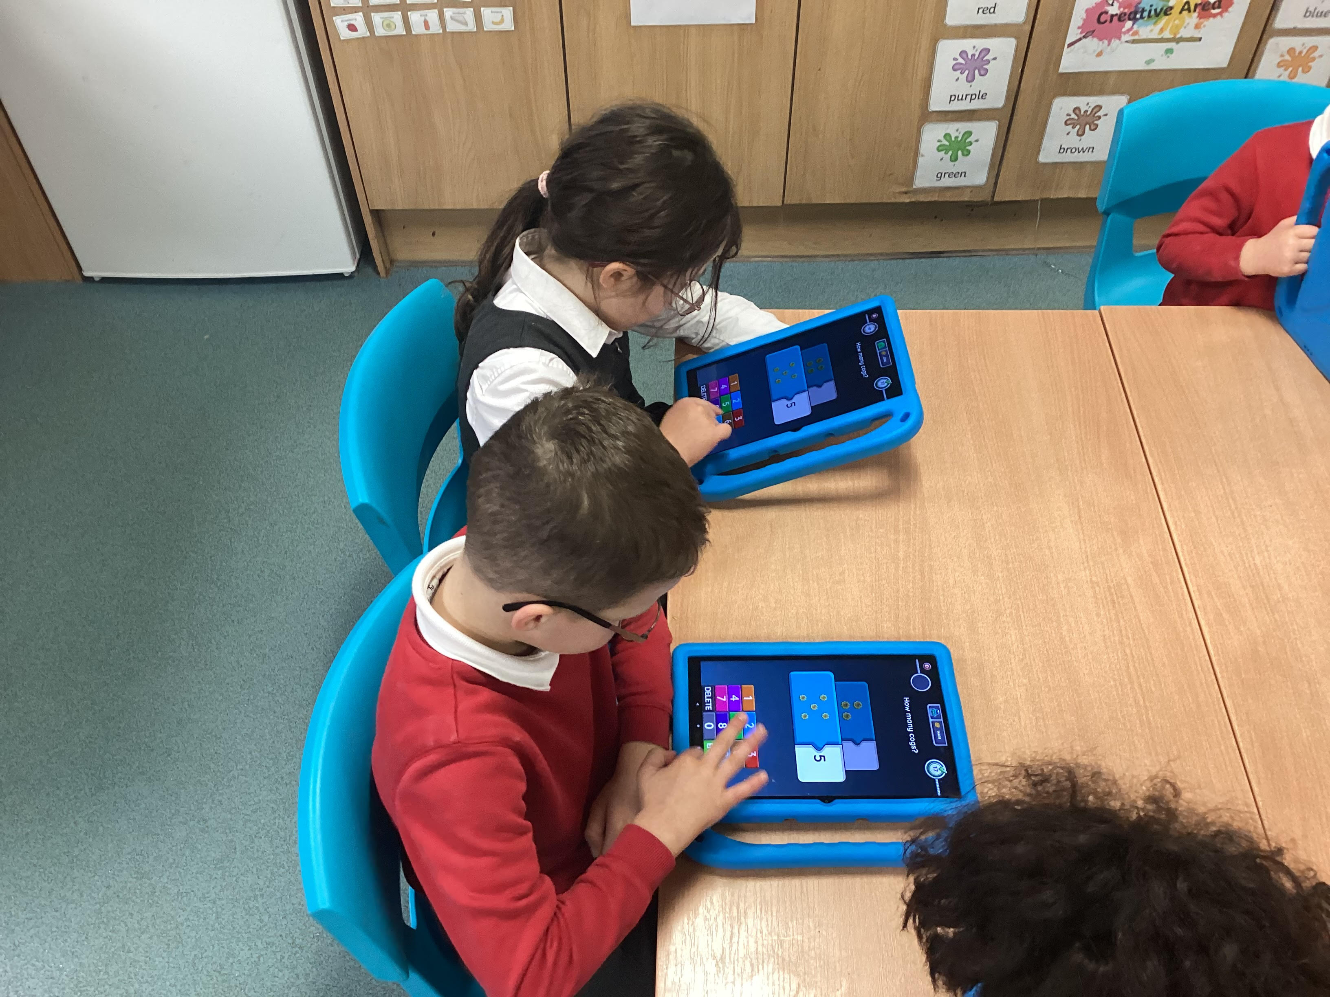
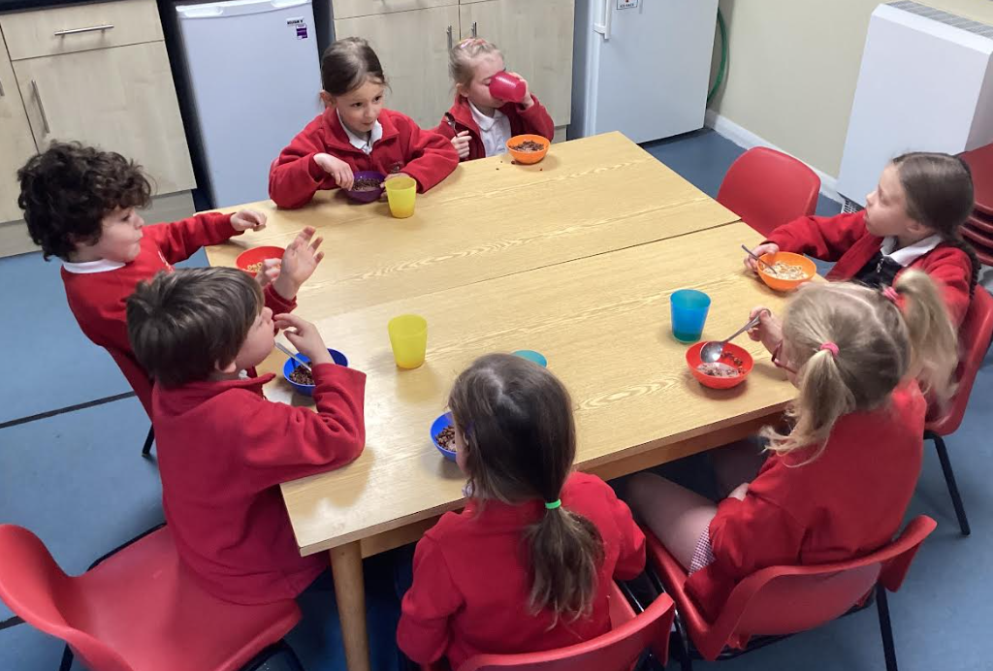
Wraparound care
We are pleased to be able to offer wraparound care from 8.00am until 5.45pm each term time day. These are run by dedicated school staff to ensure that all children feel safe, happy and enjoy a positive start or end to the school day.
Please do contact the school office for more information about either our Breakfast Club or After School Club.
We also offer a range of enrichment clubs lead by school staff and specialist, qualified coaches after school. These include gymnastics, football, multisports, craft, sewing and lego clubs.

Slide 15
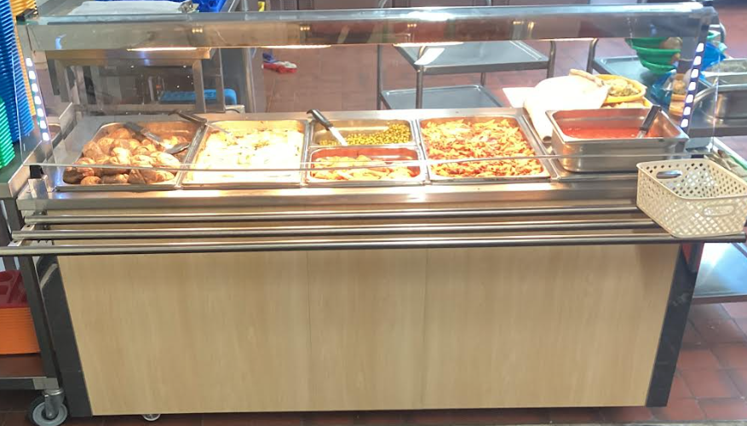
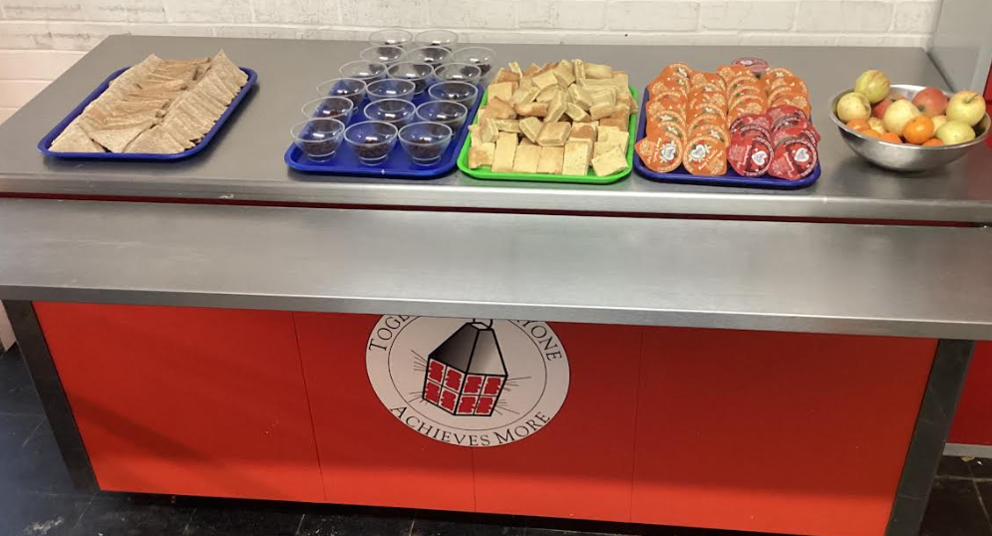
School lunches
Lunchtime is run from 11.50-12.50 for Year R and 12-1pm for Years 1 and 2. Children eat either a school dinner or a packed lunch in our school hall.
Supervisory Assistants work as a team and build up a strong knowledge of individual needs in their allocated class. Healthy choice meals are cooked in the school kitchen by Dolce (a company working in the majority of Southampton schools) and served by staff responding to children’s preferences for meat or vegetarian selections (special dietary needs are also catered for). All school meals are nutritionally balanced.
Currently, all school dinners for Early Years and Key stage 1 children are free.
Your child will receive a free water bottle, which they should bring every day. Children are encouraged to drink water regularly, and research has highlighted the positive effect this has on children’s health and learning.
Fruit and vegetables are provided as a mid-morning snack each day.

Slide 16
School day
It is very important that your child attends school every day and on time.
8.35 – 8.50am Welcome into the class. Children are greeted by the teaching staff.
8.50am Registration
8.50am-12.00 Morning session including a morning break
12.00- 1.00pm Lunchtime
1.00-3.05pm Afternoon session begins with registration and includes assembly.
3.05pm School Ends
Office Hours 8.00am – 4.00pm

Slide 17
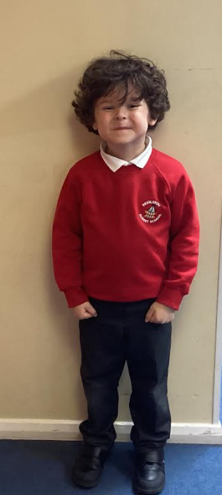
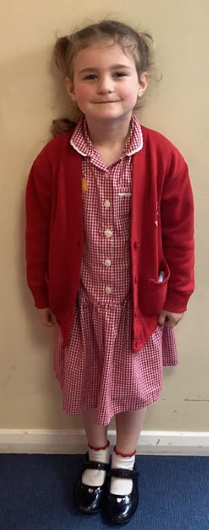
School uniform
At Woolston Infant School, we believe that the wearing of a school uniform encourages pride in the school and helps children to feel they belong to the school community.
We expect children to wear school uniform and ask parents to support us in ensuring that children come to school dressed appropriately.
The school colours are red, grey and white. Your child will need:
Sweatshirt, jumper or cardigan:
Red (plain or with the school logo) available from the school office
Shirt, blouse or polo shirt:
White
Trousers:
Long or short grey
Skirt or Pinafore:
Grey
Dresses:
School style red check
P.E:
White or Red T-Shirt and Red shorts
(T-shirts with school logo and red shorts available from the office)
Sweatshirt & Jogging trousers for outside Suitable footwear
A PE bag (available from the school office)
A school book bag:
(available from the school office)

Slide 18
Friends of woolston infants
Our ‘School Friends’ work extremely hard and effectively to organise events and raise money for our school. They organise very successful Christmas and Summer Fayres, discos and many other fun events for our children.
The money raised goes towards larger projects in the school such as redeveloping the conservation area and library as well as purchasing specific resources our children may identify they would like. The money also helps to subsidise educational visits and visitors for the children.
They meet once every half term and all parents and carers are welcome to attend. We hope you will join in the activities!

Slide 19
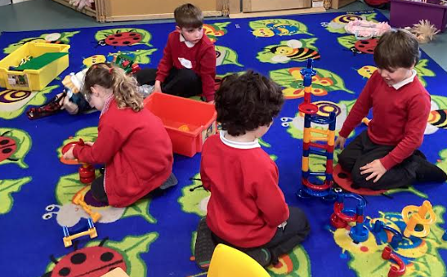
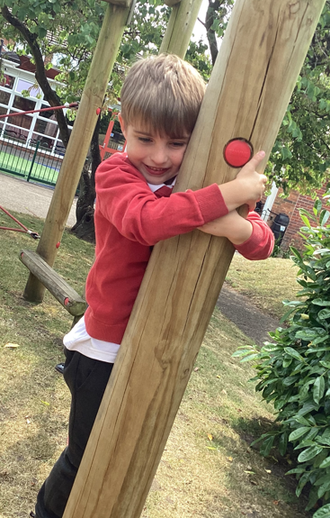
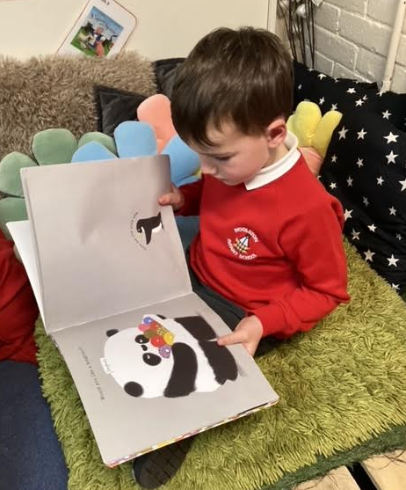
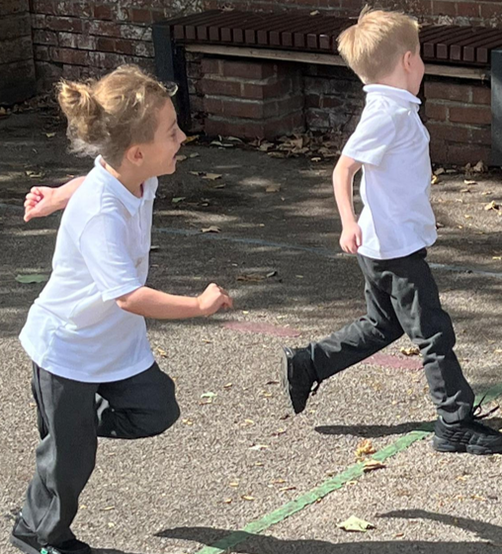
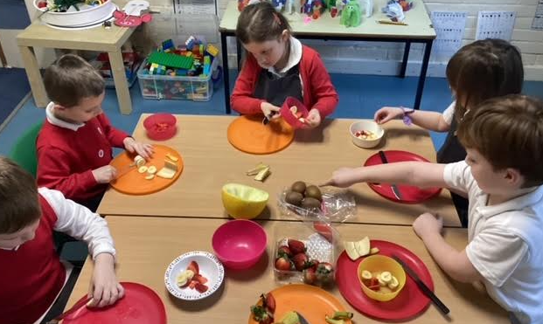
Ofsted 2024 – Headlines
“Pupils’ behaviour around the school and in class is very good.”
“Woolston Infant School is a happy place.”
“Pupils are taught how to stay safe in the local area, especially near water and railways. “
“All this supports pupils’ growing knowledge about life in modern Britain and contributes to the school being a caring, happy community.”
“Pupils develop a love of reading right from the early years.”

Slide 20
Woolston Infant school
Florence Road
Woolston
Southampton
SO19 9DB
Telephone: 023 80444447
Email: info@woolstoninfantschool.co.uk
Website: www.woolstoninfantschool.co.uk
Facebook: @Woolston InfantSchool

