Slide 1
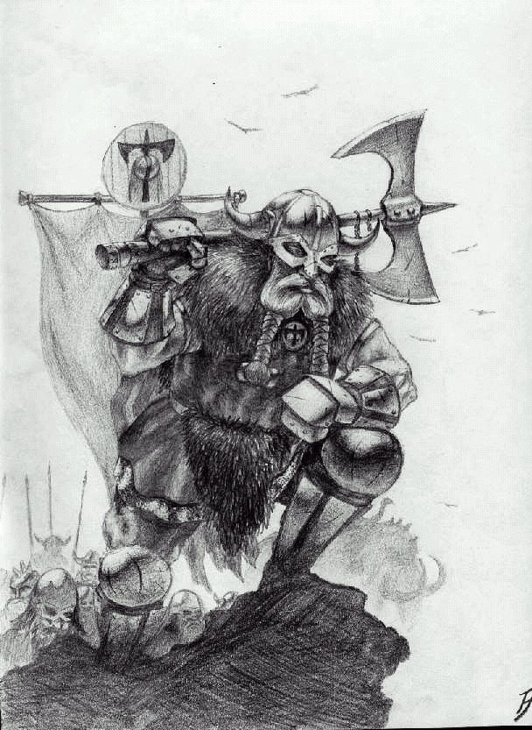
Who Were the Vikings?
Learning Challenge
To explain whom the Vikings were and where they came from.
To question why the Vikings came to Britain.
To infer how the Anglo-Saxons and Vikings would have felt and reasons for their actions.

Slide 2
Where did the Vikings come from?
Use the images and evidence you have to think about how the Vikings came to Britain.
When did they come?
How many were there?
Did they come peacefully?

Slide 3

Find the Viking!
To help you to learn who the Vikings were, you need to find the Viking within the ‘imposters’ on your table.
Everyone will read a statement you must piece together the clues to work out who the Viking is and who the imposters are! You have enough clues for THREE rounds.
Use a scribe to collect the clues; this will be useful in your activity later!
https://www.twinkl.co.uk/resource/t-t-289765-viking-invasion-map-activity

Slide 4

Who Were the Vikings?
Denmark
Norway
Sweden
The Vikings, or Norse, were a race of Scandinavian warriors
Raided Northern Europe, Western Asia, and Eastern North America.
They came from Denmark, Sweden and Norway.
The Vikings invaded Lindisfarne and were after treasure!
They battled the remaining Anglo Saxons.
They invaded many times and finally conquered in 1066.

Slide 5
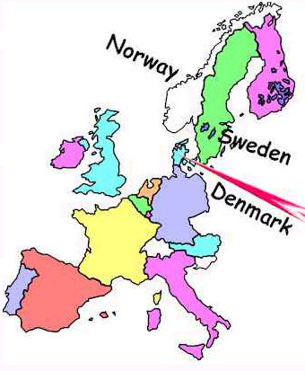
Use what you know about the Anglo Saxons. Where do you think the Vikings came from?

Slide 6
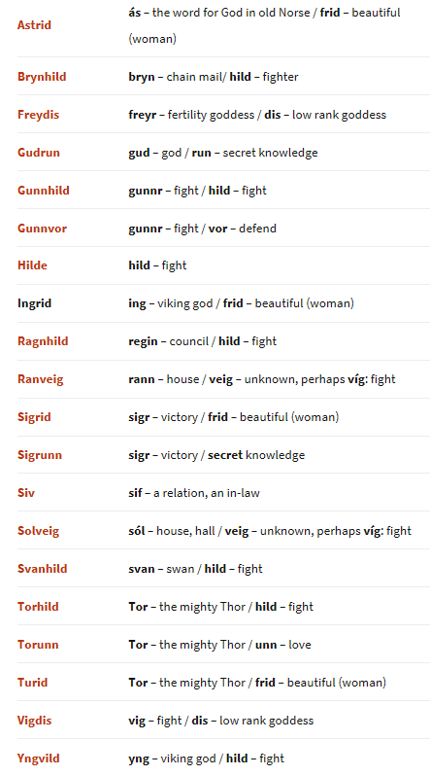
Language –
Old Norse

Slide 7
Where did the Vikings come from?
The Vikings came from Norway, Sweden and Denmark which are North of England.
Their land was not fertile. It was rocky. They found it hard to grow crops.
They found that England was rich with plentiful lands and treasures.
The climate was much warmer than where they came from, they preferred it and wanted to settle here.

Slide 8

How do you come to a country now?
What do you need?
Pair and Share

Slide 9
Your Turn
Thursday 22nd November
Can I get to know a Viking Invader?
Viking Visa
Name:
Age:
Language:
From:
Where are your fellow Vikings from?
Why do you want to invade Britain?
What are your skills/qualities?
Growth Mindset – What will happen to the people already in Britain and why?

Slide 10
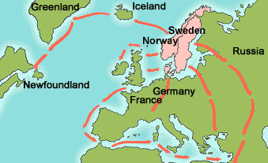
Constantinople was the main city of the Byzantine empire. The Vikings traded there.
The Vikings were the first Europeans to reach America.
The Vikings seemed to get everywhere...
Eric the Red founded a new settlement in Greenland.
The Vikings had settlements in Iceland in the ninth century.
The French king gave the province of Normandy to a Viking duke named Rollo to stop him attacking.
The Vikings settled in an area called Rus. The name Russia comes from this.

Slide 11
Your Turn
Use your map skills and what you have learnt to label each country and shade each region in the colour asked for.
Push It!
Why might the Vikings have chosen to come to Britain?
What does the map tell you about the Vikings and their power?

Slide 12
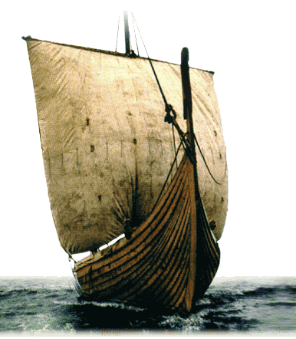
Thursday 14th November
How did the Vikings invade Britain?
To explain how the Vikings came to Britain.
To design and make a Viking longboat.

Slide 13

Where did the Vikings come from?
The Vikings invaded Britain in AD 793. The Vikings built fast ships for raiding and war. These ships were 'dragon-ships' or 'longships'. The Vikings also had slower passenger and cargo ships called knorrs. They built small boats for fishing or short trips.
Viking longships could sail in shallow water. So they could travel up rivers as well as across the sea. In a raid, a ship could be hauled up on a beach. The Vikings could jump out and start fighting, and then make a quick getaway!

Slide 14
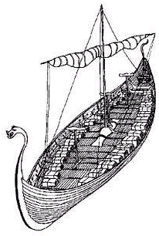
The Longships were powered by sails or by rowing with oars.
Longships
The Vikings used longships to raid and steal from other lands.
The Viking longships were crafted out of woods and were very effective and skimming across the surface of the waves. The used their boats for transporting cargo, trading and for exploring. The Vikings even travelled to America, which they called Vineland, because grapes grew there.

Slide 15
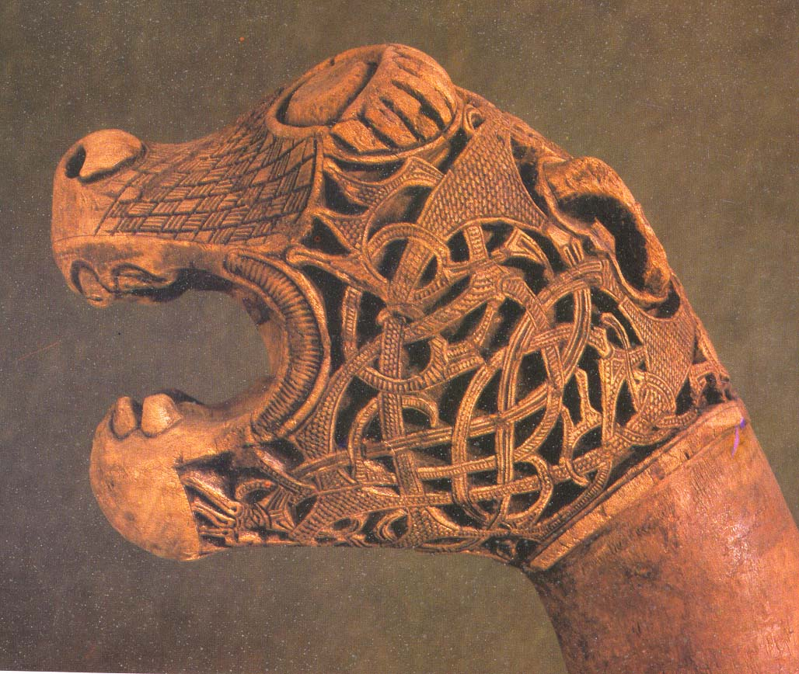
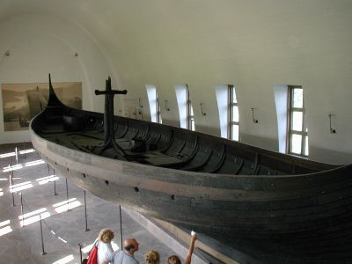

Slide 16
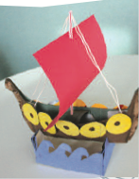
Make Your Own!
In pairs, you are going to create your own Viking longships.
Would you have been able to invade Britain?
Think about what your ship will need to be successful!

Slide 17

Make Your Own!
Follow the instructions given and on your sheets!
Use examples of Viking longships given to design your ship. Be as creative as you like!
We will check them later to see if they float!
Sometimes the Vikings would release ravens to help them towards land.

Slide 18

Viking Raids -
Lindisfarne!
To understand why the Vikings came to Britain and why they raided Lindisfarne monastery.
To learn about Vikings raids on Britain and their impact.
To report on a famous Viking raid.

Slide 19

Invaders!
We are going to complete our own invasion of another classroom!
How should we do this?
What do they need to feel?
How do we know that we have succeeded?

Slide 20
How do we know about the Vikings?
Vikings left many traces of their settlements that are still visible today. Archaeology provides physical evidence of their conquests, settlements, and daily life.
Not a lot of evidence survives, and much of what we have is either uninformative or unreliable. Many popular ideas of Vikings are 19th century inventions, such as horns on helmets.
Surviving accounts of Viking activity was almost exclusively written by churchmen. These included monastic chronicles . The chronicles reflect the fact that Vikings attacked these monasteries for their wealth and the accounts had a hostile tone to give a popular image of Viking atrocities.
The first Viking raid was on the monastery of Lindisfarne for this reason!

Slide 21
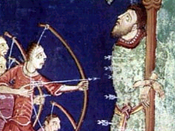
‘Men of war’ is how the Vikings are thought about and indeed they brought violence to England. Over 1200 years ago, sails were seen off the coast of Lindisfarne. The monks in the monastery watched as the longships came closer and landed.
The warriors were fierce and frightening. The monks were skilled fighters but could not hold them back. The Viking raiders took gold from Lindisfarne back to Norway, Sweden and Denmark.
‘on 8 june 787 AD ravages of heathen men miserably destroyed God’s church on Lindisfarne with plunder and slaughter’ (Anglo Saxon Chronicle)
These raids went on for many years as the Vikings stole from the monastery. The word ‘Viking’ means pirate, and these pirates were about to get even greedier….

Slide 22
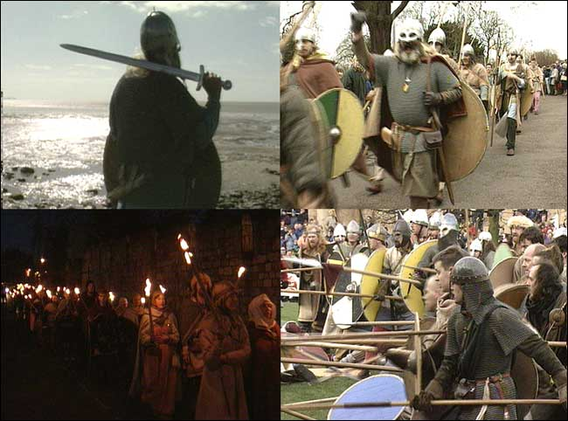
Vikings had no professional standing army and tactics and discipline seemed at little development.
Weapons training began at youth in hunting, sports, and raiding.
A leader needed to wage war frequently in order to keep his followers and maintain power against rivals.
The famous Berserker warriors fought in groups, and believed that Odin, their god of war, gave them both protection and superhuman powers so they had no need for armor.

Slide 23
Lindisfarne Raid!
In groups of four, your task is to record a news report and write a front page for the Viking raid on Lindisfarne.
Each group will rotate to interview a ‘witness’. Each witness will then join one of the groups.
Think about:
What information to include.
How people already in Britain might have felt.
Who can be interviewed?

Slide 24
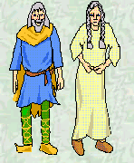
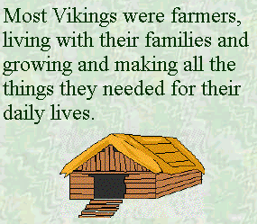
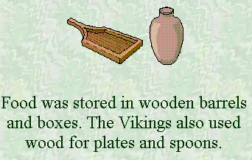
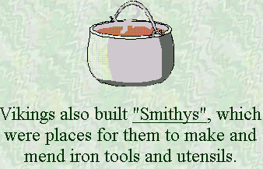
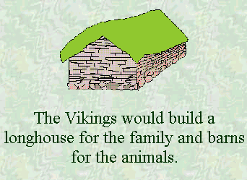
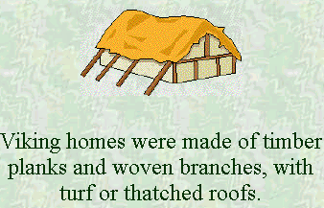
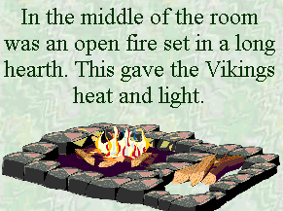
Home
Life

Slide 25
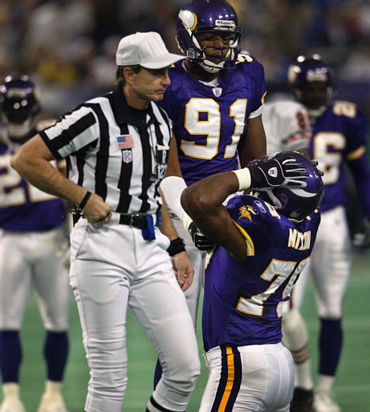
What happened to the Vikings?
Vikings became citizens of many places in Europe.
Kings instituted taxes and the economy changed so that you could get along better off as a trader than a raider.
The Viking invasions caused European kingdoms to be more centralized and focused.
European kingdoms learned how to protect themselves and gain by trading and negotiating with the Vikings instead of battling them.

