Slide 1
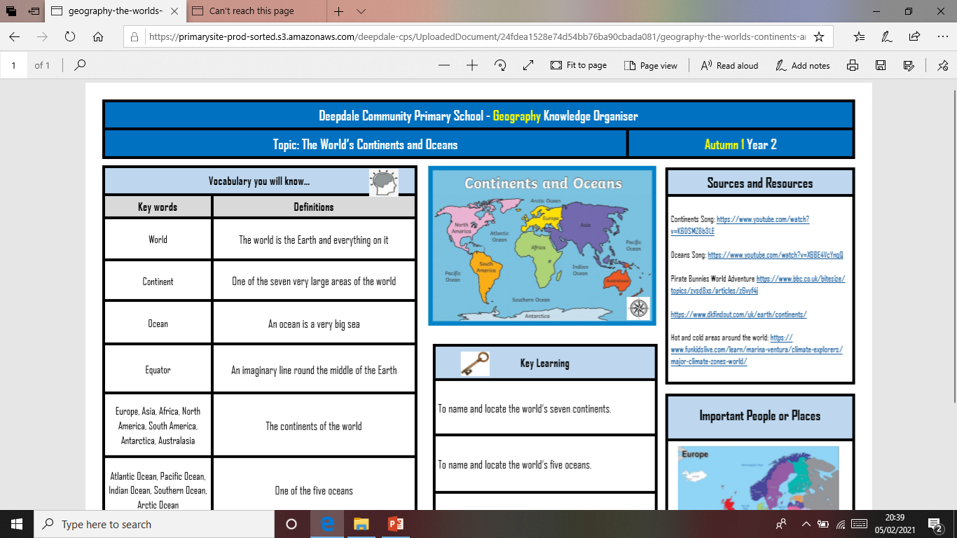
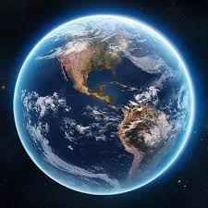
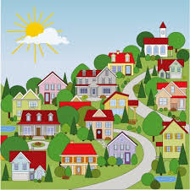
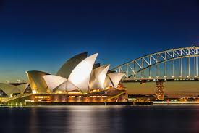
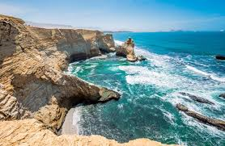
Yarm Primary - Reception
Where in the World?
Subject Specific Vocabulary​ |  |  |  | Sticky Knowledge about the World.
City | A large town. |  | After half term, we will be learning about the World around us. We have included some information that you may like to share with your child as well as some suggested activities. Have fun! | Yarm is a town in the north east of England.
 |  |  |  | The United Kingdom is made up of four countries: England, Wales, Scotland and Northern Island
Community | A group of people.
Island | An area of land that is surrounded by water on all sides.
Ocean | An Ocean is a very big sea. |  | Brain Teaser….. | There are four seas that surround the United Kingdom: The North Sea, The Irish Sea, Celtic Sea and the English Channel
 |  |  | ​ Later in the term we will be reading a book from the country that this landmark is in. Do you know where it is?
Continent | One of the seven large areas of the World.
Coast | The land next to the Ocean. |  |  | London is the capital city of England
World | The world is the Earth and everything on it.
 |  |  |  | There are nearly 200 countries in the world.
Capital City | The main city of a country.
 |  |  |  | The Earth is almost 5 billion years old.

Slide 2
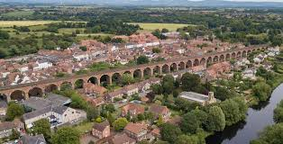
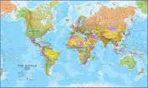
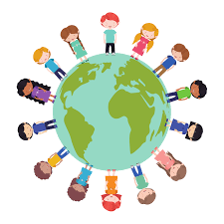
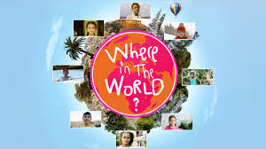
Our school is in Yarm. Can you find out some facts about Yarm? | Can you write a list of the different places you have visited? | Choose a country to research. What facts can you find?
Find out about different landmarks from around the world. Can you build a model of one? | Around the World You may want to complete some of the activities before we start our new topic. | What is the favourite part about the place that you live?
If you could go anywhere in the world where would you go? Why? | Find a recipe from around the world. Can you make it? | Can you learn a song from a different country?

