Slide 1
Friday 5th February 2021
Art

Slide 2
Recap – A few weeks ago we looked around an Art Gallery virtually.
Let’s have another look - What is in most Art Galleries?
https://www.nationalgallery.org.uk/visiting/virtual-tours
We looked at the features of a portrait: Can you remember what the features of a portrait are?

Slide 3
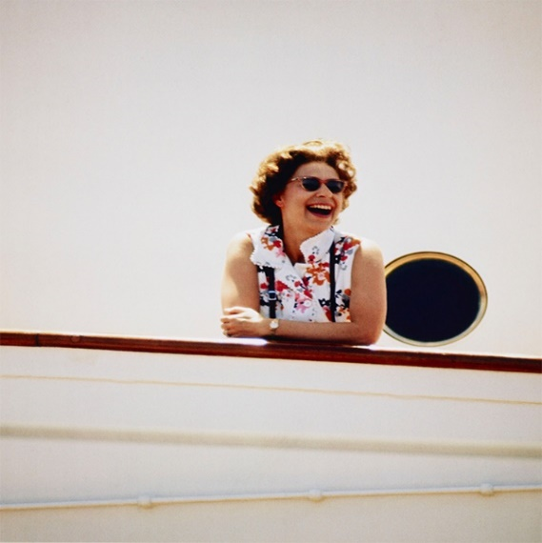
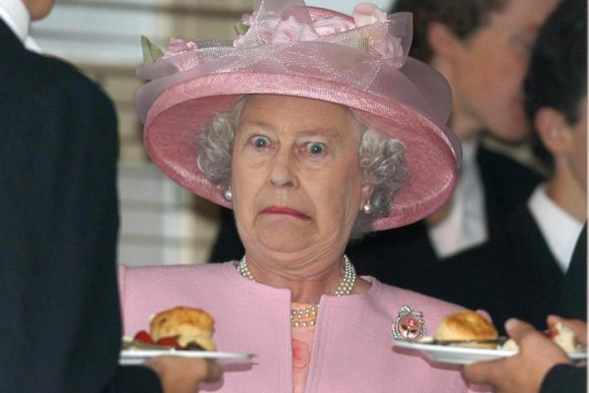
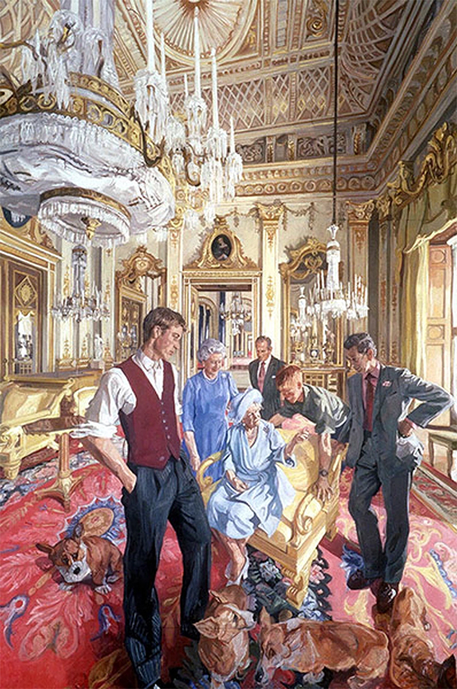
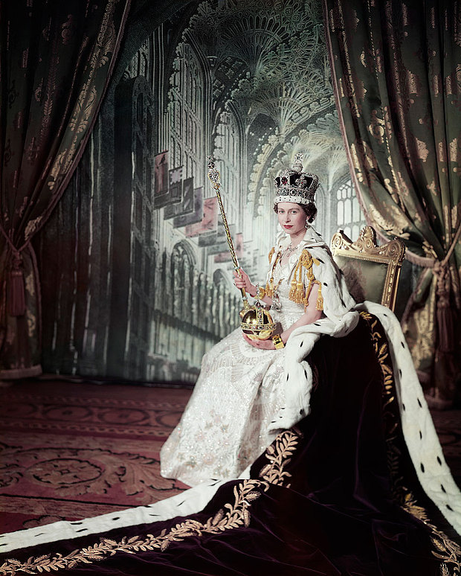
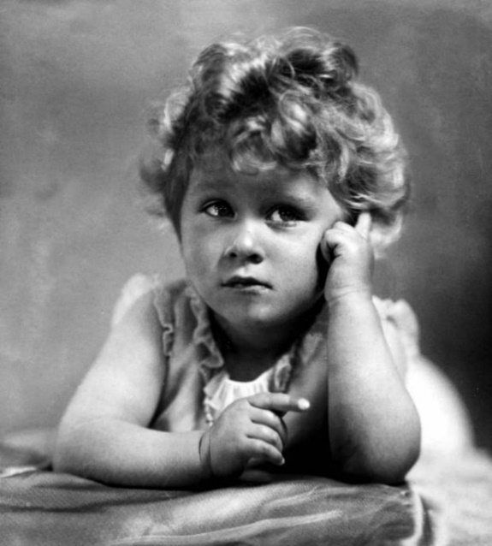
Recap - Who is this Monarch?
How do you think the Queen feels about the portraits painted of her?
Which portrait do you think would have been painted first?

Slide 4
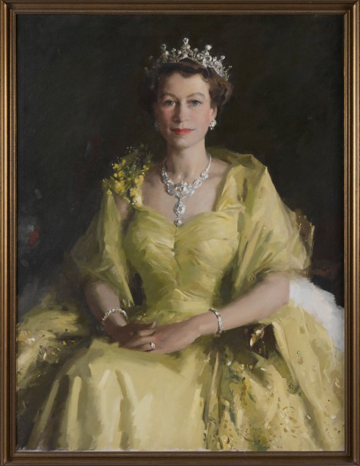
This week we are going to continue to focus on the same Monarch…. Queen Elizabeth II
Can you research on the computer some different portraits of her?
Today we are going to focus on the portrait by William Dargie.
Who is William Dargie? What was his background like?
Can you research some other work by William Dargie?
Can you find out about when the portrait was drawn?

Slide 5
Task: Can you have a go at re creating the William Dargie picture of Queen Elizabeth II?
Use resources in your house…
You can choose what size the picture is and how you represent it.
We can’t wait to see all of your fantastic creations and put them into our art gallery in the hall!!!!!

