Slide 1
Friday 12th February 2021
Art

Slide 2
Over the past couple of weeks we have been looking at a range of different artists based on two significant monarchs. Can you remember the artists names and the year they painted the portraits?

Slide 3
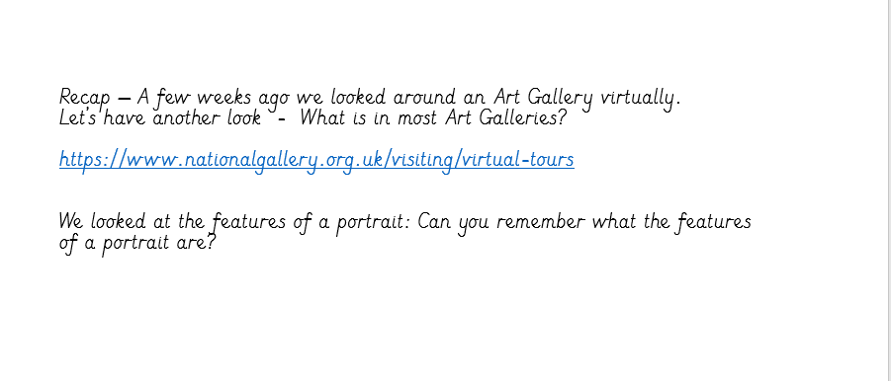

Slide 4
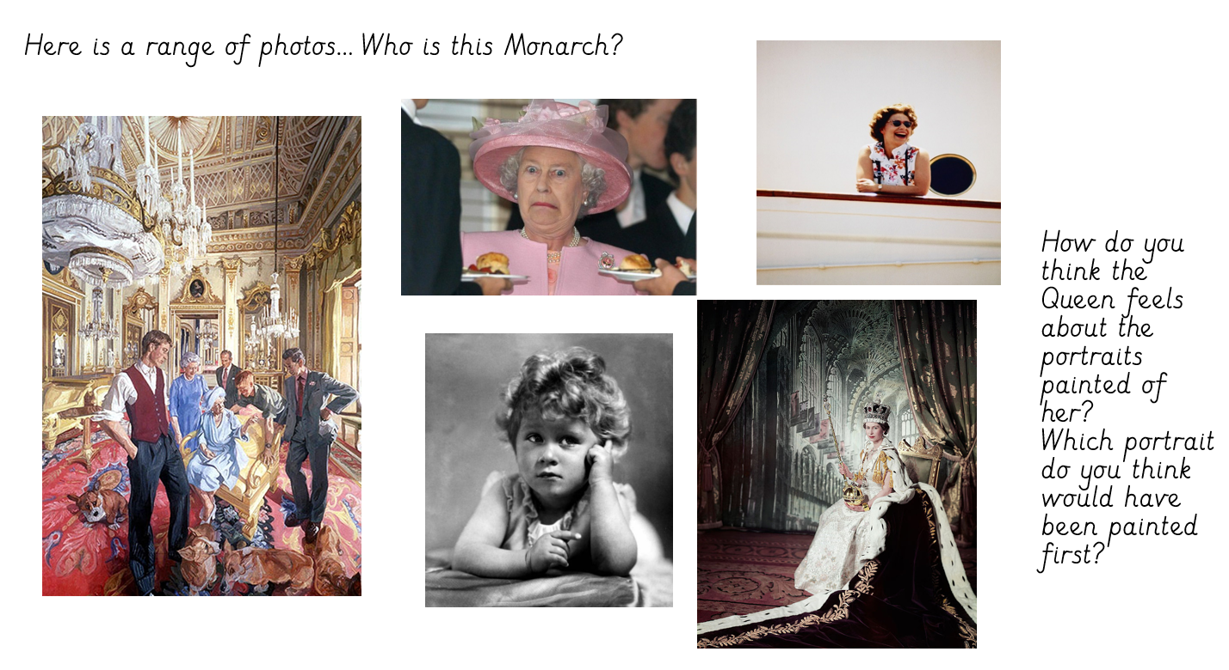

Slide 5
Look at the different portraits of Queen Elizabeth II – Can you decide which portrait you think is first? Can you make a timeline of different portraits of Queen Elizabeth II that you have researched from the internet?

