Slide 1
Friday 15th January 2021
Art

Slide 2
Last week we looked around an Art Gallery virtually.
Let’s have another look - What is in most Art Galleries?
https://www.nationalgallery.org.uk/visiting/virtual-tours
We looked at the features of a portrait: Can you remember what the features of a portrait are?

Slide 3
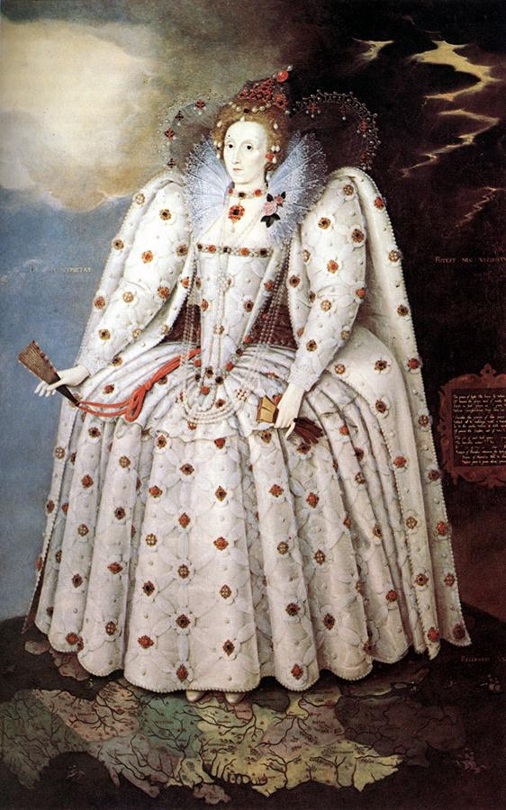
This week we are going to focus on the Monarch…. Queen Elizabeth I
Can you research on the computer some portraits of her?
Today we are going to focus on the ‘Ditchley Portrait’ 1592
What do you notice about this portrait?
Look at Queen’s Elizabeth’s face – Why do you think in the painting she looks pale?
(Queen Elizabeth has lead poisoning, so it made her skin go very pale. This is due to the make up that Queen Elizabeth I used to wear).

Slide 4
Today have a go at sketching Queen Elizabeth I in her coronation dress. Think about the features of the portrait.
I know you are all fantastic Artists, so I cant wait to see all of your fantastic sketches.

