Slide 1
Friday 22nd January 2021
Art

Slide 2
Recap the features of a portrait – What are they?
Last week we looked at Queen Elizabeth I – Can you remember any information that we talked about last week?

Slide 3
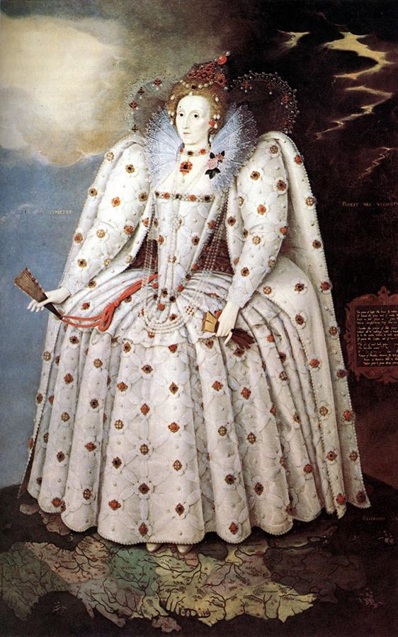
Today we are going to continue to focus on the ‘Ditchley Portrait’ 1592
Look back at your sketch – can you make your drawing even better?
Watch the video - https://www.youtube.com/watch?v=hqh1MRWZjms
Look at Austin’s butterfly technique – Can you improve your sketch?
You can either start your sketch again or improve your 1st draft.

Slide 4
Today once you have finished your final sketch – Can you use different resources in your house to colour the sketch in?
e.g pastels, paints, coloured pencil, materials to make a collage effect.

