Slide 1
Friday 29th January 2021
Art

Slide 2
Recap – A few weeks ago we looked around an Art Gallery virtually.
Let’s have another look - What is in most Art Galleries?
https://www.nationalgallery.org.uk/visiting/virtual-tours
We looked at the features of a portrait: Can you remember what the features of a portrait are?

Slide 3
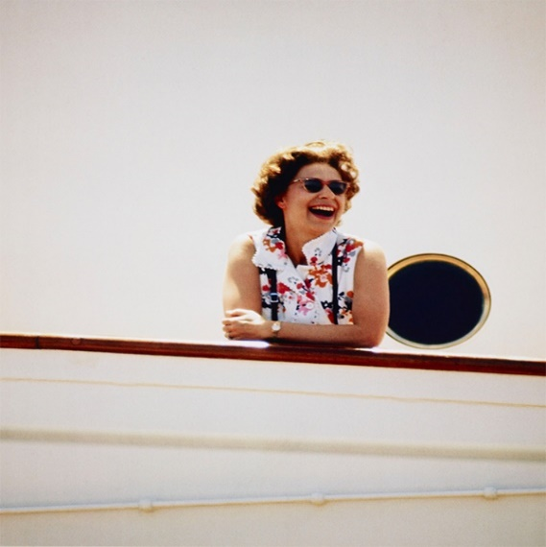
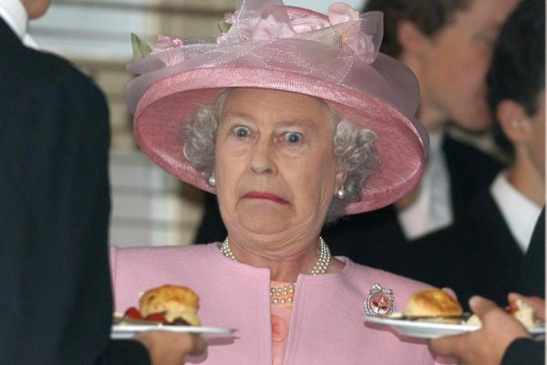
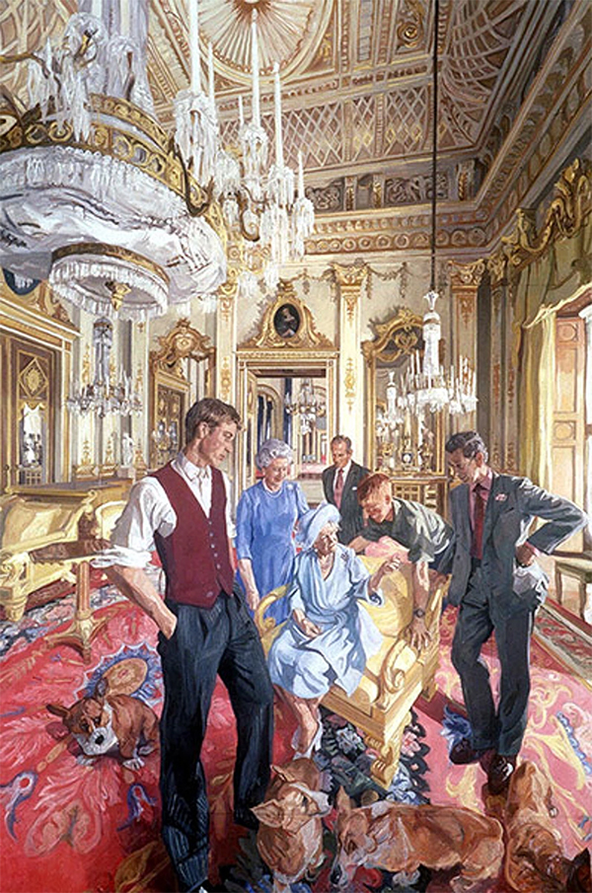
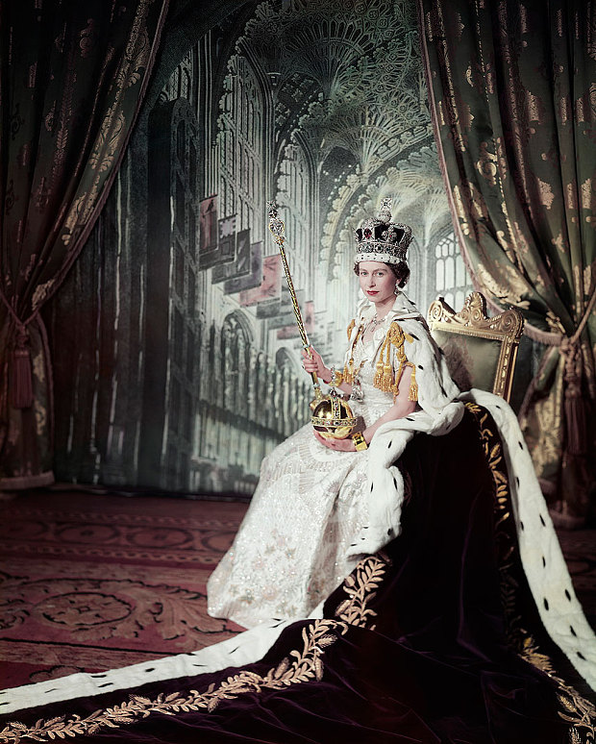
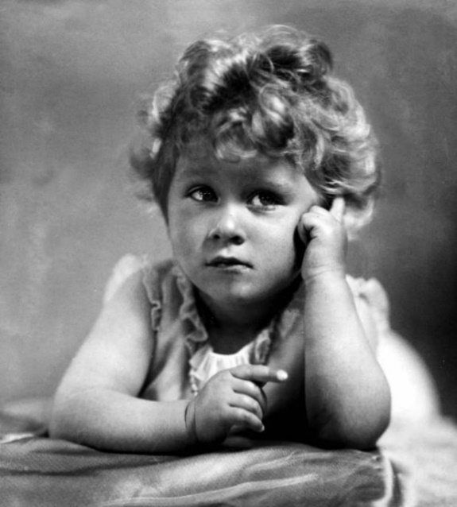
Today we are going to be looking at a different Monarch…..
Who is this Monarch?
How do you think the Queen feels about the portraits painted of her?

Slide 4
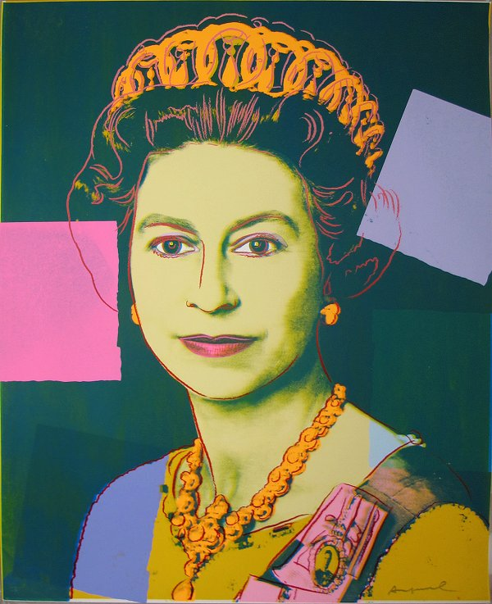
This week we are going to focus on a different Monarch…. Queen Elizabeth II
Can you research on the computer some portraits of her?
Today we are going to focus on the portrait by Andy Warhol 1985.
What type of art work is Andy Warhol famous for?
Can you research some other work by Andy Warhol?
Over the next two weeks we are going to be looking at pop art of Queen Elizabeth II.

Slide 5
Task: Can you have a go at re creating the pop art picture of Queen Elizabeth II?
Use resources in your house…
You can choose what size the picture is and how you represent it.
We can’t wait to see all of your fantastic creations!!!!!

