Slide 2

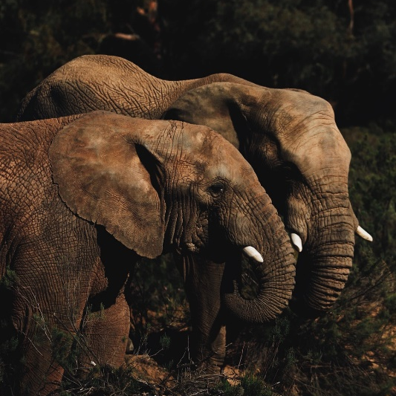
About Africa
Africa is the second largest continent in the world. It is made of 54 countries and 9 territories. There are approximately 1.1 billion people living in Africa, which is equal to 15% of the world’s population. It is estimated that there are 2000 different languages spoken in Africa.
Africa is home to rainforests, deserts, mountains, rivers and coastal plains.
Animals, such as the African elephant, giraffe, cheetah and the white and black rhinoceros, live in Africa.

Slide 3
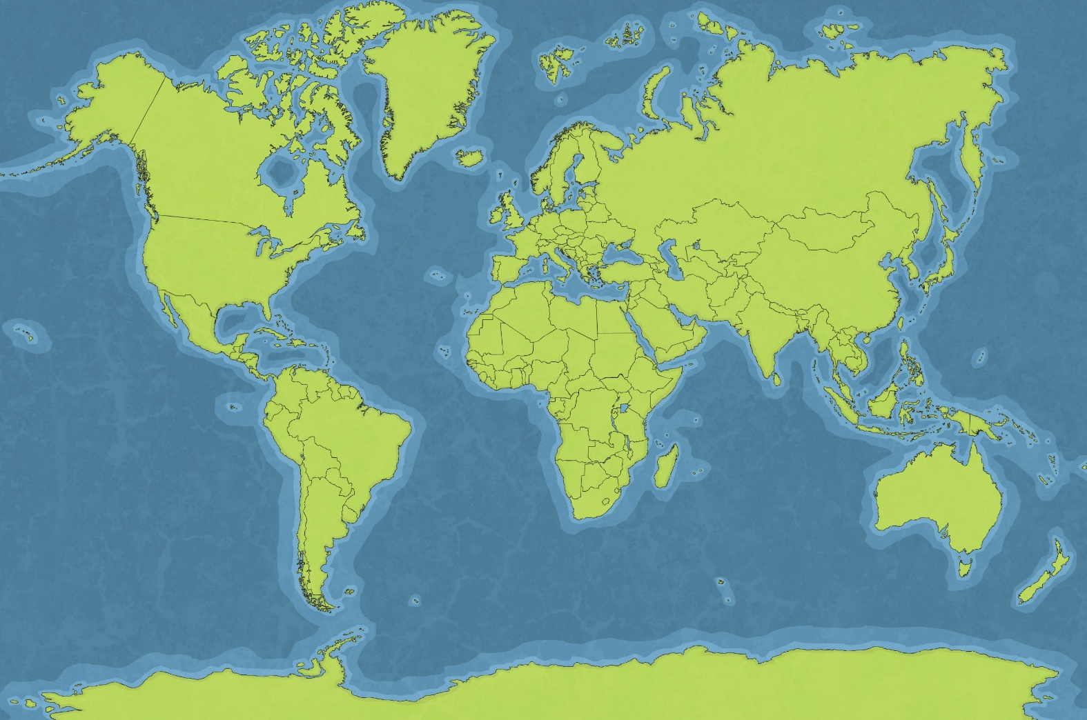
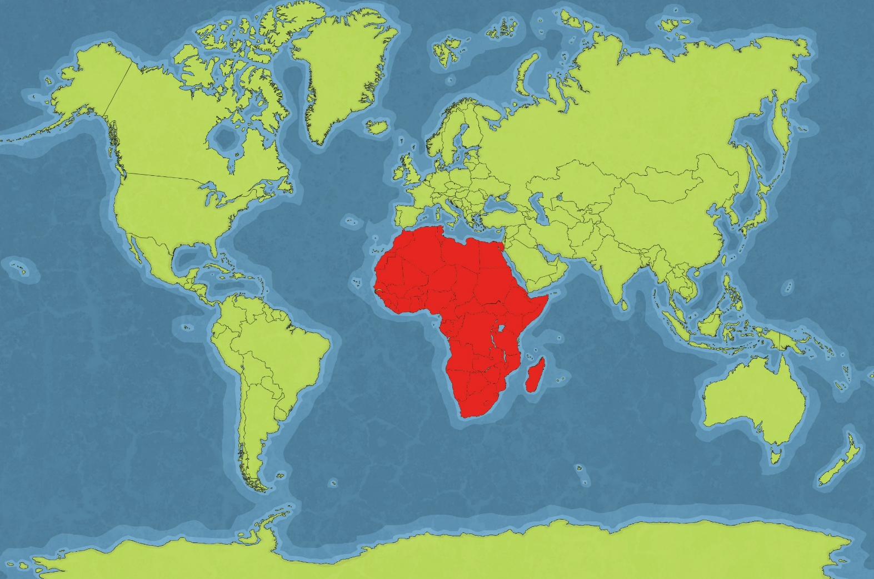
About Africa
Africa

Slide 4

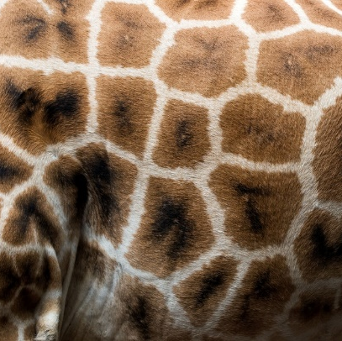

African Art
Africa is well known for its individual art.
For hundreds of years, African art has been strongly influenced by the environment and natural surroundings.
The vast richness and variety in the environment are ideal for encouraging creativity.

Slide 5
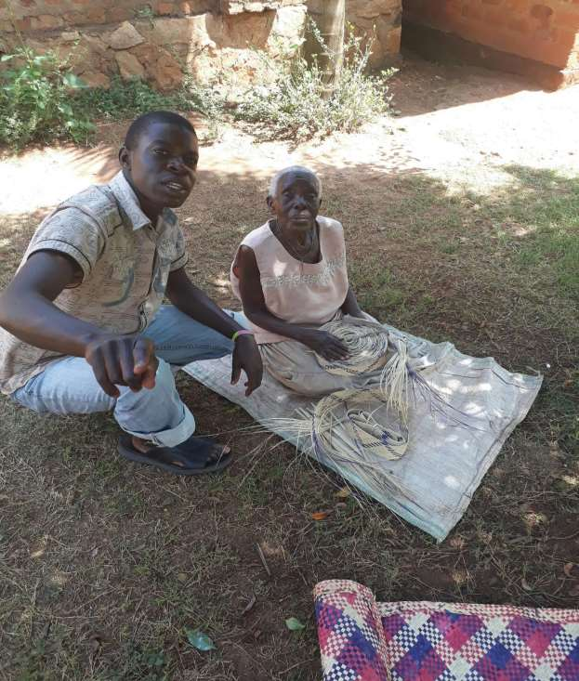
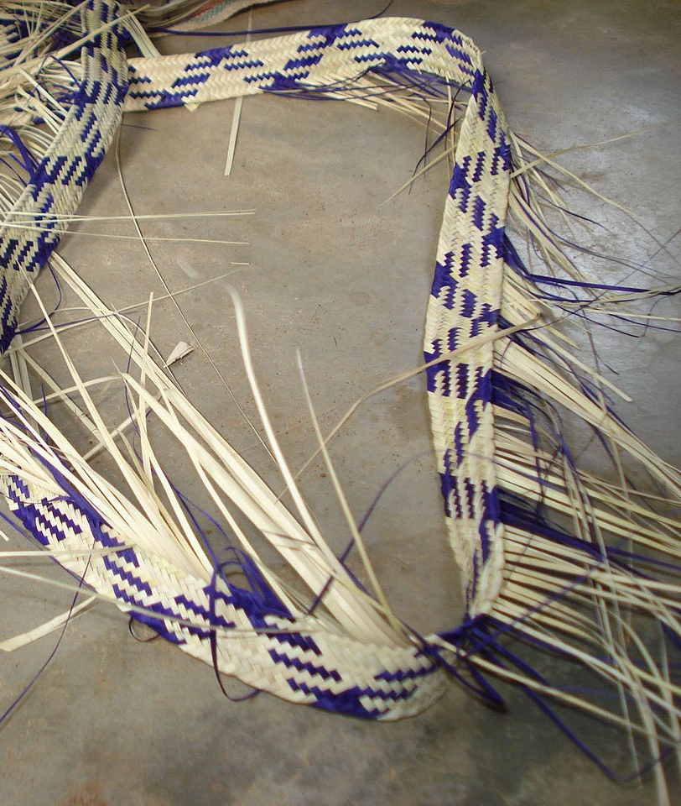
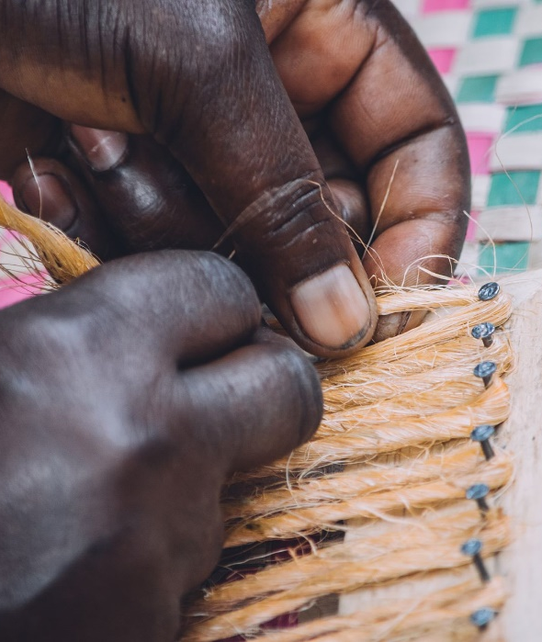
Handmade Patterns
African mats, rugs and baskets, like those made in countries such as Rwanda and Burundi by the Tutsis, are made by hand using weaving and sewing techniques.
By Ssemaluluj, By Hamijuma, By Mandelasamuel27 - Own work, CC BY-SA 3.0.

Slide 6
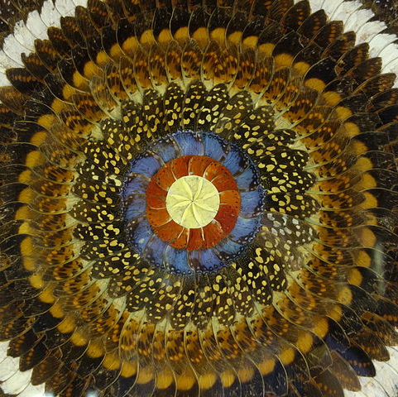
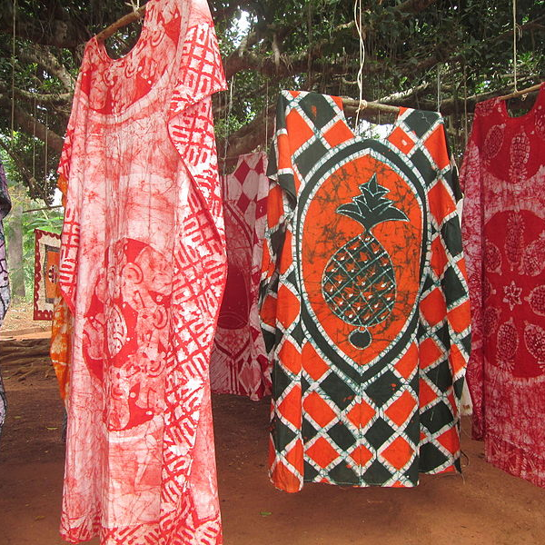
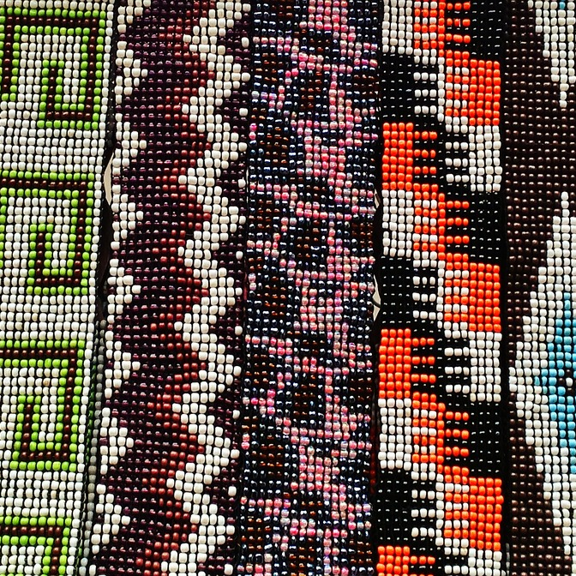
Types of Pattern
Patterns used in African art fall into two groups:
Geometric – patterns that use zigzags, chequerboard, curved lines, spirals and circles.
Symbolic – patterns that use images which have some symbolic meaning for the artist and the person using the art, whether it be on a piece of clothing or a building. These images can include crescents, stars, flowers, seeds, trees and pods.
By Papischou, By Daderot - Own work, CC BY-SA 4.0, .

Slide 7
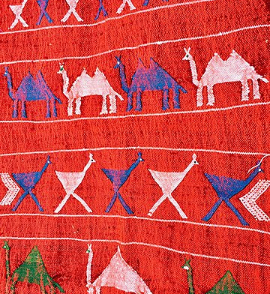
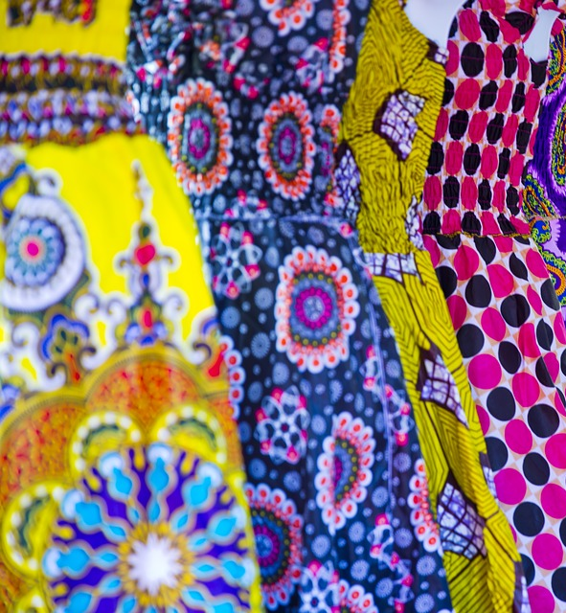
The Meaning of Patterns
The symbolic patterns represent the culture’s beliefs and history. There is a lot of meaning in the way the patterns are arranged and they often represent the wisdom of a tribe. They also act as a record of the events and daily activities of that tribe.
Common patterns include parallel zigzags which are used to remind the artist and the user that the path in life is never straightforward but instead, is often difficult to travel.
In Ghana, the Ashanti tribes apply motifs to fabric, pottery and paper that have symbolic significance and tell a story.
By Gharbal - Own work, CC BY-SA 4.0, , .

Slide 8
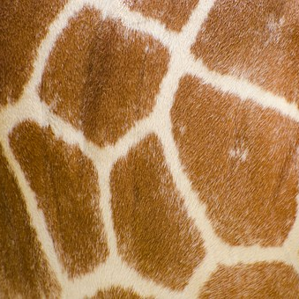
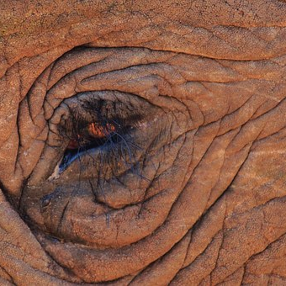
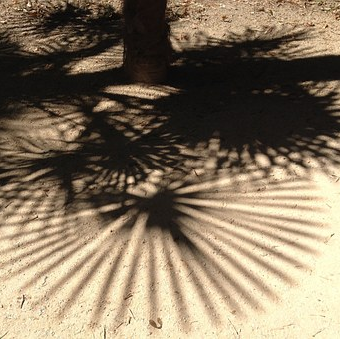
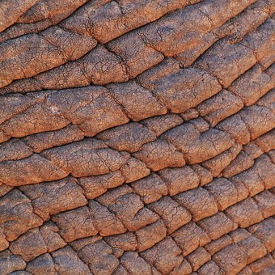

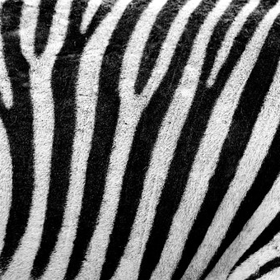
Inspiration All Day
It’s easy to see where the inspiration for art comes from in Africa.

Slide 9
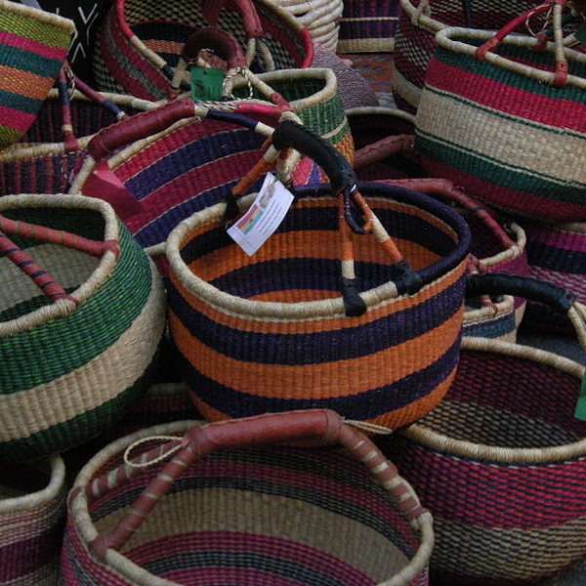
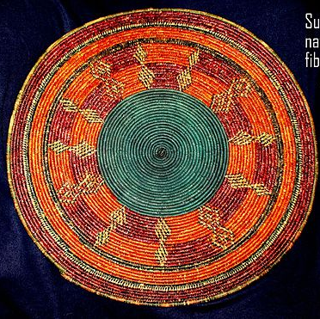
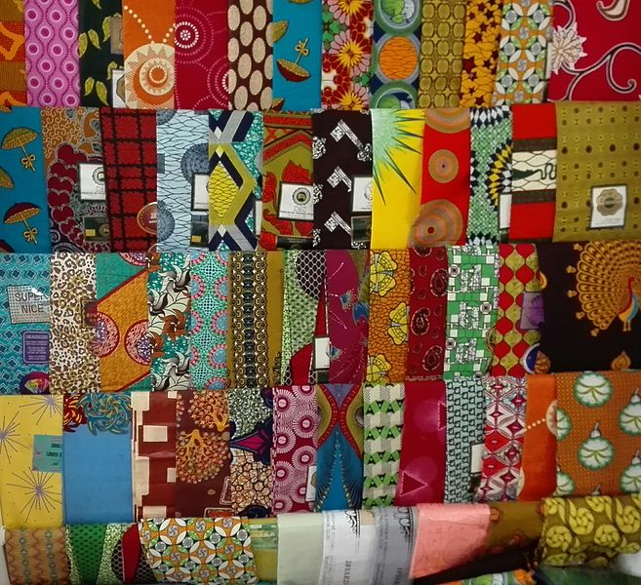
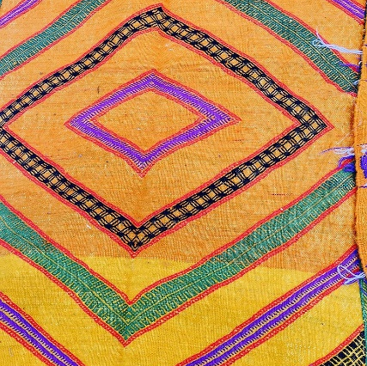
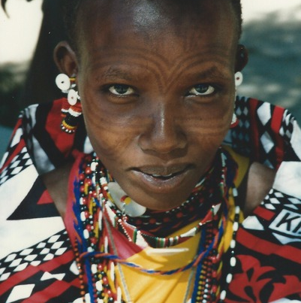
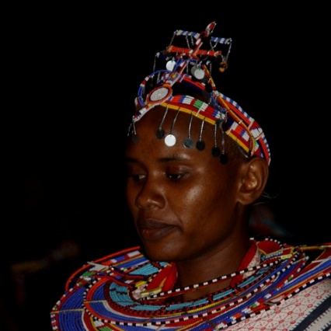
Patterns Everywhere
Repeating, colourful patterns are everywhere from baskets and rugs to jewellery and clothing.
By Haagscheblu, By Joe Mabel - Own work, CC BY-SA 4.0,

Slide 10
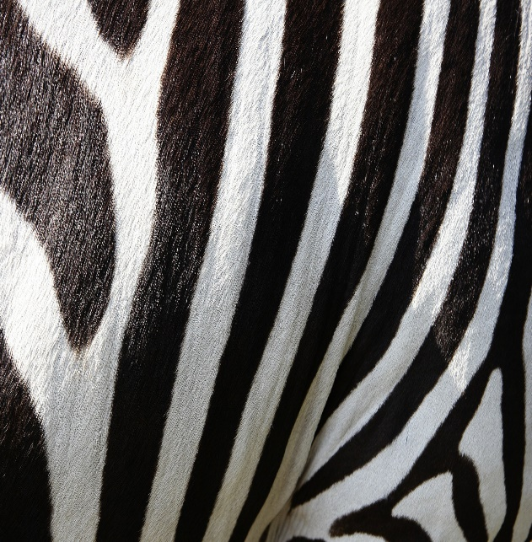
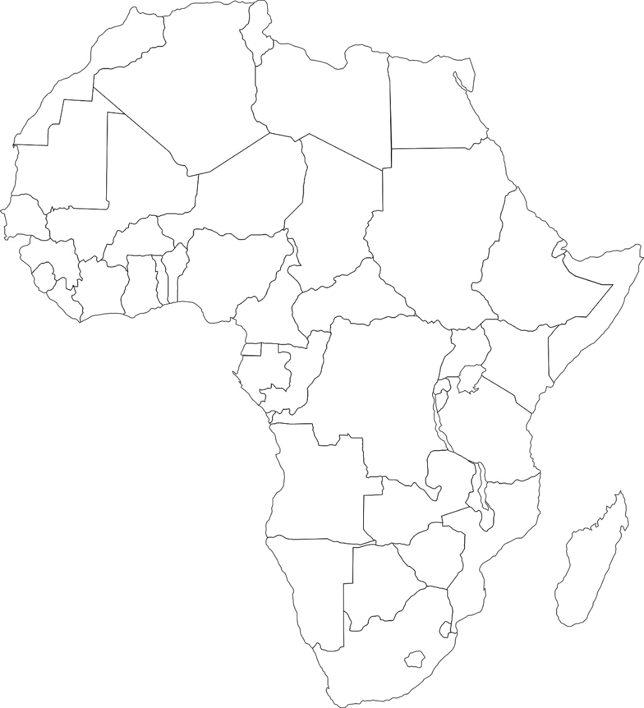

Nature Inspired Art
The patterns used in mosaic tables produced in Zimbabwe are inspired by patterns from animals, reptiles and other aspects of nature.
Zimbabwe

Slide 11
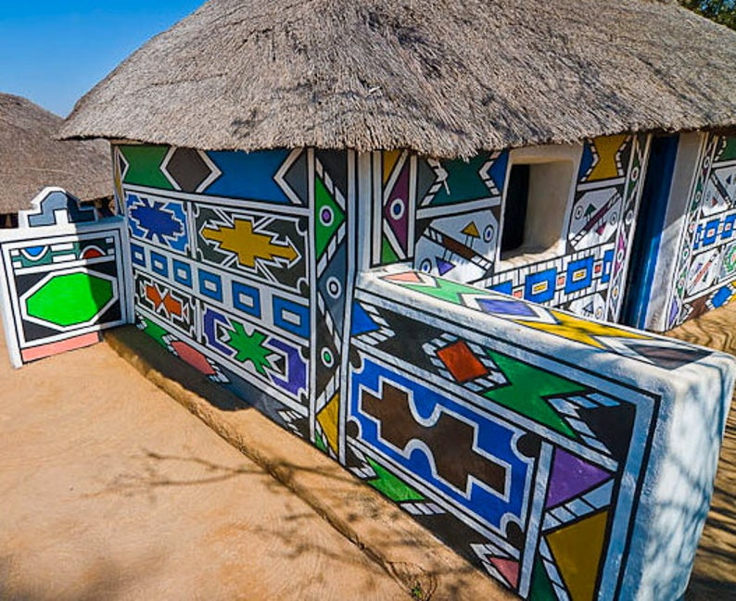
Patterns in Architecture
The Ndebele women of Zululand in the north west of South Africa have long been decorating the walls of their houses. This is a tradition called ‘ukugwala’. They use their fingers to create undulating or straight lines in geometric patterns with paint or wet clay.

Slide 12


Have a Go
See if you can get inspired by your surroundings to create a pattern using bold colours.
Go outside and see what patterns you can see and how they can be used in a piece of artwork.

