Slide 1
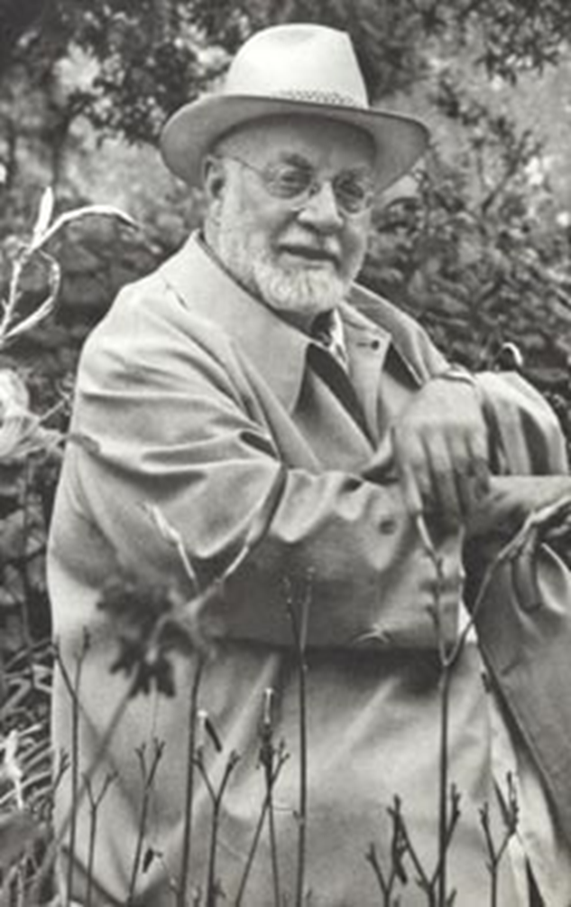

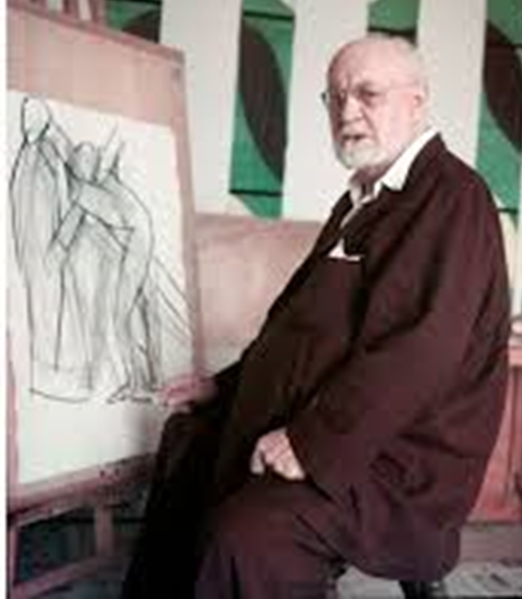
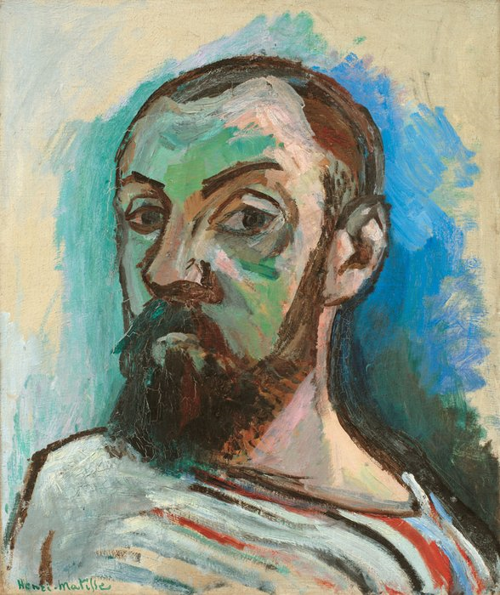

Slide 2

  Born: December 31, 1869,
  Le Cateau-Cambrésis, France
  Died: November 3, 1954, Nice, France
Matisse was an artist who was working in the 19th & 20th Centuries.
He was 85 when he died and had worked as an artist for much of his life – so during this long period he did LOTS of different types of art…

Slide 3
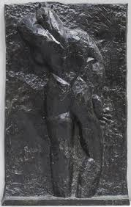
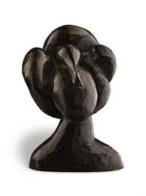
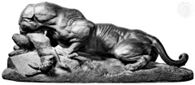
Sculpture
He was a sculptor – using metal and polished stone to make his sculptures.
What do you think he was trying to depict in these sculptures?

Slide 4

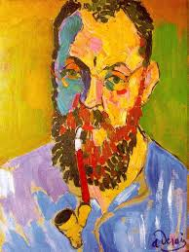
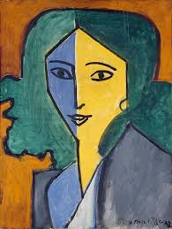
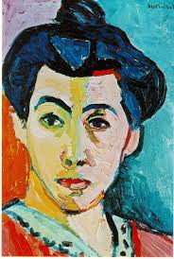
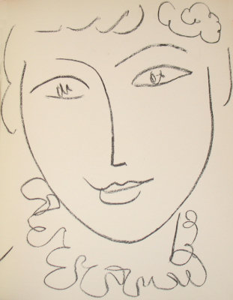
Portraits
He used different styles to paint lots of portraits. Which do you think are self-portraits?!

Slide 5
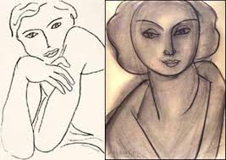
There was a particular person who inspired Matisse when he painted portraits. She was called Lydia Delectorskaya – she was his muse.

Slide 6
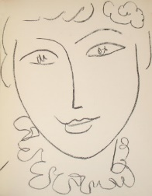
Look at this portrait of Lydia – how many lines and marks can you see?
Notice that some of them are a continuous line (he didn’t take his pencil off the paper).
Look at the picture and try to copy the image with the same number of marks.
You could make a BIG picture and then try a really small one.
Which one is easier/better?
Do you prefer working on a large or small scale? Why?
I wonder why Matisse didn’t add any colour?
You could if you want to…

Slide 7
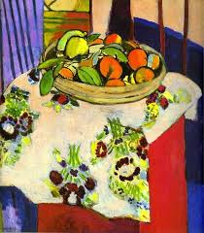
Still life
At the start of his career Matisse painted still lifes…
A still life) is a work of art depicting mostly still (unmoving) subjects, typically common objects which are either natural (food, flowers, dead animals, plants, rocks, shells, etc.) or man-made (drinking glasses, books, vases, jewellery, coins, pipes, etc.)

Slide 8
What can you see in the paintings?
What are the 3 most common colours Matisse used?
How do the paintings make you feel?
Which of these 3 paintings would you want in your room? Why?
Why do you think Matisse painted them?

Slide 9
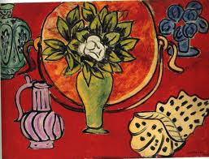
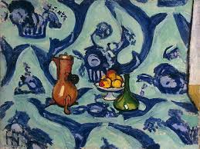
Choose 3 objects from around the house and arrange them like Matisse.
They could be from your toy box or things which Matisse could not have used – like technology…
Take photos from all the way around your still life – do you notice different things from different angles?
OR you could sketch your still life – do it from at least 3 view points – you could add colour to 1 or all of them if you want to…
Look at this video to help you improve your drawings each time … https://www.youtube.com/watch?v=hqh1MRWZjms
ask someone to give you feedback just like in the film…

Slide 10
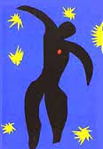
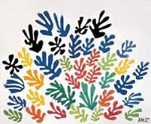
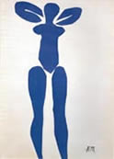
At the end of this life Matisse used a different way of working –
Paper cut collage.
Practice your cutting skills – draw a shape (like the one above) OR you could use your hand - cut out as many as you can (get someone else to help too!) Arrange them in a way you like and take a picture…you could use magazines/newspaper or plain paper which you could colour or put patterns on…you don’t need to stick down your pattern – rearrange your shapes and take another photo – make a sequence, just like lots of artists do…

Slide 11
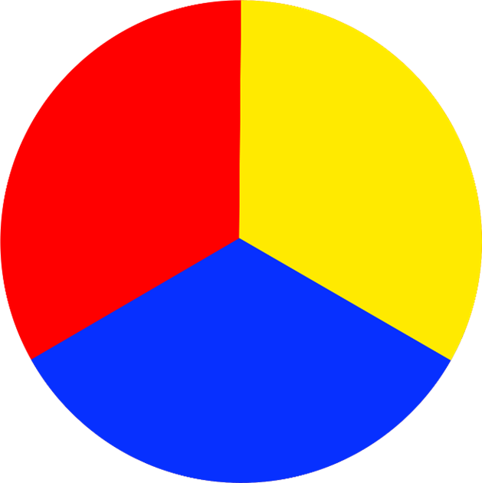
For us to be able to think carefully about Matisse’s work we need to remind ourselves about what we know about colour…
Primary colours
There are 3 primary colours – red, yellow & blue.
They can be mixed together to make other colours…

Slide 12
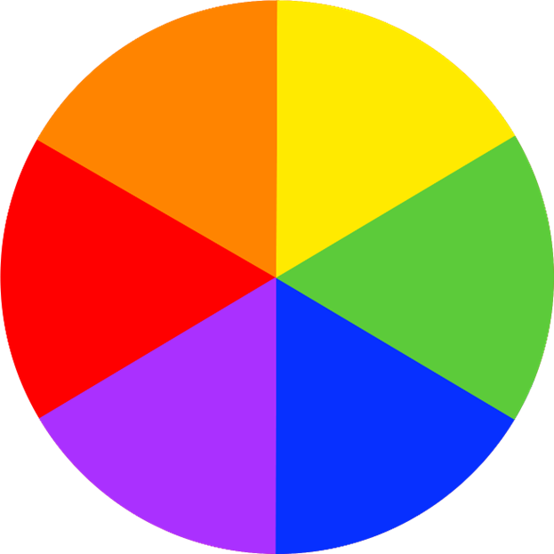
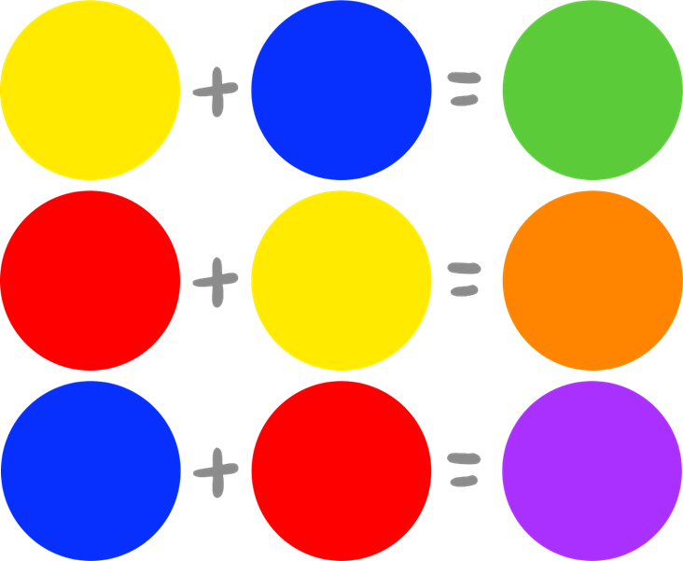
Secondary colours
We use primary colours to make secondary colours – green, orange & purple.

Slide 13
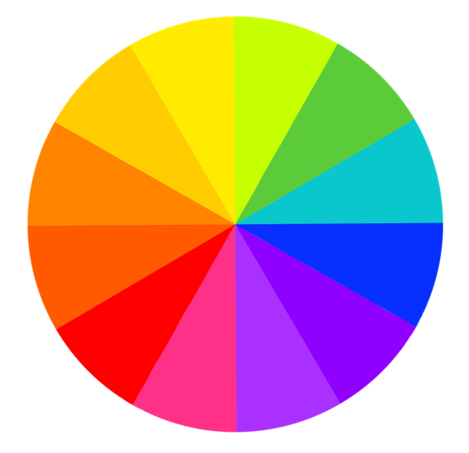
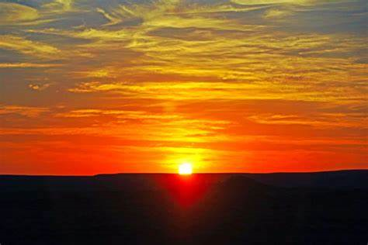
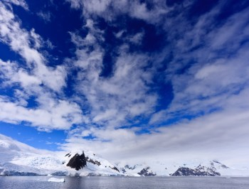
Warm and cool colours
Green, blue and purple are cool colours. They make us think of fresh, calm and chilly things.
Red, orange and yellow are warm colours. They make us think of sun, warmth and cosy things.

Slide 14
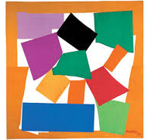
This is one of Matisse's’ most famous pictures. It uses the paper cut collage way of working.
Can you guess what it is?

Slide 15
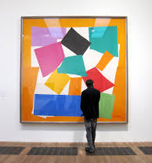
The Snail
1953
The Tate Gallery
London
Did you guess?
Look how BIG it is?

Slide 16
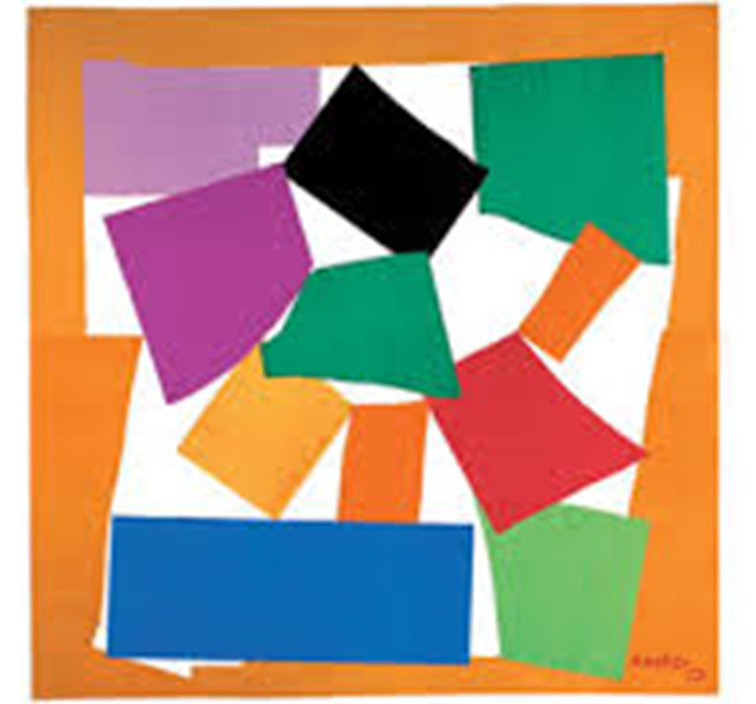
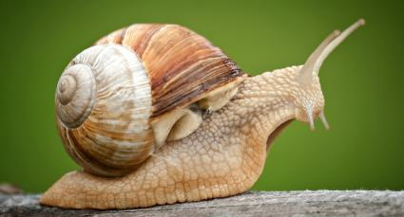
Look at it carefully again…
Can you see the snail shell and the head?
What else can you see?
What colours did Matisse use?

Slide 17
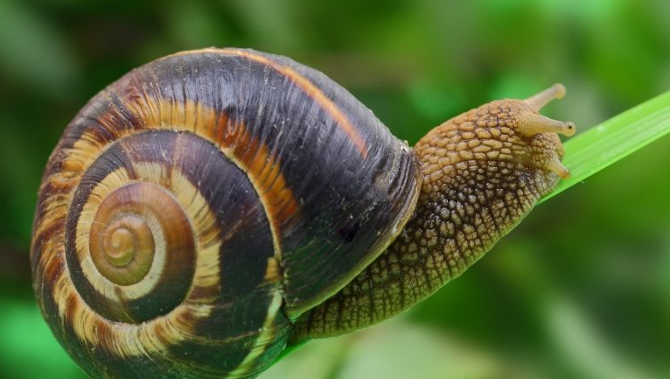
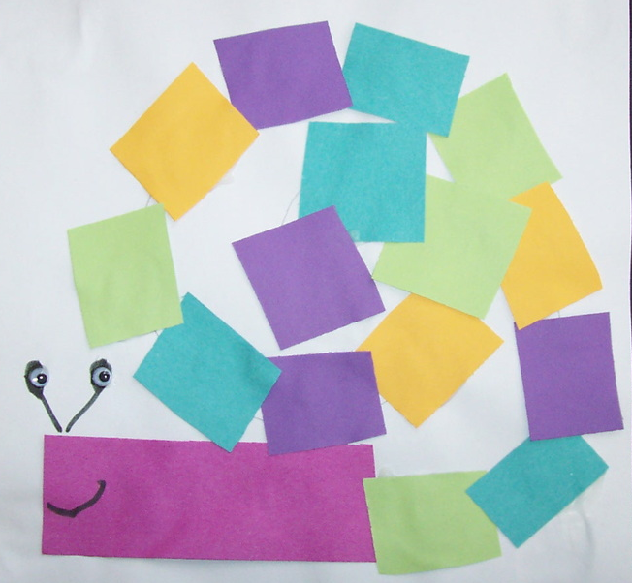
Now it’s your turn!
You can use any kind of paper – you can colour or paint some if you want to.
Rip or cut strips and shapes and arrange them to make your version of The Snail – remember there is no way you can get this wrong as it is your piece of art and will be fabulous! You don’t have to stick the shapes down – you can take a photo and then use the shapes again for another picture…
You could make a little snail OR if you have chalk, go outside and make an enormous one OR a cardboard box one…
You could make a model if you have playdoh or modelling clay.

Slide 18
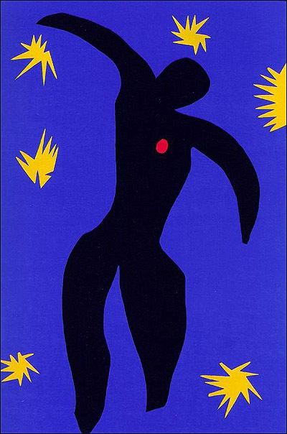
Think about what you have learned about colour and how they can make you feel.
What do you know about mixing colour?
What are 2 facts you have learned about Matisse?
Do you have a favourite painting of his?
Do you have a favourite picture that you have made?
If you don’t have paint to use, don’t worry – when we are back in school you will have some opportunities to develop this using paint…
I can’t wait to see your art work – Mrs W. x
This is my favourite Matisse picture – Icarus.
Can you guess why I like it?

