Slide 1
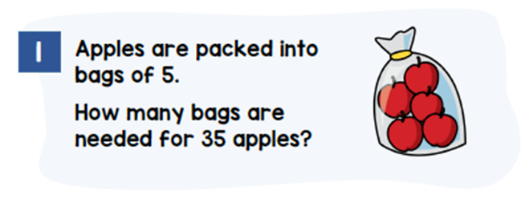
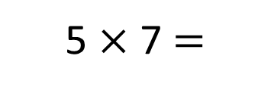
Model
Calculations
35
5 $×$ 7 $=$
35
5
5
5
5
5
5
5
7
_____ bags are needed for 35 apples.

Slide 2
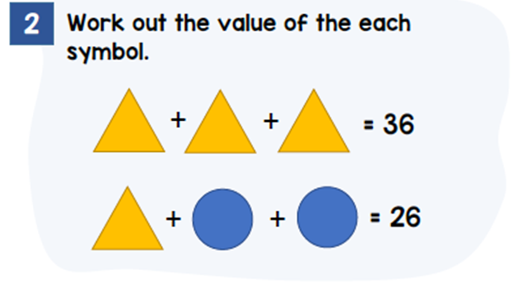
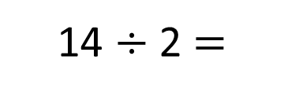
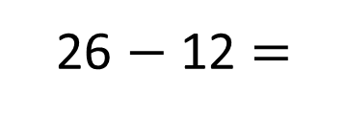


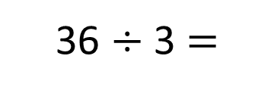
Model
Calculations
36
36 $÷$ 3 $=$
12
12
12
12
26 $−$ 12 $=$
14
7
14 $÷$ 2 $=$
12
7
7
26
$$=$$
12
$$=$$
7

Slide 3
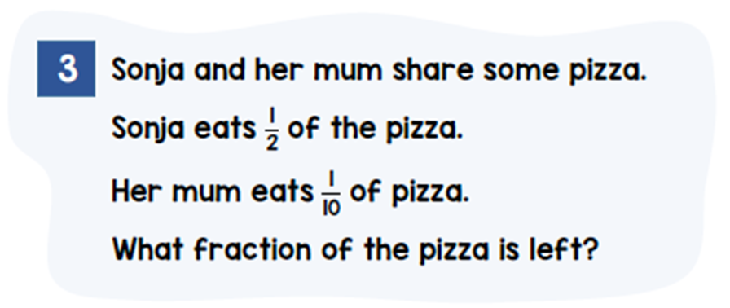


Model
Calculations
Sonja
Mum
Left
$$\frac{2}{5}$$
$$\frac{4}{10}$$
______ of the pizza is left.

Slide 4
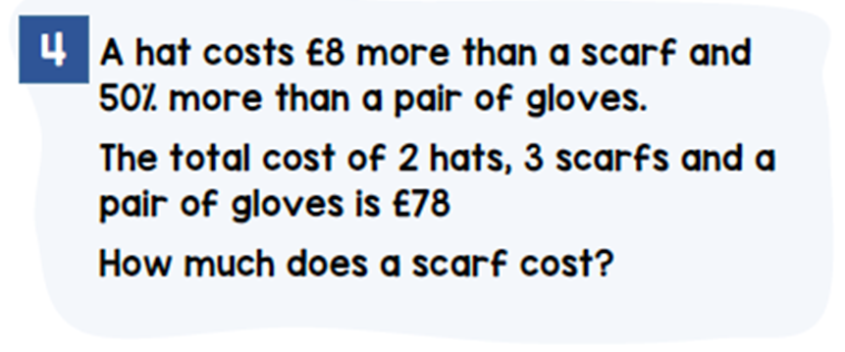
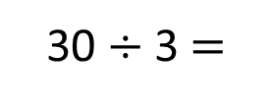


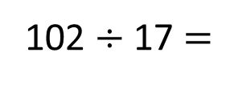
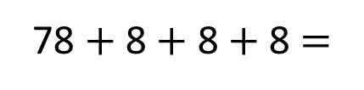
Model
Calculations
Hat
6
6
6
6
6
6
78 $+$ 8 $+$ 8 $+$ 8 $=$
102
102 $÷$ 17 $=$
6
Scarf
10
10
10
78
6
6
6
6
6
6
6
6
6
8
8
8
3 scarfs $=$ 54 $−$ 8 $−$ 8 $−$ 8
102
54
3 scarfs $=$ 30
30 $÷$ 3 $=$
Gloves
6
6
10
A scarf costs £______.
10

