Slide 1



Slide 2
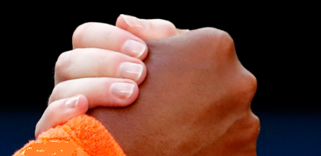

Sources and trust
Notes:
This section looks at sources and trust.
Who do they trust face to face– friend, parent, teacher?

Slide 3
Who do you trust?
Your best friend?
A parent?
A teacher at your school?

Slide 4










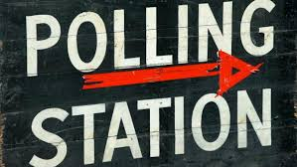

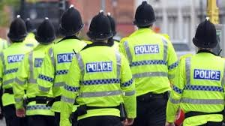
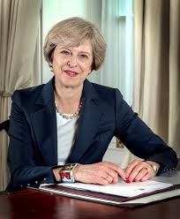
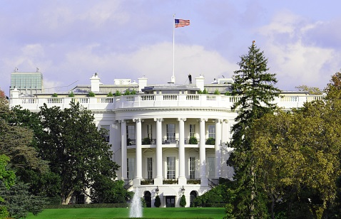


Notes:
Look at the slide and ask your child to choose between 6 and 10 of the above organisations/people and put them in order of who they trust the most, and who they trust the least. (There is no right or wrong answer for this). Ask who they chose for top 2 trustworthy and bottom 2 least trustworthy.
Notes: Images are (from the top, left to right) :
ITN, Newspapers, BBC News, Channel 4 News, Google,
Huffington Post, Sky News, Al Jazeera news, Wikipedia, Facebook,
A polling station, Snapchat, The Police, The Prime Minister, Political parties and their MPs.
The White House, You Tube

Slide 5



VIDEO
‘Who Do You Trust?’
ADD Image for Video here

Slide 6
Exercise 1: Trust bingo!
Draw a table of 9 squares, 3x3 table like this:
Notes:
Ask your child to quickly draw the table above. It doesn’t need to be neat, it just needs to be big enough to fit the names of some people and places in.

Slide 7
President of United States
School Receptionist
Weatherman
Parent
Dentist
Wikipedia
Twitter
Jessica Ennis
BBC News
Sky News
Zoella
YouTube
Head Teacher
Local MP
Doctor
Farmer
Facebook
Music journalist
Cristiano Ronaldo
Moeen Ali
Prime Minister
Instagram
Gary Linekar
Logan Paul
Notes:
Now add 9 names from this list into the table – one name per square. It doesn’t matter who they use – again there is no wrong or right names to use.
The next slide shows them how their table may look

Slide 8
Now choose a different source for each square from the list so that your table ends up looking something like this:
President of the United States | Head teacher | Zoella
Cristiano Ronaldo | Prime Minister | Instagram
BBC News | Twitter | Wikipedia
Notes:
This example shows them how their finished table will look
Now from the download sheet Exercise 1 Trust Bingo, page 3 gives a list of scenarios when a source will need to be approached to find the answer.
Students mark a cross in the correct box when they have a source suitable for the relevant scenario. It’s fine if they have several X’s in one box – but they do need to have at least one X in each box in order to shout Bingo.

Slide 9
Remember:
Use more than one source
Look at a story, event, piece of information from a different angle or point of view.
Notes:
Exercise 2 Using More than 1 source – with computers
Exercise 3 A Different Angle A Different Tale – pen and paper

Slide 10
Sources and trust
Who is the original source - author/publisher?
Can I trust them?
Who has shared the story?
Can I trust them?
Notes:
Sum Up Sources and trusting them:
Anything published, online, in print, audio or video it’s important to ask who is the source of the story, the author/publisher.
And can I trust them.
And you can also ask; who has shared this story? And can I trust them?

Slide 11

CHECK! CHECK! CHECK!
Check the source
Check other news outlets
Check the image
Check your biases
Check your instinct
Notes:
Sum up for Sources and Data
Conclusion
Check your sources and use more than one to help find the truth of the story
Check URL, time, date and your instinct to see if you think it is true
Some sources are better than others depending on the information you want
Not all sources are trustworthy.
What are your own beliefs that may make you pick one source over another?

