Slide 1
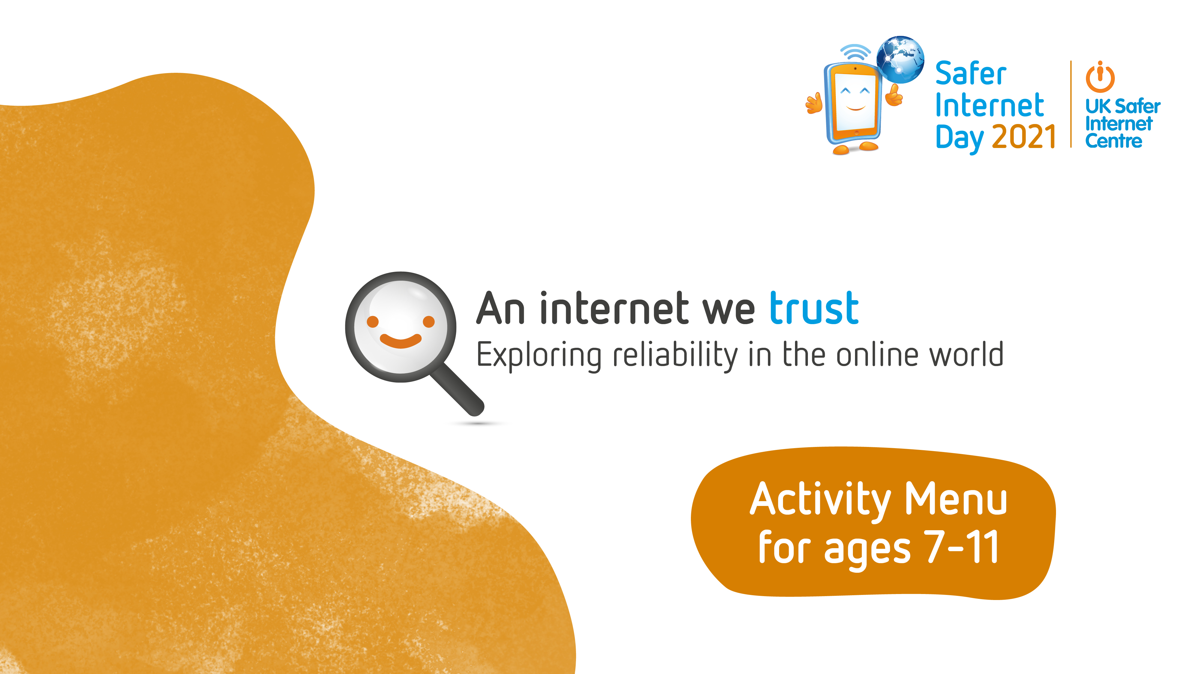

Slide 2




Slide 3



Internet Detectives
Works best with:
Any group size
Print one of the ‘Detective’ sheets for each learner (Slide 4).
Learners can carry out this activity in their classroom or their home setting.
Each learner becomes a detective to see how many of the activities they can complete on their ‘Detective sheet.
When each learner experiences or carries out an online action on the sheet, they can tick it and colour it in.
They can make a note of this action, (for example; what did you laugh at online?) It will help them remember and be able to share with others at a later date.
Internet Detectives, I wonder how many actions from your sheet you will be able to carry out?
Timing:
Ongoing – 10 minutes for explanation
Notes:
This is a set of instructions for the students to follow in their ‘Internet Detectives’ activity.

Slide 4
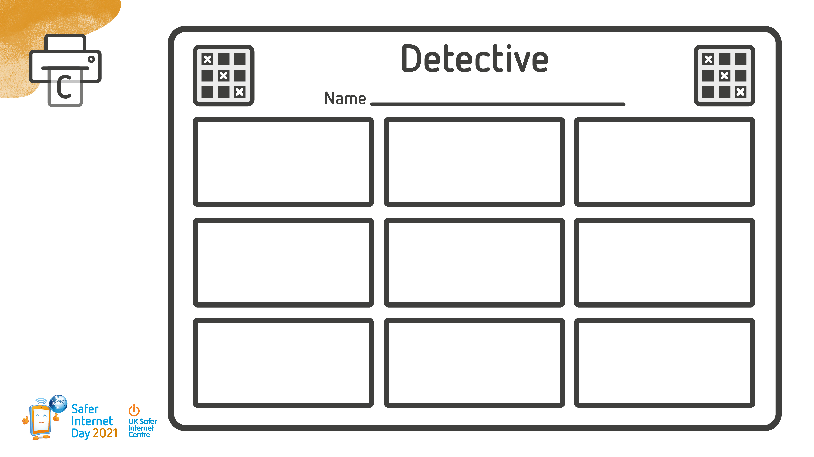
Find a fact you didn’t know before (Remember to make sure it’s reliable!)
Think about how being online is making you feel and tell someone you trust
Check 3 sources to see if something is reliable/true
Find an article or video online where a person is giving their opinion
Share something useful online to friends/family
Use a search engine and spot the sponsored results
Spend some time researching a topic you’re interested in with an adult you trust
Laugh out loud at something online
Find an image which has been edited
Notes:
This is your record sheet for the ‘Internet Detective’ activity.

