Slide 1
Friday 5th March 2021
DT

Slide 2
Recap - The focus for this half term is DT.
Over the next couple of weeks we are going to be to be learning…
Cooking and Nutrition – focussing on these strands
use the basic principles of a healthy and varied diet to prepare dishes
understand where food comes from.

Slide 3
Can you remember what our topic for this half term is?
Can you discuss your learning from last week – looking at Iqaluit and why the fishing industry is important to them.

Slide 4
Today we are going to be focussing on living in opposite climates…
What is a climate?

Slide 5
Today we are going to be focussing on the North of England Vs North of Australia…
What is the climate like in the North of England?
What is the climate like in the North of Australia?
Discuss with an adult…. Can you explain why?

Slide 6
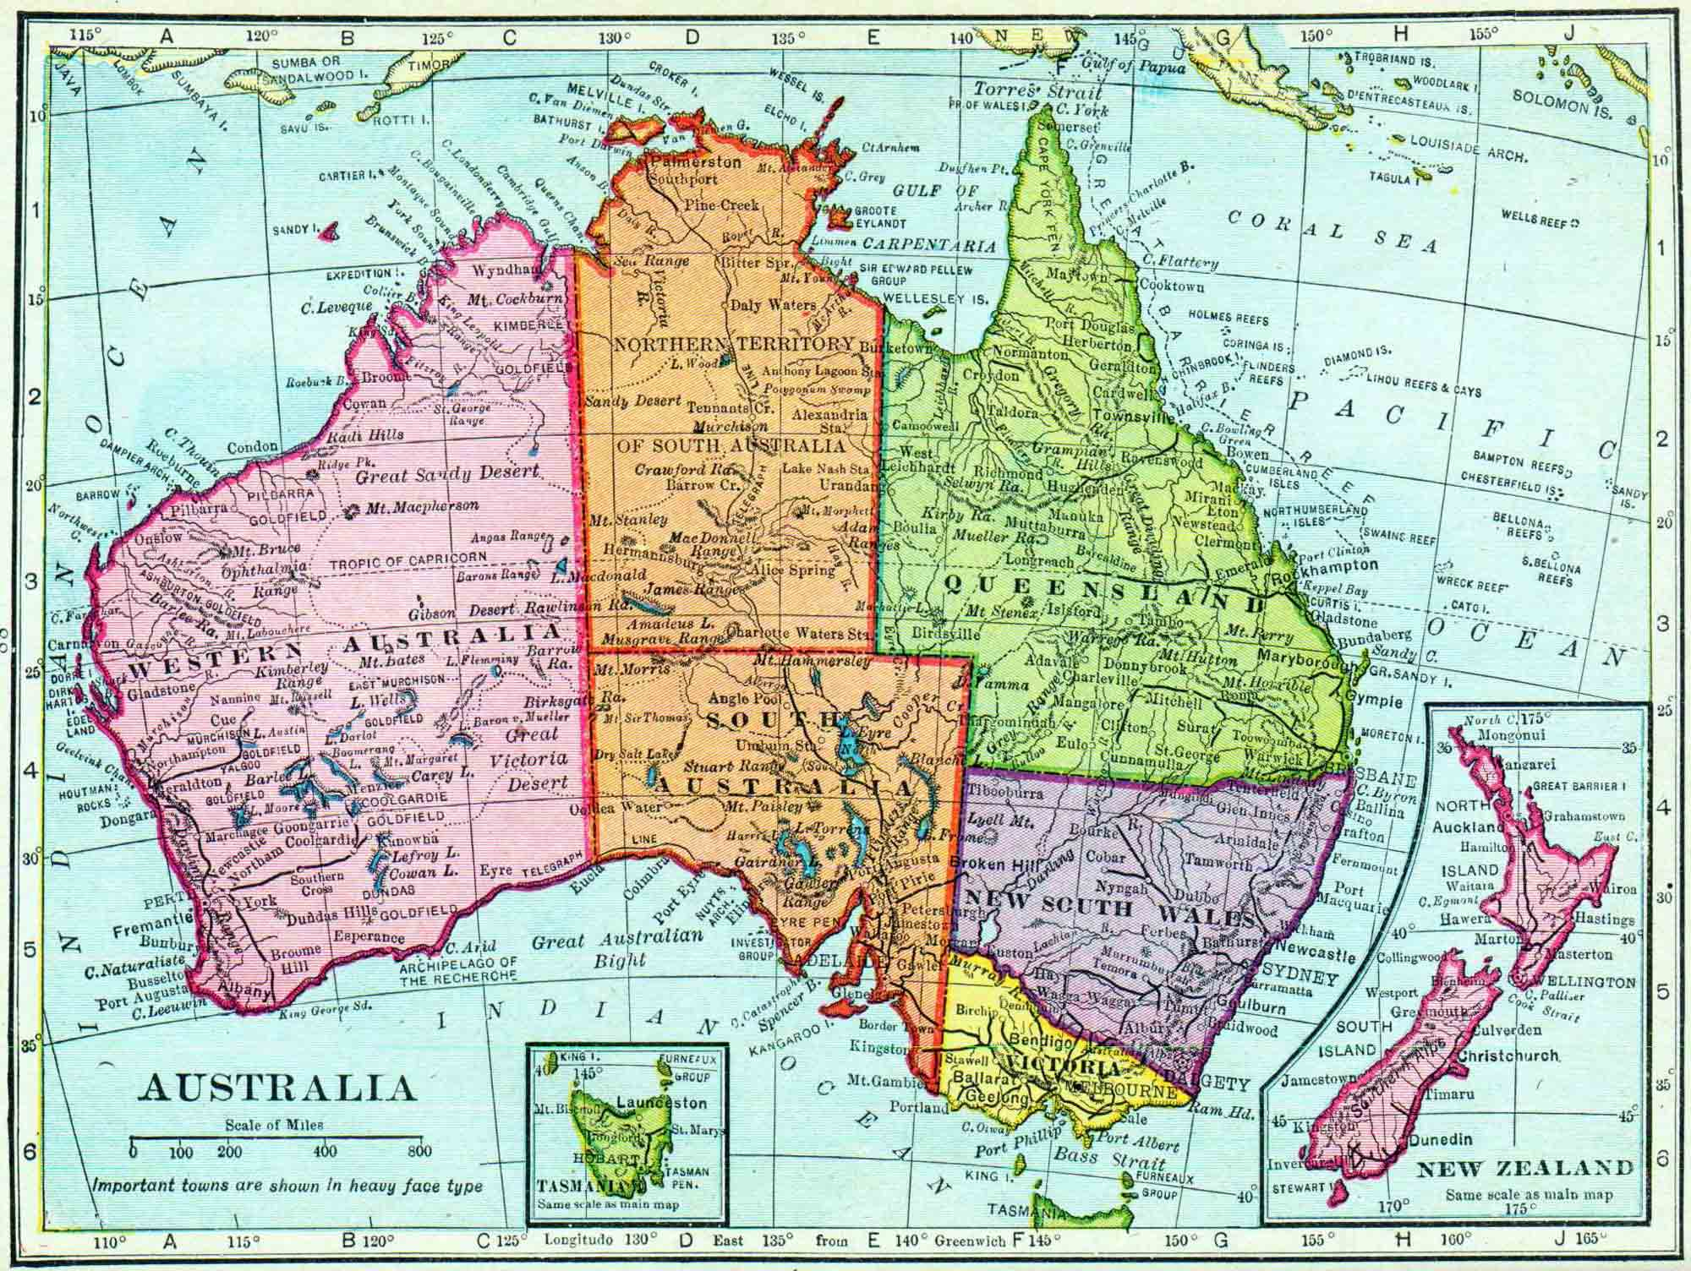
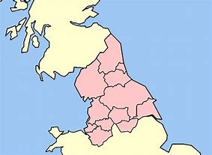
North of England
North of Australia

Slide 7
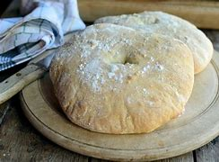
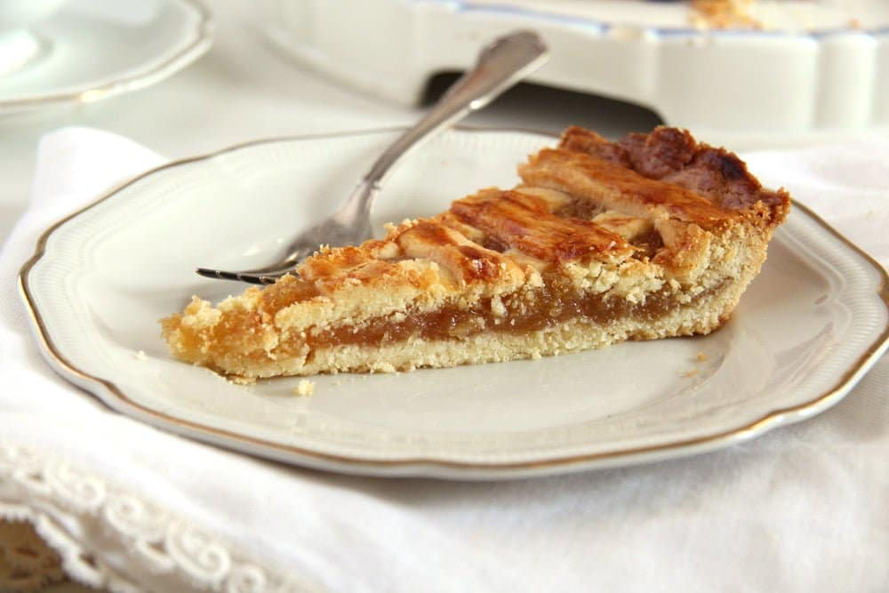
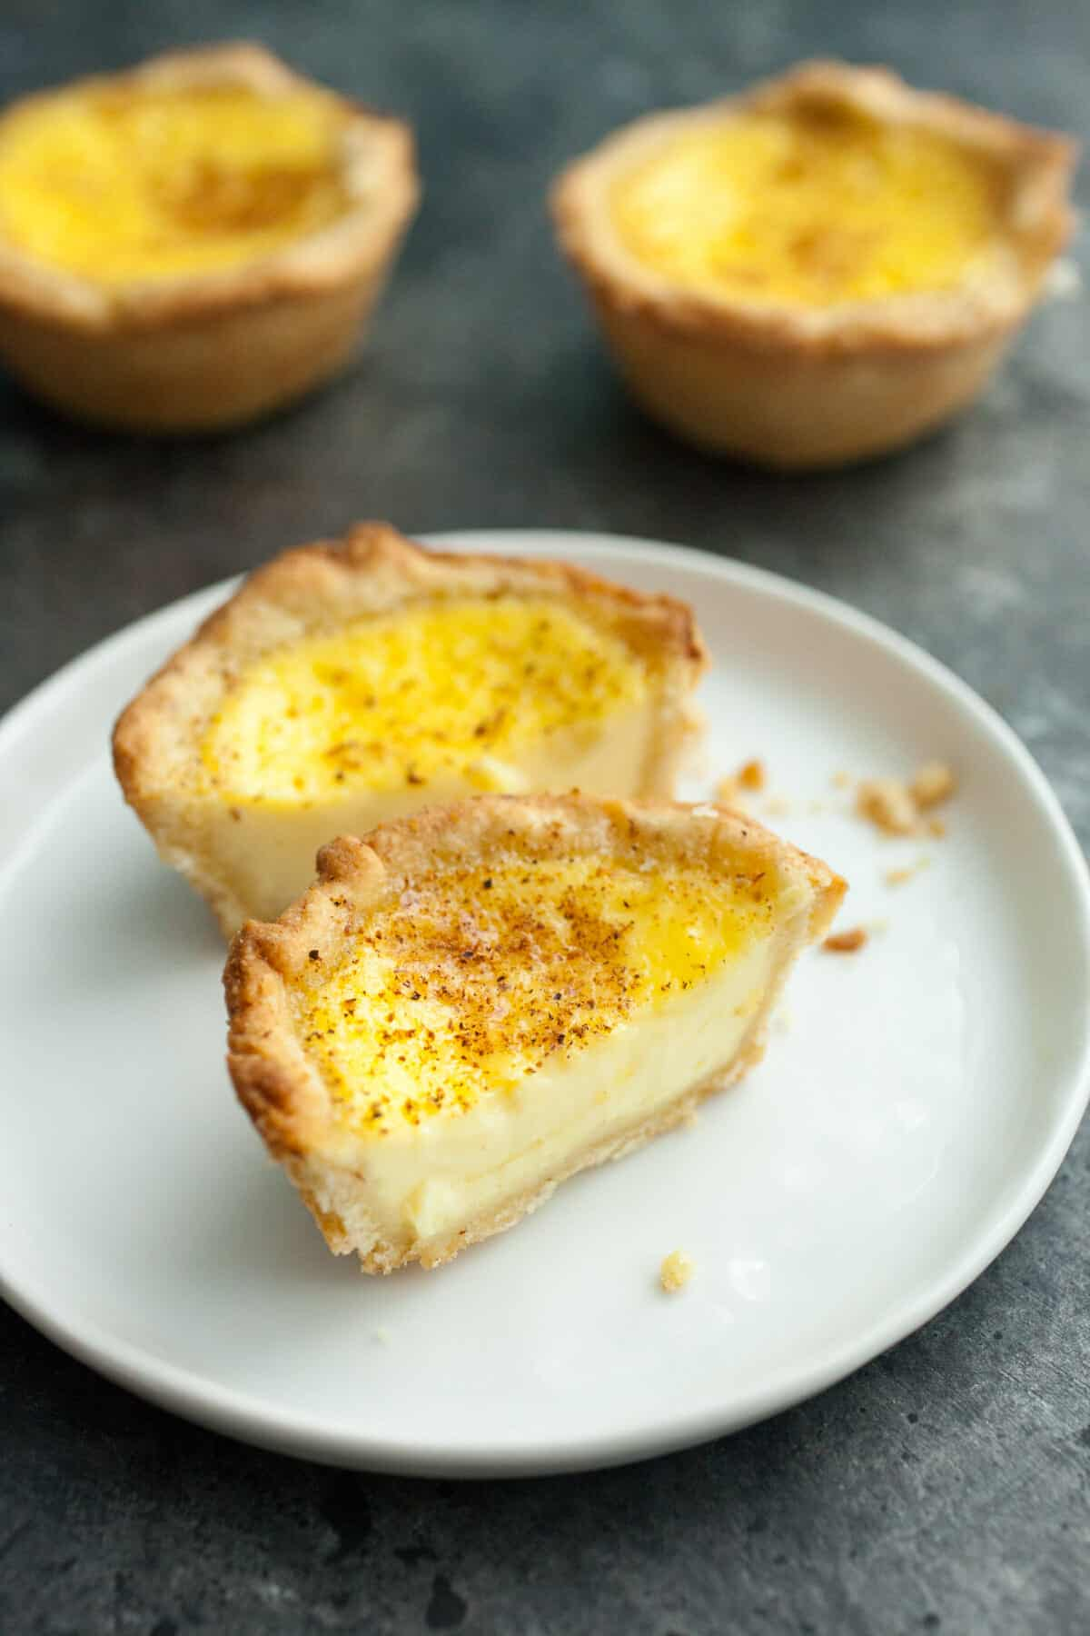
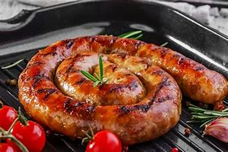
North of England….
The climate in the area tends to be cold, and many of traditional North England dishes are made from inexpensive ingredients which grow well and last in cold weather.
How do we cook foods in England? What is the most traditional way?
Here are some traditional foods that come from the North of England…
Stottie Cake
Treacle Tart
Cumberland Sausage
Egg Custards
Curd is a type of cheese, and the north of England is known for its fine dairy products.

