Slide 1
Friday 26th February 2021
DT

Slide 2
The focus for this half term is DT.
Over the next couple of weeks we are going to be to be learning…
Cooking and Nutrition – focussing on these strands
use the basic principles of a healthy and varied diet to prepare dishes
understand where food comes from.

Slide 3
This half term we are looking at the topic ‘Islands’….
What do you know about Islands?
Can you research some facts about different Islands?

Slide 4
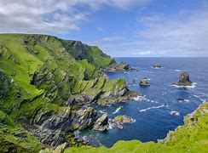
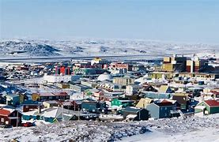
Today we are going to be focussing on living in remote places…
Shetland Islands Iqaluit

Slide 5
Today we are going to be focussing on Iqaluit….
The name Iqaluit translates as ‘the place of many fish’ and fishing is a big industry here.
Can you research some pictures of Iqaluit?

Slide 6
What do you think the climate is like in Iqaluit?
Discuss with an adult…. Can you explain why?
The weather is extremely different to the weather in Shetland, for eight months of the year the average temperature is below freezing.

Slide 7
Task: Iqaluit is known as the fishing industry…
Write a short paragraph explaining….
How do climate affect this?
How does this affect the food produce?
Challenge:Can you research some other traditional foods from Iqaluit? Can you make a poster of pictures of the different traditional foods?

