Slide 1

Friday 12th February
Writing a Formal Letter
Learning objective: Today I am learning to write a formal letter.
Success Criteria: I know I will be successful if – I can include the features of a formal letter I can include neat, joined handwriting I can include correct use of CL and P

Slide 2
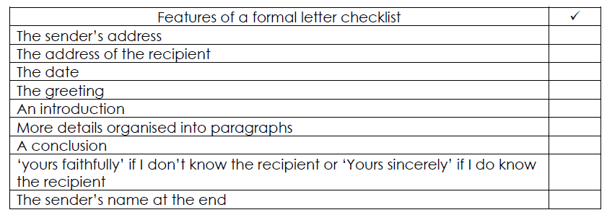
Yesterday we learnt about the features of a formal letter. Today we will have a go at writing our own letter.
So, lets quickly remind ourselves of the features…

Slide 3
Task
I would like you to write a letter to one of your school friends who is working at school or at home.
In the letter I would like you to tell your friend all about what you have been learning during the Lockdown and the things you enjoyed the most.
You could also write about some of the things you are looking forward to doing when we are all back together after the Lockdown.
Remember to include all of the features of a formal letter as well as neat joined handwriting and correct CL and P.
If you are working at home at the moment we would really like it if you could upload your finished letter onto Class Dojo Class Story. We will do the same in school.
This way we can all share in each others work and have a good old catch up!
I really look forward to hearing from you all and can’t wait to see your finished letters.

