Slide 1

Friday 5th February
The Resolution
Learning objective: Today I am using my story mountain to write the Resolution.
Success Criteria: I know I will be successful if – I can continue the Resolution paragraph of my story. I can include a 3 ed Sentence in my paragraph

Slide 2
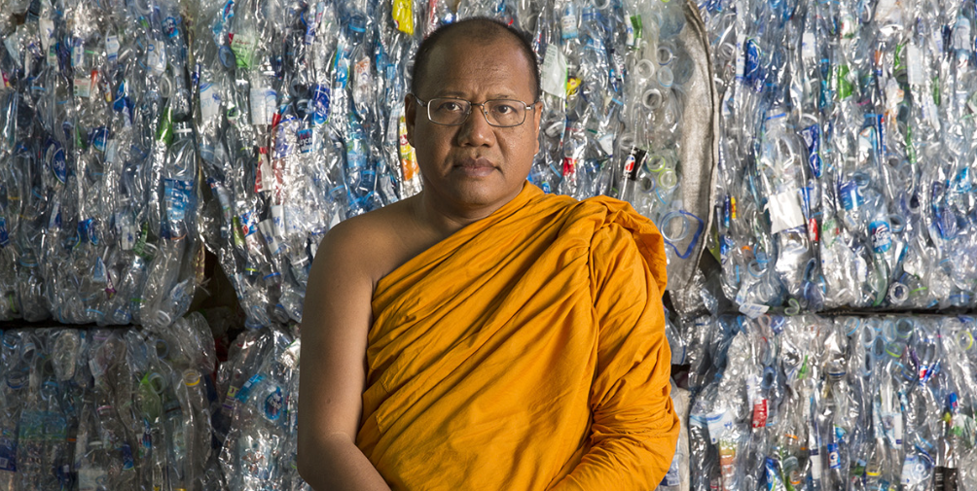
From Waste to Robes
Yesterday we wrote the Problem paragraph to our story.
Today we are going to write the Resolution.
https://climateheroes.org/from-waste-to-robes%e2%80%8b/

Slide 3
Today we will introduce the Resolution to our readers.
The resolution is the part of the story where the problem is solved.
In our story this could be when Phra Mahapranom Dhammalangaro learned that PET plastics could be recycled into fabrics.
Nobody believed him at first so he had to convince them. Then the monks announced that anyone who wanted to throw plastic bottles away could instead donate them to the temple.
The temple workers would compress the bottles into bales, ship them off to a factory to be crushed and then made into fibres.
The fibres were then sent off to be made into fabrics which were transformed into robes by the monks and workers back at the temple using sewing machines.

Slide 4
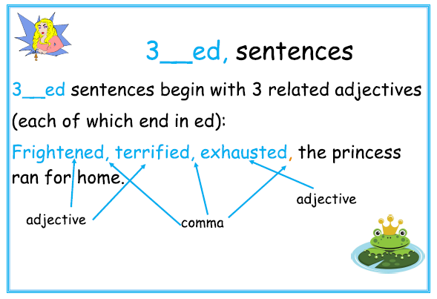
We need to continue to make our paragraph interesting for the reader, so today I would like you to include a 3 ed Sentence in your writing.
What is a 3 ed’ Sentence?
That’s correct, a 3 ed Sentence is another form of descriptive sentence.

Slide 5
Starter
Can you rewrite the following sentences as 3 ed Sentences?
Phra Mahapranom Dhammalangaro came up with a plan.
The villagers and the monks worked to transform the fabric into robes.
Think about ‘how’ Phra Mahapranom Dhammalangaro came up with his plan and ‘how’ the villagers and monks might have been working at their sewing machines.
You can use the ‘Adjectives’ page of the Year 3 English pack we have sent you to help you or you can come you with some of your own ‘ed’ adjectives.

Slide 6
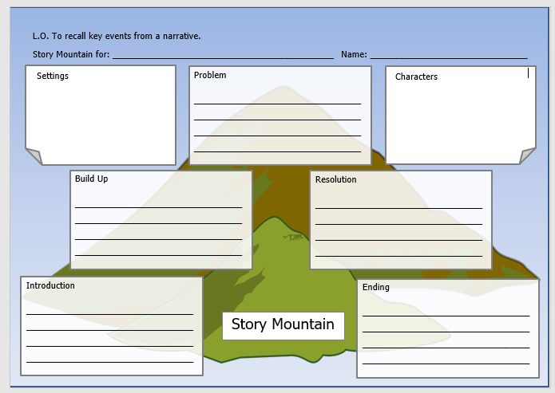
TASK
Today your task is to write the next section of our story – the Resolution.
Use your planning on your story mountain to help you.
You must include a 3 ed Sentence at least once in your Resolution.
As always, remember to include correct CL and P where appropriate.

