Slide 1
Monday 8th February
The Ending.
Learning objective: Today I am using my planning to compete my ending.
Success Criteria: I know I will be successful if – I can finish the ending of my story. I can include a Simile Sentence in my paragraph.

Slide 2
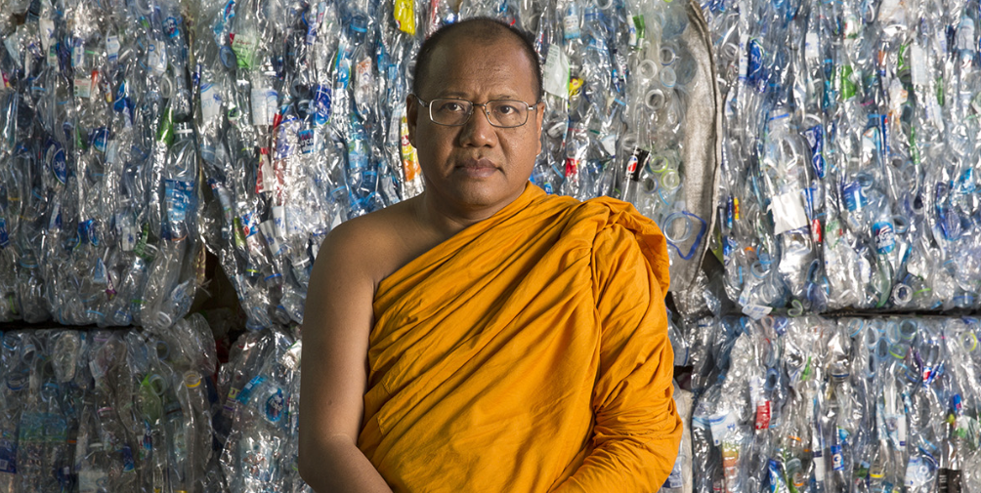
From Waste to Robes
Yesterday we wrote the Resolution paragraph to our story.
Today we are going to write the Ending.
https://climateheroes.org/from-waste-to-robes%e2%80%8b/

Slide 3
Today we will introduce the Ending to our readers.
The Ending is the conclusion to the story. Now that the problem has been solved, what has the character(s) learned? What is life like now, and what about the future?
In our story this could be that we discover that his is in fact not the end of the story! That there is now a whole recycling process. When the robes are tired and worn they are recycled into bedsheets. When the bedsheets are tired and worn they are used to clean the table and chairs. When the cleaning cloths are tired and worn they are mixed with clay to plaster the monk’s living quarters.
We also learn that Thailand is the sixth biggest source of plastic pollution in the world and because of the monk’s work, the Government has got involved and has asked the fisherman to help. Every year in December, the temple hosts a Big Cleaning Day, an event where everyone helps to collect litter form the river.
The future is looking much brighter.

Slide 4
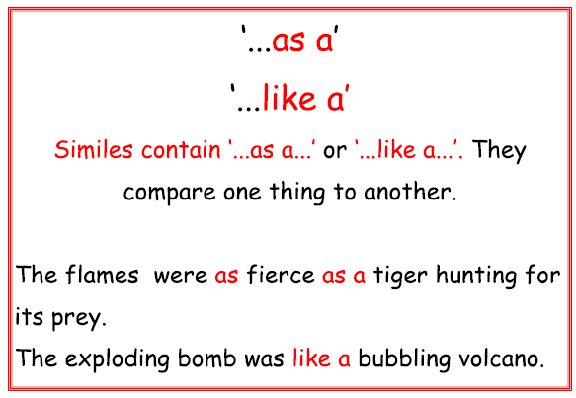
We need to continue to make our paragraph interesting for the reader, so today I would like you to include a Simile Sentence in your writing.
What is a Simile Sentence?
That’s correct, a Simile Sentence is a sentence that compares one thing to another.

Slide 5
Starter
Complete the following Simile Sentences?
The fishermen collected plastic as quickly as a….
The villagers and the monks worked to transform the fabric into robes like a...

Slide 6
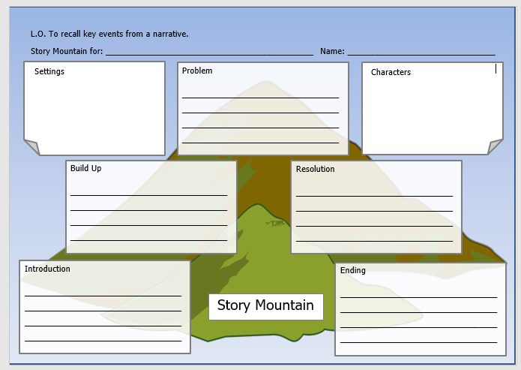
TASK
Today your task is to write the next section of our story – the Ending.
Use your planning on your story mountain to help you.
You must include a Simile Sentence at least once in your Ending.
As always, remember to include correct CL and P where appropriate.

