Slide 1
Monday 1st February
Story Mountain
Learning objective: Today I am learning to plan my own story.
Success Criteria: I know I will be successful if – I can understand what a story mountain is and how to use one I can read and research about the new story I can use the new story to compete each section of the story mountain

Slide 2
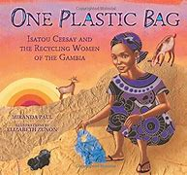

What did you find most inspiring about this story?
What would you say were Isatou’s strengths?
What would you say were the strengths of the community portrayed?

Slide 3
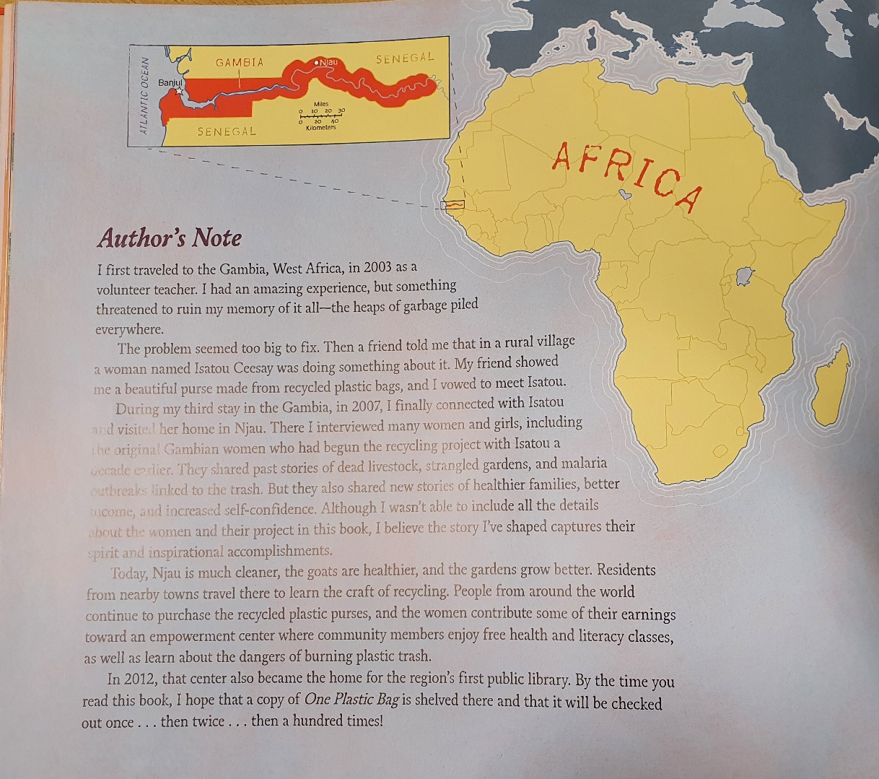
Read the author’s note…
What do you think?

Slide 4
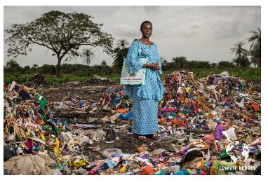
Watch this clip.
This is Isatou Ceesay sharing her journey in her own words…
https://vimeo.com/144419980

Slide 5
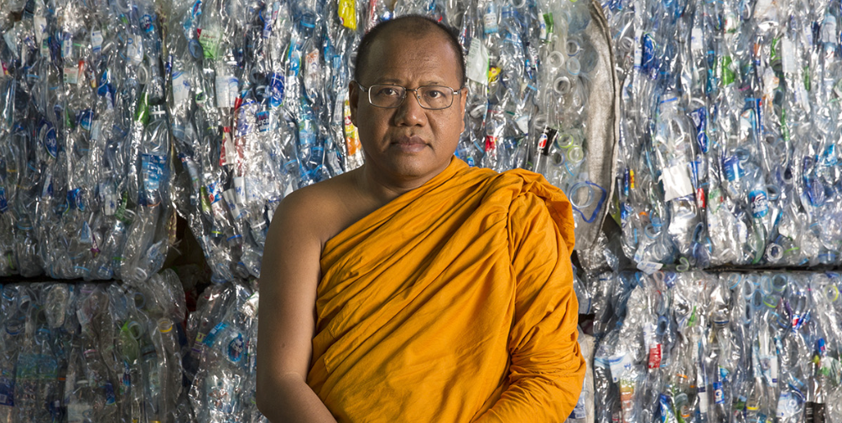
Now I’d like you to watch this video and read the information on the website for the following person, as we will be using him as inspiration to write our own story based on the book One Plastic Bag.
https://climateheroes.org/from-waste-to-robes%e2%80%8b/

Slide 6
From Waste to Robes.
What is similar in this story to One Plastic Bag?
What is different?
Who is the main character in the new story?
Where is the new story set?
What is the problem or issue in the new story?
How is the problem overcome?
How does the new story end?

Slide 7
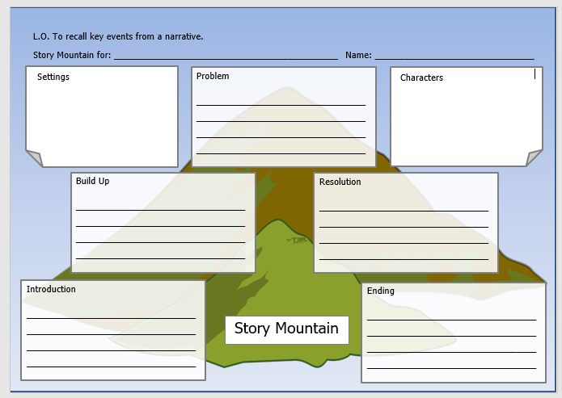
Before we write our own story, we need to plan it.
To help us to do this we will use a story mountain.
A story mountain is a tool we use to set out the different parts of the story, setting and character(s).
We need to fill in each section using notes or brief sentences which we can then use to write our story.

Slide 8
TASK
Today your task is to complete each section of the Story Mountain. Read the
text from the website and watch the video to help.
Remember, we are not looking for full sentences at this stage, just key words
and phrases which will prompt you when you come to write up your story in full.
Complete one section at a time.
I have completed the first few sections to give you an idea of what we are
expecting. (next slide)
As always, remember to include correct CL and P where appropriate.

Slide 9
