Slide 1

Thursday 28th January
Persuasive writing
Learning objective: Today I am learning to produce an advert for my product
Success Criteria: I know I will be successful if - I can include a hook to engage the reader I can include lots of persuasive vocabulary I can include the features of an advert

Slide 2
Today you will produce your own advert for the product you designed made from
re-used plastic.
Remember to refer to your plan from yesterday.
What must your advert include to make it a great advert?

Slide 3
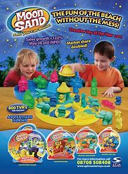
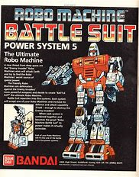
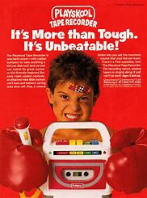
Here are some adverts for you to consider.
What do you think? Can you spot any of the features we discussed yesterday?
Can you do better?

Slide 4
Today’s challenge is to produce an amazing advert for the product you have designed.
Remember, it must include a hook, amazing, persuasive vocabulary and all of the features of an advert for it to be amazing.
Remember to refer to your planning sheet.
Good luck!!

