Slide 1

Thursday 4th February
The Problem
Learning objective: Today I am using my story mountain to write the Problem.
Success Criteria: I know I will be successful if – I can continue the Problem paragraph of my story. I can include a Double ‘ly’ Sentence in my paragraph.

Slide 2
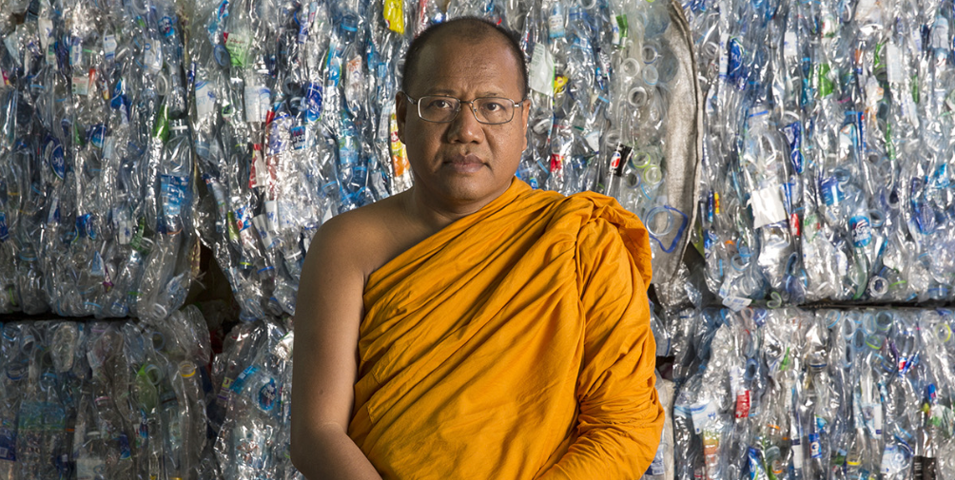
From Waste to Robes
Yesterday we wrote the Build Up paragraph to our story.
Today we are going to write the Problem.
https://climateheroes.org/from-waste-to-robes%e2%80%8b/

Slide 3
Today we will introduce the Problem to our readers.
The Problem is something that is causing trouble for one or more of the characters.
In our story this could be that fish have died, turtles died and Dugongs have died, all as a result of plastic being thrown into the river and being swept out to sea. Another issue is that when the plastic is being burned it creates a lot of pollution both in the air and in the water.
We need to continue to make our paragraph interesting for the reader, so today I would like you to include a Double ‘ly’ Sentence in your writing.
What is a Double ‘ly’ Sentence?
That’s correct, a Double ‘ly’ Sentence is another form of descriptive sentence. It has two ‘ly’ adverbs after the verb. The ’ly’ words can be at the beginning or the end of the sentence.

Slide 4
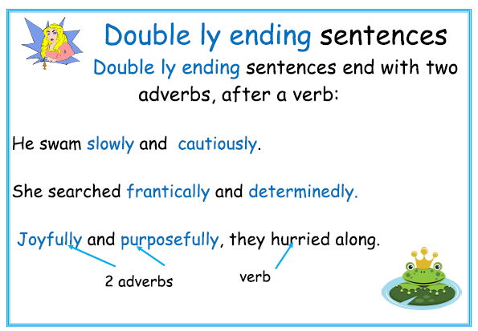

Slide 5
Starter
Can you rewrite the following sentences as Double ‘ly’ Sentences?
People threw their rubbish into the river.
Phra Mahapranom Dhammalangaro thought about the problem.
Think about ‘how’ the people might throw their rubbish and ‘how’ might Phra Mahapranom Dhammalangaro have been thinking.

Slide 6
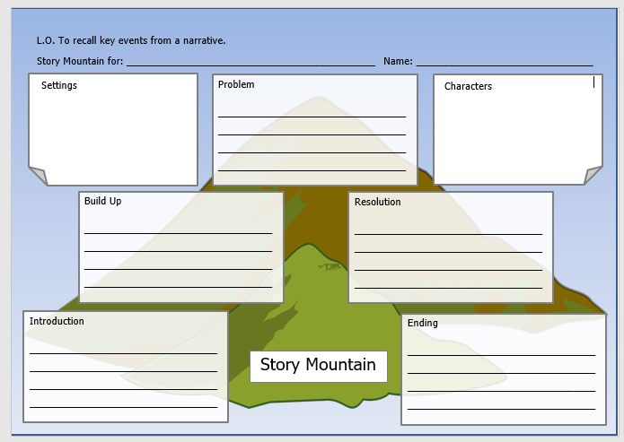
TASK
Today your task is to write the next section of our story – the Problem.
Use your planning on your story mountain to help you.
You must include a Double ‘ly’ Sentence at least once in your Problem.
As always, remember to include correct CL and P where appropriate.

