Slide 1
Tuesday 2nd February
Introduction
Learning objective: Today I am using my story mountain to write my Introduction.
Success Criteria: I know I will be successful if – I can introduce and describe a setting I can introduce and describe a character I can write descriptive sentences using 2A’s

Slide 2
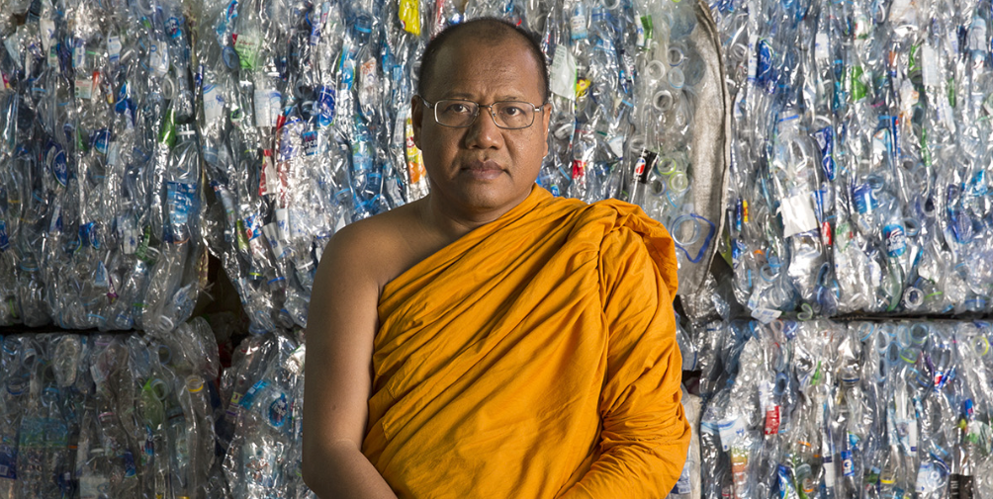
From Waste to Robes
Yesterday we learned about Phra Mahapranom Dhammalangaro and the amazing work he is doing at his temple in Thailand recycling plastic and turning it into robes for the monks, bedsheets and cleaning cloths.
https://climateheroes.org/from-waste-to-robes%e2%80%8b/

Slide 3
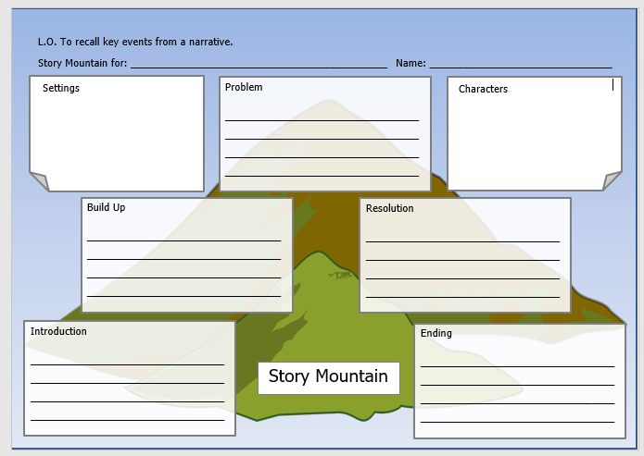
We also completed our story mountains.
Today we will use the ‘settings’, ‘characters’ and ‘introduction’ boxes to help us complete todays writing.

Slide 4
A great introduction sets the scene.
It introduces the setting and the characters of the story as well as introducing
what the story might be about.
Introducing settings and characters involves description, so today we will be focusing on describing the setting and characters as well as laying the scene for the rest of the story.
What sentence types do we know that are great for describing something?
Have a look in your English pack to see which sentence type you think will
help you today.
Did you find it? That’s correct. Today 2A sentences will help you write your
description of the setting and character.

Slide 5
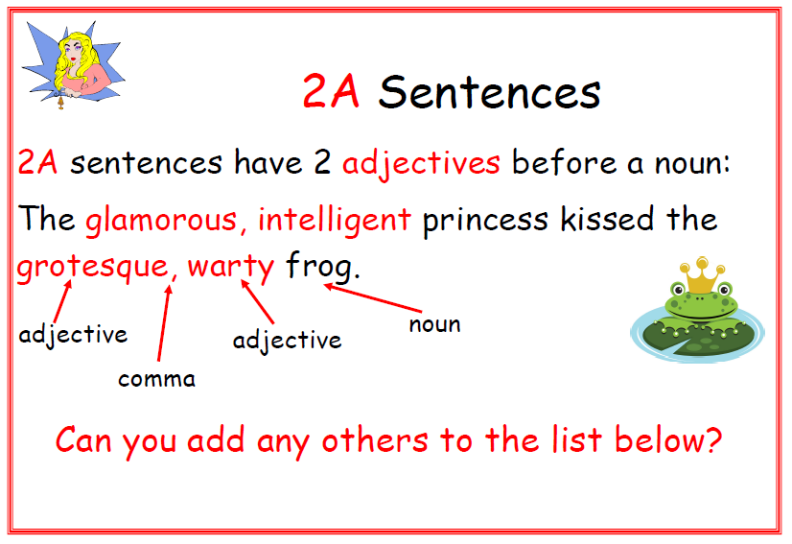
Lets recap what a 2A Sentence is…

Slide 6
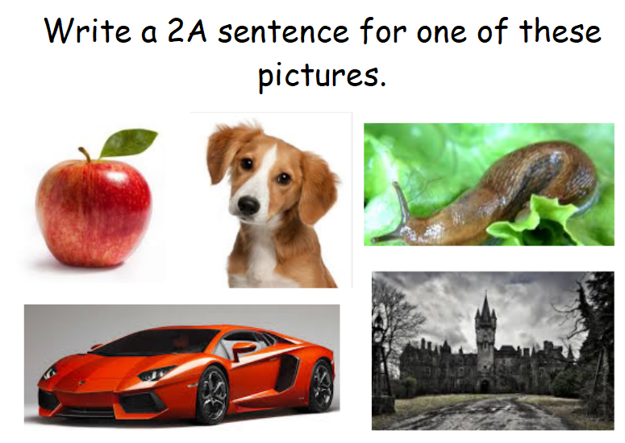
Starter

Slide 7
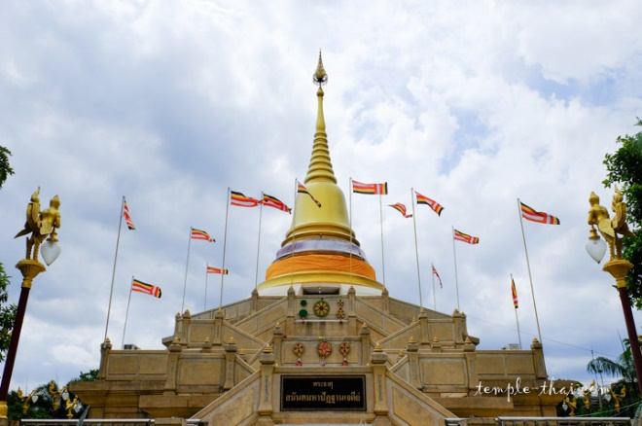
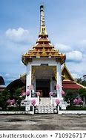
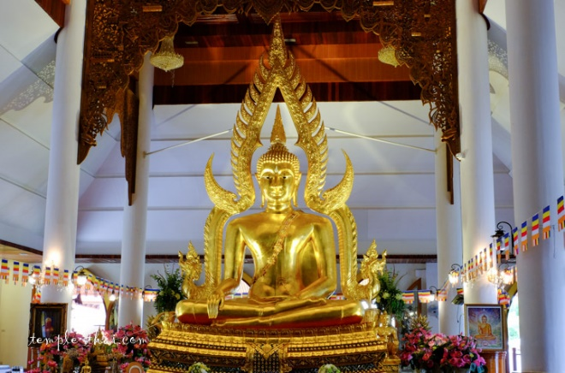
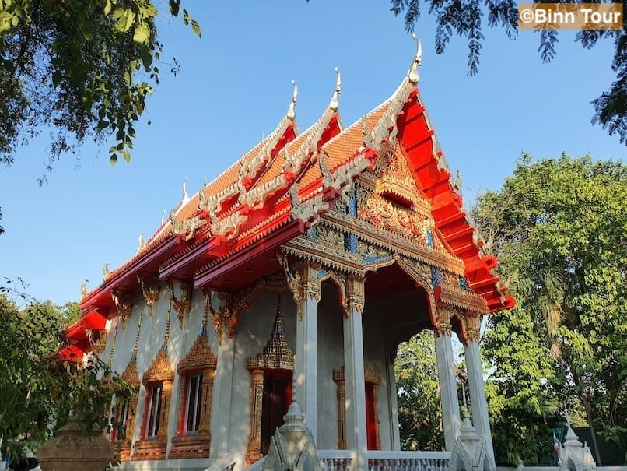
Using the pictures of the Chak Daeng Temple
as a prompt, write another 2A Sentence.

Slide 8
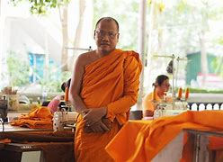
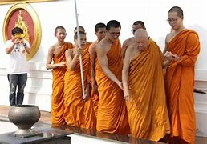
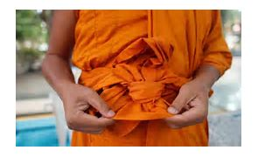
Using the pictures of Phra Mahapranom Dhammalangaro as a prompt, write another 2A Sentence.

Slide 9
TASK
Today your task is to write the opening section of our story – the introduction.
You must introduce the character, the setting and set the scene for the story.
Use your planning on your story mountain to help you.
You must include at least one 2A Sentence in your introduction.
As always, remember to include correct CL and P where appropriate.

