Slide 1
Tuesday 9th and Wednesday 10th February
From Waste to Robes.
Learning objective: Today I am using my planning to write up my story.
Success Criteria: I know I will be successful if – I can include all sections form the story mountain in my story. I can include all of the different sentence types we have covered in our planning in our story.

Slide 2
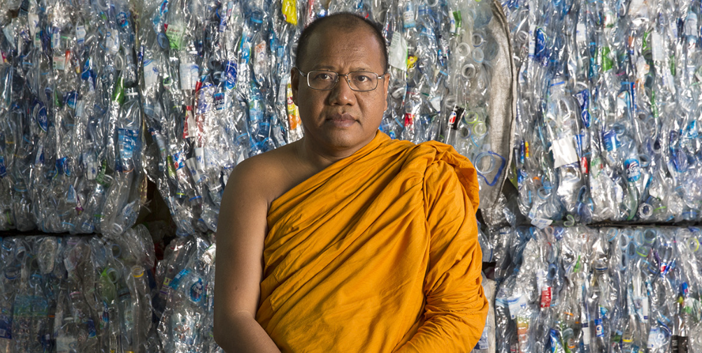
From Waste to Robes
Yesterday we finished planning our story.
Today and tomorrow we are going to use all of our planning to create our own book.
https://climateheroes.org/from-waste-to-robes%e2%80%8b/

Slide 3
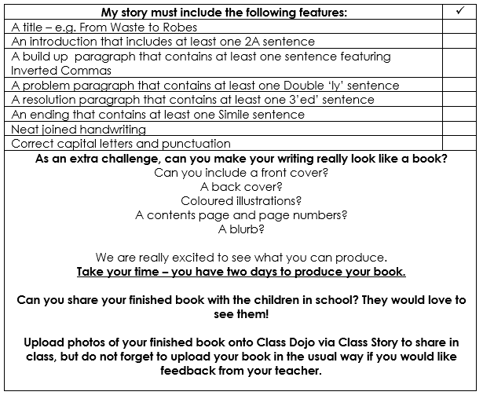
Today and tomorrow we will use all of our planning to help us create a book for our story.
Lets look at the Success Criteria and read it carefully.

Slide 4
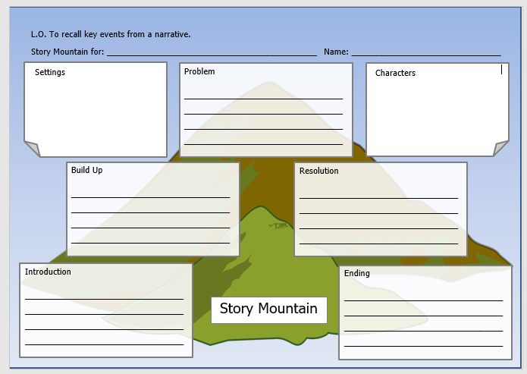
TASK
Over the course of today and tomorrow you will create your very own book!
Use the Success Criteria to see what must be included.
As an extra challenge, can you make your writing really look like a book?
Can you include a front cover?
A back cover?
Coloured illustrations?
A contents page and page numbers?
A blurb?
We are really excited to see what you can produce.
Take your time – you have two days to produce your book.
Can you share your finished book with the children in school? They would love to see them!
You can upload photos of your finished book onto Class Dojo via Class Story to share in class,
but do not forget to upload your book in the usual way if you would like feedback from your teacher.

