Slide 1
Wednesday 3rd February
Build Up
Learning objective: Today I am using my story mountain to write my Build Up.
Success Criteria: I know I will be successful if – I can continue the build up of my story. I can include inverted commas for speech

Slide 2
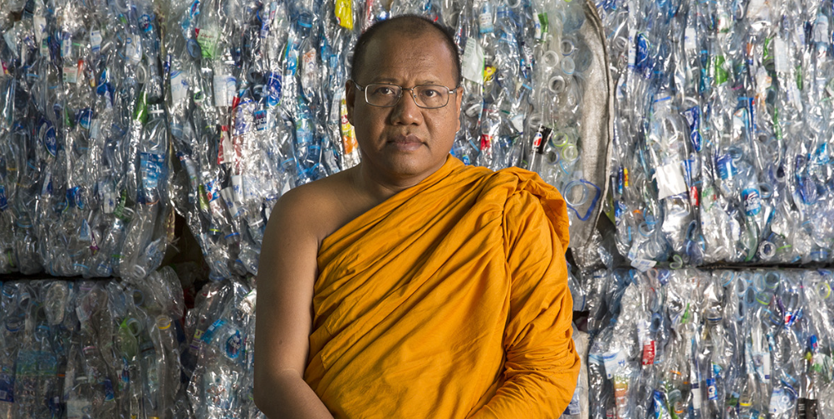
From Waste to Robes
Yesterday we wrote the introductory paragraph to our story.
Today we are going to write the build up.
https://climateheroes.org/from-waste-to-robes%e2%80%8b/

Slide 3
The build up begins to introduce the problem.
It is a small series of events that shows something is going wrong.
In our story this could be that when Phra Mahapranom Dhammalangaro
first arrived at the temple he saw that it was full of garbage and that the plastics were either burned or thrown away. People would just throw plastic in the river and forget about it.
We need to continue to make our paragraph interesting for the reader, so today I would like you to include some Inverted Commas in your writing.
What are inverted commas?
That’s correct, Inverted commas are another name for speech marks.

Slide 4
Lets recap what Inverted Commas are…
Different Names
Inverted commas can also be called:
Speech marks
Quotation marks
“ ”

Slide 5
Beginning and End
Keep your speech marks at the beginning and
the end of the words being spoken.
“Lower please!” I said.
“ ”

Slide 6
New Speaker, New Line
Start a new line whenever someone new speaks.
“How are you doing today?” asked Henry.
“I’m great!” said Ashton.
“ ”

Slide 7
Capital Letters
Begin the direct speech with a capital letter.
“What an amazing day!” he announced.
“ ”

Slide 8
Punctuation
Make sure your speech is correctly punctuated.
This includes a piece of punctuation before closing the inverted commas.
“There are times, I feel that you are a little cold,”
I said.
“ ”

Slide 9
Reporting Clause
Include in your sentences information about who is speaking and even how they are speaking. This is called the reporting clause.
“There are times, I feel that you are a little cold,” I said.
“ ”

Slide 10
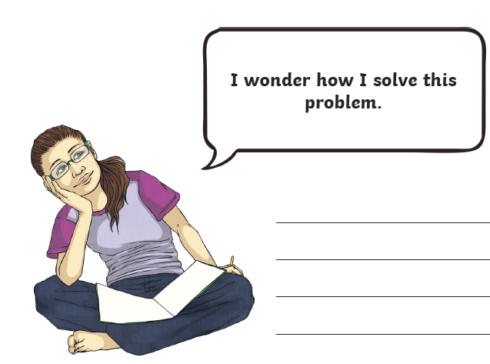
Starter
Look at the comic strip speech bubbles. Change each speech bubble into a speech sentence with inverted commas.

Slide 11
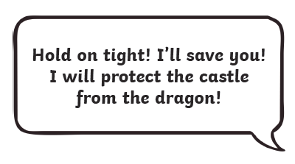
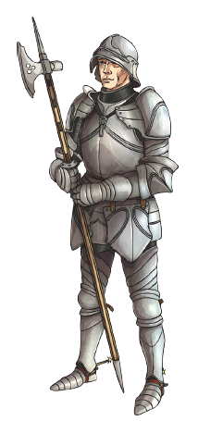
Look at the comic strip speech bubbles. Change each speech bubble into a speech sentence with inverted commas.

Slide 12
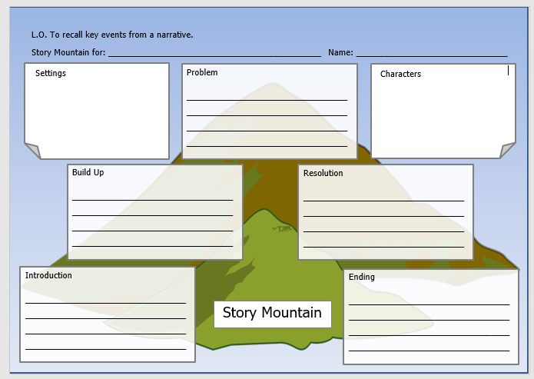
TASK
Today your task is to write the next section of our story – the Build Up.
Use your planning on your story mountain to help you.
You must include Inverted Commas at least once in your Build Up.
As always, remember to include correct CL and P where appropriate.

