Slide 1
Monday 25th January
Researching
Learning objective: Today I am learning to research and note take
Success Criteria: I know I will be successful if - I can find relevant information I can make links between my research and One Plastic Bag I can make notes of the key information

Slide 2
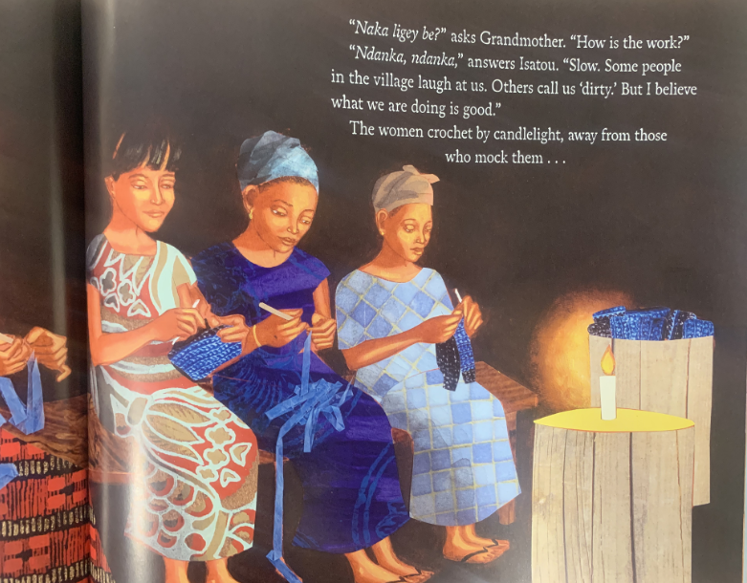
Let’s read a little more of our book…
Why might they be mocked?
Who might mock them?

Slide 3
Look at the picture carefully.
What does it show?
What can we infer from details such as the dark
background, the candle, the way in which the women
are arranged?
What might they be hoping to achieve?

Slide 4
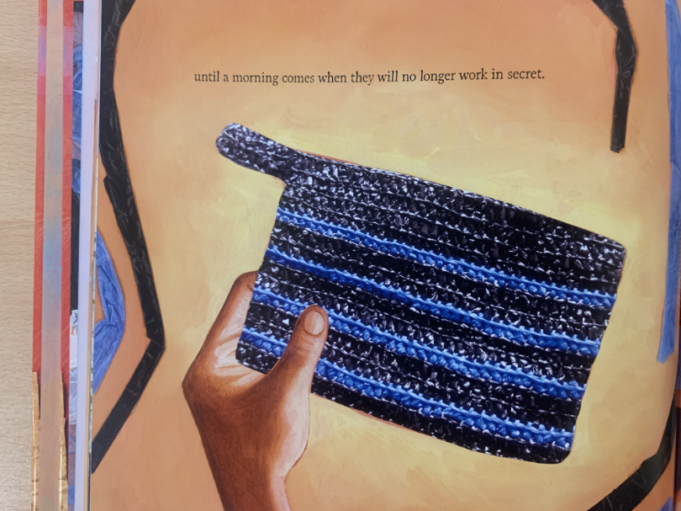
What do you notice about this picture?
How is it different to the last picture?
Think about the colour and the light.

Slide 5
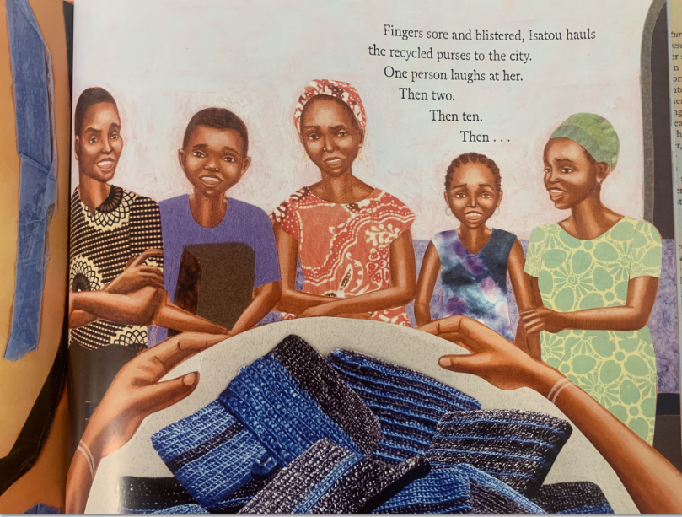
What might it
take to change their opinion about Isatou’s plan?

Slide 6
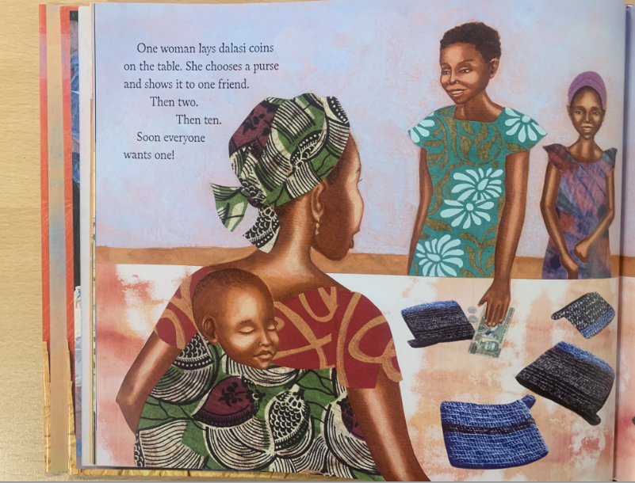
What do you notice about the picture?

Slide 7
Task
You will now research different and innovative ways that plastic has been used, recycled and repurposed in different parts of the world. Record your findings using either a list of bullet points or by using a mind map.
There are some clips below to give you some examples but you can add as many of your own ideas as you can think of!
https://www.aljazeera.com/features/2016/8/14/the-woman-turning-rubbish-into-homes-in-pakistan
http://www.aljazeera.com/programmes/earthrise/2017/05/colombia-lego-homes-170531083443884.html
https://www.onegreenplanet.org/lifestyle/beyond-plastic-10-eco-products-made-from-recycled-plastic/4/
https://www.aljazeera.com/program/episode/2013/2/5/garbage-homes-bolivia

