Slide 1
THE History of Yarm
Fact or Fiction?

Slide 2
Learning Objectives
Today we are learning to explore the life of a famous Yarm resident, Tom Brown.
Success Criteria
I will be successful if:
-I can explain what happened to Tom Brown during the Battle of Dettingen.
-I can say what honours he received.
-I can write a short fact file (non-chronological report) to describe some key facts about
Tom Brown’s life.

Slide 3
The HISTORY OF YARM: FACT OR FICTION?
On a Post-it note, write down a question that you would like to find out about Yarm.
On another Post-it note, write down one thing about Yarm’s history you think is a fact (true) and one thing you think is fiction (false.)
Let’s share these answers as a class!

Slide 4
How old is yarm?
The name of the town is thought to be derived from the Old Norse word yarum meaning an enclosure to catch fish or from the Old English gearum with the same meaning.
Yarm was first mentioned in the Domesday Book of 1086.
Bishop Skirlaw of Durham built a stone bridge, which still stands, across the Tees in 1400 .
An iron replacement was built in 1805, but it fell down in 1806.

Slide 5
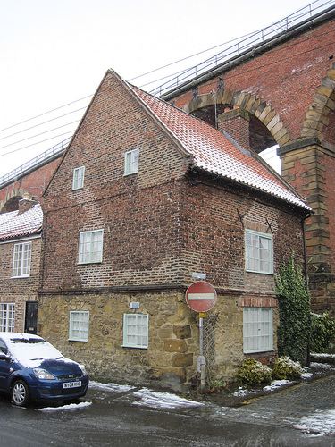
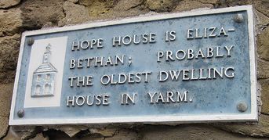
Hope HOUSE
Hope House is thought to be one of the oldest buildings in Yarm, dating from the late 16th or early 17th century.

Slide 6
Do you know anyone famous from yarm?

Slide 7
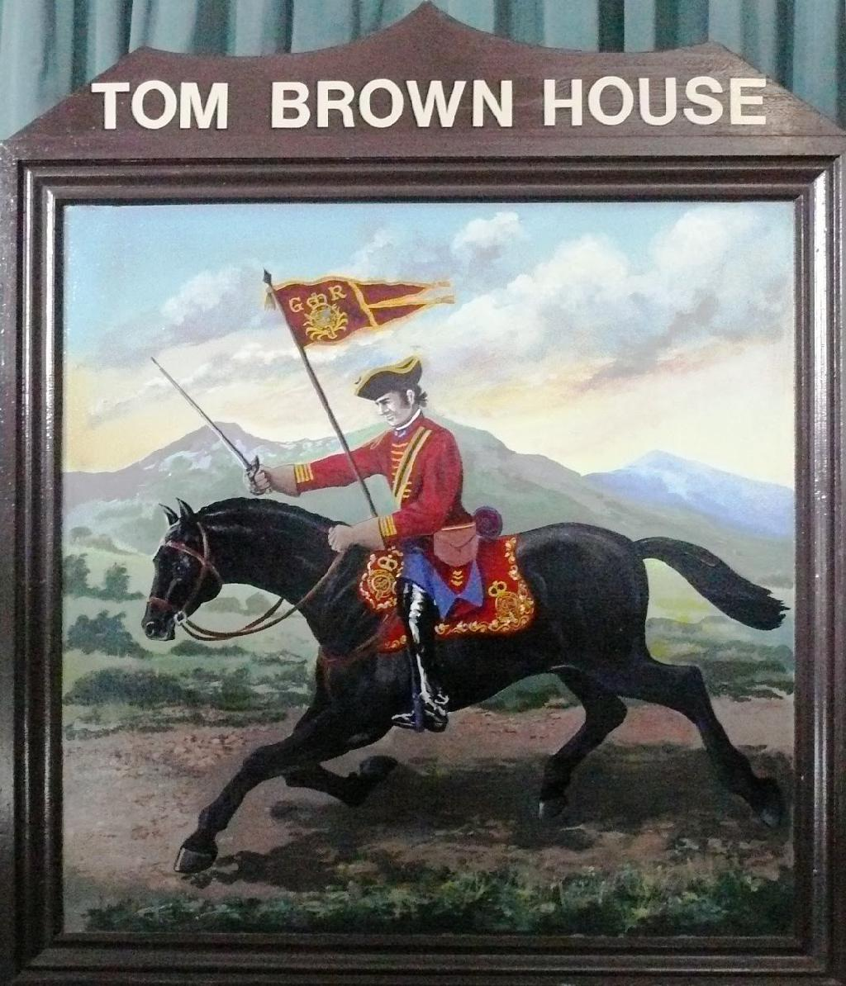
WHO WAS TOM Brown?
Why do you think he might be famous?
What do you think his job was?

Slide 8
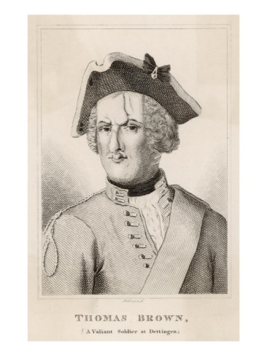
Tom brown
What do you notice about him?
Is this a photograph? Why?
Why do you think his face is as it is?

Slide 9
Tom brown
During the battle of Dettingen, a private soldier, Tom Brown of Bland's Dragoons, rescued the regiment's standard, receiving eight cuts in his face, head, and neck, as well as two bullets in his back and a cut across his forehead that went down to his right eyebrow.
Brown had two horses killed under him, and had lost two fingers from his left hand

Slide 10
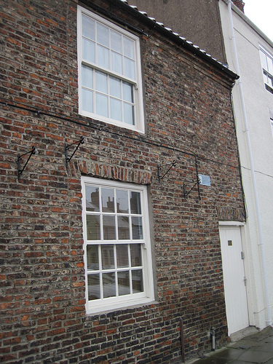
Tom brown
He is said to have been given a silver nose by King George II.
He retired to Yarm with a pension of 30 shillings from the King.
He died in Yarm in 1746.
A plaque can still be seen above the door of Tom Brown House
https://heritage.stockton.gov.uk/articles/people/thomas-brown-the-soldier-with-the-silver-nose/
https://www.gazettelive.co.uk/news/local-news/tom-browns-house-haven-history-3788561

Slide 11
Who was Tom Brown?
*Create a short fact file about Tom Brown (non-chronological report.)
*Write a short introduction introducing Tom Brown ONLY.
*Your fact file must contain at least three sections with subheadings (questions.)
*Underline your subheadings.
*It is up to you to decide on your questions (e.g. How did Tom Brown become famous?)
*Make sure you include a variety of information (not just about the Battle of Dettingen.)
*Try to put information in your own words as much as possible.
*Develop your paragraphs with your own comments and questions to the reader – this
is important so that your writing does not sound like a list!
*Use Year 5 SPaG features and sentence types from the word mats.

