Slide 1
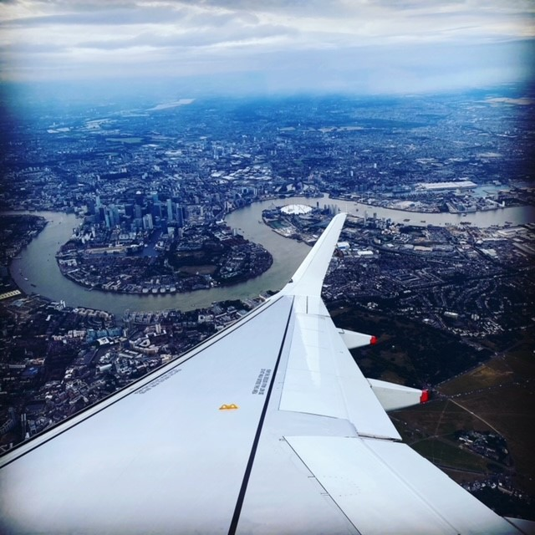
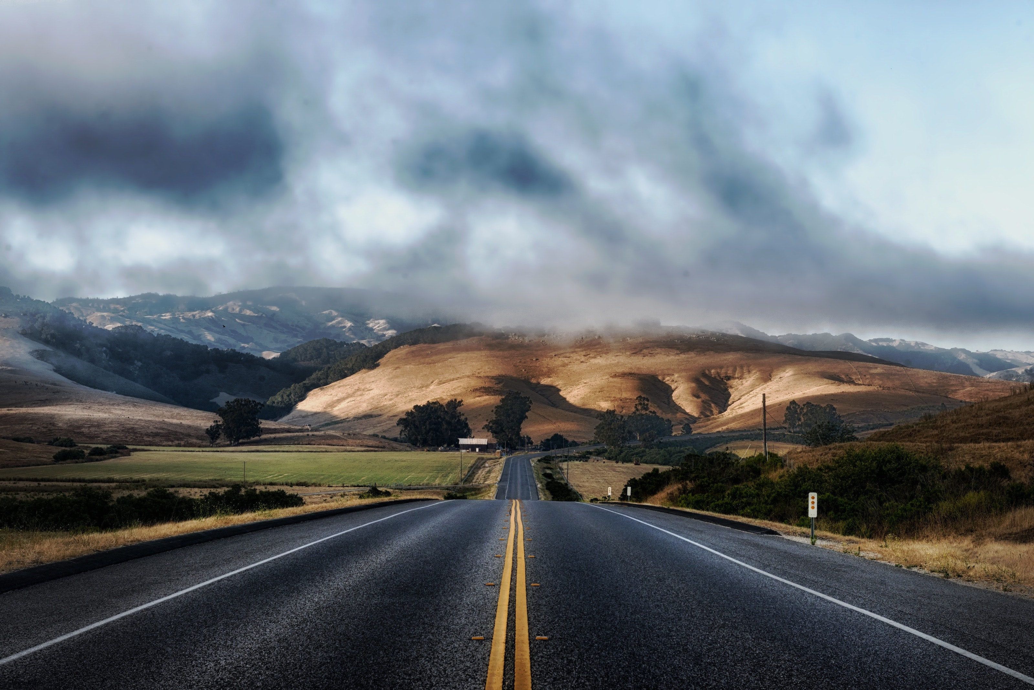
My Hobby - Travel
Can you work out where this is?
My Hobby – Travel
By Mr Painter

Slide 2
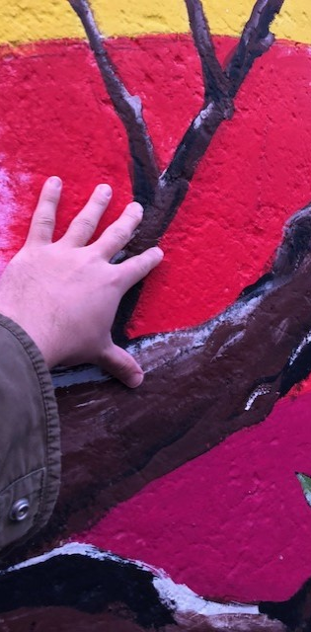
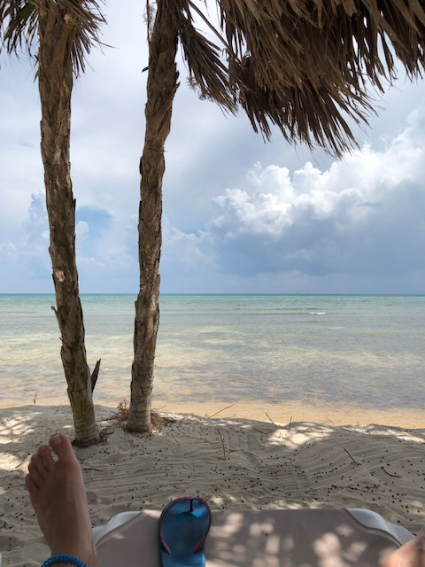
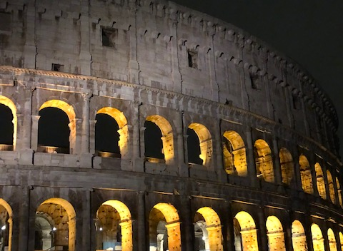
Slide title 3
I have just used a template from the ‘file’ and ‘new’ menu in PowerPoint. To add a text box, follow the same steps as last week. When adding an image, you can drag images from a file to the spaces or copy and paste into your own template. I have not added transitions for now as we will focus on this again in the future.
My favourite hobby is travelling and it all began when I was 16. I was lucky enough to visit my family in Australia and went all by myself.
With our current situation, it is the thing that I miss the most. I can’t wait to get back on a plane. Having so many pictures helps me to keep positive about the time I can go away again and has me thinking of so many places that I’d like to visit.

Slide 3
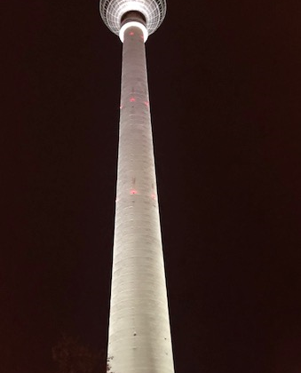
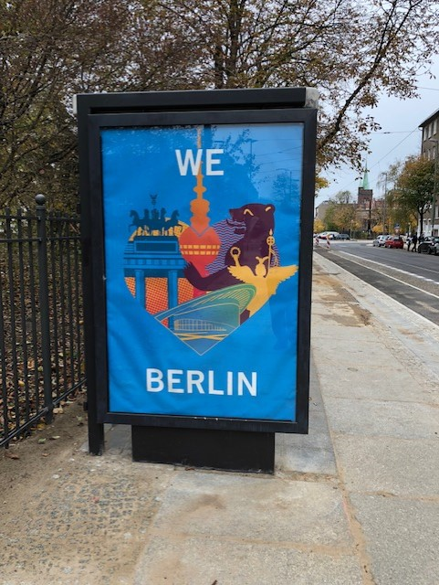
Slide title 4
History!
Here are my pictures of my favourite city – Berlin. This is the capital of Germany. I have been around 12 times! This building is the famous TV tower called the Fernsehturm!

Slide 4
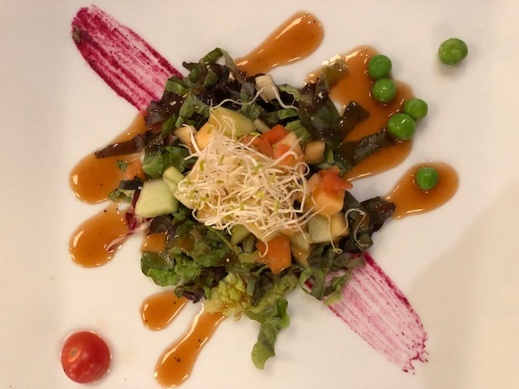
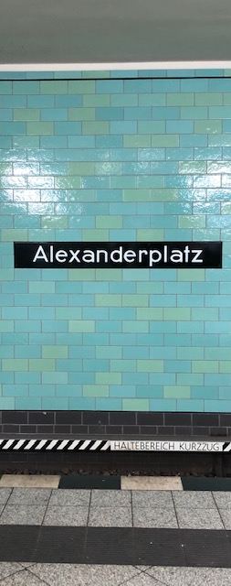

Slide title 5
Sun!
I love the sun too of course. Even though I get the worst prickly heat rash! Here are some pictures from my holiday to Mexico in 2019. Some of the food was amazing. I’m not sure what this was though. Can you think of any Mexican dishes?

Slide 5
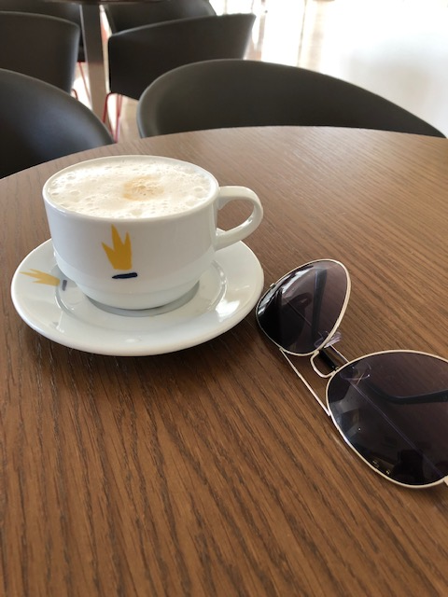
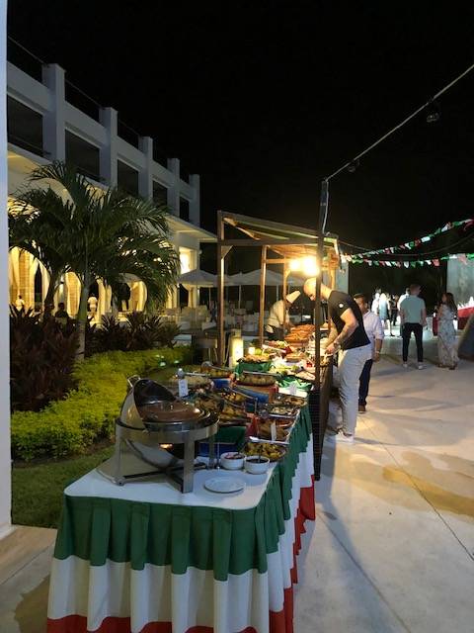
Slide title 4
Coffee!
We all know what I love the most! So I had to make sure I had lots of coffee. It was the first time I really got into iced coffee too. Just ice cubes, milk and espresso!

Slide 6
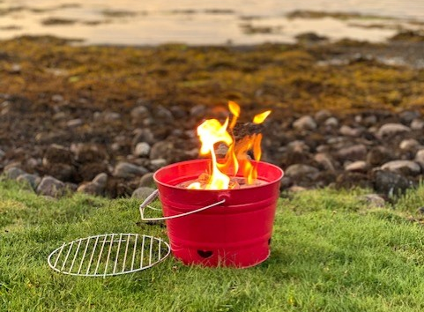
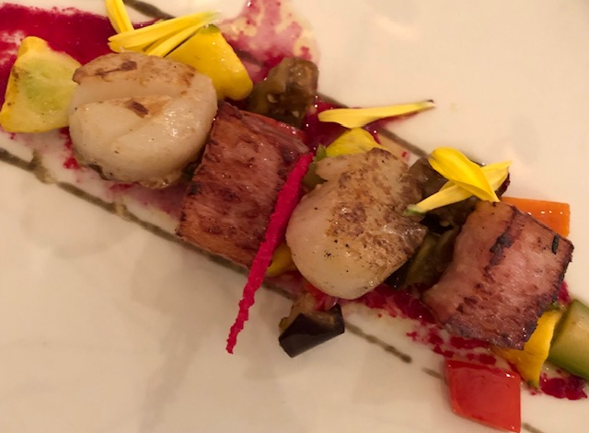
Slide title 3
Learning Objective – To use a template, text boxes and photos to create a PowerPoint about your favourite hobby!
You don’t have to attach this, you could simply take a picture or an example to show us! You can also use Keynote for Mac/iOS if you wish! You could also edit my own template to add your own photos.

