Slide 1
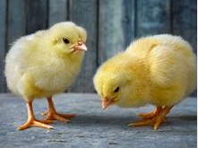
Yarm Primary
KS1 | Enquiry Question: How does a chick grow?
Subject Specific Vocabulary​ |  |  | Sticky Knowledge about
Incubator | A device which keeps eggs warm and moist while the chicks grow. | After Easter, we will be welcoming chicks into school. They will arrive as eggs and we will be able to observe them hatching and look after them for their first two weeks of life – something we are very excited about. We will focus our work on this for the first two weeks after Easter.
 |  |  | A chick takes 21 days to hatch from an egg.
​brooder | A heated box to keep newly-hatched chicks warm
 |  |  | Eggs need to be kept at the correct humidity, so the shells will not become too hard and make it difficult for the chicks to hatch. They also need to be kept at the right temperature. The incubator helps to do this.
​candling | To look at an egg with a torch in a dark room to check if there is a chick. You can actually see the chick move!
​yolk | The yellow part of the egg where the chick inside the shell gets the nutrients it needs.
pipping | Some of the shell break away when the chicks begin to hatch. |  | Chicks use a special part of their beak called an egg tooth to begin to break their shell. This is called pipping.
​Egg tooth | A special part on the top of the chick’s beak which is used to break away the shell. | ​
 |  |  | Hatching is when they finally break through the shell and emerge. The chicks are very tired.
​Embryo | The formation of the chicken in the egg up to hatching time.
humidity | The moisture in the air |  | They move into a brooder box which has light and warmth where they grow. They have food and water in here.
hatch | When the chicks finally leave the egg.
​rooster / hen | A male chicken / a female chicken |  | Hens usually lay eggs and sit on them to keep them warm. Not all eggs have chicks in – some are laid for us to eat. Yummy!

Slide 2
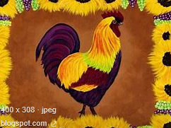
Create a poster about how to look after a chick – you will learn what you need to do at school.
Design a suitable environment for a chick to live in. Remember it needs to be secure and safe, provide shelter and warmth as well as looking great!
Create your own art work based around this piece of art.
Design and create your own chick mask. You could keep it simple, or design a new breed of chick!
Research and find how the chick grows inside the egg over the 21 days. Draw a timeline.
Share a story about a chick / hen. There are plenty to choose from – Rosie’s Walk, Little Red Hen. Write a book review and recommend to a friend.
Create a chick using 2D shapes. Can you name the shapes you will need to use? As an extra challenge, can you state their properties?
Find some recipes that use eggs. How many different ways can you enjoy an egg?

