Slide 1

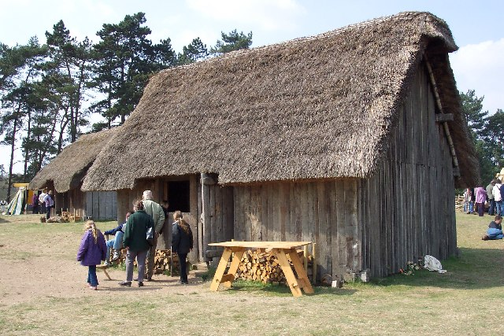


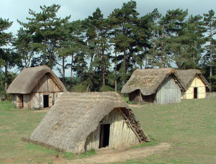
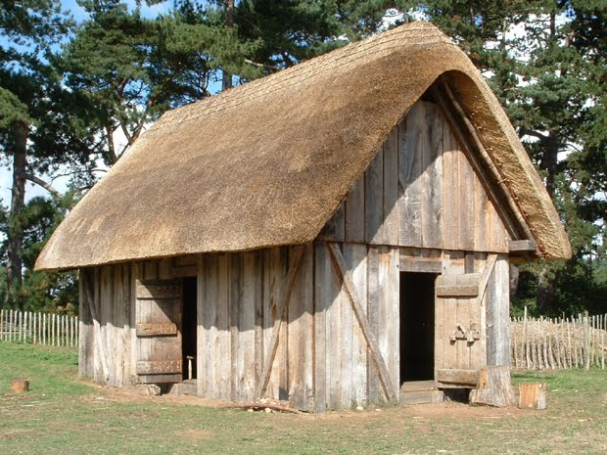
The Village
To understand where and how the Anglo-Saxons lived.

Slide 2
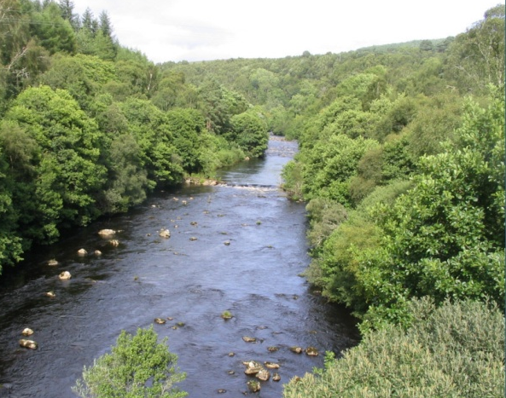
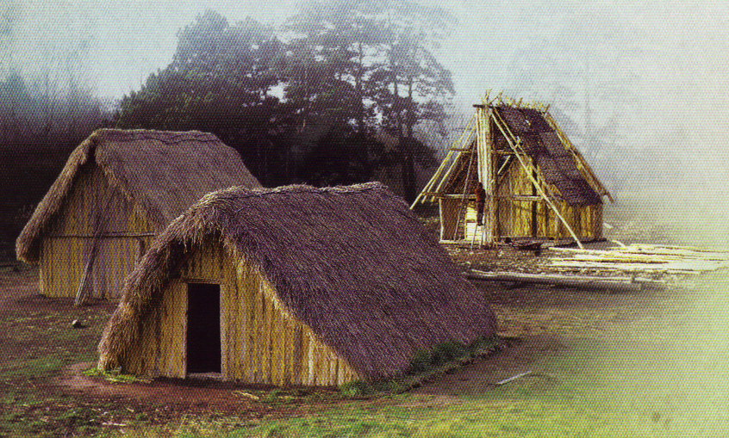
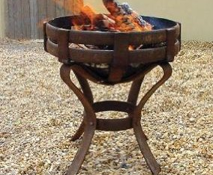
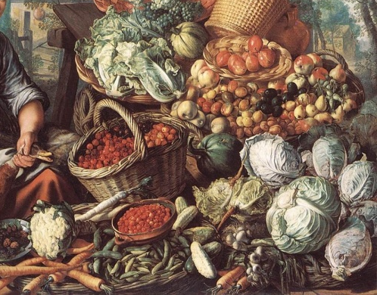
Everyday life…
Most of the Anglo-Saxon settlers lived as farmers. The villages were built near natural resources. The villagers needed food, water, fuel for heating and cooking and materials for their homes and clothes. The natural resources had to provide the villagers with what they needed to survive.

Slide 3
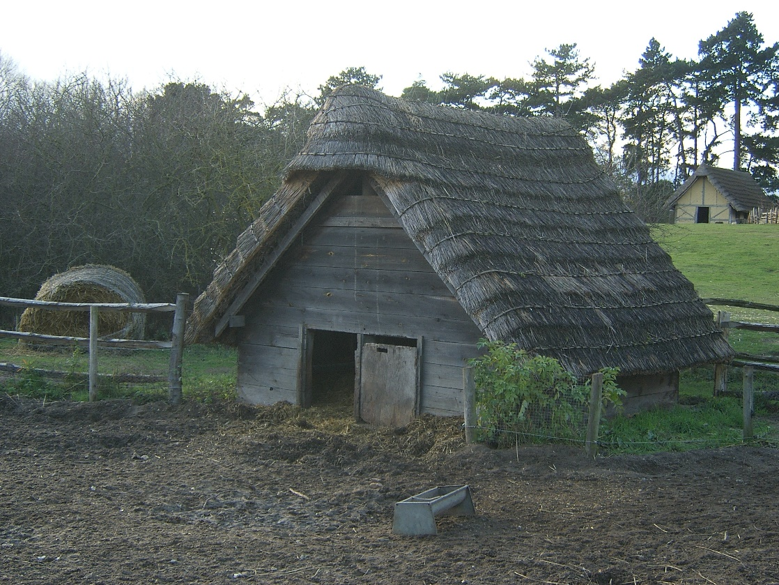
Settling Down
The Anglo-Saxons chose to live in small villages instead, which were often set up by clearing away a part of a forest.
The Anglo-Saxons lived in family houses which were built around a central hall where the village chief lived.

Slide 4
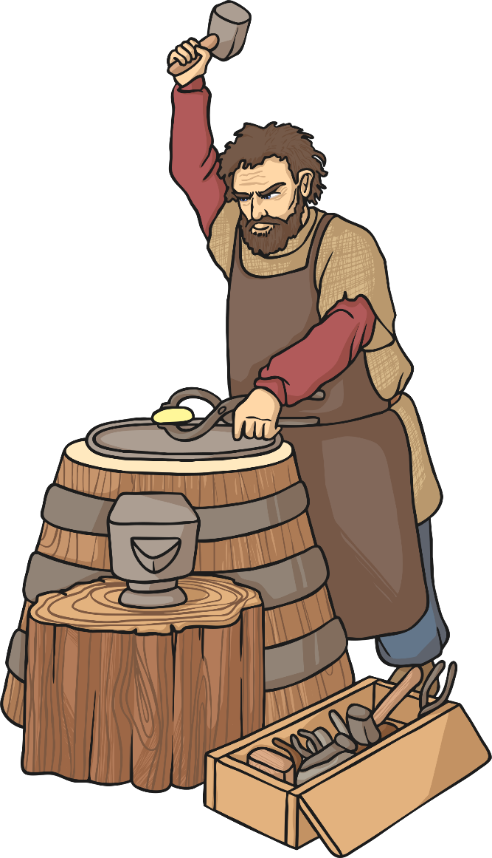
Village Jobs
Everyone who lived in an Anglo-Saxon village contributed to its running in some way.
There were a variety of every day jobs to be done including:
Clearing and ploughing the ground.
Grinding flour and making bread.
Growing crops and tending to livestock.
Some people had more specialised jobs:
Blacksmiths forged metal to make tools and weapons.
Woodworkers made bowls, wheels and furniture.
Jewellers made brooches and ornaments for the rich.
What other jobs do you think needed to be done?

Slide 5
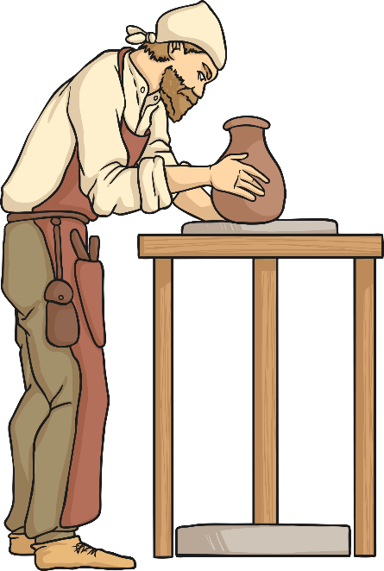
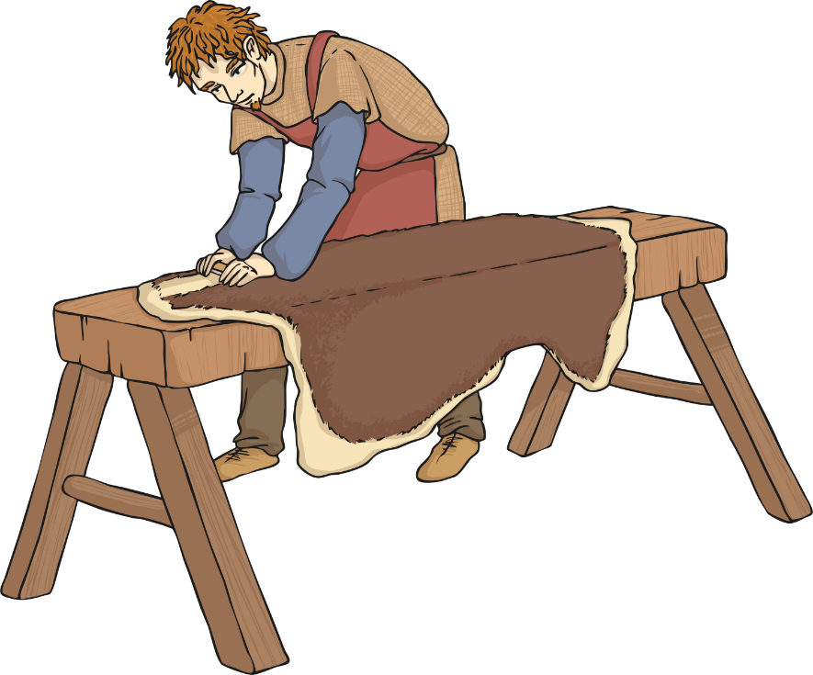
Anglo-Saxon Jobs
With your partner, find out more about one of the Anglo-Saxon jobs you have learnt about and then create a poster to advertise for an Anglo-Saxon worker for your job.
You should draw a picture of an Anglo-Saxon worker doing the job in the middle and provide details about the job and the qualities needed to do it in the boxes around the outside.
Choose one of these jobs to write about:
Smith, Tanner, Weaver, Jeweller, Woodworker, Potter

Slide 6
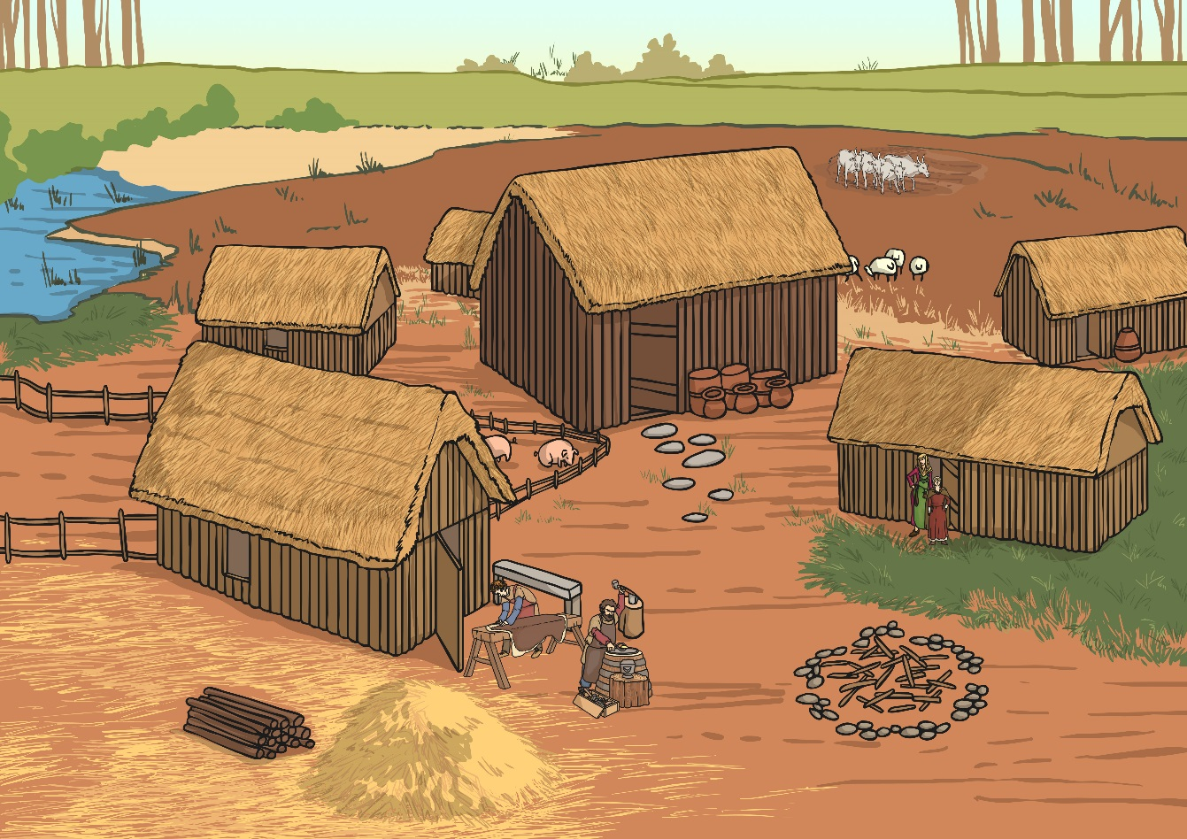
In the Village
The chief of the village lived in a larger house in the centre of the village. This house might also contain a meeting hall.
The Anglo-Saxons positioned their villages near a water source, such as a river or lake, which would provide drinking water and fish to eat.
Fields for growing crops were ploughed over to prepare them for planting. Oxen would pull a basic plough which was called an ard.
Livestock was kept in the village. Children would often be responsible for looking out for wolves, which were wild in Britain during the Anglo-Saxon times.
Family groups lived in smaller village houses.
Some buildings were reserved for specific purposes, such as a space for performing a craft like weaving or as storage units.
Pots made from clay were fired (dried out and hardened) on a large open fire.

Slide 7

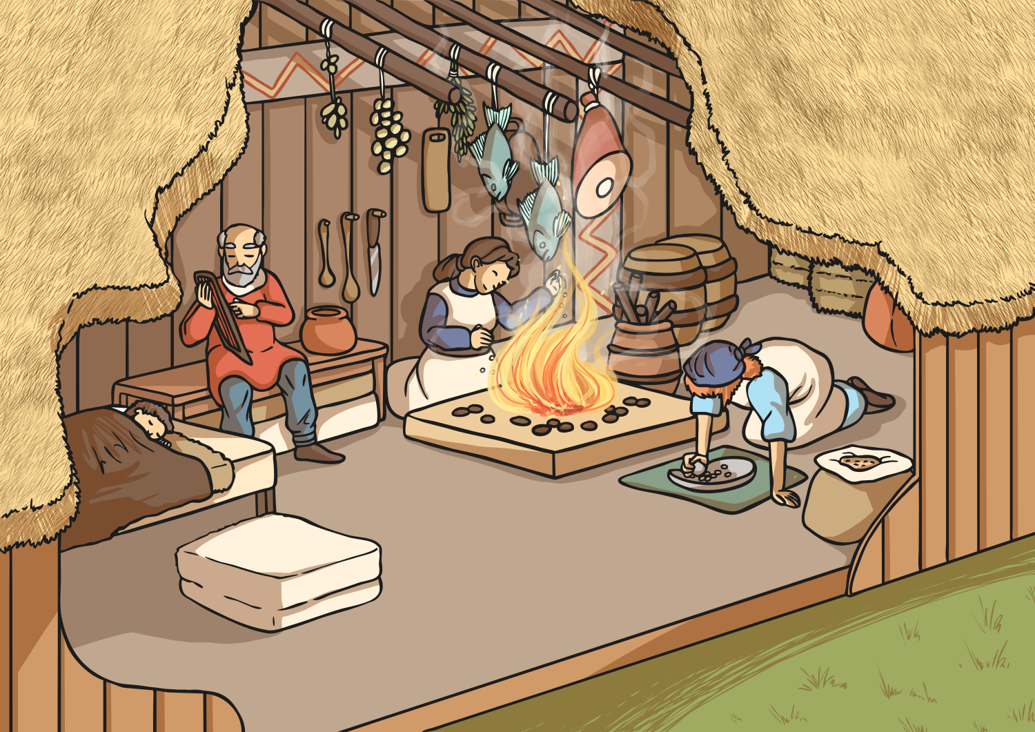
In the House
People played instruments to provide entertainment. This man is playing a lyre.
Meat and fish are hung up at the ceiling above the fire so that the smoke can cure it (dry it out and preserve it).
The roof of the house is thatched with straw.
The walls of the house are made from planks of wood.
Most houses had one room, people also slept here.
A large barrel holds beer to drink.
A fire in the centre of the room provides warmth and light and a place to cook the food.

Slide 8

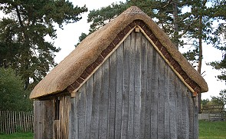
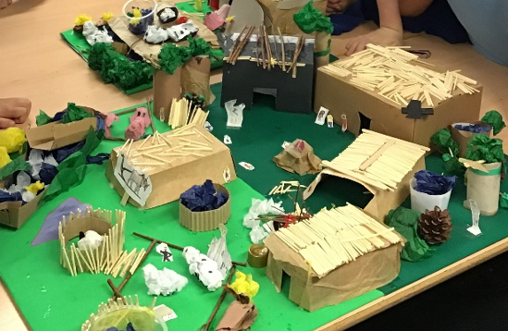
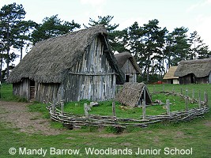
Design a Village!
Your task is to design and make a typical Saxon village.
On your designs you must include a list of the materials you would like to use and a description of how you will put it together.
You could also make your village if you’d like to with materials from around your home…

