Slide 1
Episode 6 - Order Order!
To know who ruled and why
To understand how order was kept.
To describe and compare crime and punishment.

Slide 2
How can society be ruled?
There are two major types of political system.
TALK-PAIR-SHARE
What are these two systems?
Which is the best and why?
Which might have been used by the Anglo Saxons and why?

Slide 3

Anglo Saxon Monarchy
Each group of Anglo-Saxon settlers had a leader or war-chief. A strong leader became 'cyning' - Anglo-Saxon for ‘king'. Each king had a small army and ruled their kingdom.
By around AD600 there were five important Anglo-Saxon kingdoms. They were Northumbria, Mercia, Wessex, Kent and East Anglia. From time to time, the strongest king would claim to be 'bretwalda' - which meant ruler of all Britain. Perhaps the most famous king was Offa. Offa was King of Mercia from AD757 to 796. Mercia was the strongest kingdom in Anglo-Saxon England, and Offa was the most powerful English king.

Slide 4
Monarchy vs Democracy!

Slide 5
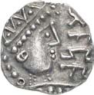
Crime and Punishment
The Anglo-Saxons didn't have prisons. People found guilty of crimes were either executed or punished with fines. If they ran away, they became 'outlaws' (outside the law), and anyone could hunt them down - unless they hid in a church.
The fine for breaking into someone's home was 5 shillings (25p), paid to the home-owner. For minor crimes like stealing, a nose or a hand might be cut off. If you couldn’t pay then you became a slave.
If a person killed someone, they paid money to the dead person's relatives. This was 'wergild'. The idea was to stop long quarrels or 'blood feuds' between families.

Slide 6
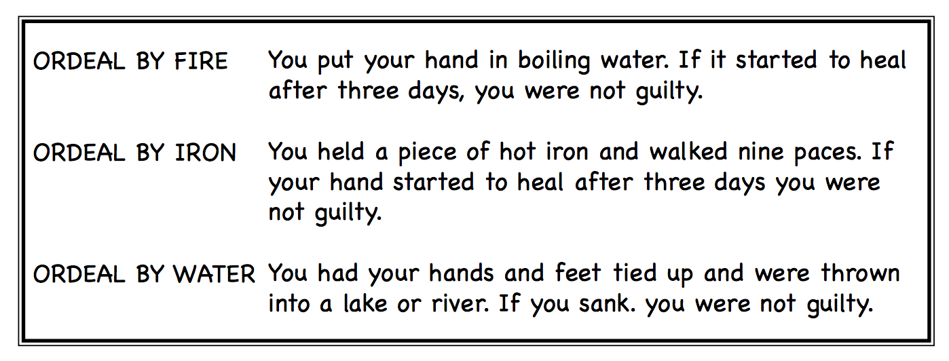
Ordeals!
If you said that you were not guilty then you had to find men who would swear that you were innocent. These were called oath helpers. If you could not find enough oath helpers, then you had to go through an ordeal.

Slide 7
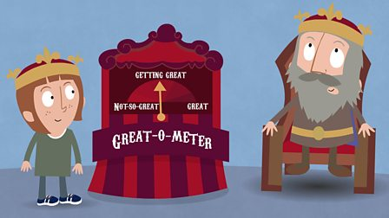
Thursday 11th February
Do we agree with Anglo Saxon punishments?
Work in groups of 3/4 to complete the game on your tables.
Then – Choose TWO/THREE case studies.
Case Study –
Saxons –
Modern –
Your opinion and why?
How could their justice system be improved and how does it compare to the UK?
Extra Challenge?
Which system of law and order is fairer and why? Explain

