Slide 1
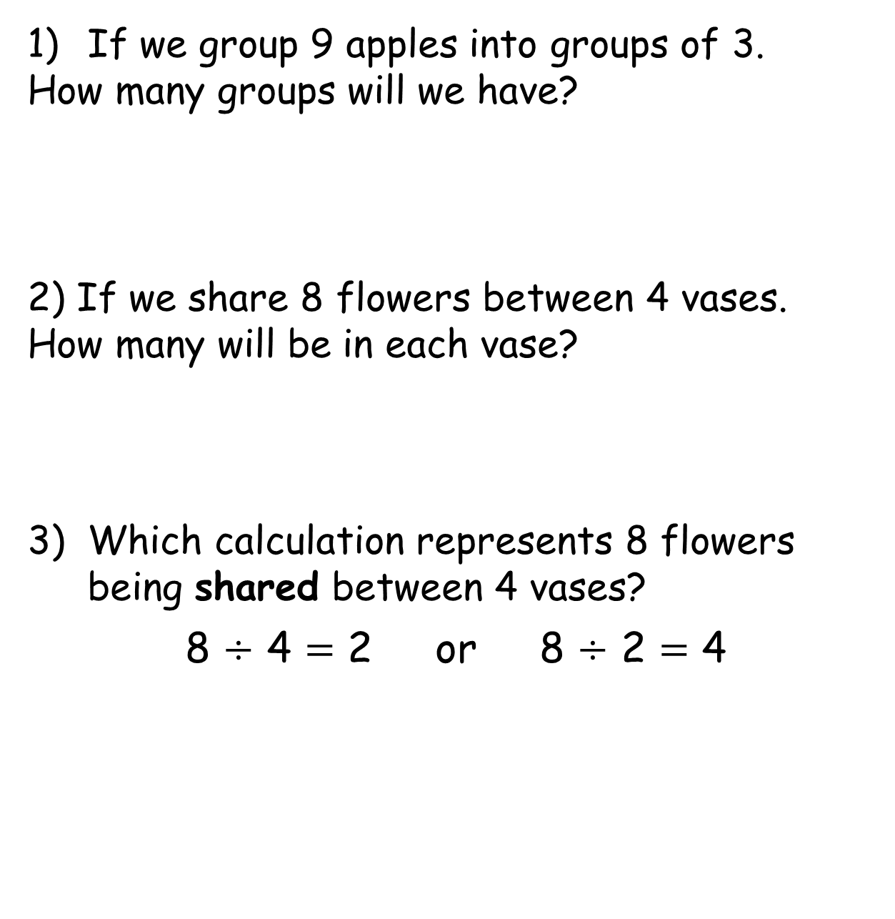
If we group 9 apples into groups of 3.
How many groups will we have?
2) If we share 8 flowers between 4 vases.
How many will be in each vase?
Which calculation represents 8 flowers being shared between 4 vases?
8 $÷$ 4 $=$ 2 or 8 $÷$ 2 $=$ 4

Slide 2




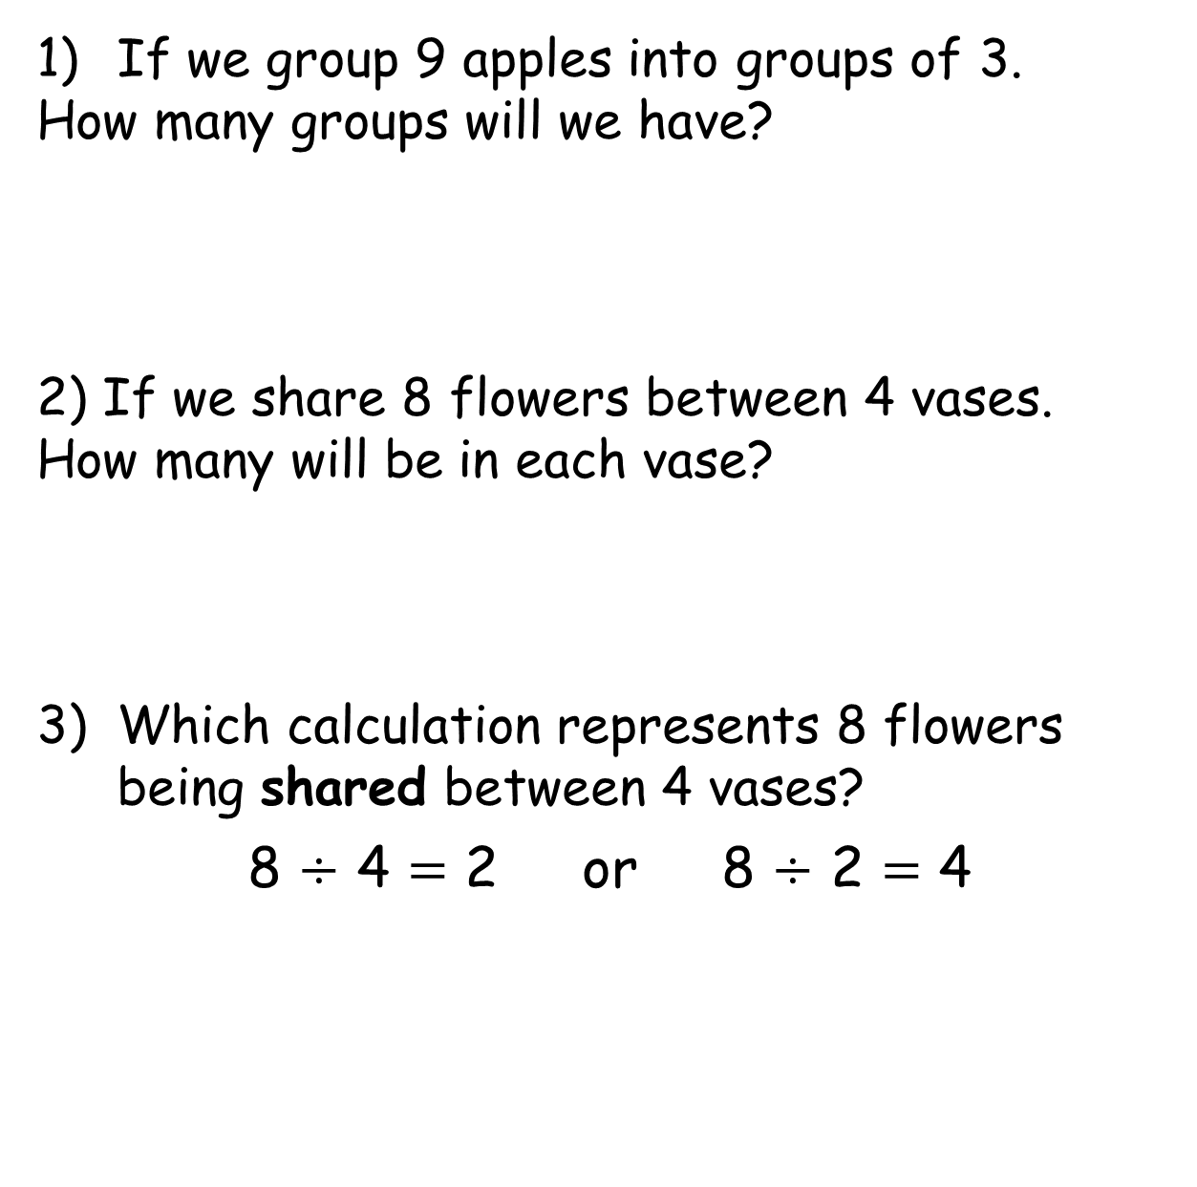
If we group 9 apples into groups of 3.
How many groups will we have?
2) If we share 8 flowers between 4 vases.
How many will be in each vase?
Which calculation represents 8 flowers being shared between 4 vases?
8 $÷$ 4 $=$ 2 or 8 $÷$ 2 $=$ 4

Slide 3
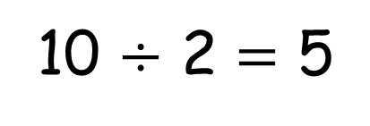
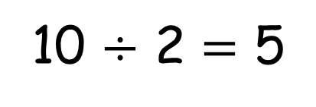
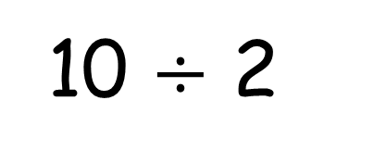
10 $÷$ 2
Sharing
10 $÷$ 2 $=$ 5
Grouping
10 $÷$ 2 $=$ 5

Slide 4

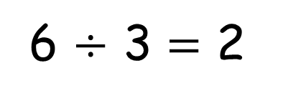
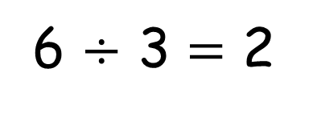
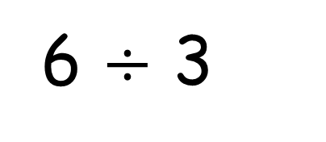
6 $÷$ 3
Have a think
Sharing
6 $÷$ 3 $=$ 2
Grouping
6 $÷$ 3 $=$ 2

Slide 5
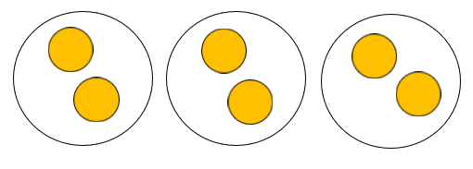
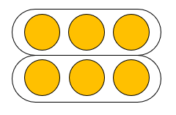
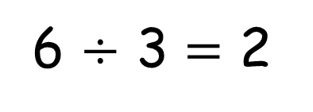
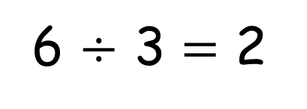
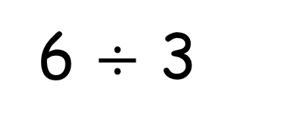
6 $÷$ 3
Sharing
Grouping
6 $÷$ 3 $=$ 2
6 $÷$ 3 $=$ 2
How many groups we are sharing between
How many in each group

Slide 6
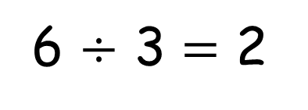
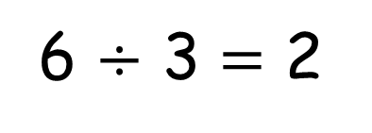
6 $÷$ 3
Sharing
Grouping
6 $÷$ 3 $=$ 2
6 $÷$ 3 $=$ 2
How many are in each group
How many groups we can make

Slide 7




How many groups of 10 can you make?
How many groups of 5?
How many groups of 4?
How many groups of 2?
How many groups of 1?
Have a think
Send a photo of how you made these groups please.

Slide 8
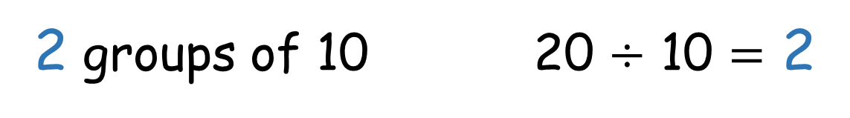
2 groups of 10 20 $÷$ 10 $=$ 2

Slide 9
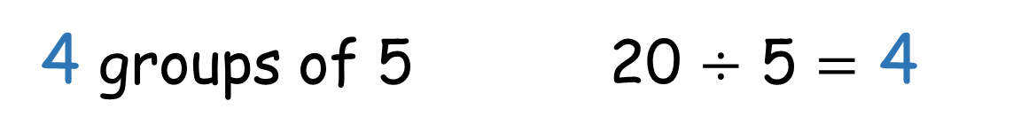
4 groups of 5 20 $÷$ 5 $=$ 4

Slide 10
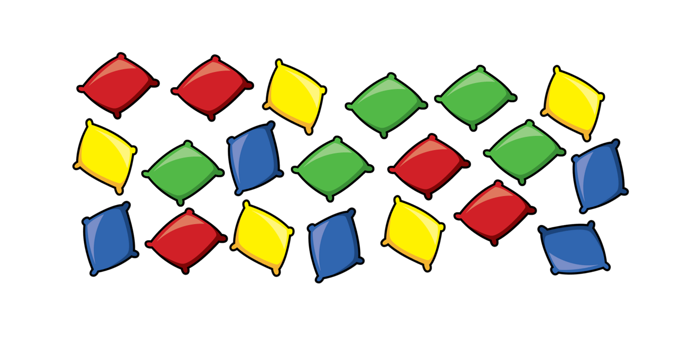



5 groups of 4 20 $÷$ 4 $=$ 5
10 groups of 2 20 $÷$ 2 $=$ 10
20 groups of 1 20 $÷$ 1 $=$ 20

Slide 11

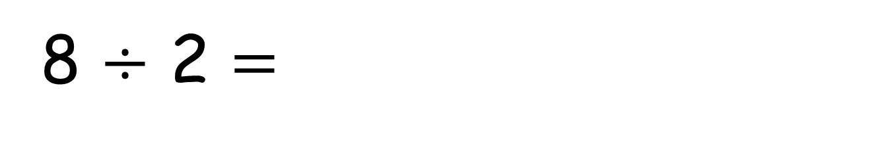
8 $÷$ 2 $=$
4
0 2 4 6 8 10 12 14
4 jumps of 2 are equal to 8

Slide 12
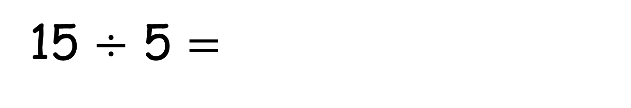
15 $÷$ 5 $=$
3
Have a think
0 5 10 15 20 25 30 35
3 jumps of 5 are equal to 15

Slide 13

60 $÷$ 10 $=$
6
Have a think
0 10 20 30 40 50 60
6 jumps of 10 are equal to 60

Slide 14
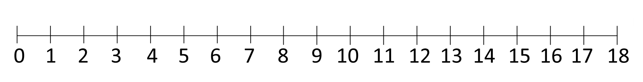
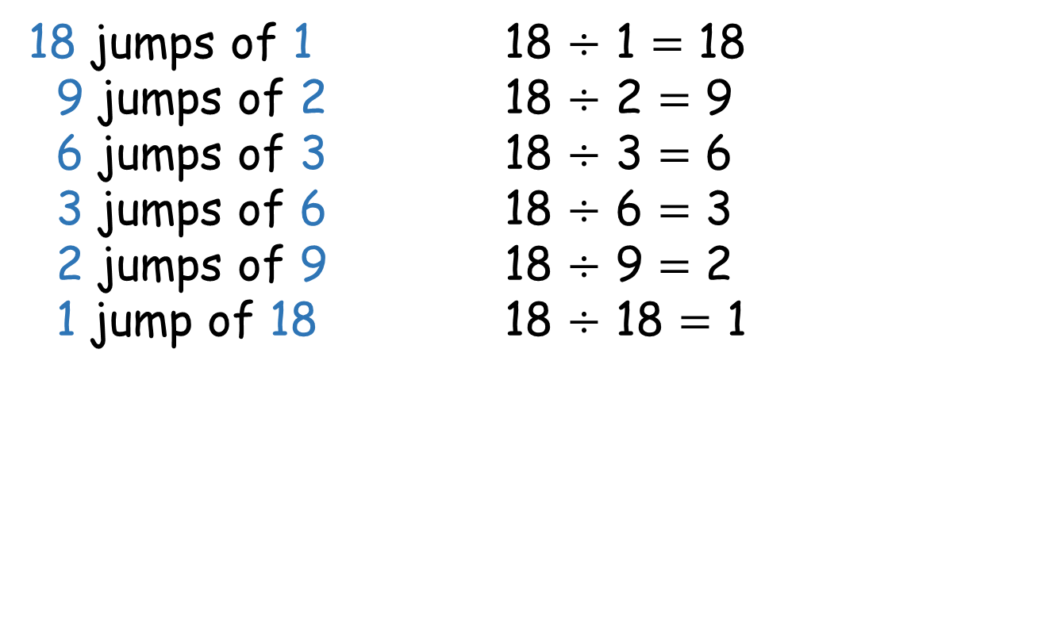

18 $÷$ $=$
Have a think
18 jumps of 1 18 $÷$ 1 $=$ 18
9 jumps of 2 18 $÷$ 2 $=$ 9
6 jumps of 3 18 $÷$ 3 $=$ 6
3 jumps of 6 18 $÷$ 6 $=$ 3
2 jumps of 9 18 $÷$ 9 $=$ 2
1 jump of 18 18 $÷$ 18 $=$ 1
Send a photo of how you solved this problem.

Slide 15




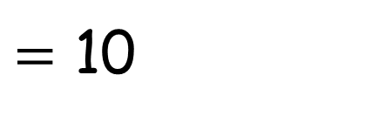



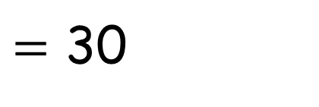



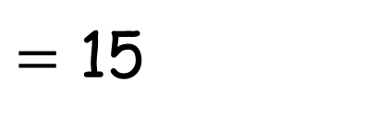



30$\text{÷}$1
$=$ 30
30$\text{÷}$5
$=$ 6
30$\text{÷}$2
$=$ 15
30$\text{÷}$6
$=$ 5
30$\text{÷}$3
30$\text{÷}$7
$=$ 10
$=$
30$\text{÷}$4
$=$
Have a think
How many different groups can you make from 30 crayons?
Send in your answers.

