Slide 1





Complete the sentences below.
1) There are ____ groups of ____ apples.
2) There are ____ groups of ____ flowers.
3) There are ____ groups of ____ sweets.

Slide 2
Complete the sentences below.
1) There are ____ groups of ____ apples.
2) There are ____ groups of ____ flowers.
3) There are ____ groups of ____ sweets.
3
3
4
2
3
5

Slide 3

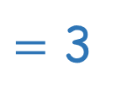
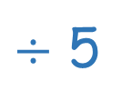
15 pears are divided into groups of 5
There are 3 groups.
15
5
3
tells us how many in total
tells us how many in each group
tells us how many groups
15
$÷$ 5
$=$ 3

Slide 4










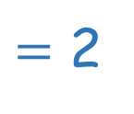

10
10
5
2
$÷$ 5
$=$ 2
tells us how many in total
tells us how many in each group
tells us how many groups
10 _____ are divided into groups of 5
There are 2 groups.

Slide 5





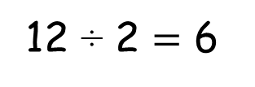
12 oranges, 2 in each basket.
Have a think
12 divided into groups of 2
12 ÷ 2 $=$ 6

Slide 6






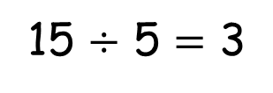
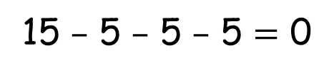
– 5
– 5
– 5
0
5
10
15
15 $–$ 5 $–$ 5 $–$ 5 $=$ 0
15 $÷$ 5 $=$ 3
15 divided into groups of 5 is equal to 3.

Slide 7



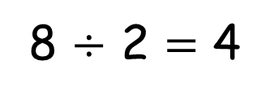
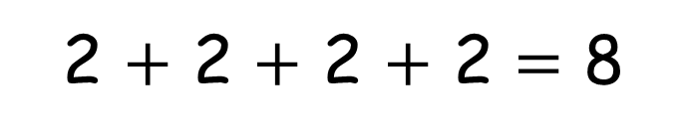



2 $+$ 2 $+$ 2 $+$ 2 $=$ 8
$+$ 2
$+$ 2
$+$ 2
$+$ 2
0
2
4
6
8
8 is made of 4 equal groups of 2
8 $÷$ 2 $=$ 4

