Slide 1
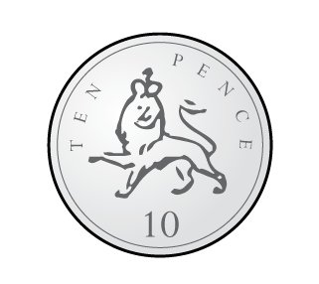
Should we count in 2s, 5s or 10s?
1)
2)
3)

Slide 2
Should we count in 2s, 5s or 10s?
1)
2)
3)
10s
2s
5s

Slide 3


There are 6 eggs altogether.
Each basket has 2 eggs.
6 eggs shared equally between 3 is 2

Slide 4


24
How many sweets are there?
24
shared equally between is
3
8

Slide 5
How many sweets are there?
24
24
shared equally between is
8
3

Slide 6
How many sweets are there?
24
24
shared equally between is
4
6

