Slide 1
1) What is missing? 1, 2, 3, __ , 5 , 6 , 7, __
2) How do spell 2?
3) What is missing? 10, 11, ___, 13, ___
4) You have only 1 nose and 1 mouth.
What do you have 2 of?

Slide 2
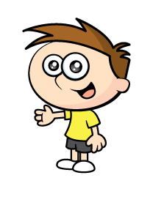
1) What is missing? 1, 2, 3, __ , 5 , 6 , 7, __
2) How do spell 2?
3) What is missing? 10, 11, ___, 13, ___
4) You have only 1 nose and 1 mouth.
What do you have 2 of?
4
8
two
12
14

Slide 3
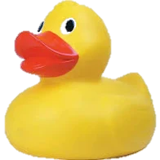
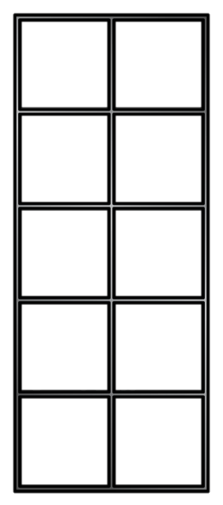
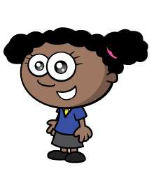
How many ducks?
Now I can count by 2s!
2 , 4 , 6 , 8
There are 8 ducks.

Slide 4
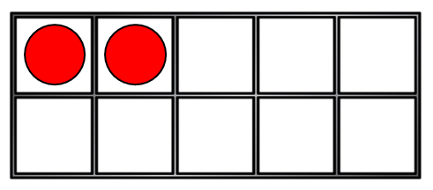
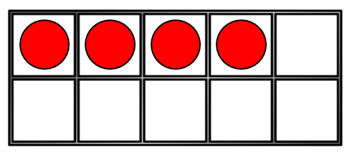
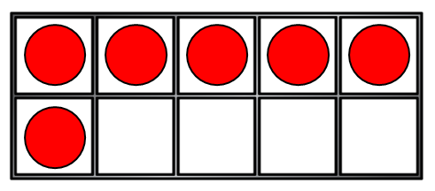
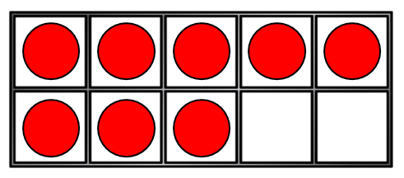
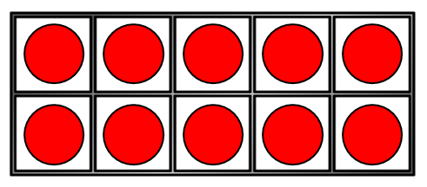
How many counters?
0
2
4
6
8
10

Slide 5

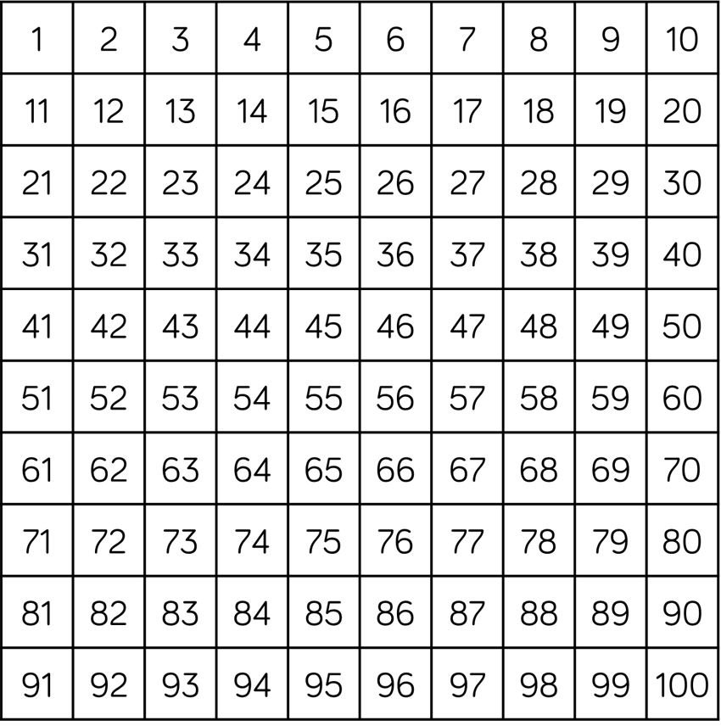

Have a think
How many gloves?
There are 20 gloves.

Slide 6

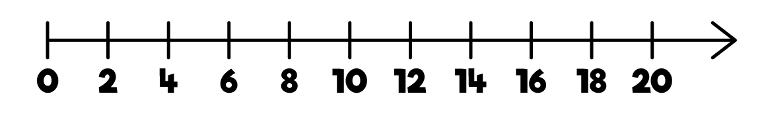
Have a think
Can you count in 2s starting at 8?
There are 20 eyes!

Slide 7

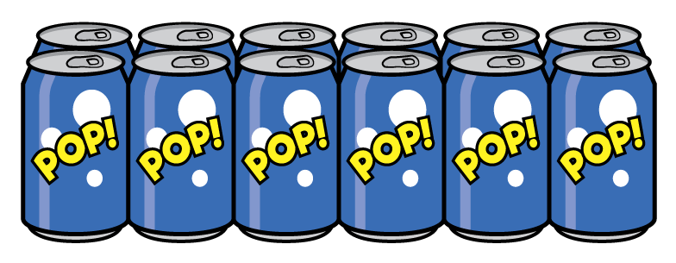
Have a think
How many pencils?
16
How many cans of pop?
12

Slide 8
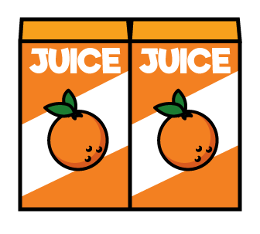
Let’s count backwards in 2s!
There were 12 boxes of juice.
After playtime the children were thirsty.

Slide 9
What is missing?
36 | 38 | 40 | ? | 44 | 46 | 48 | ?
36 | 38 | 40 | 42 | 44 | 46 | 48 | 50

