Slide 1
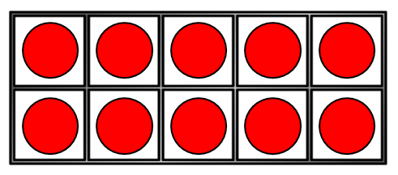
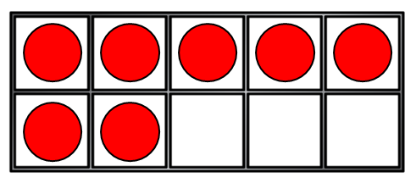
1) What comes next? 8, 9, 10, ___
2) How do you spell 19?
3) How many counters?
4) 2 tens is equal to ___

Slide 2
11
1) What comes next? 8, 9, 10, ___
2) How do you spell 19?
3) How many counters?
4) 2 tens is equal to ___
nineteen
17
20

Slide 3
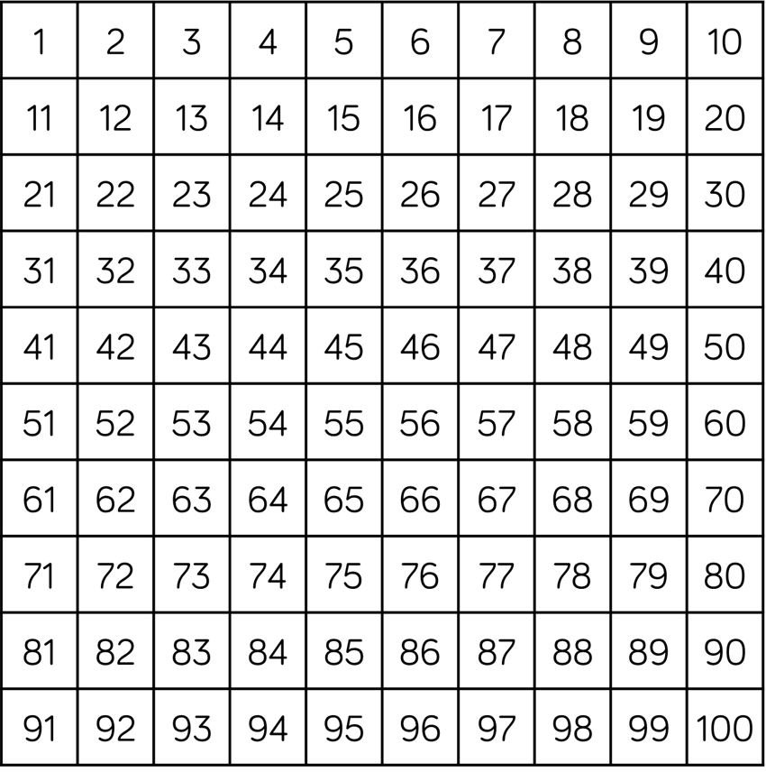
Numbers to 50
Can you find these numbers?
ten
twenty
thirty
forty
fifty

Slide 4
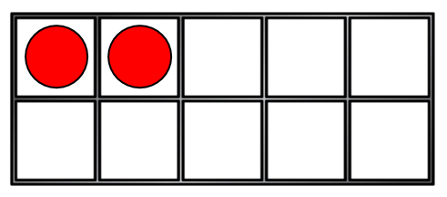
How many counters?
How can we count them?
10
20
21, 22
There are 22 counters.

Slide 5


How many grapes?
How can we count them?
30
10
20
31, 32, 33, 34, 35
There are 35 grapes.

Slide 6

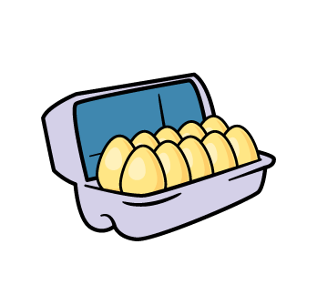
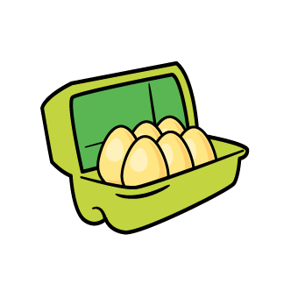
How many eggs?
Have a think
How can we count them?
10
30
6
20
40
There are 46 eggs.

Slide 7

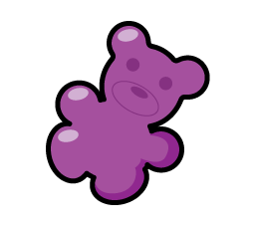
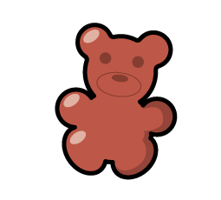


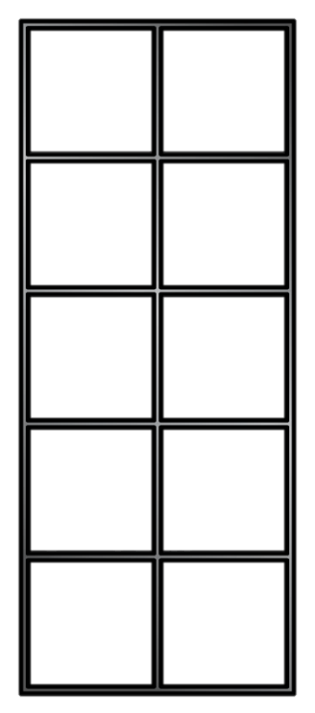
I need to
organise these!
There are 27 bears.

Slide 8
Numbers to 50
Have a think
Can you find these numbers?
thirty-three
twenty-eight
forty-six
fifteen

Slide 9
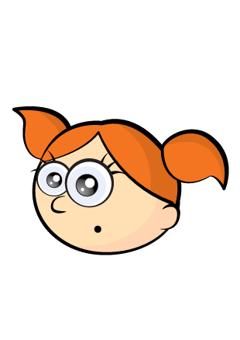
Counting on a number track
I can count from 19 - 33 with a number track.
19 | 20 | 21 | 22 | 23 | 24 | 25 | 26 | 27 | 28 | 29 | 30 | 31 | 32 | 33

Slide 10
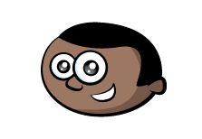
Have a think
I can count from 37 - 49 without a number track!
Which of these numbers will Mo say?
18
29
38
40
50
46

