Slide 1

Which one of these is the odd one out? Why do you think this?

Slide 2
Which one of these is the odd one out?
Notes:
Only one with spots – not found in the shape drawer at school
2d shape with staright sides, I can see squares on the 3d shapes as they have square faces
Cuboid – the only one to have rectangular faces
The only one to have a curved side

Slide 3



Can you name each shape as they appear?

Slide 4
Sometimes I make an x with my arms as I say hexagon
Both six and hexagon have an x in them

Slide 5

Which shape is the hexagon?
Have a think

Slide 6

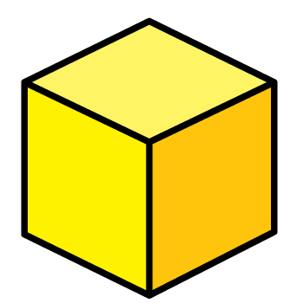
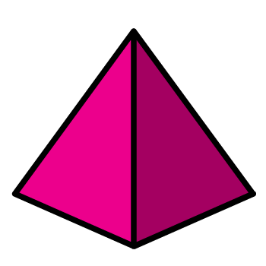

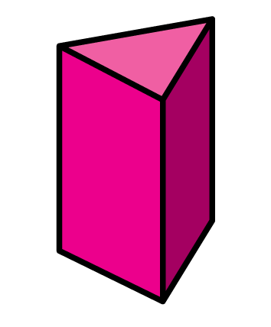


Can you name these 3D shapes?

Slide 7
Which of these shapes are cylinders?
Have a think

Slide 8
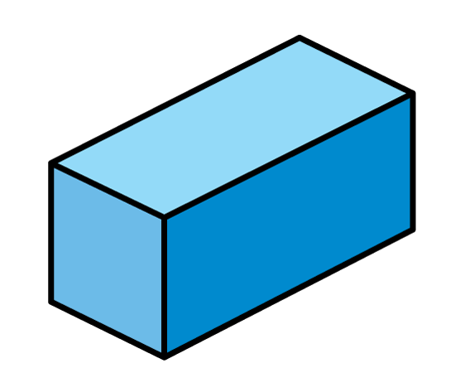
Which shapes can you see?
Have a think
Cone
Sphere
Pyramid
Cylinder
Cube
Cuboid

Slide 9

Shape Tally Total
Triangles
3
Squares
1
Pentagons
1
Hexagons
3

