Slide 1
1) Let’s count in 2s
2) Let’s count in 5s
3) How do you spell 8?
4) Compare: 37 is ______ than 49
2, 4, 6, 8, ___, ___, ___
5, 10, 15, ___, ___, ___

Slide 2
1) Let’s count in 2s
2) Let’s count in 5s
3) How do you spell 8?
4) Compare: 37 is ______ than 49
10
12
14
2, 4, 6, 8, ___, ___, ___
20
25
30
5, 10, 15, ___, ___, ___
eight
less

Slide 3


Have a think
green
blue
The tower is taller.
The tower is shorter.

Slide 4

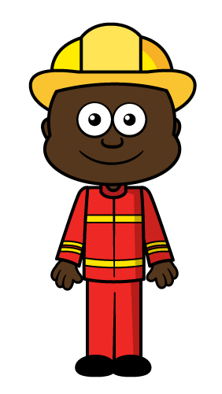
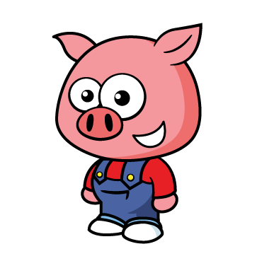
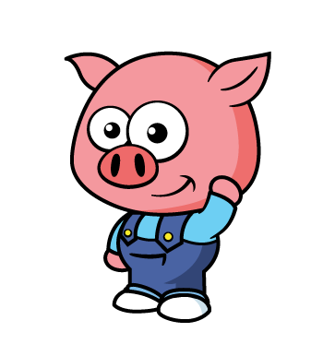
Let’s compare height
Who is shorter?
✓
✓

Slide 5

Let’s compare height
Have a think
✓
✓
Which is taller?

Slide 6

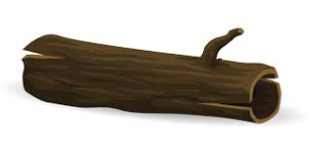
Let’s compare length!
Have a think
✓
✓
Which is shorter?

Slide 7

Which is longer?
Which is shorter?
The toothbrush is longer.
blue
The toothbrush is shorter.
green

Slide 8
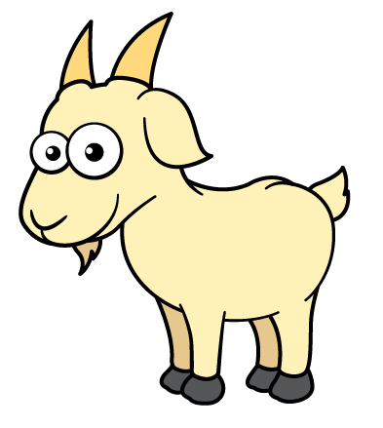
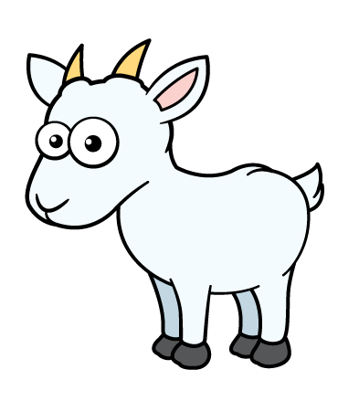
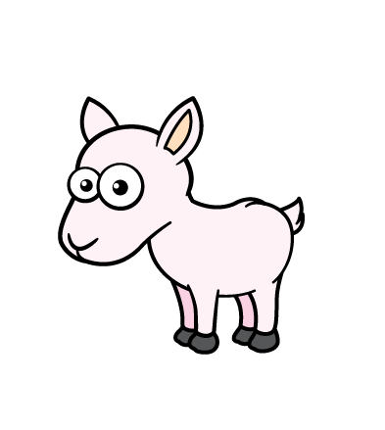
Have a think
Can you put these in order from
shortest to tallest?
shortest
tallest

Slide 9


Can you put these in order from
longest to shortest?
Have a think
longest
shortest

Slide 10
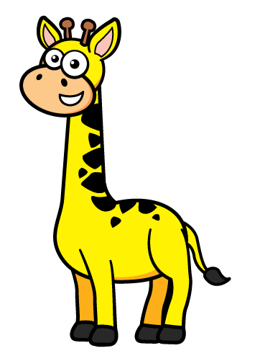
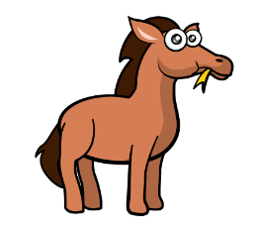
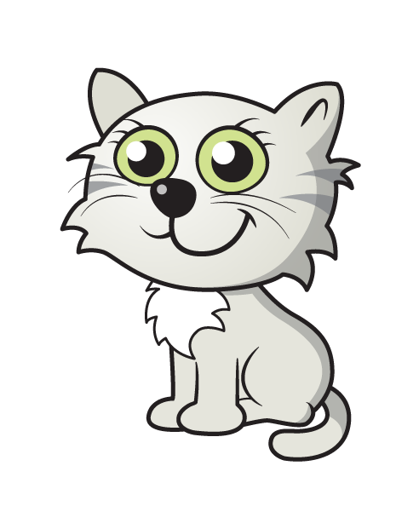
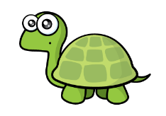
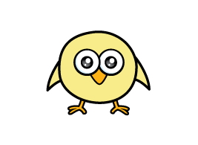
Have a think
The is taller than the
The is shorter than the

Slide 11
Have a think
The is the .
tallest
shortest
The is the .

