Slide 1


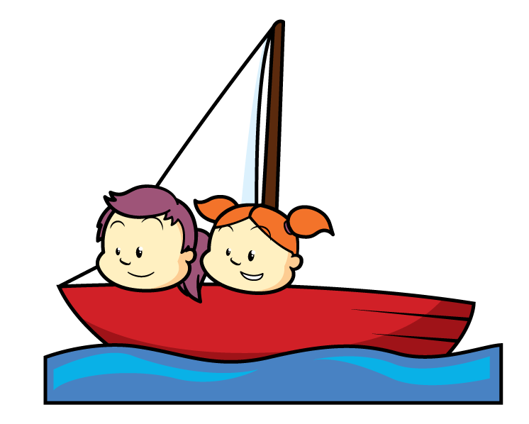
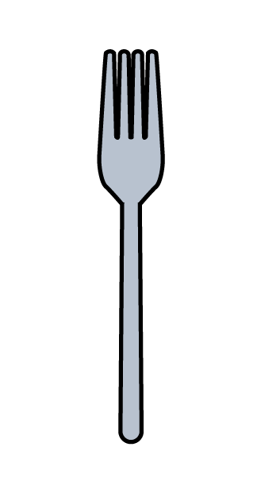



Have a think
How many?

Slide 2
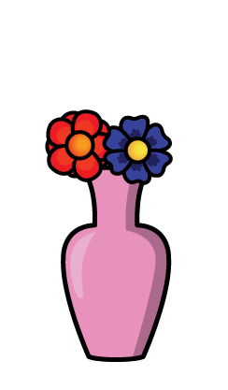

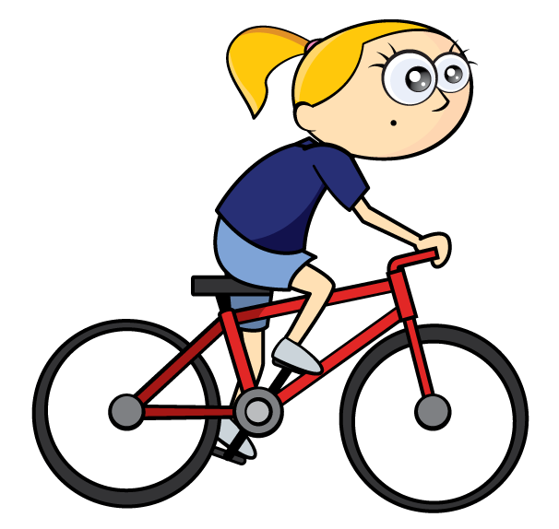


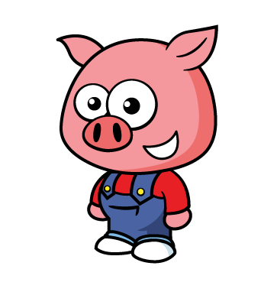


Have a think
Why count in 2s?
Can you think of things that come in pairs?

Slide 3




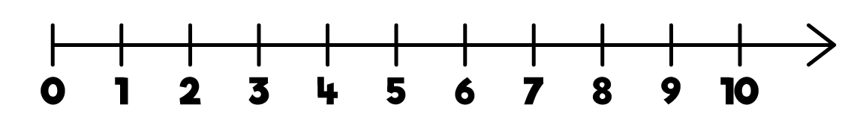


Have a think
Can you count in 2s
with your fingers?

Slide 4
Have a think
Try “Whisper… Shout”
Try ‘whisper’ and ‘shout’. How far can you go?
You could play this with a partner.

Slide 5
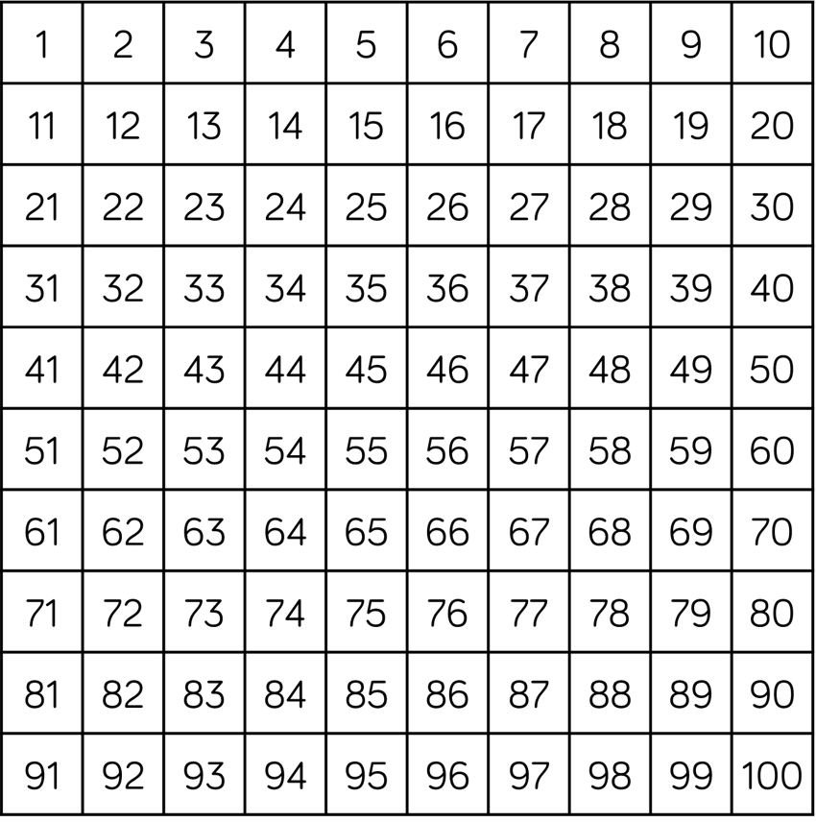
Have a think
What patterns can you see?
On the number square colour in all the numbers you would say if you counted in twos.
What do you notice about the numbers?

