Slide 1
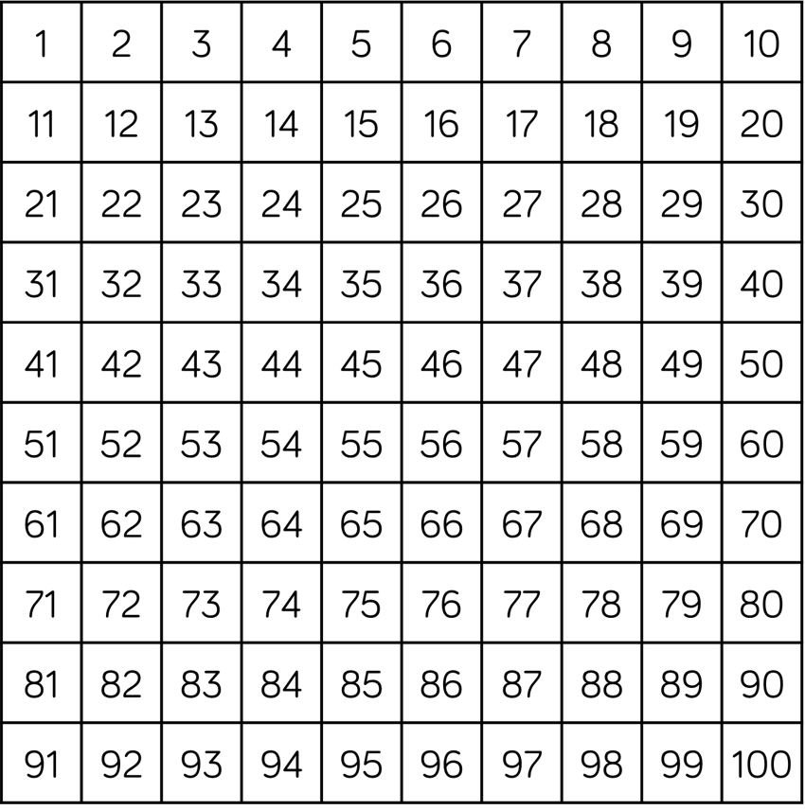
1) Find the number 13
2) Find the number 43
3) Find the number 25
4) Find the number 35

Slide 2
1) Find the number 13
2) Find the number 43
3) Find the number 25
4) Find the number 35

Slide 3
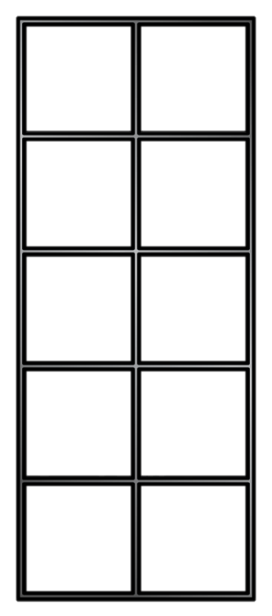
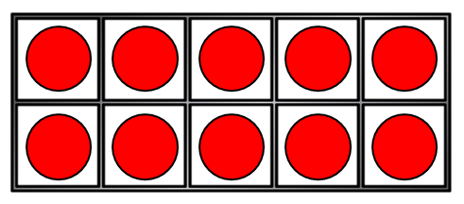
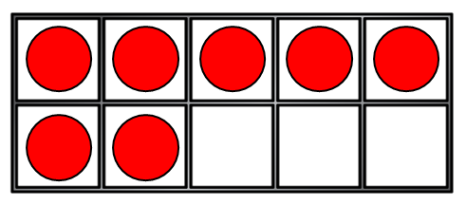
Counting forwards
17 | 18 | 19 | 20 | 21 | 22 | 23 | 24 | 25 | 26 | 27
How many red counters can you see in the tens frame?
Do we need to count each counter?
Count on from this number using the yellow counters to help you.

Slide 4
Counting backwards
35 | 34 | 33 | 32 | 31 | 30 | 29 | 28 | 27 | 26 | 25
How many red counters can you see in the tens frame?
Do we need to count each counter?
Count back as each counter is removed.

Slide 5

Have a think
Counting forwards
with a number track
41 | 42 | 43 | 44 | 45 | 46 | 47 | 48 | 49 | 50
28 | 29 | 30 | 31 | 32 | 33 | 34 | 35 | 36 | 37
How do you know if a number track is counting forwards?
Which numbers help you?
What are the hidden numbers?

Slide 6
Have a think
Counting backwards
with a number track
41 | 40 | 39 | 38 | 37 | 36 | 35 | 34 | 33 | 32
28 | 27 | 26 | 25 | 24 | 23 | 22 | 21 | 20 | 19
How do you know if a number track is counting backwards?
Which numbers help you?
What are the hidden numbers?

Slide 7

Have a think
Can you spot the mistakes?
27 | 28 | 29 | 20 | 31 | 32 | 33 | 34 | 35 | 36
27 | 28 | 29 | 30 | 31 | 32 | 33 | 34 | 35 | 36
38 | 39 | 40 | 41 | 42 | 44 | 45 | 46 | 47 | 48
38 | 39 | 40 | 41 | 42 | 43 | 44 | 45 | 46 | 47

Slide 8
Have a think
What comes after…
35
36
22
23
49
50

Slide 9
Have a think
What comes before…
13
12
39
38
41
40

Slide 10
Have a think
What is missing?
27 | 28 | 29 | 30 | 31 | 32 | 33 | 34 | 35 | 36
?
?
38 | 39 | 40 | 41 | 42 | 43 | 44 | 45 | 46 | 47
?
?
?

