Slide 1
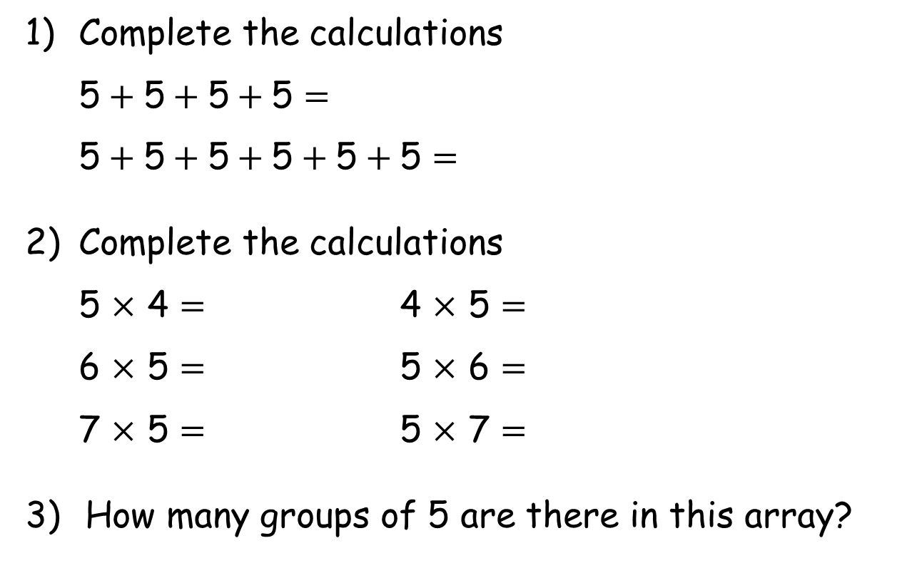
1) Complete the calculations
5$+ \text{5}+\text{5}+\text{5}=$
5$+ \text{5}+\text{5}+\text{5}+\text{5}+\text{5}=$
2) Complete the calculations
5 $×$ 4 $=$ 4 $×$ 5 $=$
6 $×$ 5 $=$ 5 $×$ 6 $=$
7 $×$ 5 $=$ 5 $×$ 7 $=$
How many groups of 5 are there in this array?

Slide 2
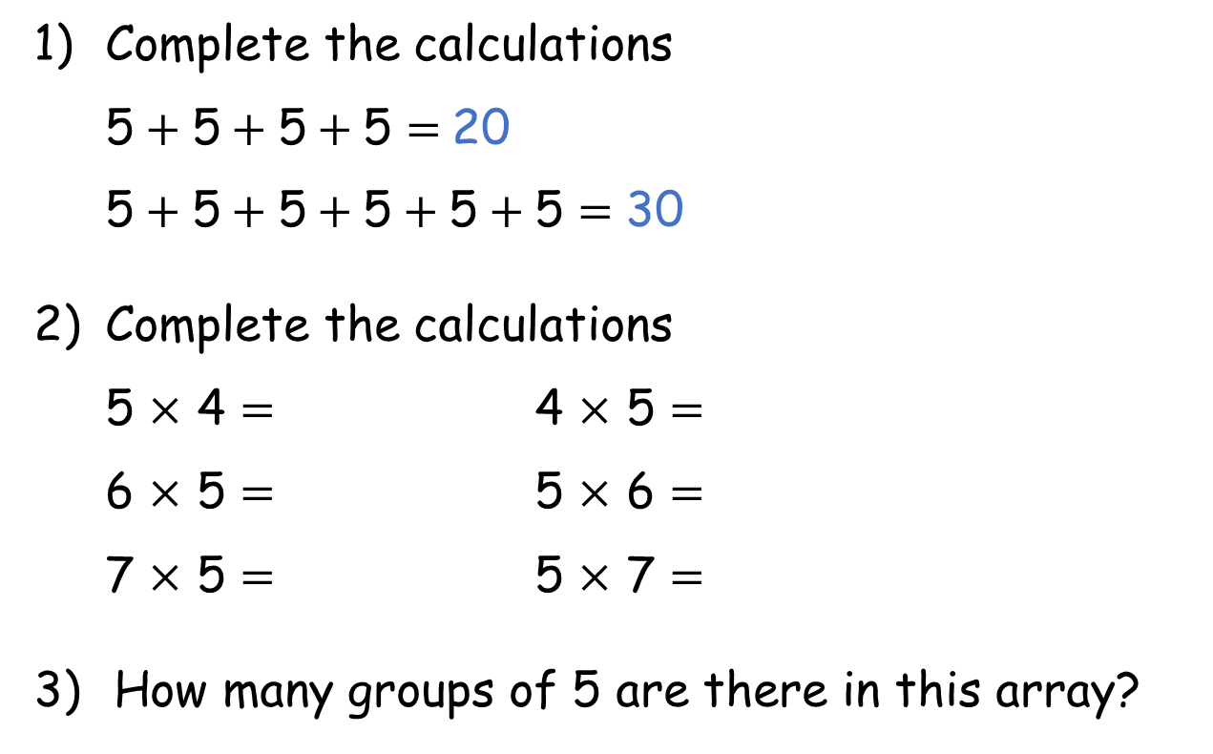
1) Complete the calculations
5$+ \text{5}+\text{5}+\text{5}=$20
5$+ \text{5}+\text{5}+\text{5}+\text{5}+\text{5}=$ 30
2) Complete the calculations
5 $×$ 4 $=$ 4 $×$ 5 $=$
6 $×$ 5 $=$ 5 $×$ 6 $=$
7 $×$ 5 $=$ 5 $×$ 7 $=$
How many groups of 5 are there in this array?
20 20
30 30
35 35
2

Slide 3

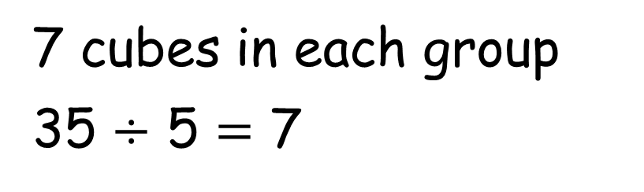
Whitney has 35 cubes.
She shares the cubes into 5 equal groups.
How many will be in each group?
7 cubes in each group
35 $÷$ 5 $=$ 7

Slide 4
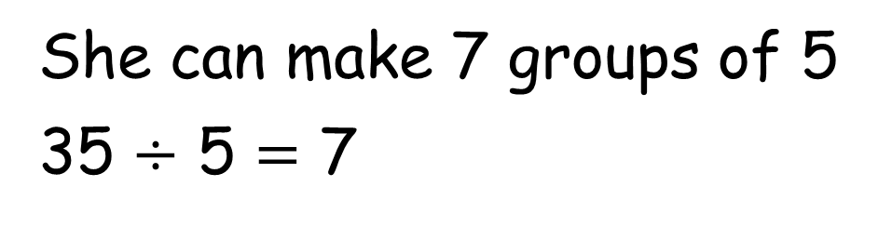
Whitney has 35 cubes.
She groups the cubes into 5s.
How many groups can she make?
She can make 7 groups of 5
35 $÷$ 5 $=$ 7

Slide 5
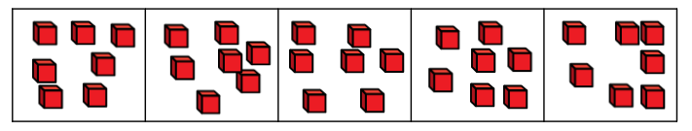
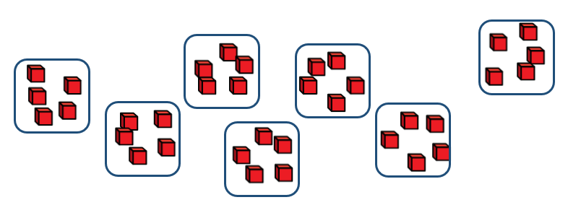
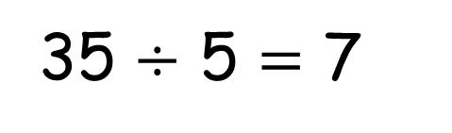
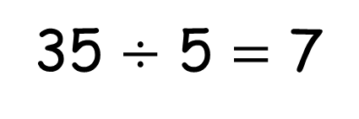
Sharing
There are 7 cubes in each group.
35 $÷$ 5 $=$ 7
Grouping
There are 7 groups of 5
35 $÷$ 5 $=$ 7

Slide 6


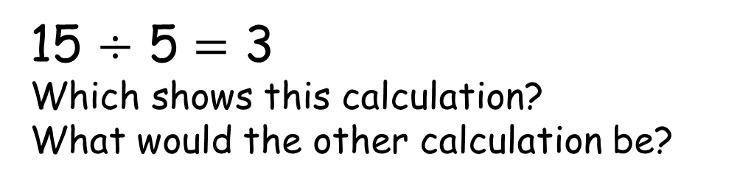
Here are 15 conkers.
The conkers are shared into 5 equal groups.
The conkers are grouped into 5s.
Have a think
15 $÷$ 5 $=$ 3
Which shows this calculation?
What would the other calculation be?

Slide 7
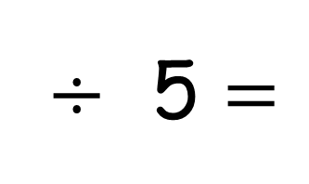
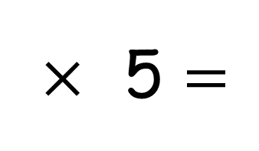
Use the array to complete the calculations
$×$ 5 $=$
6
30
$÷$ 5 $=$
30
6

Slide 8



The farmer has picked 25 apples.
He puts them into bags of 5
How many bags of 5 can he make?
5
10
15
20
25
0
5
10
15
20
25
Have a think

Slide 9
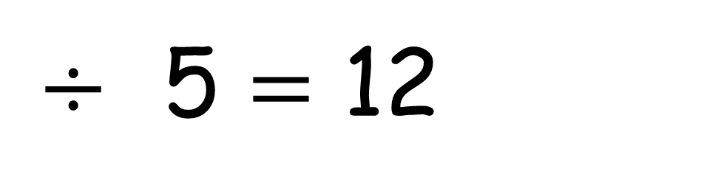
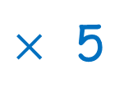
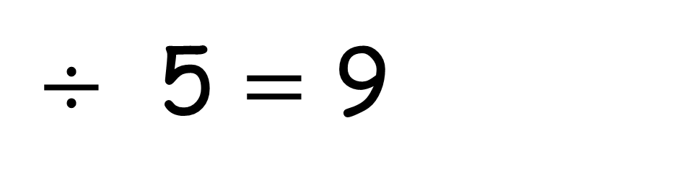
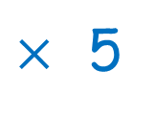
45
$÷$ 5 $=$ 9
If I have shared by 5 and have 9 groups of 5, how many did I start with?
$×$ 5
60
$÷$ 5 $=$ 12
If I have shared by 5 and have 12 groups of 5, how many did I start with?
$×$ 5
Have a think
We can use the inverse to help us. Inverse means opposite.

